Slide 1
Hallway Conversations in 2020 with the ASCCC President and Vice President Breakout Session 3 | 3:00-4:00

Slide 2
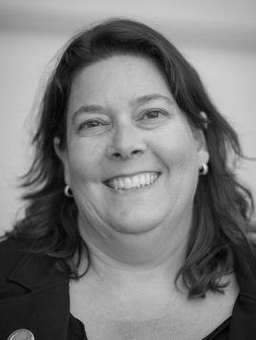
Presenters
Dolores Davison, Ginni May,
ASCCC President ASCCC Vice President

Slide 3
Description
This year, 2020 has required everyone to make dramatic changes in their lives. The spring 2020 plenary session was cancelled, and this plenary session is virtual, a first. Hallway, breakfast, lunch, and dinner discussion opportunities are missing. However, faculty have demonstrated resiliency, rising to meet the needs of students, colleagues, and their institutions. Join the ASCCC President and Vice President in an open conversation to share statewide issues that are of concern to you in regard to academic and professional matters and learn how the ASCCC represents faculty interests at the state level? Take this opportunity to have those hallway discussions on current trends, challenges, and issues being faced statewide and at local campuses.

Slide 4
In the Googledoc…(link is posted in the Chat)
Who are you? Write your name, college, and your role at your college (i.e. academic senate president, senator, interloper…)
Briefly (really briefly) describe 1 opportunity of 2020 and 1 challenge of 2020 (yes, there are more than 1, but just 1 for now).
Next, add “+” signs next to those positives and those challenges that resonate with you…

Slide 5
Let’s Talk… about the comments in the Googledoc!
Share an opportunity or a challenge that resonates with you…simply unmute yourself and we will call on you to talk. Take about 3 minutes to allow time for others to share as well. Let’s go to Gallery View…

