Slide 1
What Can the Senate Do For You: The Local Senates Handbook, Resources, & Visits
Kale Braden, ASCCC North Representative, Relations with Local Senates Chair
Buran Haidar, Relations with Local Senates Committee Member
Cleavon Smith, Relations with Local Senates Committee Member

Slide 2
The Relations With Local Senates Committee
Kale Braden,
Cosumnes River College, Theatre Arts
Dan Crump,
American River College, Library Science
Eve Adler
Santa Monica College, Health Sciences
Maria Biddenback
Napa Valley College, Nursing
Matt Clark
Woodland Community College, Mathematics & Statistics
Sam Foster
Fullerton College, Chemistry
Buran Haidar
San Diego Miramar College, Biology
Kathy Oborn
Los Angeles Pierce College, Criminal Justice
Cleavon Smith
Berkeley City College, English

Slide 3
The Relations With Local Senates Committee
The Relations with Local Senates Committee serves to augment the work of the Executive Committee in its efforts to provide an opportunity to share information on issues of concern at the local and state levels.
While members of the Relations with Local Senates Committee are primarily liaisons and conduits for information and requests for assistance.

Slide 4
The Local Senates Handbook
A Substantive Revision

Slide 5
History and Context
First Introduced in 1996 as the paper:
Empowering Local Senates: Roles and Responsibilities of and Strategies for an Effective Senate
Revised
2001-2002
2007
Moved to an online resource
All appendices were lost in the transfer

Slide 6
Strategies and Though Behind Current Revision
Every member of the Relations With Local Senates Committee was in their second year of being a Senate President
“What I wish I had known two years ago!”
Updating material
Some of the sections still referred to programs or legislation which sun set years ago
Converting from a “Paper” model to a “Living Document” model

Slide 7
Strategies and Though Behind Current Revision
Dual Use Document
“Cover to cover” readers verses “Problem Solver” readers
Give the tools to find resources rather than static information
Title 5 changes—Senate leaders need to know how to find current information
“Effective Practices” not “Best Practices”

Slide 8
Handbook: The Revision

Slide 9
What has Changed?
Added in sections on accreditation and the senate (absent in the 2007 version)
Added in a Table of Contents and Index to aid users in finding specific information that they need.
Created a “Works Cited” page with links to all of the supporting documents.

Slide 10
What Has Been Added?
Recreated the appendices
Moved all of the supporting documents to the Leadership Resources page of the ASCCC website.
Created/assembled a number of new supporting documents including:
Examples of Decision Making Handbooks,
Searchable documents containing multiple senate Constitutions and Bylaws,
A searchable document containing 68 districts board policies on participatory governance.

Slide 11
What Has Been Added?
Linked to “Additional Information” available in ASCCC Papers and Rostrum articles to flesh out topics
Created links within the document to refer to different sections which deal with similar topics.
Often information about a topic may be spread throughout the document, now there are links to allow for the reader to navigate through.

Slide 12
What about the Structure?
Moved the language from first to third person both for a more academic tone as well as added specificity in who should be performing tasks.
Attempted to provide specific suggested strategies instead of broad pronouncements on some of the senate president’s tasks
E.g., instead of simply saying “Secure adequate funding for the senate”—from the 2007 version—the new draft discusses strategies for senate presidents on how to have conversations about senate resources with their administration.

Slide 13
The Layout
Preface
Using this handbook
Part I: The Academic Senate for California Community Colleges: A Brief History
Part II: Roles and Responsibilities of the Senate
The Legal Basis: Education Code, Title 5, Accreditation, and Local Implementation
College Governance, Senate/Union Relations, and Senate Roles in Accreditation

Slide 14
The Layout
Part III. Duties as a Local Senate President
A Local Senate President’s Duties Include The Following:
Recommendations for Developing Senate Participation and Leadership
College/District Reports Requiring Senate Sign-Off, Review or Vigilance
Committee Appointments

Slide 15
The Layout
Part IV. Ensuring the Effectiveness of the Local Senate
Placement In The College’s Governance Structure
Effective Senate Operations
Effective Structures for Conducting Senate Meetings
Adapting the Resolution Process for Local Use
Keeping the Faculty Informed
Faculty Participation
Resources Available in Senate Files
Institutionalizing a Senate's Effectiveness: Seeking Technical Assistance to Ensure Compliance

Slide 16
The Layout
Part V. Linking Local Senates to the Academic Senate for California Community Colleges
Functions of the Academic Senate
Outreach from the Academic Senate
Senate Plenary Sessions
Participation on Academic Senate Committees
Nominations for Statewide Awards and Service
Consultation Process
Concluding Thoughts

Slide 17
Other Resources
Relations With Local Senates Committee

Slide 18
Services: Local Senate Visits
Local senates may request visits from members of the Executive Committee and the Relations with Local Senates Committee.
The purpose of such a visit is for the committee members to serve as a liaison between the Senate and the local senate.
Our role is to listen to your discussions, share Senate resources to support you and gather questions and concerns to forward to the Academic Senate President for consideration and response.
The visit can be with the local senate president, the local executive committee, the entire senate-whatever you would like.

Slide 19
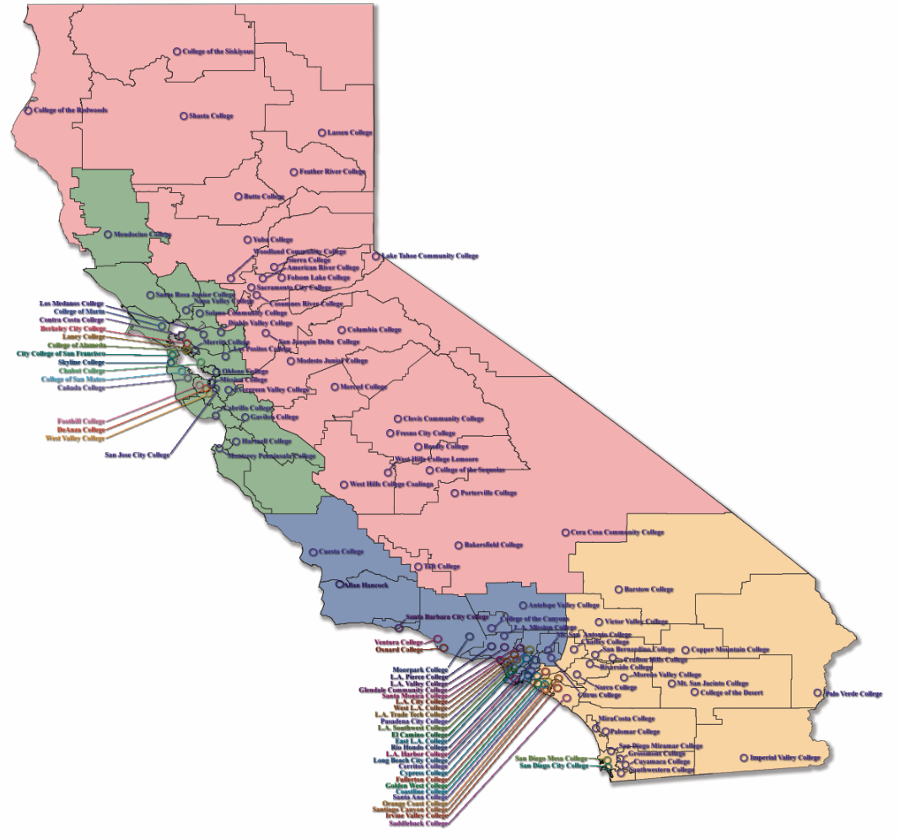
Local Visits 2014-2015

Slide 20
Services: Accreditation Resource Teams
As a new service to local academic senates, the Accreditation Resource Teams will provide a direct and custom-made response to the needs of local academic senates concerning issues around the 10+1.
This is in contrast to the multi-college plenary, institutes and regional trainings provided by the Academic Senate.
These teams consider the problem statement developed by the local senate regarding an issue, and then create training and potential solution options adapted to the requesting college culture and student populations based upon Academic Senate positions and papers.

Slide 21
Services: Technical Assistance
A Joint Program of the Academic Senate and Community College League
Visit must be supported by both the administration and Senate

Slide 22
Services: Other visits
Budget Process
Curriculum
Disciplines List
Equivalence
Minimum Qualification
Participatory Governance

Slide 23
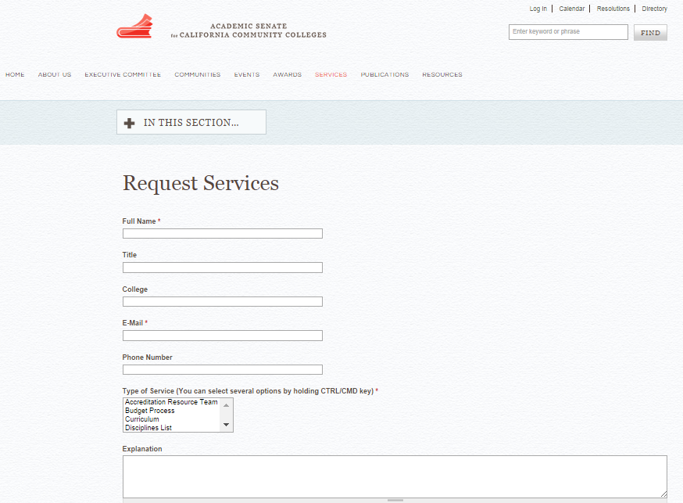
Requesting Services

Slide 24
Questions?

