Slide 1
Seeking Pipelines and Preparing for the Hiring Process Friday, February 19 at 9:00-10:00 a.m.

Slide 2
Presenters
Chelsea Hull, ASCCC Part-Time Committee participant, Santa Monica College (she/her)
Mike Harutunian, College of the Canyons (he/him)

Slide 3
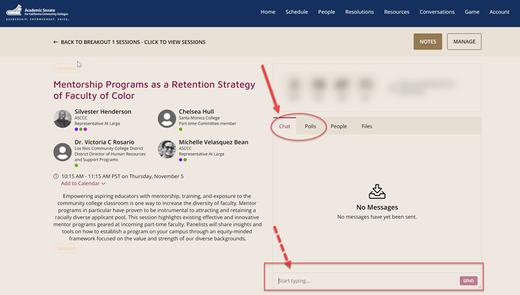
Questions
Use the Pathable platform CHAT box

Slide 4
Session Description
As an adjunct, have you ever wondered how the hiring process works behinds the scenes? Sometimes it seems like there are secrets to being a successful adjunct or landing a full-time tenure track interview that no one wants to discuss. Being an adjunct, part-time or full-time instructor has always been complicated. Join us in this session to discuss the history of how the adjunct profession came to be what it is today, explore avenues for prospective employment, and get some practical knowledge to help you stand out in the deepest of part-time pools.

Slide 5
Session Content
How did we get here?
Legislative history of adjunct hiring
Hiring demystified
The dreaded “adjunct pool”
Systemic failures
What are pipelines?
Gathering materials

Slide 6
Our Stories
Mike’s Story
Chelsea’s Story
Notes:
This is an option slide, so we can take it or leave it. I figured including how you were able to get into the adjunct market and then transition into full-time would be a good parallel to the conversation of me coming in as an adjunct during AB705 – both conversations highlight the importance of understanding legislative framework.

Slide 7
Legislative History of a Faculty Hiring
Administrative Growth + Reduction in Faculty Standing
Professionalism vs. Unionization
CA laws
50% law (this is currently suspended until June 30, 2021)
Pedagogy Recursiveness and adjunct faculty consequences
Unintended consequences
Control of entry into the profession
AB 1725 and the 75% rule
Education perpetuates bureaucratization of modern society
Notes:
Notice of exemption status for 50% law: https://www.cccco.edu/About-Us/Chancellors-Office/Divisions/College-Finance-and-Facilities-Planning/Fiscal-Standards-and-Accountability-Unit/Fifty-Percent-Law

Slide 8
Systemic Failures
college & state level
Culture focuses on tenure
Everything depends on when you’re being hired
Know the history & don’t repeat it
Remediation, Guided Pathways, and AB705 impact all fields

Slide 9
The Adjunct Pool
What’s its purpose?
Standing out in the pool – is it possible?
Adjunct faculty seniority

Slide 10
What are pipelines?
Types of pipelines
Mentorship programs or internal recruitment of existing employees
Finding Pipelines
Look for mentorship / internship opportunities
Necessary for faculty hiring equity
CA does not have Affirmative Action
In your interview, ask about mentorship chances
Not all pipelines are the same – evaluate them
Not all colleges have pipelines

Slide 11
Preparing for the hiring process
Before applying
Research the college and learn their mission statement & DEI goals
You’re being interviewed – now what?
Prepare for a teaching demo (10 mins max)
Do not use the same cover letter for all pools
Tailor your CV to match the language
Do not give more materials than what’s asked of you
Use a “bridge” and demo the hiring panel correctly
Be ready to explain methodology and buzzwords

Slide 12
Tips for success
Use the same language in your cover letter on the job description
Apply for what the college is asking for, not what you want
Focus on the “behind the scenes” of teaching – legislative fronts, online learning, and field impact

Slide 13
After the application
Now what?
Adjunct pools do not determine your worth
Always renew your pool application, seniority exists
You’re hired!
Set boundaries for yourself
Don’t feel compelled to take every class offered
TL;DR
There is no rhyme or reason to the pool
Hiring systems were set up on a lottery purposefully

Slide 14
Central Takeaways
Adjunct pools are largely out of your hands, but you can still make yourself stand out
There are systemic issues with hiring, both at state and college levels
There are instructors who adjunct ancillary to their dominant field – don’t compare yourself to another teacher
Ask questions and understand the mechanics of your field

Slide 15
For Further Information and Support
Email info@asccc.org
Contact Info:
Chelsea Hull: hull_chelsea@smc.edu
Mike Harutunian: Mike.Harutunian@canyons.edu

