Slide 1
Opportunity Awaits…Getting that Job! Friday, February 11, 2022 at 3:30pm – 4:55pm Michelle Velasquez Bean, ASCCC Treasurer Nadia Khan, MiraCosta College /NOCE

Slide 2
Session Description
Many part-time faculty aspire to obtain a full-time faculty position within the California Community College system, but it can be challenging to understand the complex hiring processes and how it differs from the hiring procedures as part-time faculty. Diversity statements? Resume? Vitae? Teaching Philosophy? Cover letter? Equivalency Processes? Include this, but not that? This breakout includes info, insights, and ideas for what it takes to get that job by understanding how to navigate hiring processes and procedures to position yourself to take on this next professional endeavor!

Slide 3
Land Acknowledgement
We begin today by acknowledging that we are holding our gathering on the land of the Nisenan Nations, the location of the ASCCC Office on One Capitol Mall, Sacramento, the Luiseño/Payómkawichum nations, where Nadia is located now called Oceanside, and the Tongva/Gabrieleño nations, where I am currently located in what is now called La Mirada. We recognize the sovereign people who have lived and continue to live here. We recognize the Nisenan, Tongva, and Payómkawichum Nations and their spiritual connection to the ocean and the land as the first stewards and the traditional caretakers of these areas.
As we begin, we thank them for their strength, perseverance, and resistance. We also wish to acknowledge the other Indigenous Peoples who now call these areas their home, for their shared struggle to maintain their cultures, languages, worldview, and identities in our diverse cities.
We invite you to research your area to see the Indigneous tribes and information about land acknowledgment or find your area at https://native-land.ca.

Slide 4
Agenda
Share Stories of Successful Hires
Navigating the Hiring Process
Preparing the Application
Keys to Developing the Resume, CV, Cover Letters, Teaching Philosophies, Diversity Statements
Understanding the Equivalency Process
Preparing for the Interview and Teaching Demo
What Happens After the Process
Key Takeaways
Things on the Horizon
Volunteer for ASCCC

Slide 5
Stories to Share
Let’s learn about Dara’s story
Hired using equity-minded rubric and practices.
Faced passive-aggressive behavior from immediate colleagues.
Overcame barriers with the help of supportive HR and supervisor.
Got hired full-time after five final interviews--the issue? No network!

Slide 6
Formal Process
The department’s dean works with the respective discipline chair.
The chair is always planning which faculty will be filling the course offerings for the semester.
You must also register in the faculty list or pool. That is where the administration looks to fill the available classes.
Do not be afraid to contact the dean with your concerns and questions.

Slide 7
Informal Process
It is very important to stay in touch with the chair and administration whether you have a class or not.
If hired, it is important to attend the governance meetings that are open to you.
Try to join working committees so that you know what goes on in the college and campus community.
Ask questions; it shows you care and are interested.
Become familiar with the bargaining contract that governs your district.
Stay in touch with your human resources contact at the district office.

Slide 8
Informal Process continued
Try to attend the regular department meetings.
Attend the beginning of semester orientations.
Participate in the Flex learning activities every semester.
Take advantage of further education and advancement.
Find statewide opportunities at the Part-time Faculty Nexus: https://sites.google.com/view/part-timefacultynexus

Slide 9
Initial Applicant Screening
Applications are typically screened to determine if
the application is complete
the applicant met the minimum qualifications
the applicant has qualifications equivalent to the minimum qualifications*
*this depends on the structure of the college/district equivalency procedures and may be done either by the committee, the committee chair, or classified professional staff in collaboration with faculty
Applications are screened based on the initial screening criteria typically determined by the screening committee.
Committees cannot consider anything that is not included in the application.
Helpful reminders to be successful at this stage:
Don’t assume that because you are working at the college that the committee will know everything that you have been doing.
Infuse equity-mindedness and how you actualize diversity, equity, inclusion, and accessibility in all parts of your application materials and answers to questions.
Give yourself plenty of time to complete all parts.
Have someone read over your application for content, spelling, grammar, and mechanics.

Slide 10
Things to Avoid When Applying
Don’t use a form cover letter. Try to add something that customizes the letter to the application. This is particularly important in a multi-college district.
Don’t include the name of the wrong college in any of your materials.
Don’t just restate your work history in the cover letter. The letter should tell your story, not just list your experience.

Slide 11
Tips for Success
Use the similar language in your cover letter as on the job description.
Apply for what the college is asking for, not what you want.
Focus on the “behind the scenes” of teaching – legislative fronts, online learning, and field impact.

Slide 12
Preparing for the Moment
Research the institution.
Ask for letters of recommendation.
Ask for references.
Build your professional network; use your network.
Be confident.
Review your work history.
Know what you know; know what you don’t know (where are your gaps).
Learn what it means to be a full-time faculty member.
Document your successes.
Fail wisely.

Slide 13
Preparing the Application - Resume
Keys to Developing the Resume/CV:
Tailor-made for job posting.
Map out key responsibilities and duties and compare with what you have or are missing.
Don’t include everything in the resume--keep some examples for the cover letter.
Not just action words; use result-oriented phrases; show results, too.
Revise; show peers.
Take the approach that fits your current self-summary of skills first.

Slide 14
Cover Letter
Tailor-made for job posting.
Thread through a theme (e.g., inclusion or equity focus, then build that throughout the cover letter and show this through examples).
Topics to expand in the cover letter:
DEI initiatives
Technology and online teaching
Professional development
Community involvement

Slide 15
Teaching Philosophy
Center student success as a foundation of your philosophy.
Review the knowledge, skills, and abilities in the job description and infuse those elements in your teaching philosophy.
Build a theme throughout the philosophy that describes that you authentically believe and actualize diversity, equity-mindedness, and inclusion into learning spaces.
Consider adding in praxis and theories from your discipline (e.g., ESL–engaging total physical response, task-based learning).

Slide 16
Diversity Statement
Find the college’s mission, vision, and diversity statement and use that as a springboard.
Build on how you have actualized DEI and antiracism in your work, both in the community and in courses/teaching.
Use concrete examples of student successes in your classroom.
Elaborate on your work with racially diverse and historically marginalized groups.
Link to articles and publications that you have written that show your support of marginalized groups.

Slide 17
Understanding the Equivalency Process Use the Pathable Chat for True or False
Degrees should have the same exact names to meet qualifications.
True, but there is an equivalency process available if the degree is not exactly the same name or needs international accreditation.
Getting equivalency at one district means you get it at another.
False–each district has its own policy.
Equivalency can be granted to teach one course in the discipline.
False–equivalency is granted to teach courses in the entire discipline.
Key Point to Remember: Human resource office representatives are usually the first contacts in the equivalency process.

Slide 18
Professional Network
Build now, use later
Diversify
Network outside your discipline, organization
Seek out people unlike you
Three types of networks – task, career, social
More is always better
Take notes
Give freely, give often
Schedule time to stay connected
Set reminders to keep in touch
A “brand” is just a reputation
Be known as: ethical, truthful, trustworthy, effective (get results) nice, smart, punctual, collaborative

Slide 19
Preparing for the Hiring Process
Before applying
Research the college and learn their mission statement & DEI goals.
Do not use the same cover letter for all pools.
Tailor your CV to match the language.
Do not give more materials than what’s asked of you.
You’re being interviewed – now what?
Prepare for a teaching demo (10 mins max).
Use a “bridge” and demo that to the hiring panel correctly.
Be ready to explain methodology and buzzwords.

Slide 20
The Successful Applicant
Be sure this is what you want. Understand what are they looking for.
Prepare by knowing your potential audience.
Read the instructions, answer all questions and ensure application is complete.
Letter of interest – thorough but concise.
Demonstrate minimum and desirable qualifications.
Demonstrate depth and breadth of experience teaching, and ancillary instruction related duties.
Showcase outcomes, not duties.
DEI statement – what have you done, what have you learned.
Life happens, apply early.
Prepare for technological glitches.
Check, double-check, triple-check your materials, then follow-up.

Slide 21
The Interview
Anticipate the questions.
Practice!
Answer the questions they ask.
Don’t know, be willing to grow.
Be real; represent yourself, don’t over sell.
DEI foremost.
Know the room.
Communicate your worldview.
Know your “why.”
Be mindful of time; use time wisely.
A pause is okay.
Prepare for teaching demonstration or presentation.
Behavioral answers are best.
Make eye contact, smile, speak slowly, speak up.
It’s about them, not you.
“I want an offer, and here’s why.”

Slide 22
Screening/Interviewing Scoring Rubrics
DEI Focused Example
1 point: Application response failed to address the question or demonstrated inadequate preparation and performance
2 points: Application response indicated some related experience or preparation, but no clear examples of successful outcomes
3 points: Application response clearly articulated adequate experience or preparation with successful outcomes
4 points: Application response clearly articulated adequate experience or preparation with successful outcomes AND provided successful DEI-related application of job skills in prior experience
5 points: Application response clearly articulated adequate experience or preparation with successful outcomes AND provided successful DEI-related application of job skills in prior experience AND provided positive contributions to an overall culture of DEI beyond their individual job performance
Notes:
ACHRO

Slide 23
Teaching Demonstration or Presentation
Know your
audience – committee or students?
time limit – time yourself – are you giving a ten-minute demonstration or ten minutes of a demonstration?
technology – use it purposefully and effectively.
your topic – if one is provided, understand how topic fits with course.
Have a backup plan!
Can you provide handouts?
Hit a few big ideas relevant to the topic or the institution; don’t try to show everything you know in the demo.

Slide 24
Teaching Demonstration or Presentation (continued)
Organize and deliver a purposeful lesson.
This is the first time you are doing this today, but the tenth time the committee is hearing it.
Engage your audience/students; demonstrate your student-centered approach.
Practice!
Be relaxed and confident, not overly nervous, but also show enthusiasm and passion for the topic.
Inside Higher Ed – Teach Like You Mean It

Slide 25
Helpful Hints for the Initial Interview (full-time positions)
Be prepared for the committee to be large. Committees of 10 or more individuals are not unusual.
Don’t expect the committee members to respond to you. They are often told and trained to be as neutral as possible—non-reactionary.
If given the questions ahead of time, write notes about your potential answers.
Pay attention to time, especially for your teaching demonstration – practice ahead of time.
Be prepared to talk about why you want to work at that college. Make sure that you know something that is specific to the students and the college where you are interviewing.

Slide 26
Be Prepared for Additional Screening
Reference checks are typically performed.
Background checks may be performed.
Successful candidate is offered a position.

Slide 27
Managing the Outcome
No offer: That’s ok!
Look to the future
Learn & Grow
Prepare for “next time”
Reflect
Remember the why
See the value in the experience
Rehearse interviewing
Ask for feedback
Continue to build and grow your network

Slide 28
After the Application
Adjunct pools do not determine your worth.
Always renew your pool application; seniority exists.
Now what?
Set boundaries for yourself.
Don’t feel compelled to take every class offered.
You’re hired!
You are valued and amazing!
Keep trying—you will get it ☺
Remember

Slide 29
Key Takeaways
Adjunct pools are largely out of your hands, but you can still make yourself stand out.
There are systemic issues with hiring, both at state and local levels.
There are instructors who adjunct ancillary to their dominant field – don’t compare yourself to another teacher.
Ask questions and understand the mechanics of your field.
Highlight aspects that set you apart from other candidates.
DEI work is important at all levels.
Build your network.

Slide 30
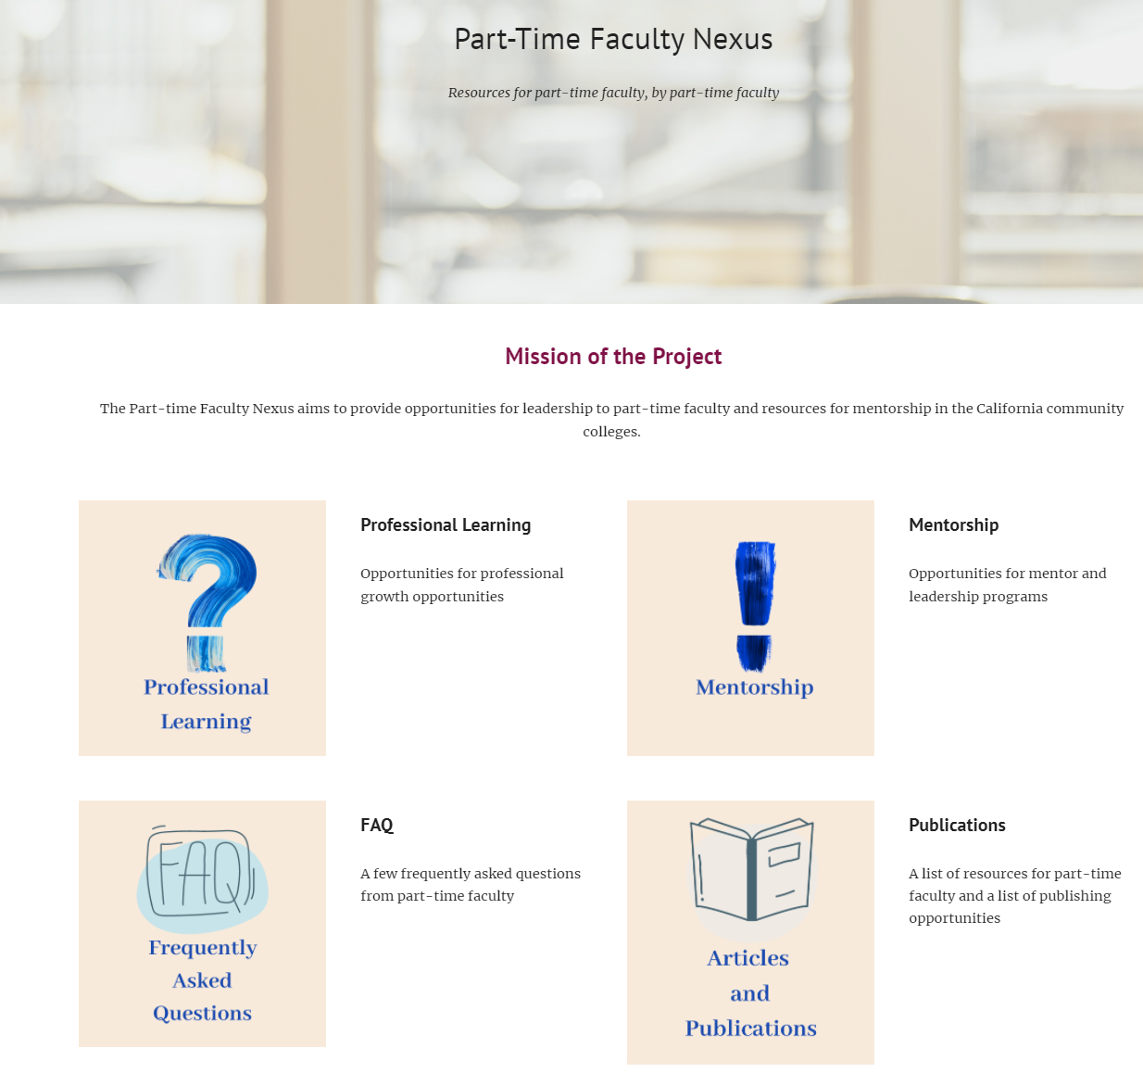
Part-time Faculty Nexus: Connect with Resources!
WEBSITE:
Professional Learning
Mentorship & Leadership
Articles & Publications
FAQ
Notes:
Mentorship Handbook: https://asccc.org/sites/default/files/publications/asccc_mentorship_handbook_2021.pdf
Part-time Nexus: https://sites.google.com/view/part-timefacultynexus/home?authuser=0

Slide 31
CCC Registry
It is important to know where to look when searching for part and full-time positions.
Applying for one position does not establish on-going applicant status at a college/district.
The CCC Registry is an excellent source for community college positions.
What is the CCC Registry?
The job website for faculty, administrator, and staff openings supported by the Chancellor’s Office.
It is a recruitment resource for the proactive job seeker. Registration on the site includes the option to sign up for e-alerts for jobs in your field.
The CCC Registry hosts job fairs annually in Los Angeles and Bay Area in January/February.
In 2022, a virtual career event is being held from January 27 – February 28.

Slide 32
You are valued and supported!
Volunteer for statewide service: https://asccc.org/content/new-faculty-application-statewide-service
ASCCC email: info@asccc.org

