Slide 1
Hot Topics in CTE and Career Pathways
Notes:
Finish the slides by Wednesday.

Slide 2
ASCCC Part-time Committee Faculty
Dr. Olivia Herriford, Regional Director, Bay Area Community College Consortium
Mayra Cruz, ASCCC Treasurer
Alpha Lewis, ASCCC Part-time Committee
Notes:
Part-time Committee Self Introductions: 30 seconds each: state your discipline and college(s)

Slide 3
Session Description
California is witnessing a seismic shift throughout all sectors of the economy. Community colleges will ​continue to play a ​significant role in preparing our current and future workforce to navigate the changing landscape. These changes will require an adaptive approach to student preparedness. ​Part-time faculty play a unique role as industry experts. Join us for in an engaging conversation on Career and Technical Education, looking at the role that ASCCC, industry partners, advisory committees, and regional consortiums ​play in promoting ​career preparation opportunities for student success.

Slide 4
Session Agenda/Objectives
Engage in Q&A from attendees
Regional Advisors and CTE programs
Hot topics in CTE
Teaching CTE programs during a pandemic

Slide 5
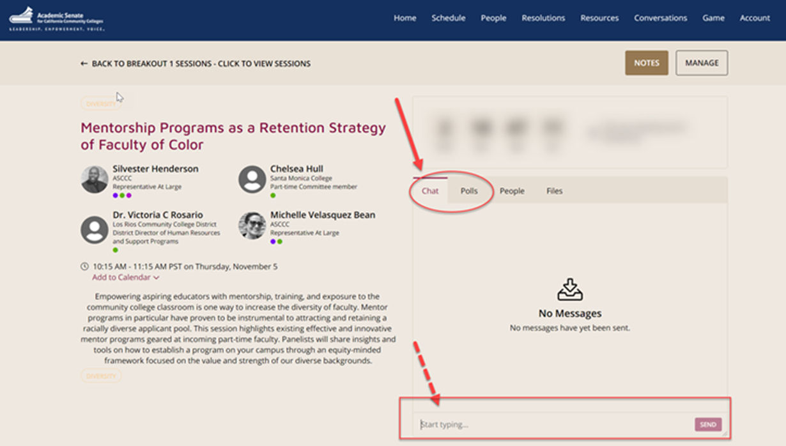
Questions: Use the Pathable platform CHAT box

Slide 6
Regional Advisors and CTE Programs
Regional consortia workforce development and CTE support
Past, present, and future structural changes
Creating a CTE program and how regions assist
Roles of regional directors in supporting and sustaining a CTE program

Slide 7
Regional advisors for workforce development and career education
Regional Directors, Employer Engagement
  For priority industry sectors (Health, ICT-Digital Media, Business & Entrepreneurship, Adv Manufacturing, Adv Transportation & Logistics, Agriculture Water & Environmental Tech, Energy Construction & Utilities, Life Sciences, Global Trade, Retail Hospitality & Tourism)
Regional Directors
  For Special Projects, Apprenticeships
Regional Centers of Excellence for Labor Market Research
K14 Technical Assistance Providers
Regional Coordinators Guided Pathways
Notes:
These are strategic positions, adding value to individual college programs by responding to significant labor market trends, engaging industry participation, and arranging funding that helps build initiatives throughout the region to increase student success.
Regional Directors work with business and industry, colleges, and other stakeholders to help create career educational opportunities for students. They proactively engage industry with the colleges in creating initiatives that enable student employment and lifelong learning in the sector. Consistent with the Vision for Success, RDs connect colleges with opportunities to enrich career education student success through relationships with business and industry, assist faculty and programs to increase student employability, and facilitate access to resources. Key requirements are for RDs to apply business and industry expertise and fluency in articulating priorities, such that the colleges can take effective action.

Slide 8
Regional Directors…
Develop and coordinate regional employer/industry partnerships to
  Provide curriculum guidance for emerging career education
  Engage organizations that support and provide industry-recognized certifications
  Identify student work-based learning opportunities
  Collaborate with workforce development boards
  Connect with community-based organizations for equity outreach
Augment local program advisories
Lead collaborative projects that
  Respond to regional priorities
  Leverage regional funding for common initiatives
Support CTE program design, development, and sustainability
Notes:
Regional Directors (RDs) and Technical Assistance Providers (TAPs) must work closely with the regional Center of Excellence (COEs), Regional Consortia (RCs), Chief Instructional Officers (CIOs), Deans and others to assist their colleges and regions to:
Examine and obtain a deep understanding of the workforce needs of the industry clusters within their region, as well as growth industries;
Craft workforce solutions tailored to specific industry and the region;
Demonstrate that the competency and skills-based training offered relates directly to jobs and employment for students;
Identify emerging industries, research projected workforce needs and prepare colleges to respond;
Provide technical assistance to colleges and regions, and work to align career support structures within colleges to connect students directly to employment;
Collaborate and coordinate with other state, regional or local agencies involved in education and workforce training in California (including but not necessarily limited to, the California Workforce Development Board, local workforce investment boards, the Employment Training Panel, the State Department of Education, and the Employment Development Department), and leverage investments to better serve students;
Develop financial and in-kind resources (public and private) to support college, regional economic and workforce development and career education programs; and,
Collaborate and coordinate with representatives of business, labor, and professional trade associations to develop education and training solutions to assist new and incumbent workers in the state’s growth and emerging industry sectors.
In certain geographies, there may be multiple Regional Directors for a sector providing coverage to the macro-region depending upon regional priorities

Slide 9

Collaborating with Regional Directors
RD benefits to the colleges for an assigned sector include:
  Increased enrollment in college programs
  Increased student persistence and completion
  Increased student employment in living wage jobs
RD benefits to industry include:
  Bridging supply/demand gaps
  Enhancing the talent pipeline from colleges into the industry
  Upskilling incumbent workers to meet new technological demands

Slide 10
Past, current, and future structure
Past:
  Deputy Sector Navigators and Statewide Sector Navigators
  Established in 2013 by the Economic and Workforce Development Program
Current:
  Regional and Statewide Directors for Employer Engagement
  Funded by the WEDD
  Increased focus on employer partnerships resulting in students being hired at the end of their education or training
Future:
  TBD
  WEDD no longer funding regional advisors after 2020-2021
  Shifting ownership to the regions, who may continue and fund as SWP positions
Notes:
“Doing What Matters for Jobs and the Economy” initiative to target investment at priority and emergent sectors as chosen by each of the ten regions of the State and meet the intent of specific objectives of the Economic and Workforce Development Program and the Career Technical Education Pathways Program.
Deputy Sector Navigators (DSNs) served as in-region contacts for a sector, working with the region’s colleges and employers to create alignment around and deliver on workforce training and career pathways.

Slide 11

Regional assistance with CTE program creation
Provide college partners with business and industry insights for design
  Talent forecasts – jobs in demand 18-36 months out
  Necessary KSAs to get hired
Plan, coordinate faculty PD on new curriculum content
Engage business and industry partners to confirm program outcomes
Prepare supporting LMI for program recommendation
Facilitate collaborative program creation
Notes:
The program recommendation process outlined by the California Community College Chancellor’s Office (CCCCO) requires that all requests to add new programs or certificates to a college’s inventory of occupational programs include a recommendation from the Regional Consortium. Complete instructions for this process are included in the Program and Course Approval Handbook-7th Edition.
The process for obtaining recommendation/endorsement from the Regional Consortium (RC) is intended to inform and engage members of the Consortia in adding programs at member colleges, and to foster a spirit of collaboration and coordination that results in viable choices for Career Education courses/programs across the region.

Slide 12

Regional support for CTE program sustainability
Keep colleges and programs engaged with the changing workforce development ecosystem
Business and industry relationship management
Ongoing
  Program awareness
  Faculty PD
  Employer engagement in student work-based learning opportunities

Slide 13
Trending in Career Technical Education (CTE)
Competency-Based Education
Short-Term Credentials
Innovation/New Programs
College Advisory Board
Funding and strategies

Slide 14
Why Now! Competency-Based Education
Focuses on teaching and facilitating learning so that students can achieve the learning outcomes (competencies) identified for a course or program
Focuses on the outcomes in the design of instructional experiences (course or program)
Communicates outcomes for students
Considers industry and employer expectations
Notes:
Mayra
Title 5, Division 6, Chapter 6, Subchapter 3- § 55260
Key Points from Cheryl (Speak to CBE broadly, not as it specifically applies to the CCC CBE Collaborative or is used at Western Governor's and high flex universities)
Competency based education is a focus on teaching and facilitating learning so that students can achieve the learning outcomes (competencies) identified for a course or program
It's important to focusing on the outcomes in the design of instructional experiences (course or program)
Clearly communicate outcomes for students...makes learning relevant and meaningful. Do this in more ways than just putting it in the syllabus. Make the link between learning and assessment to the outcomes clear throughout the course
For CTE, it's important to consider industry and employer expectations - outcomes should be aligned with those intentions and expectations.
Goal:
Empower students in their learning journey by providing a personalized, flexible, adaptive, and culturally responsive curriculum with which students can engage.
Allows students to demonstrate mastery of learning and the achievement of competencies at their own pace, aided by customized instructional and support services
Why CBE and Why Now
For-credit CBE programs are a needed addition to our instructional portfolio
• CBE will help us meet our goals (Vision for Success)
• CBE is an economic mobility lever
• Career preparation is essential to the future of our state and our system
• CBE can flex with changing technologies, employer demands, and unexpected societal shifts
Points:
CBE is based on outcomes and designing instruction to achieve those outcomes.
Any and all courses and classrooms can be CDE without a major curriculum revision..

Slide 15
Meet the Demands of a Global Economy
Short Term Credentials
Strong workforce certificates in great demand by both employers and colleges
The need will accelerate as a result of the pandemic
Provide a pathway to continued education training
Considerations to develop short terms programs:
  Conduct data research and future casting of employment needs
  Select sectors that have a skill gap positioned for short term training
  Engage employers in regional advisory committees
Notes:
Mayra
Key points:
Lead to meaningful employment
Serve as a stepping stone to career advancement, higher pay, and future opportunities
Provide a pathway to continued education training—and lifelong learning
https://www.luminafoundation.org/wp-content/uploads/2020/07/what-are-short-term-credentials.pdf

Slide 16
Re-Imagining CTE: Innovation/New Programs
Advancing access and focusing on equity
Connecting students to high-demand, living-wage careers
Delivering a relevant learning experience
Using community resources
Notes:
Mayra
Resource: 06/19/2019 Think Tank Identifies Innovative CTE Programs
https://ctepolicywatch.acteonline.org/2019/06/think-tank-identifies-innovative-cte-programs.html

Slide 17
Strengthen the College Advisory Committee
Why: Provide relevant, timely curricular options for our students based on industry needs
Regulation and mandates
  Title 5 requirement §55601
  CTE programs receiving federal funding through Perkins must “have extensive business and industry involvement”.
  Strong Workforce Program to engage employers, workforce boards, economic development entities, and other workforce organizations with faculty in the program development and review process.
Notes:
Mayra
Resource: https://www.asccc.org/content/cte-advisory-committees-making-them-work-you
Title 5 §55601[1]:
The governing board of each community college district participating in a vocational education program shall appoint a vocational education advisory committee to develop recommendations on the program and to provide liaison between the district and potential employers.
The committee shall consist of one or more representatives of the general public knowledgeable about the educational needs of disadvantaged populations, students, teachers, business, industry, the college administration, and the field office of the Employment Development Department.
CTE programs receiving federal funding through Perkins must “have extensive business and industry involvement, as evidenced by not less than one annual business and industry advisory committee meeting” (Section 135(b) of Perkins IV[2])
2016, the Strong Workforce Taskforce recommendations further highlighted the need for engagement of industry professionals and faculty. Specifically, Recommendation 9(a)[3] states: “Engage employers, workforce boards, economic development entities, and other workforce organizations with faculty in the program development and review process.”

Slide 18
Be Creative! Funding and Strategies
Collaborations with Regional Advisory groups and employers
Perkins Innovation and Modernization Program
Grants hold the key to maintaining momentum in CTE
  State Departments of Administration (DOA) grants
  U.S. Department of Defense (DOD) grants
  U.S. Department of Labor (DOL) grants
  National Science Foundation grants
  Private family foundation grants
  Corporate foundation grants
  Trade association grants
Notes:
Mayra
Resources:
https://cte.ed.gov/grants/innovation-and-modernization-grant-program
Stengthening Career and Technical Education for the 21st Century Act (P.L. 115-224), otherwise known as Perkins V

Slide 19
Teaching CTE programs during a pandemic
Online teaching strategies
Collaboration With Your Campus/District
Get Involved Stay Informed

Slide 20
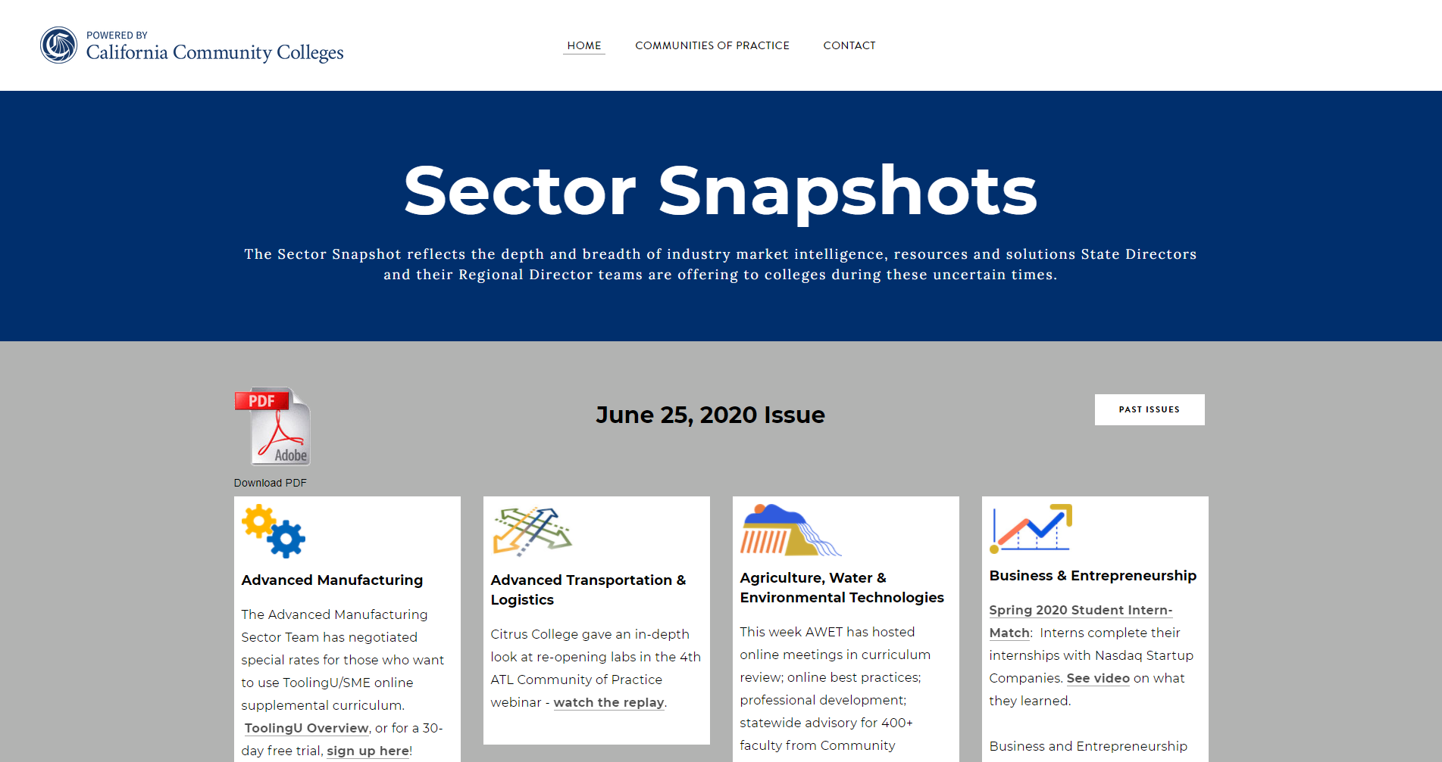
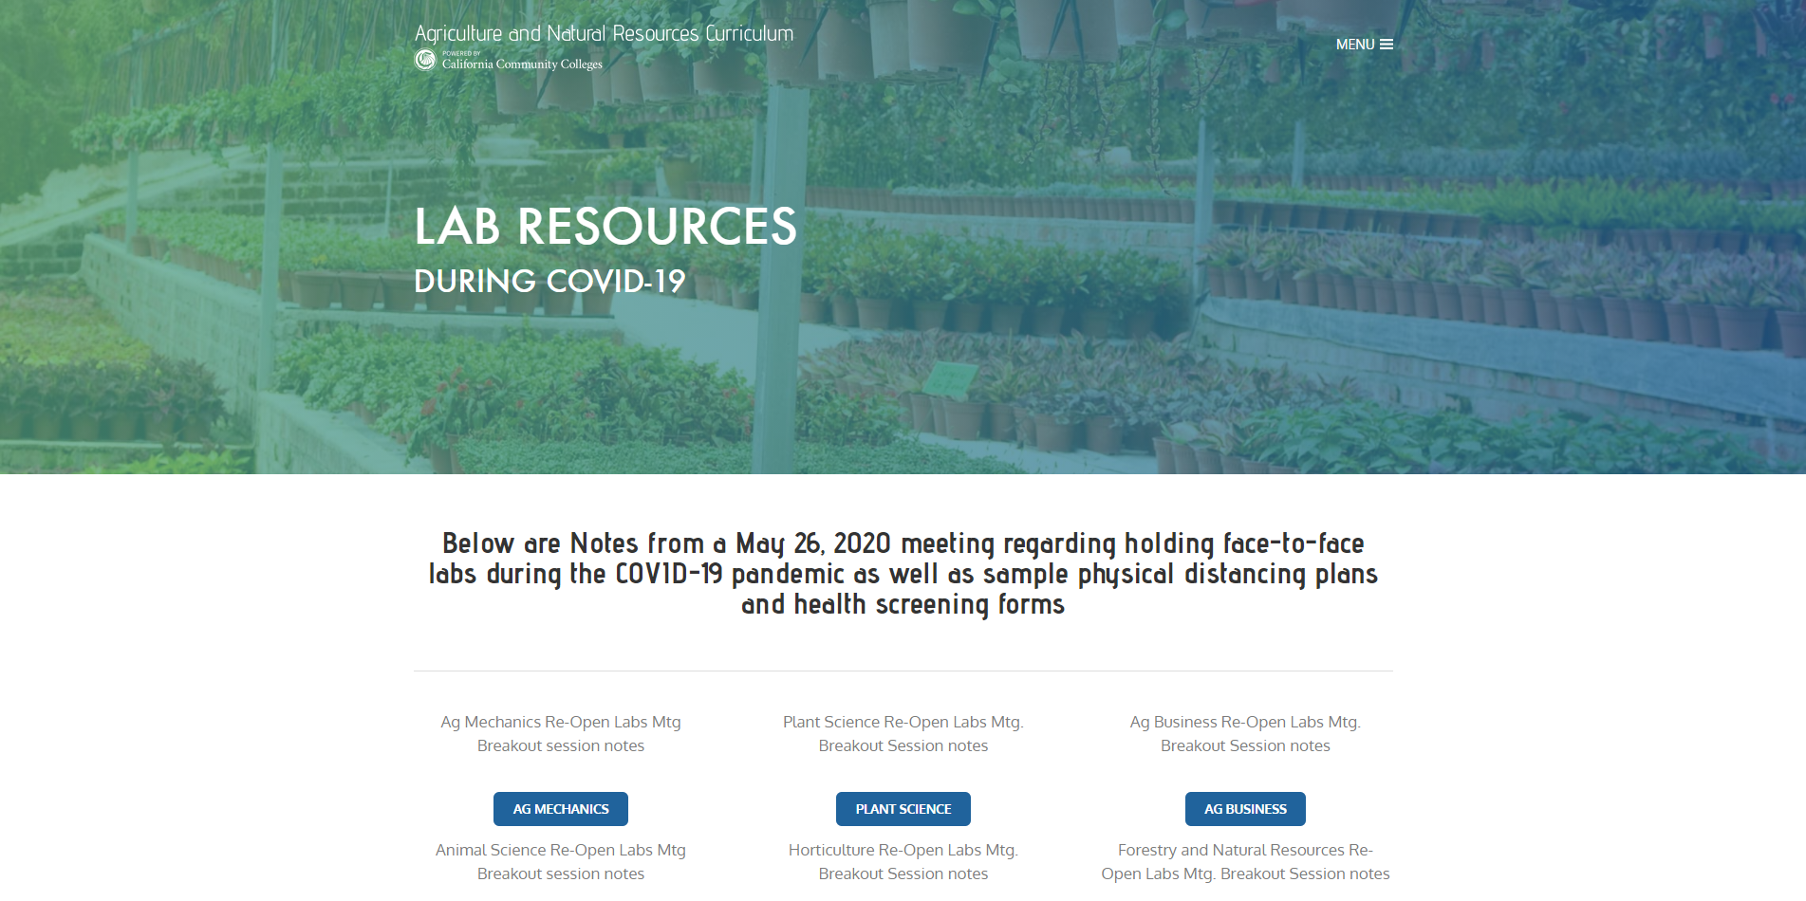
Online Teaching Strategies
(resource and best practices)
https://sectorsnapshots.weebly.com/
http://www.agnrcurriculum.org/lab-resources-covid-19.html
Notes:
Nancy Gutierrez: Lab resources on the AGNR curriculum page http://www.agnrcurriculum.org/lab-resources-covid-19.html
Spreadsheet of distance learning resources https://docs.google.com/spreadsheets/d/1Wn6ThGYQyXkM75RERCaawMNS6wOgZDvVzc13IPNQM0w/edit#gid=0

Slide 21
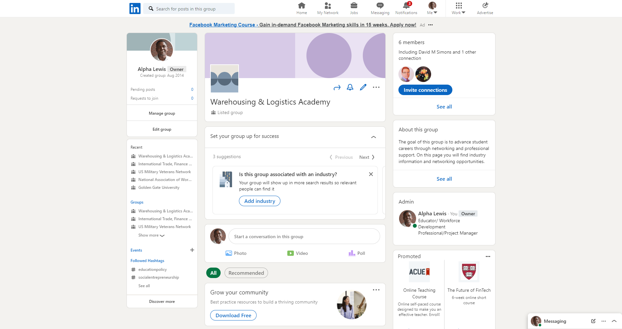
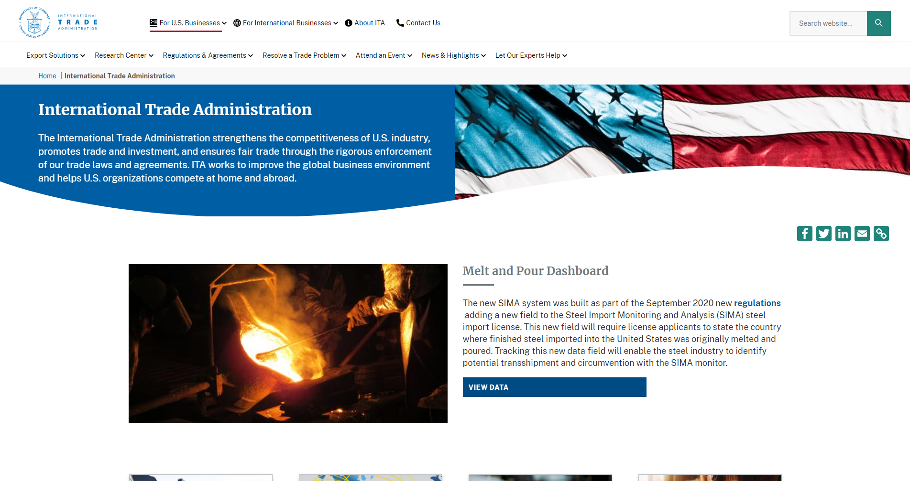
Online teaching strategies
(curriculum development)
Integrating Social Media or establishing student groups in your curriculum
Engage in Active Learning strategies using industry specific resources
Notes:
Nancy Gutierrez: Lab resources on the AGNR curriculum page http://www.agnrcurriculum.org/lab-resources-covid-19.html
Spreadsheet of distance learning resources https://docs.google.com/spreadsheets/d/1Wn6ThGYQyXkM75RERCaawMNS6wOgZDvVzc13IPNQM0w/edit#gid=0

Slide 22
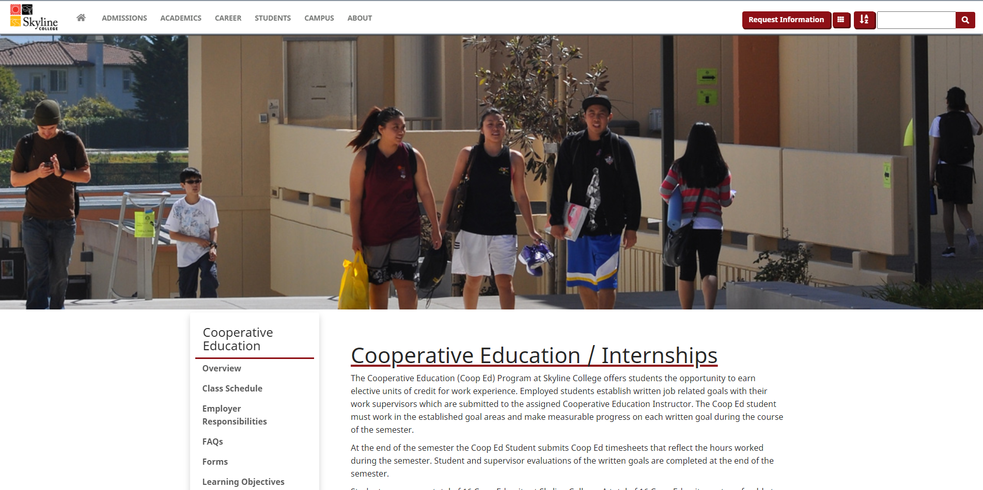
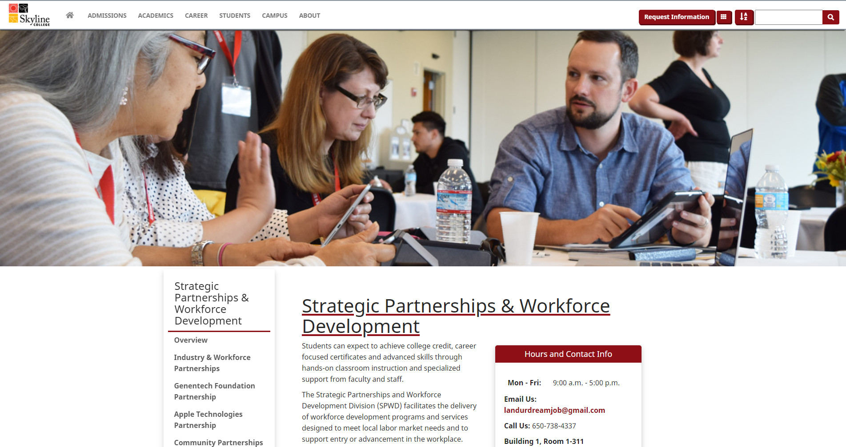
Collaboration With Your Campus/District
Don’t go it alone - partner and share ideas with colleagues
Elicit support from your Dean or administrator to think outside the box

Slide 23
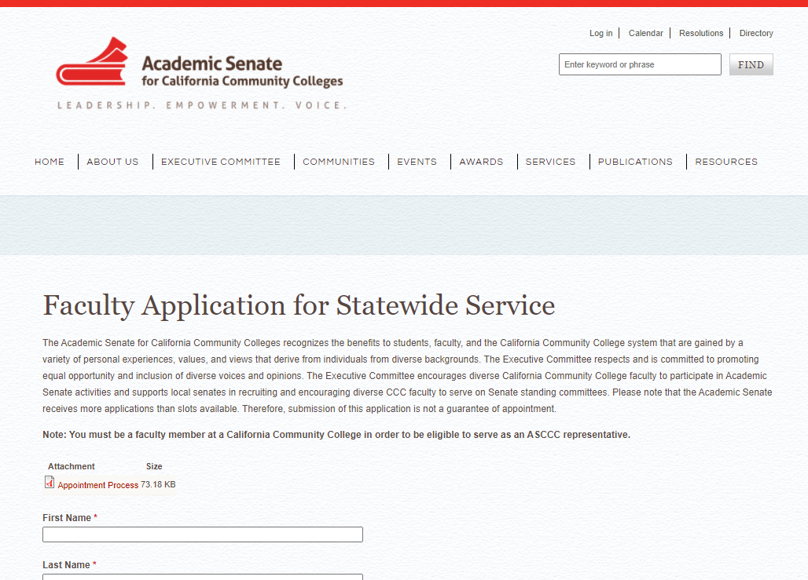
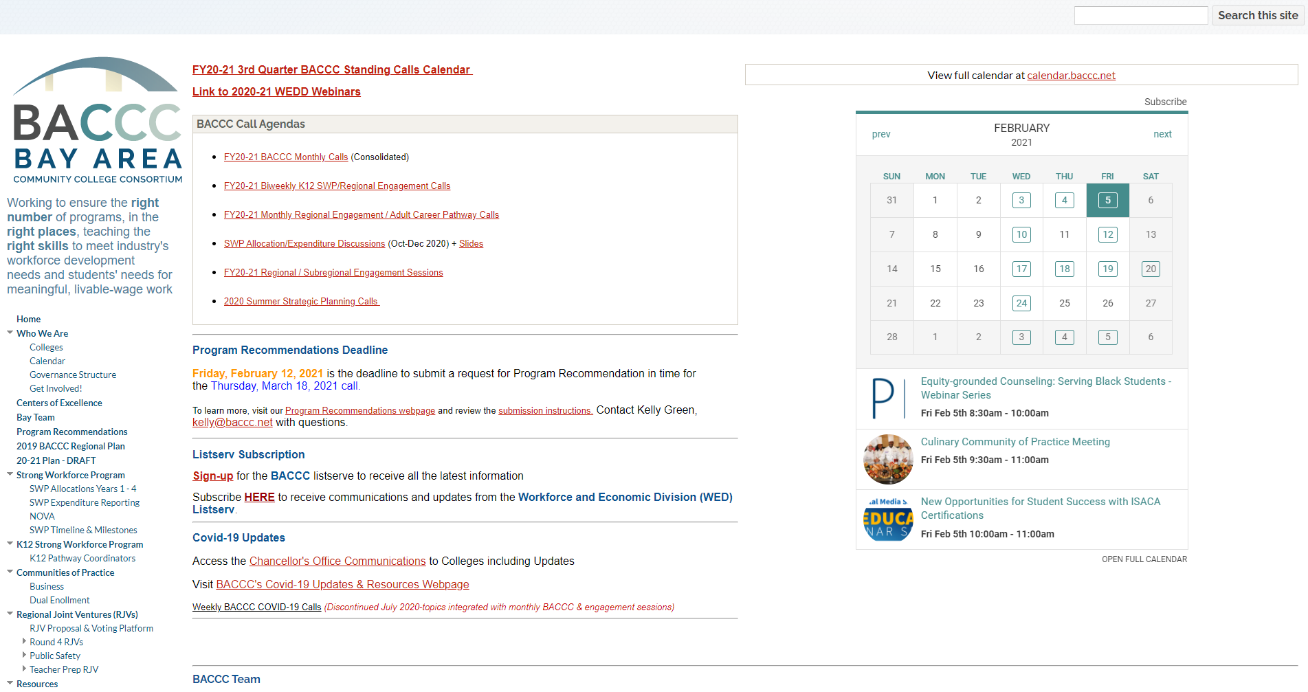
Get Involved Stay Informed
Baccc.net
https://asccc.org/content/faculty-application-statewide-service

Slide 24
Community Discussions
Notes:
Finish the slides by Wednesday.

Slide 25
Further Information and Support
Email info@asccc.org

