Slide 1
Hot Topics IN Online Education
The Library Services Platform (LSP), OEI, changes in Title 5 language to Distance Education regulations
Doug Achterman, President, Council of Chief Librarians and LSP Task Force
Amy Beadle, CCC Technology Center and LSP Program Manager
Anna Bruzzese, ASCCC South Representative
Dan Crump, American River College
Jory Hadsell, CVC-OEI Executive Director
Kate Jordahl, CVC-OEI Director of Academic Affairs and Consortia
Conan McKay, ASCCC Area B Representative

Slide 2
What are some of the Hot Topics in Online Education?
Recent developments in OEI
Changes in Title 5 language to Distance Education regulations
The Library Services Platform (LSP)
Others?

Slide 3
Recent developments in CVC-OEI
Expansion of the California Virtual Campus-Online Education Initiative (CVC-OEI) Consortium
The CVC-OEI is a collaborative effort among California Community Colleges to ensure that significantly more students are able to complete their educational goals by increasing both access to and success in high-quality online courses.
Currently 56 colleges in the Consortium – Additional colleges will be invited to join in 2019.
  • Cross-enrollment
  • Featured in Course Finder
  • Featured Online ADTs
  • Subsidized tools for a rich online ecosystem for student success!

Slide 4
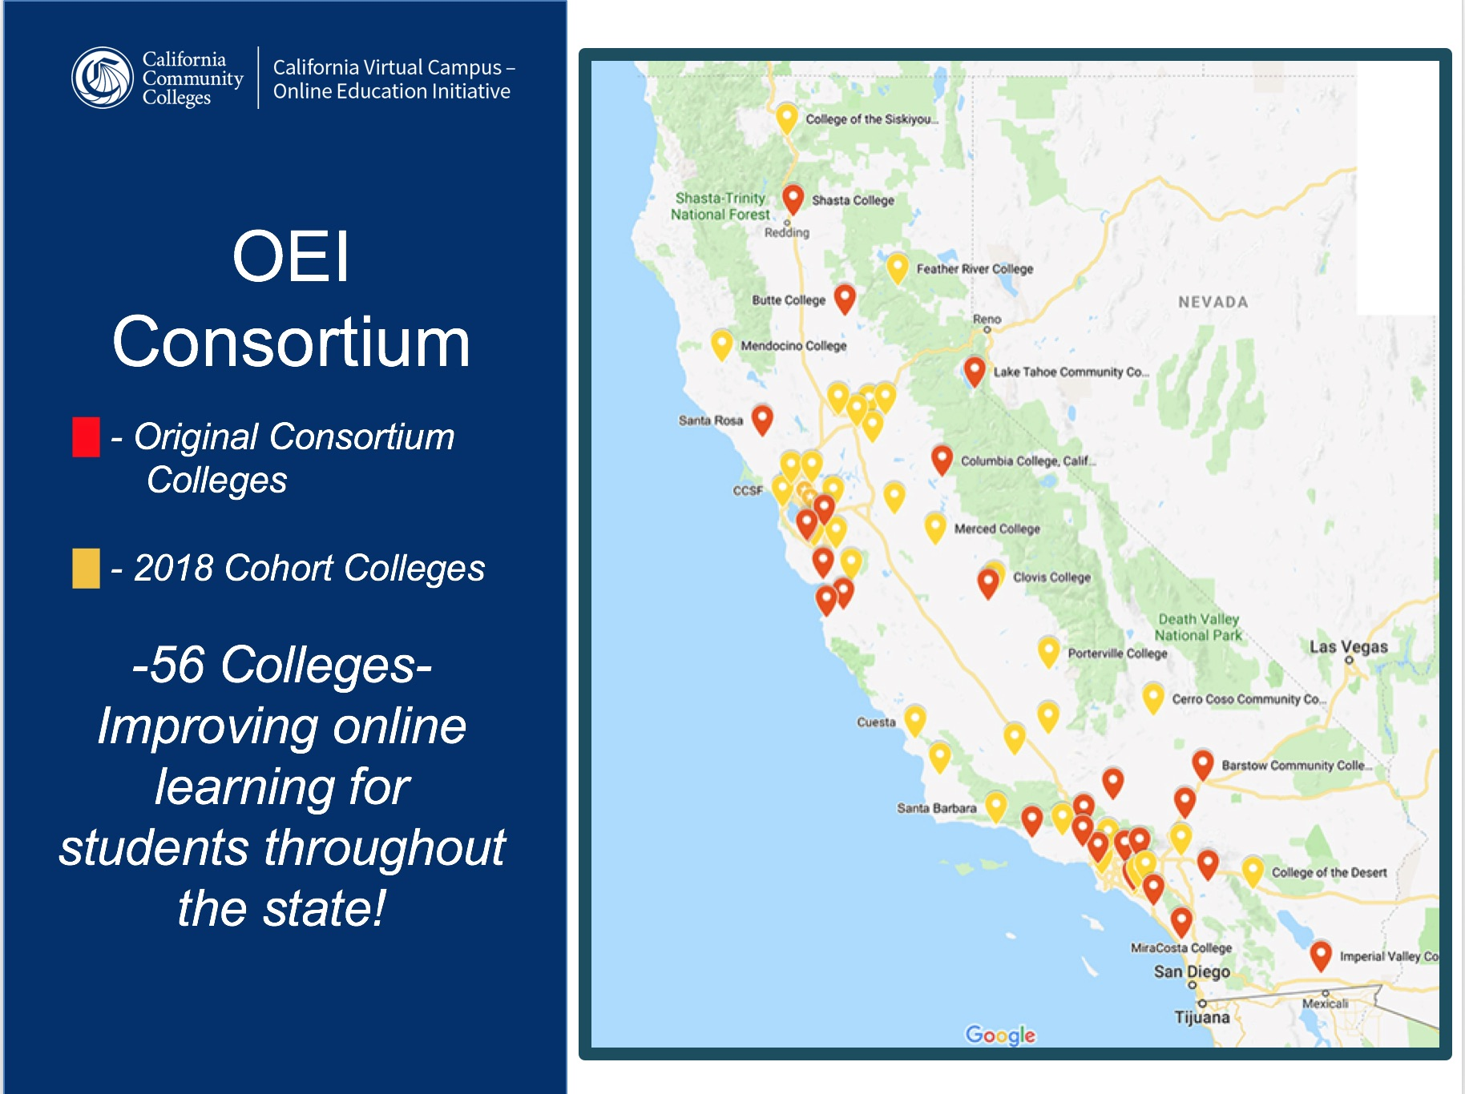

Slide 5
Recent developments in CVC-OEI
California Virtual Campus (CVC)

Slide 6





Recent developments in CVC-OEI
CVC-OEI ecosystem

Slide 7
New Title 5 Language for Distance Education
§ 55200. Definition and Application.
Distance education means instruction in which the instructor and student are separated by time and/or distance and interact through the assistance of technology. All distance education is subject to the general requirements of this chapter as well as the specific requirements of this article. In addition, instruction provided as distance education is subject to the requirements of the Americans with Disabilities Act (42 U.S.C. § 12100 et seq.) and section 508 of the Rehabilitation Act of 1973, as amended (29 U.S.C. § 794d).

Slide 8
New Title 5 Language for Distance Education
§ 55202. Course Quality Standards.
The same standards of course quality shall be applied to any portion of a class conducted through distance education as are applied to in-person classes, in regard to the course quality judgment made pursuant to the requirements of section 55002, and in regard to any local course quality determination or review process. Determinations and judgments about the quality of distance education under the course quality standards shall be made with the full involvement of faculty in accordance with the provisions of subchapter 2 (commencing with section 53200) of chapter 2.
Note: Authority cited: Sections 66700 and 70901, Education Code. Reference: Section 70901, Education Code.

Slide 9
New Title 5 Language for Distance Education
§ 55204. Instructor Contact.
In addition to the requirements of section 55002 and any locally established requirements applicable to all courses, district governing boards shall ensure that:
(a) Any portion of a course conducted through distance education includes regular effective contact between instructor and students, and among students, either synchronously or asynchronously, through group or individual meetings, orientation and review sessions, supplemental seminar or study sessions, field trips, library workshops, telephone contact, voice mail, e-mail, or other activities. Regular effective contact is an academic and professional matter pursuant to sections 53200 et seq.
(b) Any portion of a course provided through distance education is conducted consistent with guidelines issued by the Chancellor pursuant to section 409 of the Procedures and Standing Orders of the Board of Governors.
Note: Authority cited: Sections 66700 and 70901, Education Code. Reference: Sections 70901 and 70902, Education Code.

Slide 10
New Title 5 Language for Distance Education
§ 55206. Separate Course Approval.
If any portion of the instruction in a new or existing course or to be provided through distance education in lieu of face-, an addendum to the official course outline of record shall be required. In addition to addressing how course outcomes will be achieved in a distance education mode, the addendum shall at a minimum specify how the portion of instruction delivered via distance education meets:
(a) Regular and effective contact between instructors and students and among students as referenced in title 5, section 55204(a), and
(b) Requirements of the Americans with Disabilities Act (42 U.S.C. § 12100 et seq.) and section 508 of the Rehabilitation Act of 1973, as amended, (29 U.S.C. § 749d)
The addendum shall be separately approved according to the district's adopted curriculum approval procedures.
Note: Authority cited: Sections 66700 and 70901, Education Code. Reference: Sections 70901 and 70902, Education Code.

Slide 11
New Title 5 Language for Distance Education
§ 55208. Faculty Selection and Workload.
(a) Instructors of course sections delivered via distance education technology shall be selected by the same procedures used to determine all instructional assignments. Instructors shall possess the minimum qualifications for the discipline into which the course's subject matter most appropriately falls, in accordance with article 2 (commencing with section 53410) of subchapter 4 of chapter 4, and with the list of discipline definitions and requirements adopted by the Board of Governors to implement that article, as such list may be amended from time to time.
(b) Instructors of distance education shall be prepared to teach in a distance education delivery method consistent with local district policies and negotiated agreements.
(c) The number of students assigned to any one course section offered by distance education shall be determined by and be consistent with other district procedures related to faculty assignment. Procedures for determining the number of students assigned to a course section offered in whole or in part by distance education may include a review by the curriculum committee established pursuant to section 55002(a)(1).
(d) Nothing in this section shall be construed to impinge upon or detract from any negotiations or negotiated agreements between exclusive representatives and district governing boards.
Note: Authority cited: Sections 66700 and 70901, Education Code. Reference: Sections 70901 and 70902, Education Code.

Slide 12
Library Services Platform Project
What is it?
A CCCCO/CCCTC project to implement a single cloud-based Library Services Platform (LSP) to replace the various integrated library systems now in use in any of the 114 libraries which choose to participate.
The CCCCO and the CCCTC have partnered with the Council of Chief Librarians (CCL) to form the LSP Task Force and project team, develop the project work-plan, complete the procurement process, engage with the vendor and provide project governance.

Slide 13
Library Services Platform Project
Tell Me More
After a lengthy review process, the Ex Libris Alma and Primo products were selected to serve as the systemwide LSP.
The project team, CCL, vanguard schools and other stakeholders are now working with Ex Libris to assure a successful implementation across the system.
A single implementation for all participating libraries will begin in January 2019 with all participants going live on the system between December 2019 and January 2020.

Slide 14
Library Services Platform Project
Money Matters
The implementation fee and the 2020-21 subscription costs will be funded by the LSP project for all participating institutions.
A request for ongoing funding for an additional five years was approved by the Board of Governors on September 17, 2018.
If awarded, funding would include the ongoing Alma/Primo subscriptions, the possible addition of additional library software and subscriptions, as well as ongoing project management, administration and library systems expertise at the program level.

Slide 15
Library Services Platform Project
Benefits
The Product:
Modern Architecture and Design
Enhanced Discovery
Integrated Workflow
Improved Maintenance
Robust Analytics
Better User Experience
The Systemwide Program:
Collaboration with other CCC libraries
Potential for resource sharing
Support staff at the system-level
Equitable experience for all students and adjunct faculty

Slide 16
Library Services Platform Project
Participation
107 colleges have committed to the statewide implementation beginning in January 2019.
What? Did you really mean to say 107? That’s unheard of!
The vendor has granted us a 2-week extension due to our outstanding participation levels to allow any of the remaining 7 colleges opt in. November 15th is the extended deadline.

Slide 17
Library Services Platform Project
Work Groups
ASCCC approved statewide faculty workgroups will recommend policies and best-practices to the LSP Governance Committee, as well as serve as representatives of the various specialized areas.
Current work groups are:
Acquisitions/Electronic Resource Mgmt. | Discovery and User Experience
Analytics | Instruction
Cataloging | Professional Development
Circulation | Systems

Slide 18
Library Services Platform Project
Governance
LSP Task Force Members/CCL Representatives (5)
Vanguard Members
(Large, Medium, Small) (3)
CISOA (1)
Work Group Members (8)
ELUNA Members (2)
LLRPAC (1)
ASCCC (2)
League Library Consortium Director (1)
CCCCIO (1)
CCCCO Project Monitor (1)

Slide 19
Library Services Platform Project
Vanguard Phase
11 colleges are currently participating in a pre-implementation phase of the project, lasting approximately four months.
During this phase the participating colleges will go through the major steps of implementation, including training, data migration, network zone building, system configuration and initial workflow planning.
The lessons learned from this phase will influence decisions to be made on collaborative workflows, new policies, new services, etc. that may be facilitated by the LSP.

Slide 20
Library Services Platform Project
Project Timeline
Late January 2019 | Implementation Kick-off
March-April 2019 | Test loads delivered Sandboxes available
April –October 2019 | Data review and integrations
October 2019 | Provision local SFTP servers for test loads Authentication forms complete 3rd party integrations completed
November 2019 | Product experts certified
December 2019-January 2020 | Product Go-Live
January – February 2020 | Configuration refinements/review
March 2020 | Switch to standard support

Slide 21
Library Services Platform Project
Project Resources
Beginning in late January 2019, there will be
  Weekly training webinars
  Weekly project meetings
  Specialized webinars for IT
  Northern and Southern in-person workshops
  Regional collaboration opportunities
  Ongoing professional development
  Systemwide support specialists

Slide 22
Library Services Platform Project
Q&A
More questions?
Contact:
Amy Beadle
Statewide Program Manager
LSP Project Lead
abeadle@ccctechcenter.org

Slide 23
Thank you!
Doug Achterman, dachterman@gavilan.edu
Amy Beadle, abeadle@ccctechcenter.org
Anna Bruzzese, bruzzeaa@piercecollege.edu
Dan Crump, Crumpd@arc.losrios.edu
Jory Hadsell, jhadsell@cvc.edu
Kate Jordahl, kjordahl@cvc.edu
Conan McKay, cmckay@mendocino.edu

