Slide 1
How to Use Equity Tools to Have Equity Conversations Karen Chow, ASCCC Area B Representative
Manuel Velez, ASCCC Area D Representative
EDAC Brown Bag Webinar
November 15, 2022

Slide 2
Breakout Description
The DEI in Curriculum Model Practices and Principles and the ASCCC OERI IDEA Framework are two DEI curricular tools that can be used to facilitate systemic changes. Join us for a discussion on how to support the use of these tools at your college. Presenters will provide promising practices to support college engagement with these resources.

Slide 3
Session Learning Outcomes
Overview of useful tools for IDEAA work in curriculum
DEI in Curriculum Model Principles and Practices Chart
OERI framework
Review practical examples of how to apply these tools
In the classroom
At the curriculum committee

Slide 4
Overview of Tools
DEI chart history and creation process
The California Community College Curriculum Committee (5C) recommended framing the curriculum dialogue and decision-making in principles that reimagine curriculum through an equity lens.
This tool is its response, developed in collaboration with CIOs, faculty, CO representatives, curriculum specialists, deans, and students.
OERI framework history and creation process

Slide 5
DEI in Curriculum: Model Principles and Practices
Traditional Educational Practice Supporting research may be found at the end of this document | Equity Principle Supporting research may be found at the end of this document | Culturally Responsive Classroom Practices All faculty have the opportunity to engage in conversations about equity-minded practices within the context of their disciplinary expertise and curricular practices and such practices may include but are not limited to the following: | Culturally Responsive Practices for Curriculum Committees and Local Senates Curriculum committees and senates have the opportunity to engage in equity-minded review processes of curriculum that may include but are not limited to the following:

Slide 6
What does it mean to apply the tool?
DEI in Curriculum chart focuses on:
Textbooks
Student-facing documents
Role of discipline faculty
Course syllabus
Classroom assignments/assessments
DEI in all disciplines
Ethnic Studies as a discipline
Siloed programs and services
Your college can add more!
Notes:
Chart: https://www.asccc.org/sites/default/files/CCC_DEI-in-Curriculum_Model_Principles_and_Practices_June_2022.pdf

Slide 7
Culturally Responsive Classroom Practices
Engaging with the third column:
All faculty have the opportunity to engage in conversations about equity-minded practices within the context of their disciplinary expertise.
This column provides promising practices that faculty can begin implementing at the classroom level.
Classroom level and curricular practices may include but are not limited to those listed in the chart.

Slide 8
Examples of Practice
Shifting student-facing documents and descriptions focused on deficit-minded language to asset-minded and decolonized language
e.g., minority students vs minoritized; unprepared vs underprepared
Shifting language from impersonal verbiage and descriptions to warm, culturally responsive content
e.g., high minority population vs richly diverse community
Rewording language from a colonized mindset to an equity mindset
e.g., colonized vs colonial; enslaved instead of slaves
Collaborate with student services faculty and classified professionals to prioritize student needs in a more hands-on, holistic approach that addresses the whole student
e.g., basic needs, mental health, support services

Slide 9
Updating Syllabus Language
BEFORE: DEFICIT LANGUAGE
Every student is required to participate in class discussion. The teacher will call on all students as a form of assessment (to check for understanding); therefore, every student should come to every class prepared.
Each student is responsible for reading daily, in order to prepare for possible Pop Quizzes on the assigned material. If a student misses a Pop Quiz, he or she may not make it up. Points assigned to quizzes may vary.
Homework is assigned daily. IT IS THE STUDENT’S RESPONSIBILITY TO CHECK THE HOMEWORK SCHEDULE. Students may check the homework sheet, the course website, or email the teacher with any questions or concerns regarding homework.
NOW: EQUITY FOCUSED
My Commitment to You
You are entitled to an equitable learning environment that is free of unfair practices and a space that celebrates your voice, fosters your agency, and develops your capacity for self-advocacy. As your instructor, I am committed to equity and inclusion for you, our diverse Rio Hondo College students, acknowledging and rejecting institutional racism and discrimination. Your classroom should be a safe place to express, to reflect, to guide, and to be guided. I commit to protecting students of color, Dreamers, and students who are lesbian, gay, bisexual, transgender, queer, questioning, intersex, and asexual.
If life happens and you need assistance or support, please email me immediately; I am here to support!

Slide 10
Culturally Responsive Assessment in Sociology
Before
Most sociology courses already include explicit multicultural and social justice content, objectives; many sociology OER materials already available
However, content is only half the battle:
Do methods of instruction and evaluation implicitly reinforce the historically racist, sexist, exclusionary higher education practices?
Lecture-heavy instruction
Assignments and grading are “objective”
Students can share perspectives and opinions but doesn’t count towards grade
Now
Shift to more student-centered focus
in-class polls (anonymous)
online discussions (graded)
small group breakouts
Added – and rewarded –multiple opportunities for student self-reflection and course feedback
Anonymous surveys
“Reflect and Connect” section on exams

Slide 11
Rethinking Assignments in Biology*
Example 1: Racist roots of eGFR
Glomerular filtration rate (GFR)- the amount of filtrate formed by both kidneys each minute
Difficult to measure directly, so GFR is estimated (eGFR) based on age, gender, race, and levels of creatinine
Example: African Americans get their eGFR increased due to an assumption of higher muscle mass (x1.210).
Consequence? African Americans are de-prioritized for kidney transplants
This week's discussion, read Hidden in Plain Sight – Reconsidering the Use of Race Correction in Clinical Algorithms and report back on issues with other clinical tests.
Example 2: Fat phobia
What is BMI? Body mass index only takes into consideration your height and weight, nothing about exercise or your nutrition, like fat phobia, also has racist origins.
Racist origins of BMI: Only western European bodies used to establish BMI
For this week's discussion, read Everything You Know About Obesity is Wrong and listen to Fat Phobia and its Racist Past and Present
* Examples provided by Dani Crain, Woodland Community College

Slide 12
Model Curriculum Committee Practices and Policies
Engaging with the fourth column:
Curriculum committees and academic senates have the opportunity to engage in equity-minded review processes of curriculum.
This column shows ways that local curriculum committees and academic senates may support equity work in reviewing credit and noncredit curriculum, course outlines of record, and curriculum documents and processes in culturally responsive ways.

Slide 13
Curriculum Committee IDEAA Review: Case Study
Woodland Community College curriculum committee has been piloting incorporating IDEAA into curriculum review since Fall 2021 – no formal policy yet; waiting for title 5 revisions
Started with professional development for committee and discipline faculty on incorporating IDEAA throughout the COR (See "Moving the Needle" link in Resources slide)
Committee began to look for tangible evidence of IDEAA in course descriptions, content, objectives, outcomes, assignments, and materials
Sent back course proposals to faculty originators with requests to include IDEAA in different elements of the COR, depending on course
AJ class already had explicit DEIA elements in content; asked faculty to consider adding objectives, outcomes, and student-centered description to highlight that focus
ECE courses had objective to "promote diversity in the classroom"– asked faculty to expand on this in content, assignments, and methods of evaluation
Health course revised to have more student-friendly description (jargon-free), added explicit content on intersectionality of race, ethnicity, gender, and age

Slide 14
Results of WCC Pilot
Art History courses revised to diversify representation and decolonize language:
Removing heavy focus on European art in Global Art History class; adding additional art forms from Africa, Oceania, Asia, Mesoamerica to balance representation
Adding more diversity to Contemporary Art: Black, Chicana/o/x, and Feminist art movements, Mexican muralists
Decolonized language in course description:
BEFORE: Survey of Art history, painting, sculpture, and architecture; Art from the Paleolithic period through the Early Christian World, including pre-literate art and Pre-Columbian art.
AFTER: Survey of global art history, painting, sculpture, and architecture. This course will cover a geographically diverse range of art from around the world, starting with prehistoric art through the first millennium.
English department planning major revisions to degree:
Adding World Lit sequence
Deactivating "segregated" courses on Women's Lit and Ethnic Voices; revising all existing comp and lit courses to explicitly include diverse authors and perspectives

Slide 15
Applying the Open Educational Resources Initiative (OERI) Tool
OERI framework developed and intended to be used to:
Review commercial texts.
Review open educational resources (OER).
Why would the OERI develop such a tool?
Proactively establish an OERI standard.
Leverage the power of open.

Slide 16
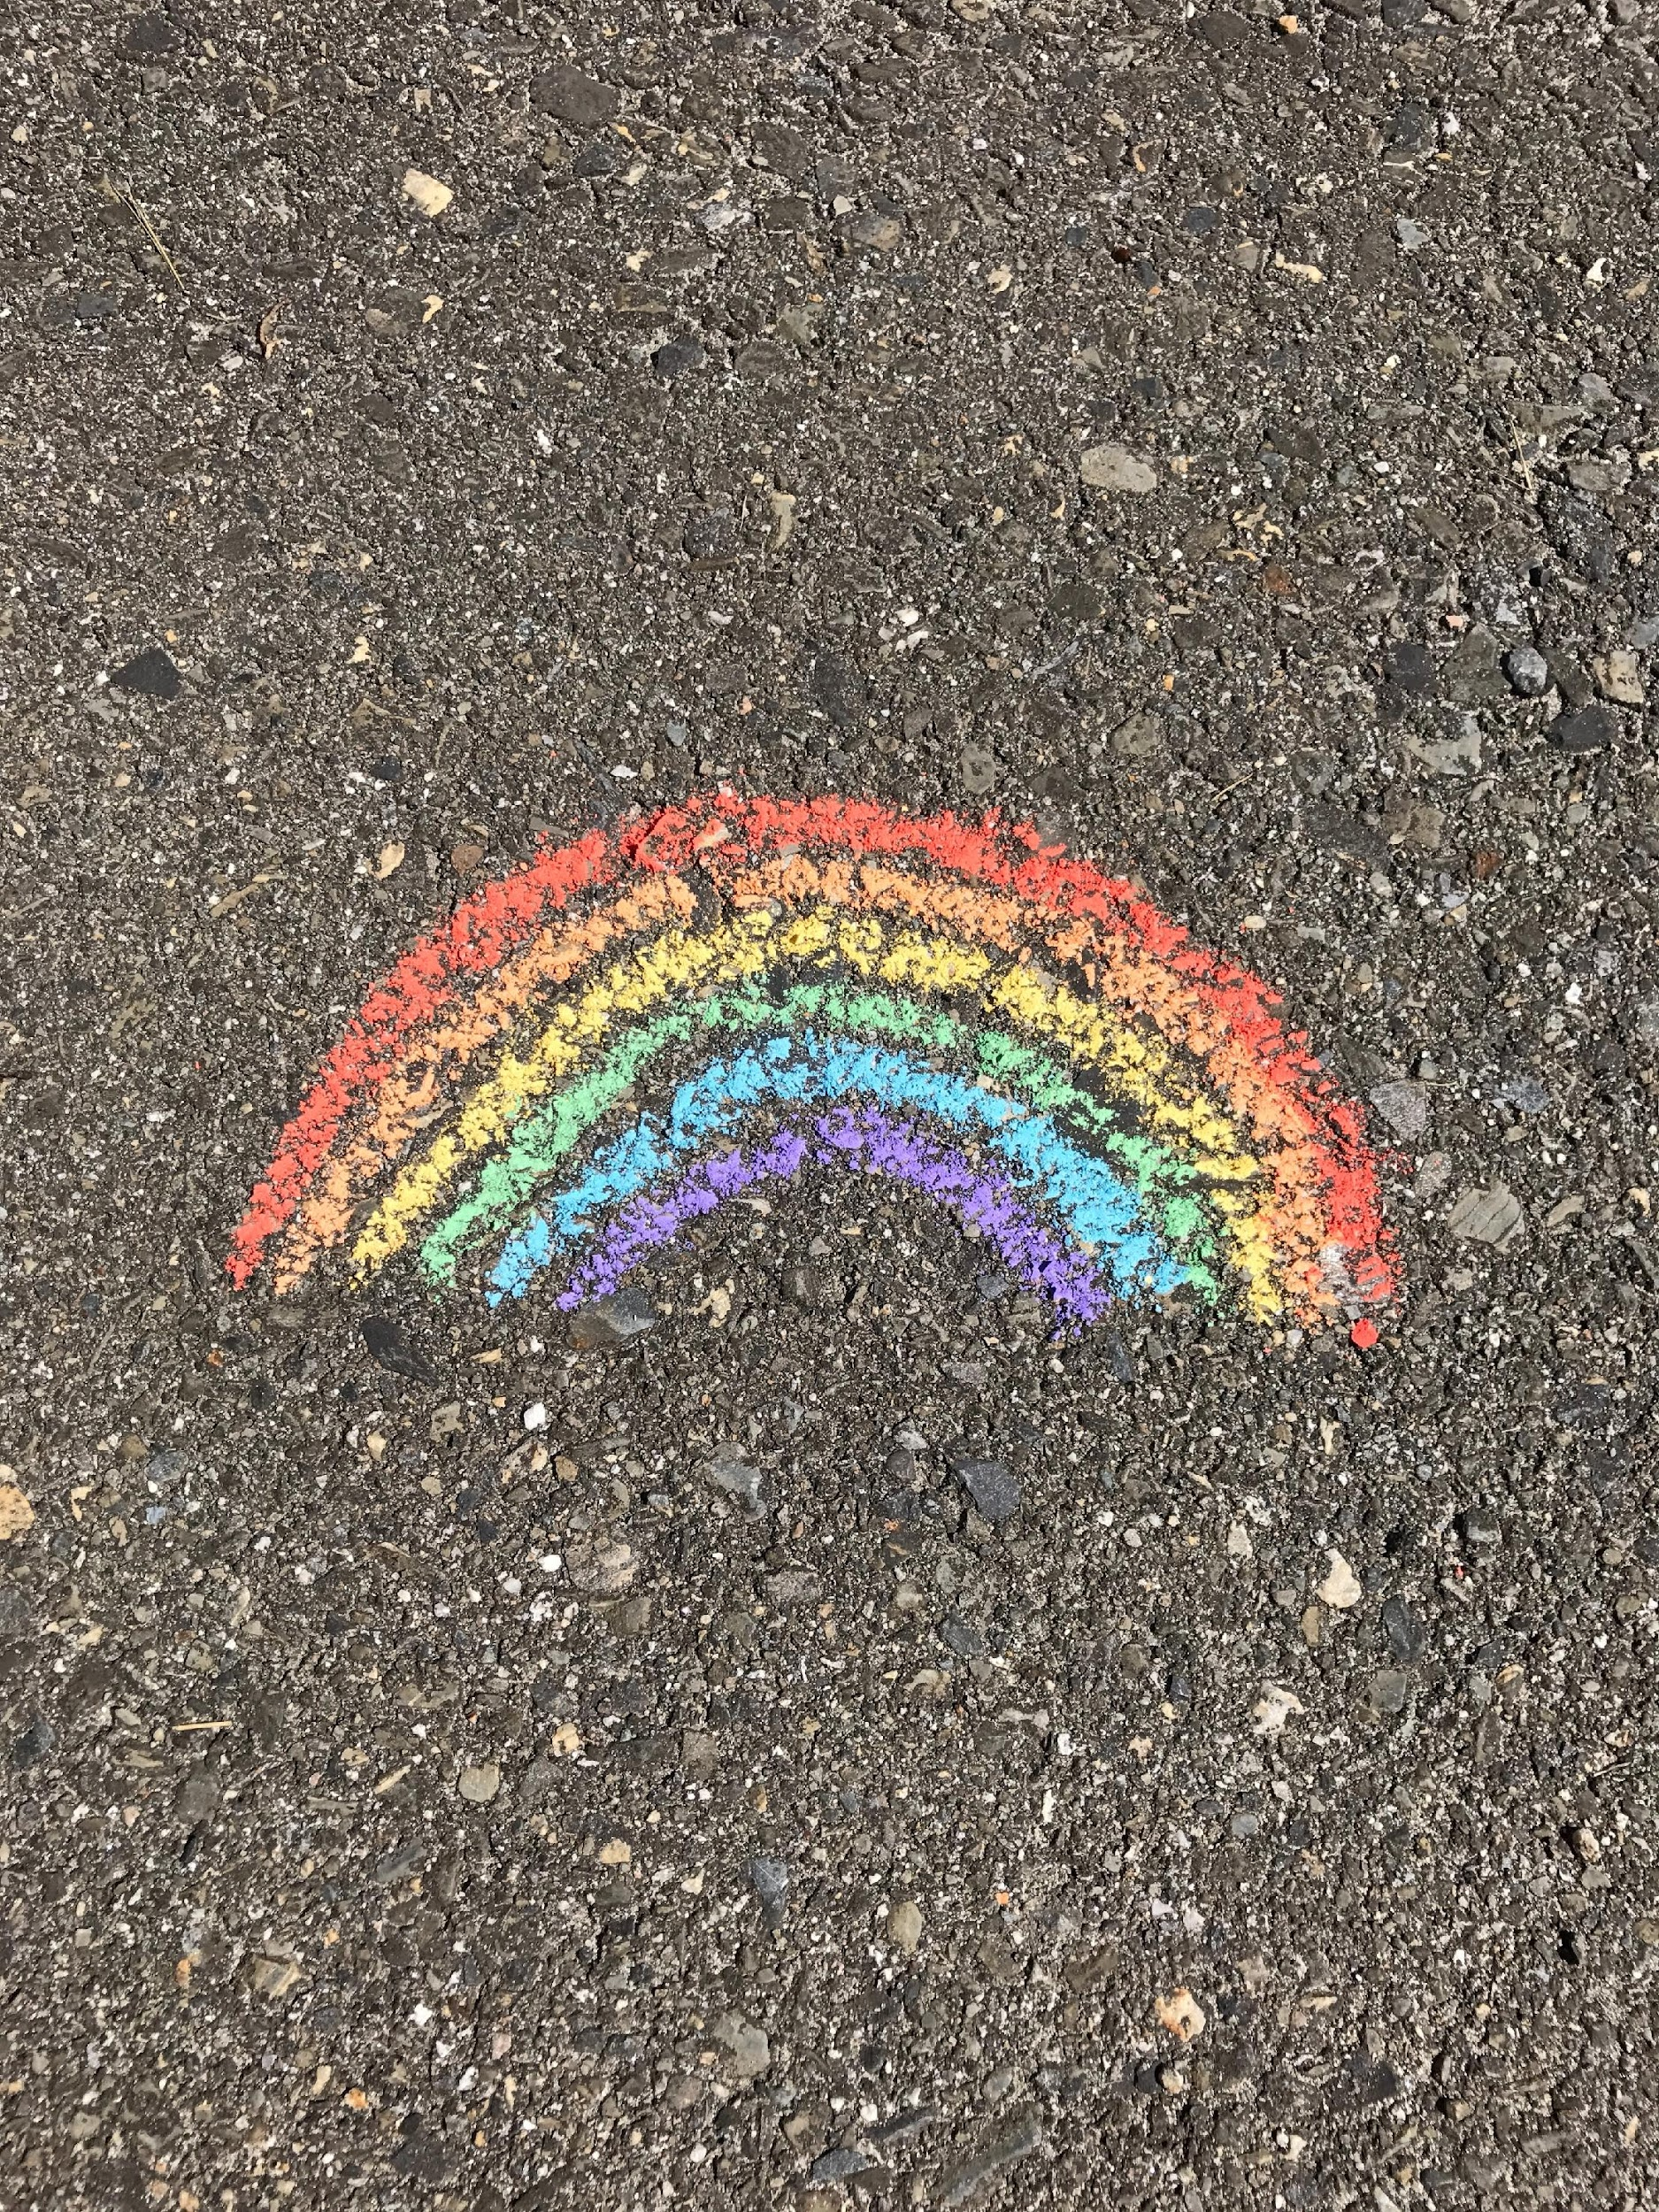
ASCCC OERI IDEA Framework
Inclusivity, Diversity, Equity, Inclusion and Anti-Racism
Note – the OERI always emphasizes accessibility – for this reason we have not specifically referenced accessibility
Photo by Alex Jackman on Unsplash

Slide 17
Who writes our textbooks?
Author Characteristic (*% of professoriate) | Commercial Texts | OER Texts
Female (46) | 33.9% | 49.6%
White (75) | 96.1% | 89.6%
Black (6) | 0% | 2.9%
Asian (12) | 2.2% | 5.8%
Latinx (6) | 1.1% | 0.6%
Source: Thiede, Who Writes Traditional Textbooks? Who Writes OERs? An examination. 2021 *The National Center for Educational Statistics, 2020
Notes:
What’s wrong with textbooks today – why do we need to consider them through an IDEA lens? Aruna, Sanghapali, et al. Decolonizing Our Stories and Knowledges, part 1, 2018, https://whoseknowledge.org/new-resource-our-stories-our-knowledges/

Slide 18
College Chemistry Textbooks In Gender Representation*
45% of bachelor’s degrees in chemistry in the US are earned by students of color and 50% are earned by women.
Images of men appear 2x more than women.
A man’s name appears every 4 pages; a woman’s 250 pages.
First person of color in an image? 300 pages in.
*The authors acknowledge their own limited view of gender.
Becker, M. & Nilsson, M. J. Chem. Educ. 98, 1146–1151 (2021)
Notes:
NB Becker & Nilsson acknowledge that the binary frame they used fails to register the broader landscape of gender, and so provides only a partial picture of gender representation in these texts
At a time when 45% of bachelor’s degrees in chemistry in the US are earned by students of colour and 50% are earned by women, texts feels particularly out of step

Slide 19
IDEA Framework Guiding Principles
Design and present resources always with students in mind and contribute to a learning environment that facilitates learning and growth.
Strive for meaningful inclusion of diverse populations to ensure that their perspectives and their experiences are reflected and valued.
Creating a classroom that supports diversity, equity, and inclusion is integral to teaching and an ongoing process.

Slide 20
ASCCC OERI IDEA Framework
Intended to be a living document.
Designed for use by all faculty – from those who are hesitant to those who are highly motivated.
Currently being reviewed in collaboration with (The Institute for a Racially Just, Inclusive, and Open STEM Education).
Your feedback - all feedback – is welcome and encouraged.
Access the IDEA Framework at tinyurl.com/OERI-IDEA.

Slide 21
Questions to Consider
Where can you include a more diverse and underrepresented voice in a meaningful way?
Who has a stake in the issues or content being discussed? Are they present?
Are there other voices that have a place in the conversation beyond the usual?
Will these new voices play a significant role in what will be assessed?
Where are the biases and how do we counteract?

Slide 22
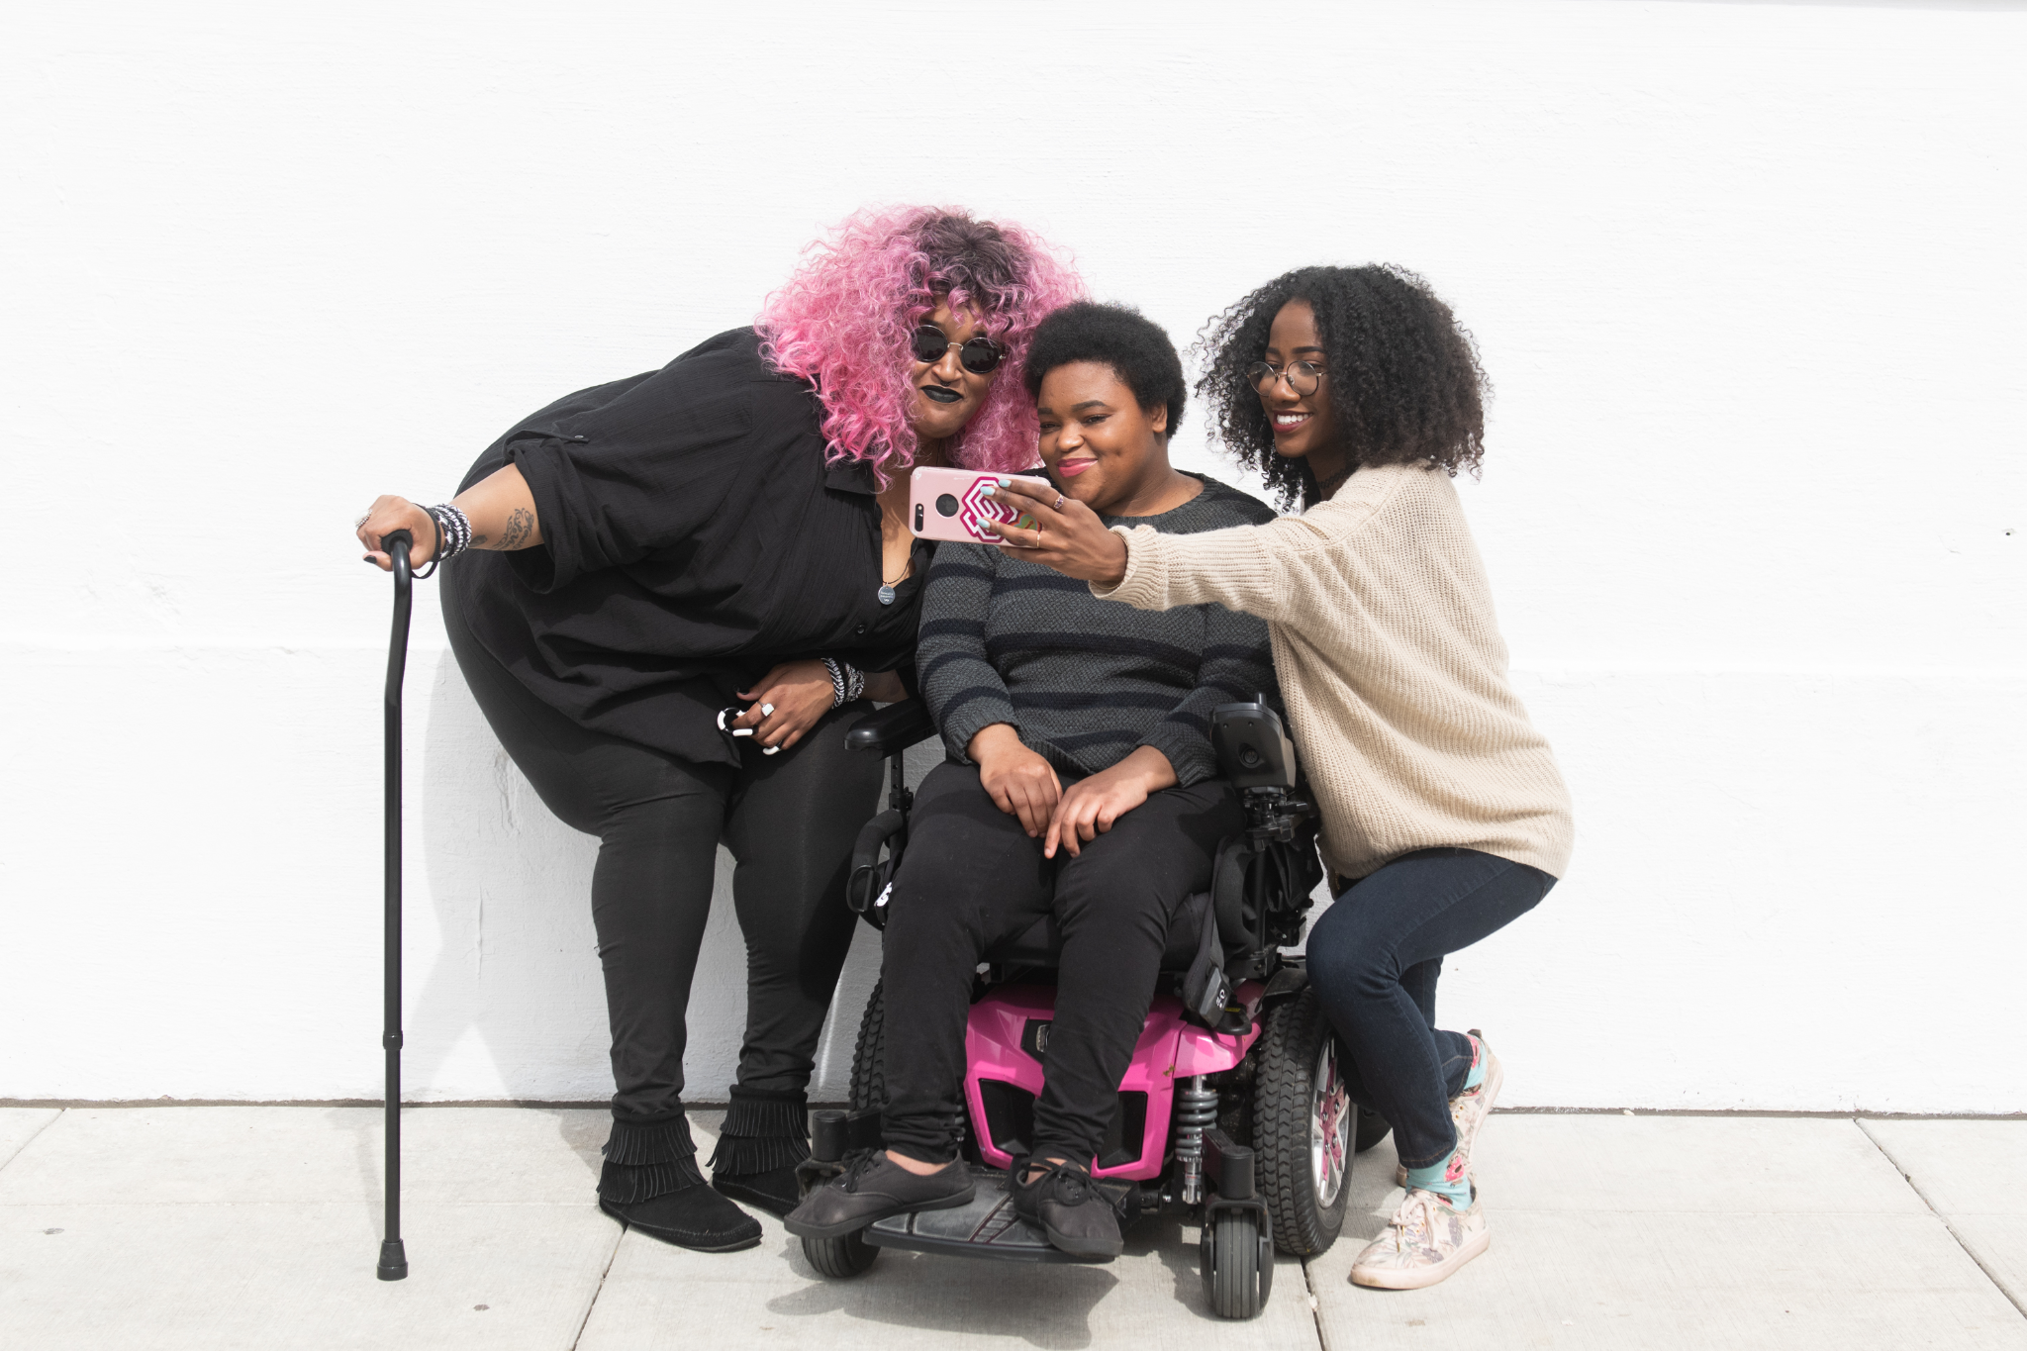
Framework Components (1-3)
Illustrations and Photos
Example Names
Gender-Inclusive Language and Use of Pronouns
Three friends selfie by Disabled and Here; CC BY 4.0
Notes:
To find images: https://ccconlineed.instructure.com/courses/4543/pages/image-sources?module_item_id=304565

Slide 23
Framework Components
Each area has two sections:
“Restorative Requirements”
“Elements for Consideration”
The aim is to restore and include voices that have been excluded and marginalized. For each section, the goal is to meet the “Restorative Requirements.”
The “Elements for Consideration” section offers areas to assess, tips, and examples that will help meet the requirements.

Slide 24
4. Historical, Pioneering, or Current Researchers/ Studies in the Field
Restorative Requirements - Referencing discipline contributors - e.g., researchers, scholars, academics - with backgrounds similar to those of students both validates and affirms the students as student-scholars and invites them into the academic conversation. Recognize that all people carry around biases that affect what they include and exclude.
Counteract these biases by actively seeking out achievements and discipline contributions from all cultures and countries.

Slide 25
5. References/Bibliography and Credits to Diverse Researchers/Authors
Avoid the Marie Curie effect - she becomes the stand-in for women scientists.
We make choices in many areas that signal to students what we think our disciplines are and who belongs within them.
Be intentional and consistent: http://www.sciencestories.io/welcome

Slide 26
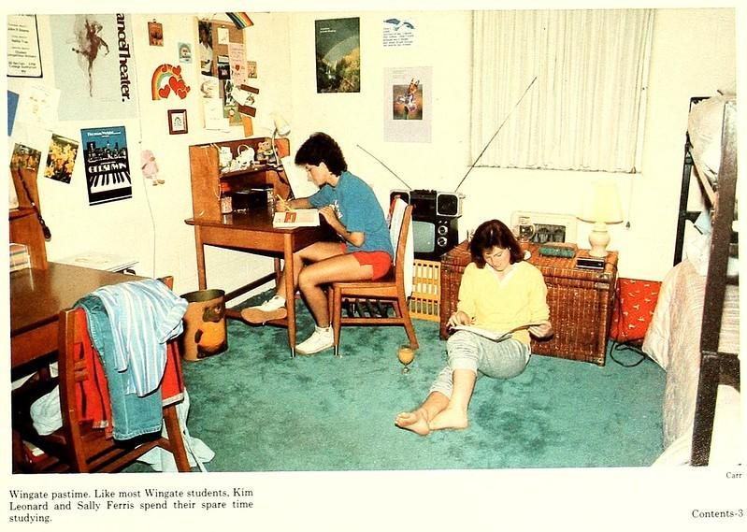
6. Applications, Examples, and Problem Scenarios that Relate to Diverse Audiences
Question the assumptions that may be inherent in your examples.
Dorm Life, Wingate College, North Carolina College and University Yearbooks licensed CC BY-NC-ND 2.0 via Flickr

Slide 27
7. Appropriate Terminology
For historical uses that must remain in place, consider adding context, such as “a widely used term at the time.” Ensure that quotations or paraphrases using outdated terms are attributed, contextualized, and limited.
Guidelines for Inclusive and Conscientious Description
Notes:
https://wiki.harvard.edu/confluence/display/hmschommanual/Guidelines+for+Inclusive+and+Conscientious+Description
https://countway.harvard.edu/news/describing-better-outdated-language

Slide 28
Consider Your Discipline
What is included and what is missing?
Has bias been explored in your discipline?
Does your text provide an overly-simplified narrative?

Slide 29
Concluding Thoughts
"Too often, we focus on only doing something to culturally and linguistically diverse students without changing ourselves...
Remember that even as educators, we... feel anxious, fearful, confused, and overwhelmed as we step outside our comfort zone. Embrace this stage and use it as a time for inquiry and reflection because this too shall pass.”
― Zaretta L. Hammond, Culturally Responsive Teaching and The Brain: Promoting Authentic Engagement and Rigor Among Culturally and Linguistically Diverse Students

Slide 30
Helpful Resources
ASCCC OERI Website (asccc-oeri.org) - resources, webinars, and events
ASCCC OER E-Mail (oeri@asccc.org)
DEI in Curriculum: Model Principles and Practices
Moving the Needle: Equity, Cultural Responsiveness, and Anti-Racism in the Course Outline of Record (ASCCC Rostrum Nov 2021)
Culturally Responsive Higher Education Curriculum Assessment Tool (Allan Hancock College) - pdf uploaded with presentation materials
Books: Culturally Responsive Teaching and The Brain: Promoting Authentic Engagement and Rigor Among Culturally and Linguistically Diverse Students (Zaretta L. Hammond)
Scholars: Gloria Ladson-Billings, Bettina Love
ASCCC local senate visits: Info@asccc.org

