Slide 1
Walking the IDEAA Talk: Reimaging Your Curriculum Processes and Classroom Practices
Juan Arzola, ASCCC At Large Representative Amber Gillis, ASCCC South Representative Jennifer Vega La Serna, Ph.D., CCCCIO Past-president, 5C Member

Slide 2
Program Description
You may have heard the popular Deming quotation that goes, “every system is perfectly designed to get the result it gets,” where both intentional and unintentional consequences are inadvertently a part of every system, regardless of original design motivations. Furthermore, the need to redesign systems that are either inefficient or that are not producing the desired results should be the top priority of any organization to mitigate negative consequences or success gaps. Join us for this interactive session where session presenters will share ideas and strategies for actualizing IDEAA at your local college, with intentionality, throughout your college curriculum processes and classroom pedagogy and practices.

Slide 3
Session Outcomes
At the completion of this session, attendees will:
Identify their personal role and positionality in their institution's IDEAA efforts.
Have an increased understanding of their own local curriculum processes and where to identify IDEAA gaps in their handbook.
Demonstrate an increased understanding of how to evaluate their classroom practices.

Slide 4
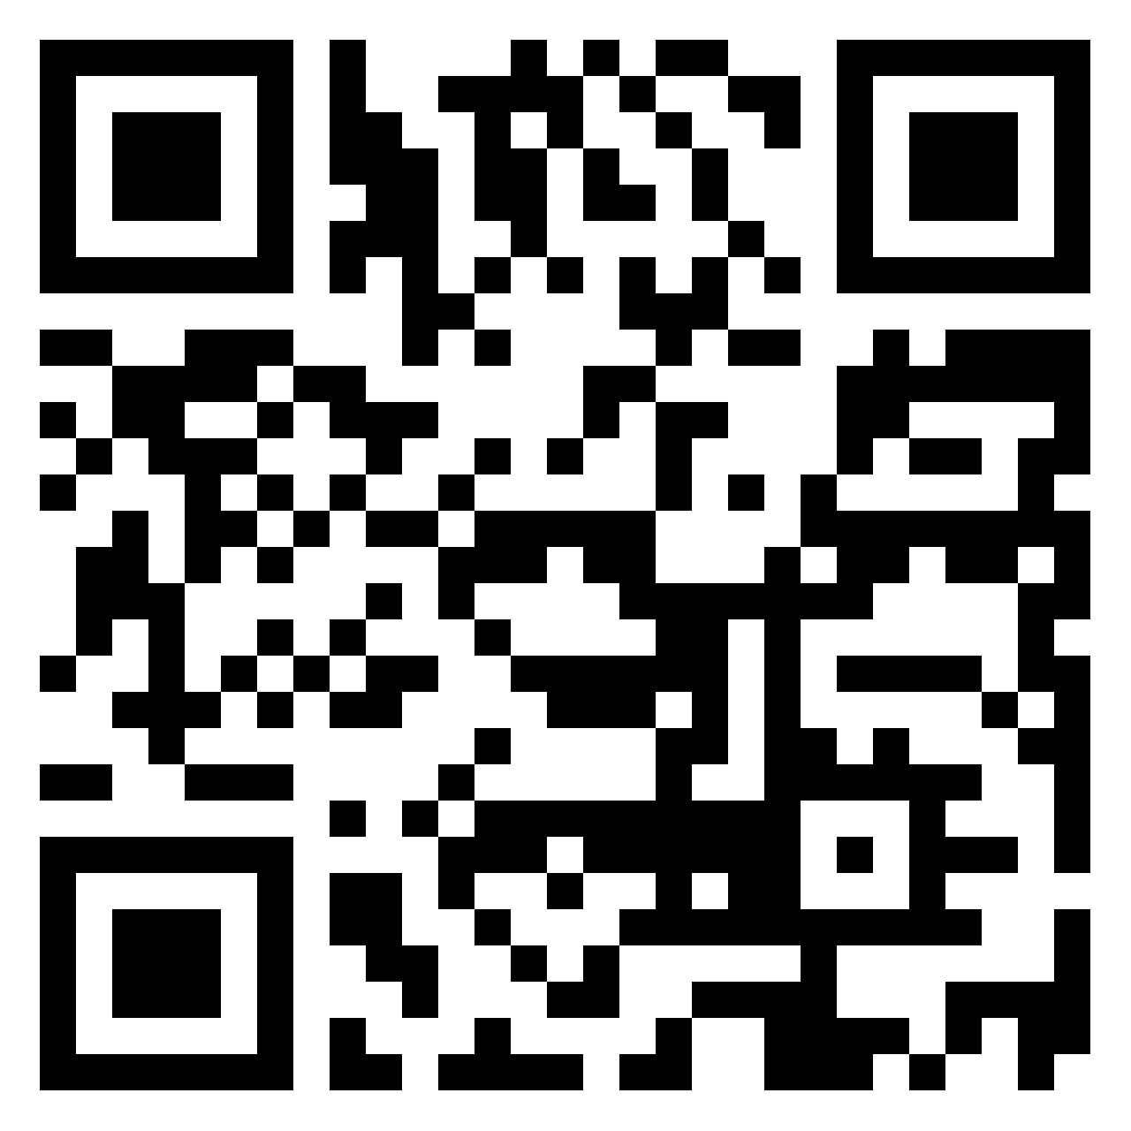
Ice Breaker Activity
1. In Pathable, please take the poll:
Who’s in the room? (Please use Pathable chat)
How long they’ve been in the role? (Please use Pathable polls)
2. In Padlet, please answer the question:
Now that you just came out of the IDEAA/DEI
framework general session, what are your goal(s)
in your current position?
https://padlet.com/ambergillis123/l6w6fbgbw14ybdct

Slide 5
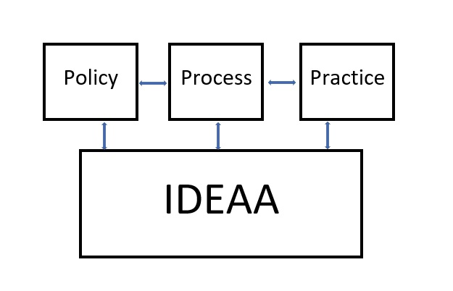
A Bright IDEAA for Your College
Challenge: Move away from using language that identifies IDEAA as a "lens." Instead, we view this as a foundational framework that informs all college policies, processes, and practices.

Slide 6
New Guide for DEI in Curriculum
Transform traditional practices by applying equity principles
Explore culturally responsive classroom practices
Identify practices for curriculum committees and local senates

Slide 7
Curriculum Committee - Structure
Structure of Committee
Who is on your committee?
How is this determined?
What are your local board policies and administrative regulations/procedures and what do they say?
Do you feel that there is adequate constituent group representation?
If not, how do you begin to change this structure?

Slide 8
Curriculum Committee - Handbooks
What does your process for making curriculum changes look like?
Is the process for making changes or reviewing courses straightforward? Complex process? Tons of steps?
Identifying IDEAA Gaps, Microaggressions, Hierarchical Structures
How do you identify gaps, microaggressions, and hierarchical structures?
How do you close these gaps, microaggressions, and hierarchical structures?
How do you mitigate future gaps, microaggressions, and hierarchical structures?

Slide 9
Looking at Your Local Curriculum Handbook Activity #1
Go to your local college's curriculum committee webpage and download the curriculum handbook.
Select a portion of the handbook that explains a process.
Consider the following questions:
What is the role of the discipline faculty in this process?
What is the role of students/ASB/ASG in this process?
What is the process to evaluate this process, if any?
Look at the phrasing/wording of this process. Are there instances of microaggressions or bias in the phrasing or process itself?

Slide 10
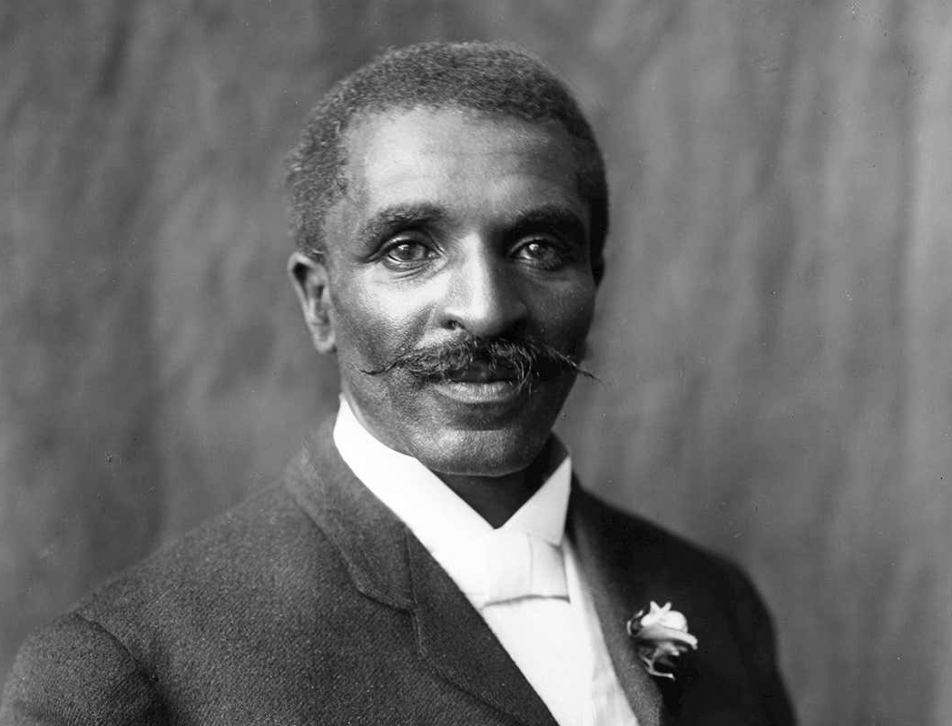
"Education is understanding relationships."
George Washington Carver

Slide 11
Curriculum and Relationships
Curriculum Committees and Local Academic Senates
What do your processes for communication look like?
How often does your AS President and Curriculum Chair/VP meet?
How is representation on curriculum committees determined?
Are roles of curriculum committee members codified?
What are some ways that communication can be strengthened?
Curriculum Committees and your Colleges CIO/VPAA
What do your processes for communication look like?
How often does your Curriculum Chair/VP and CIO/VPAA meet?
What is the relationship of the Curriculum Analyst with the Curriculum Chair/VP?
What are some ways that communication can be strengthened?

Slide 12
Anti-Racism Journey
Your Curriculum Committee’s Journey
Authenticity: Are we checking boxes or are we really doing this work?
How does racism, ableism, and homophobia affect our policies and processes?
Where do we see examples of bias and microaggressions in our existing policies.
Do we have enough training to recognize blind spots and microaggressions?
Would we benefit from qualified professionals to help us through meaningful and long-lasting change?
How often do we determine that the steps we taken are successful?
How often do we reflect and address gaps or missed opportunities in our journey?
Notes:
We are all in different places in our anti-racism journeys; however, how can we extend this to entire organizations or grouping that are responsible for the oversight of 10+1 scopes? These questions are a start.

Slide 13
Traditional Education Practice | Equity Principle | Culturally Responsive Classroom Practices | Culturally Responsive Practices for Curriculum Committees & Local Senates
Institutional culture of deference to discipline faculty as the only experts on curriculum. | Interrogate systemic and institutional barriers. Dismantle institutional deference to hierarchies that perpetuate barriers. Move as a faculty collective toward antiracist critical consciousness. | Complete training and professional development on cultural curriculum audits. Embrace DEI discussions, value cross-functional input, and solicit interdisciplinary feedback. Take care not to “weaponize” academic freedom and academic integrity as tools to impede equity in an academic discipline or inflict curricular trauma on our students, especially historically marginalized students. | Assert the voice of and embrace the power and authority granted in educational code and title 5 to make curriculum decisions, as is the responsibility of curriculum committees. Intentionally include culturally responsive experts on curriculum committees and for review of course outlines of record (CORs). Agendize and normalize DEI discussions and intentionally alter practices that perpetuate barriers. Create a curriculum committee handbook that requires a diversity, equity, inclusion, and antiracist lens for the COR. Make time for critical conversations, empowering faculty to hold each other accountable for embedding cultural humility in faculty self-reflection and cultural competency into lessons and activities.

Slide 14
Classroom Practices – Assignments & Activities
As you design your courses consider the following:
Do assignments include opportunities for students to see and reflect upon themselves as academics?
Do assignments establish/reinforce hierarchy or create a top-down model of learning?
How do discussion topics mitigate silence and encourage active engagement from diverse voices in the classroom?
Are assignments and activities encompass a blend of affective and cognitive domain?
How do assignments and activities align to SLOs--> PLOs --> ILOs?
How often do I determine that the steps I've taken are successful?
How often to I reflect and reapproach my classroom practices?
Notes:
Note: "Encourage active engagement" without tokenizing or calling out BIPOC students.

Slide 15
"[…] nine out of ten LGBT students repeatedly hear the word 'gay' used in a negative way and three-fourths of students regularly hear homophobic remarks, such as 'faggot' or 'dyke,' in school. Even more serious, LGBT students are routinely called names, harassed and bullied in school and will often skip classes or even full days of school because they feel unsafe."
GLSEN’s National School Climate Survey, 2016

Slide 16
Traditional Education Practice | Equity Principle | Culturally Responsive Classroom Practices | Culturally Responsive Practices for Curriculum Committees & Local Senates
Cultural experiences, assignments, and assessments are built from an individualistic perspective | Shift to a collectivism perspective to engage authentic lived experiences and relate to students’ cultural norms | Build on diverse backgrounds to engage as a familia, tribe, or village through collaborative classroom activities. Be a warm demander and co-learner with students. Intentionally create collaborative engagement opportunities (e.g., group work, peer-to-peer work, pair shares, etc.). | Encourage assignments, practices, and assessments that are formative in addition to summative. Review for a variety of methods of evaluations, assignments, and assessments. Encourage and provide professional development for the creation of authentic assessments.

Slide 17
"Universal design is the design of products and environments to be usable by all people, to the greatest extent possible, without the need for adaptation or specialized design.”
Ronald Mace, architect and innovator of Universal Design

Slide 18
Classroom Practices - Environment
What steps have I taken to recognize and reduce IDEAA bias and microaggressions in my own pedagogical/andrological approaches?
How do discussion topics mitigate silence and encourage active engagement from diverse voices in the classroom? (Repeat from previous slide)
What steps have I taken to create and maintain a safe and responsive learning environment for neuro-divergent and LGBTQ+ students?
How can I use "Universal Design" principles in my classroom setting to increase student learning and retention?
How often do I determine that the steps I've taken are successful?
How often to I reflect and reapproach my classroom practices?
Notes:
Note: "Encourage active engagement" without tokenizing or calling out BIPOC students.

Slide 19
What can ASCCC do for you?
Is this a local issue or a statewide issue?
Papers, resolutions, and resources for research
Local visits...let's talk
info@asccc.org
Notes:
Amber

