Slide 1
Serving the Students We Have: How IDEAA in the COR Can Encourage Inclusive Instruction Dolores Davison – ASCCC C-ID Curriculum Director Dr. Marshall T. Fulbright III – Grossmont College, 5C Nili Kirschner – Woodland Community College, ASCCC Curriculum, 5C Dr. Jennifer Vega La Serna – CCCCIO past president, College of the Sequoias, 5C

Slide 2
Breakout Description
The Course Outline of Record (COR) is essential to all aspects of curriculum at our colleges and drives the decisions we make as educators in the implementation of teaching strategies and course design. Follow up on our first general session by looking at specific practices for ensuring inclusion, diversity, equity, antiracism, and accessibility (IDEAA) is woven throughout the elements of the COR.
This session will include a brief overview of the COR and discussion on the impact the elements of the COR have on providing diversity and equity in the classroom. Join us for an interactive discussion on how educators can provide rich, robust, and culturally responsive curricula to meet the needs of our diverse student populations.

Slide 3
Learning Outcomes
In this session we will review and discuss:
Elements of Course Outline of Record (COR)
Roles and responsibility for curriculum standards
Importance of Inclusion, Diversity, Equity, Antiracism, and Accessibility (IDEAA) in curriculum
Strategies for incorporating IDEAA throughout elements of COR

Slide 4
Required elements of COR
Introductions:
What is your role at your college?
What is your level of familiarity with curriculum?
Elements of COR:
Indicate whether PCAH says each element is REQUIRED or RECOMMENDED on the COR

Slide 5
COR Elements – Quiz Answers
Element | Answer
Catalog description | Required
Content in terms of a specific body of knowledge | Required
Course number and title | Recommended
Enrollment limitations (if any) | Recommended
Expected number of contact hours | Required
Expected number of outside of class hours | Required - Credit only
Expected number of total student learning hours for the course as a whole | Required - Credit only
Field trips | Recommended
Objectives | Required
Prerequisites, corequisites or advisories on recommended preparation | Required for credit, recommended for noncredit
Repeatability | Recommended - credit only
Representative Textbook(s), including open educational resources | Recommended - necessary for articulation
Status (noncredit versus credit or others) | Recommended
Student Learning Outcomes | Recommended - required by ACCJC
Types or examples of instructional methodology | Required - credit only
Types or examples of methods of evaluation | Required
Types or examples of required reading and writing assignments | Required
Types or examples of other outside-of-class assignments | Required
Unit value | Required - Credit only

Slide 6
Curriculum = Faculty Primacy
Who Else Should Be Involved?
Why? (Specific reasons?)
How? (In what capacity?)
To What Extent?
What is the role of the Board?
Academic Freedom?

Slide 7
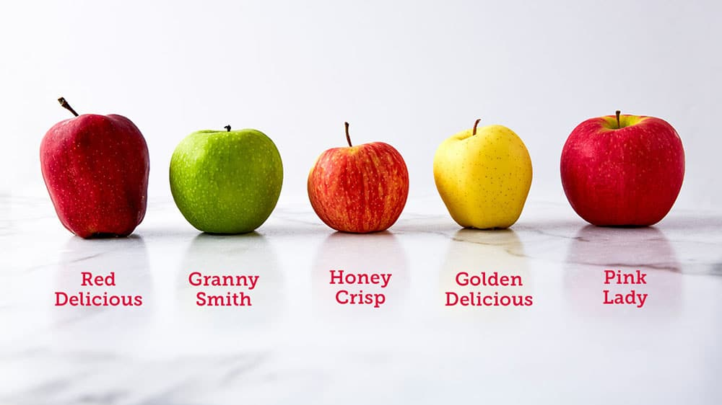
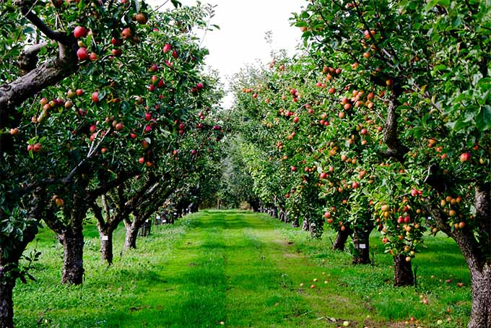
IDEAA in the COR
If curriculum is the CORe of education, then why doesn't the COR matter?
Isn't what happening in the classroom more important?

Slide 8
Why focus on IDEAA in the COR?
Inclusion, diversity, equity, antiracism, and accessibility (IDEAA) efforts are not limited to curriculum, but it is a crucial piece of the puzzle.
The Course Outline of Record (COR) is a legally binding document that sets the tone and expectations for the course. Changing the COR can have ripple effects into the classroom and the college:
CORs guide all instructors
All faculty benefit from looking at their CORs with fresh eyes
Transfer institutions look at CORs to determine equivalency
Students see parts of the COR in the catalog and schedule

Slide 9
Fall 2021 ASCCC resolution 9.01: Adding Culturally Responsive Curriculum, Equity Mindedness, and Anti-Racism to the COR Requirements in Title 5
Whereas the Course Outline of Record (COR) is at the center of local curricular process22; its required elements have been outlined in California Code of Regulations Title 5 including Section 55002 and the application of those requirements is detailed in the Program for Course and Approval Handbook (PCAH);
Whereas the elements of the COR need to be integrated so each reinforces the purpose of the other elements and obvious relationships should be built between course objectives, methods of instruction, assignments, and methods of evaluation; ...
Resolved, That the Academic Senate for California Community Colleges work with the California Community Colleges Chancellor’s Office to revise California Code of Regulations Title 5 including section 55002 titled “Standards and Criteria for Courses” to include a component of culturally responsive curriculum, equity mindedness and anti-racism integrated into the COR that allows for local control on how that requirement is fulfilled; and
Resolved, That the Academic Senate for California Community Colleges work with the California Community Colleges Chancellor’s Office to include in future publications, webinars, and other resources guidance and multiple examples of how to infuse cultural responsiveness, equity mindedness and anti-racism in the COR.

Slide 10
Proposed title 5 revisions
5C in early stages of drafting revisions to 55002 in response to ASCCC resolution
Proposed changes will be vetted in the field before going to BOG for public comment
Currently considering adding IDEAA to the standards of approval for all courses
Not a separate or new element on COR, but rather a standard that could be integrated throughout different elements of COR as appropriate to discipline and course content

Slide 11
Incorporating IDEAA throughout the COR
Ideas for discipline faculty who are developing curriculum, and for committees who are reviewing and approving it
Based on Moving the Needle: Equity, Cultural Responsiveness, and Anti-Racism in the Course Outline of Record (ASCCC Rostrum Nov 2021)

Slide 12
Course Title and Description
These are usually the first things students see about your class; what message do they send?
Is the title descriptive, accurate, and inclusive?
Is the description student-centered, using accessible and inclusive language, with a focus on what the student will gain from the course?
Is it inviting and welcoming?
Where discipline-specific terminology is necessary, have those terms been appropriately defined or explained through context?
The goal is to ensure that every student, even before enrolling in the class, can read the description and understand what the course will cover and how it may be relevant for them.
For example, consider how Black, indigenous, and other people of color have traditionally been erased from the curriculum.

Slide 13
Units and Hours
Higher units and hours can slow student progress and have consequences for financial aid.
Are course units/hours aligned with transfer institutions, industry standards, or model curricula?
Do lecture/lab hours accurately reflect the ratio of inside to outside-of-class hours?
If units are higher, is there a plan to validate them using disaggregated data that identifies the effects on enrollment for disproportionately impacted groups, including racial/ethnic groups?
Are there noncredit options, if appropriate?

Slide 14
Conditions of Enrollment
Conditions or limitations on enrollment can be designed to increase student success but can also create barriers for students.
Are there barriers to enrollment (such as pre- and co-requisites or advisories) that may have disproportionate impact on any students?
For example, putting a prerequisite or advisory of College Comp. on a class that does not have college composition level writing assignments may disproportionately deter students for whom English is not their first language
Have limitations on enrollment been appropriately validated?
Don’t forget to look at advisories!

Slide 15
Course Content
Where appropriate, consider explicitly including culturally responsive and anti-racist content:
Is there an acknowledgement and discussion built into the course of major debates or disagreements within the field? If there is a racist or sexist history, don’t gloss over it – discuss it openly.
Are there opportunities built in for students to see themselves and their experiences represented, or to bring their authentic selves to the course through strategies like reflection or response?
Consider language and terminology used: be cognizant of where the terms and topics reflect Eurocentric or colonizing views (for example, “Third World countries”)
Move marginalized experiences of Black and Indigenous people to the center. It is important not just to examine what is in the course, but what is left out.

Slide 16
Course Objectives and SLOs
Consider adding course objectives and learning outcomes with specific IDEAA focus
For example, a course outcome addressing anti-racism could include articulating or analyzing how social and historical context affected major theories and/or discoveries in the field, particularly in light of systemic racism.
A specific SLO, aligned to the course content, allows faculty to focus on these areas in assessment, and ensure that their students’ learning includes equity and anti-racism.
Even where IDEAA-focused outcomes are not explicitly present, ensure your assessment process includes equity review and thoughtful data disaggregation.

Slide 17
Methods of Evaluation & Assignments
Delivering course content for multiple learning styles and ensuring students have a variety of methods to demonstrate their learning can lead to more equitable outcomes and a more inclusive learning experience.
Do the typical assignments listed align with equitable course content?
Do they provide opportunities for students to bring their own experiences to the course content?
Do methods of evaluation account for different learning and communication styles?
Are there some authentic assessments, capturing more contextualized understanding?
Do assessment rubrics avoid grading on hidden curriculum?
Example of hidden curriculum: grading on grammar and writing ability if there is no English prerequisite or advisory, and these are not explicitly part of the course content

Slide 18
Course Materials
Course materials, especially textbooks, can be a barrier for students in terms of affordability, accessibility, and representation.
Although textbooks listed on the COR are primarily examples, they are an important guide for faculty about what kinds of texts are considered acceptable for the course and have an important impact on the texts that are ultimately selected.
Do textbooks, manuals, or other materials include diverse representations in authorship and/or content? If not, what supplemental materials can be included?
Are materials ADA-accessible and 508-compliant?
Are they affordable? Are there Open Educational Resources (OER) alternatives?

Slide 19
Putting it into Practice
A common concern about incorporating IDEAA into curriculum is that it isn't appropriate for all courses and disciplines.
In small groups, brainstorm ways IDEAA could be incorporated in a COR for
Welding
Statistics
Chemistry
Physical Education
Business Accounting

Slide 20
Discussion/Q&A
What ideas did you come up with?
What support and resources do faculty and committees need in order to have these discussions on your campus?

Slide 21
Resources
DEI in Curriculum: Model Principles and Practices (CCCCO in partnership with 5C, ASCCC, CCCCIO, SSCCC)
Moving the Needle: Equity, Cultural Responsiveness, and Anti-Racism in the Course Outline of Record (ASCCC Rostrum Nov 2021)
Culturally Responsive Higher Education Curriculum Assessment Tool (Allan Hancock College) - pdf uploaded with presentation materials

