Slide 1
From IDEAA to Action: Decolonizing our Educational Systems
Michelle Velasquez Bean, ASCCC Treasurer
Manuel Vélez, ASCCC Area D Representative
Nzingha Sonya Dugas, Executive Director and CEO, Umoja Community Education Foundation
Jessica Dominguez, SSCCC

Slide 2
Introduction and Overview of Session
Why it’s important to talk about “de-colonization” in academia
Putting the historical and lived experiences of Black and Brown students in the center
Classroom redesign through the lens of students of color
Effective IDEAA practices

Slide 3
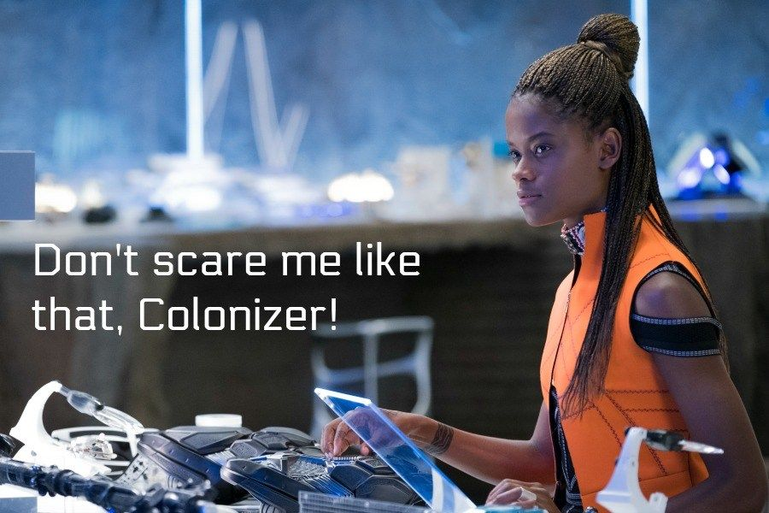
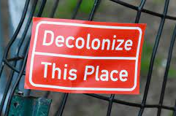
What does “Decolonization” mean?
As terms such as “colonizer” and “decolonization” enter into mainstream popular discourse their meanings become broadened and vague.
They stem from Postcolonialism, a theoretical framework developed in the mid twentieth century as a means of analyzing the impact of colonization and imperialism especially among the colonized.
Contrary to today’s popular discourse, colonization is not an individual attitude or belief but a system of power intended to subjugate and control indigenous populations.
Through this system, colonial powers exert control over indigenous community through a process that replaces indigenous linguistic, cultural, religious, political structures with those of their own. Because of this, embedded within this process is a notion of european/white supremacy.
Because colonization involves the replacement of cultural and societal structures it relies on educational institutions for this replacement and for the “normalizing” of colonial structures.

Slide 4
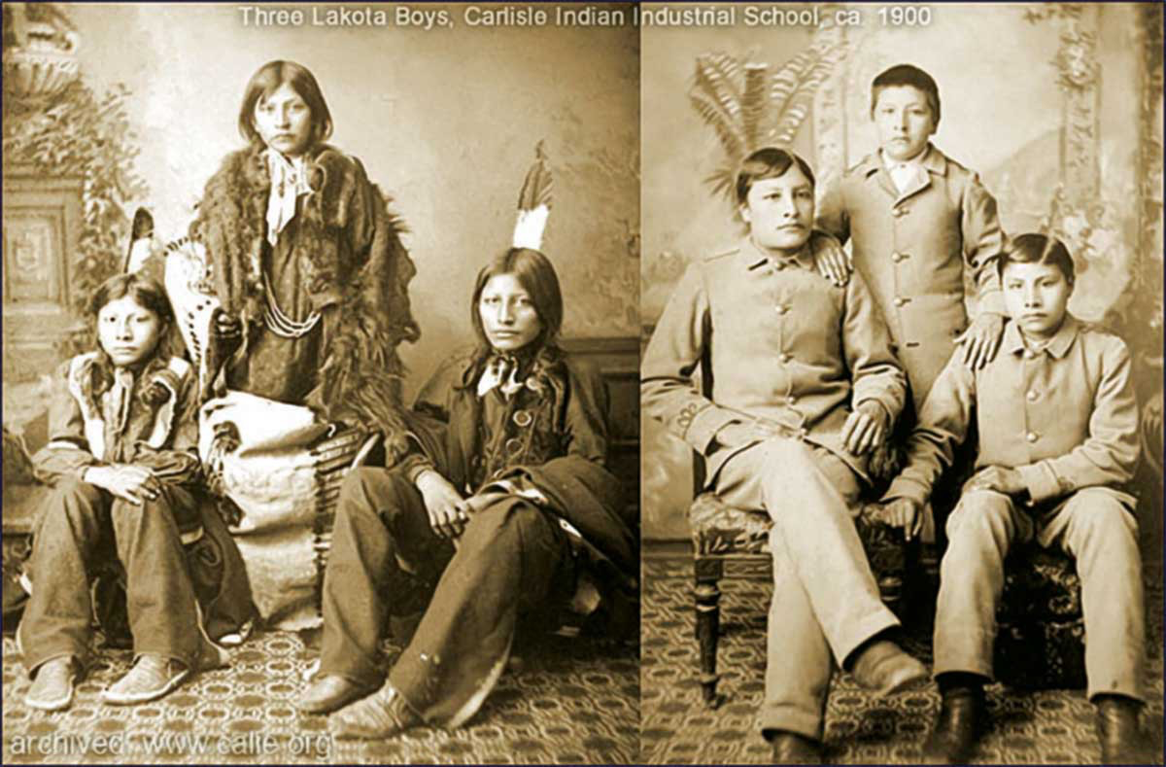
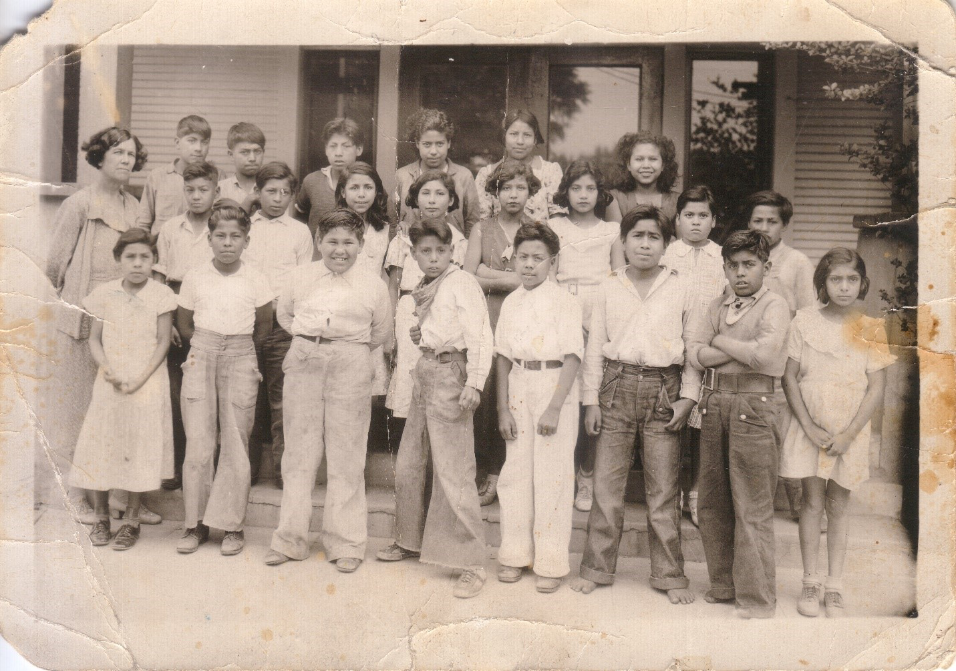
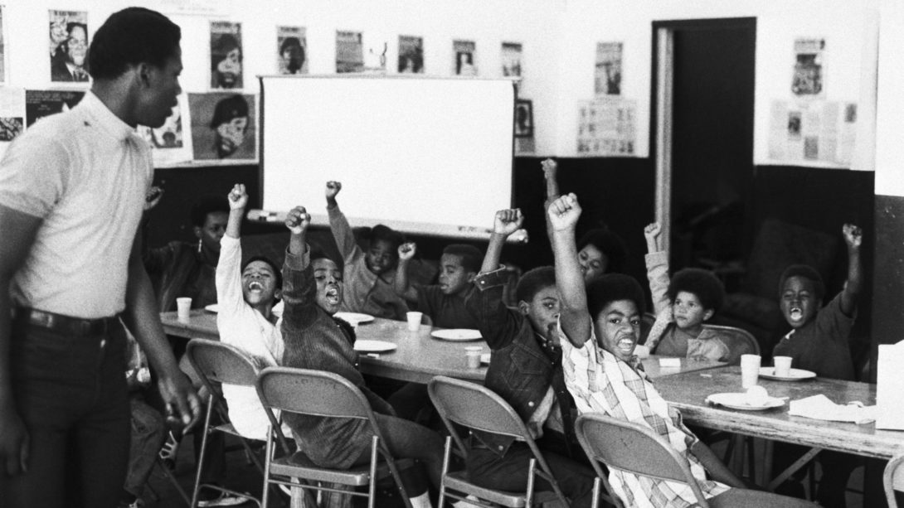
“Decolonization” and academia today
A consequence of colonization is an academic system centered on a male eurocentric lens.
In U.S. history this is evident with the Americanization schools Native American and Mexican students were forced to attend as well as the overall history of segregation.
Evidence of this eurocentric lens can also be found in efforts against ethnic studies curriculum and CRT.
Decolonization in academia focuses on moving the lens away from a singular eurocentric one to an inclusive lens that centers the experiences of the colonized.

Slide 5
“Decolonization…does not mean a total rejection of all theory or research of Western knowledge. Rather, it is about centering our concerns and world views and then coming to know and understand theory and research from our own perspectives and for our own purposes.”
-Dr. Linda Tuhiwai Smith
“The work of decolonizing education means combating the systemic erasure of Indigenous Peoples’ truths, values, worldview, knowledges, ways of life, education, literature, and learning.”
-Dr. Kathy Absolon
“The modern educational system was created to maintain the identity, language, and culture of a colonial society, while ignoring the need to decolonize. Culture in this educative context is a mask for evolutionary or racial logic. Its theory is derived from a biased position.”
-Dr. Marie Battiste

Slide 6
Examining Colonialist & White Supremacy Culture & Frameworks
Deconstructing, Reconstructing and Transforming Leadership, Teaching, and Programming at Community Colleges

Slide 7
LAND & SPACE ACKNOWLEDGEMENT
We acknowledge that we inhabit the area physically situated in the ancestral homelands of the Cahuilla, Serrano, Luise’o, Chemehuevi, Mojave, and possibility others unnamed. We acknowledge that the lands that we live and work on were once inhabited by diverse peoples of LatinX ancestry. We acknowledge our native ancestors and pay respect to them for the land we now inhabit and call home.
We honor their past and future–and for their lasting presence in our homeland and throughout our history.

Slide 8
RECOGNITION OF HUMANITY
I am the descendant of Erma & Adam, Adele, Carrie & John Henry, Mabe & Lue, & Nigerian, & Senegalese peoples & countless Africans who are unknown. In our verbal libation today, let us remember the place we are blessed to call home, was designed, plotted, & built by African ancestors through horrid conditions. Because they endured & survived, we stand today. And, in our work to be become higher humans, we always remember their struggle, contributions and collective resilience.

Slide 9
Positionality as a Researcher and Educator

Slide 10
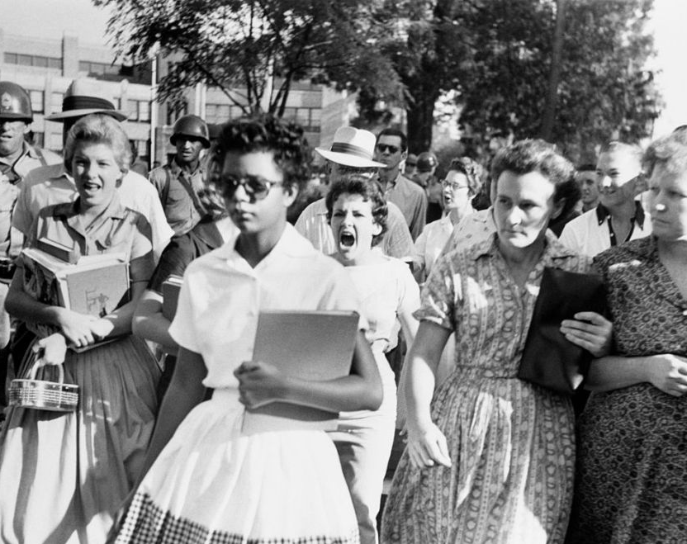
Over 25 years in public education
Raised/Reared in a working-class Black family & community
Belief in abolitionism, activism, pro-student possibility & potentiality
Committed to learning, transformation & liberation; cultural framework for learning; Sankofa as a daily practice
Biases: Been Black all my life; Black woman; educated; have/have had privileges & access

Slide 11
SESSION OBJECTIVES
01
02
03
01
02
03
Understand the historical trajectory and impact of—
Eurocentric ideology, values & White Supremacy Frameworks (WSF) in education
ahistorical pedagogy and curriculum
erasure, exclusion, and omission of the authentic American fabric
Understand the importance of shifting instructor and leader mindsets and behavior by—
a willingness to decenter the pedagogy of a WSF
becoming a practitioner of deconstructive work
continuing to transform and evolve (reconstructive)
The power of teachers/ leaders and other educators to destroy or enlighten (Illuminate).
Ethic of Love: “I have never encountered any children in any group who are not geniuses. There is no mystery on how to teach them. First thing, treat them like human beings and then love them.” – A. Hilliard
Understand the historical trajectory and impact of—
Eurocentric ideology, values & White Supremacy Frameworks (WSF) in education
ahistorical pedagogy and curriculum
erasure, exclusion, and omission of the authentic American fabric
Understand the importance of shifting instructor mindset and behavior by—
a willingness to decenter the pedagogy of WSF
practitioner of the deconstruction work
continuing to transform and evolve
The power of teachers/ leaders and others to destroy or enlighten (Illuminate).
Ethic of Love: “I have never encountered any children in any group who are not geniuses. There is no mystery on how to teach them. First thing, treat them like human beings and the second, love them.” – A. Hilliard

Slide 12
Premise
“If you don’t understand White supremacy, then everything else you think you know will simply confuse you.” – Neely Fuller

Slide 13
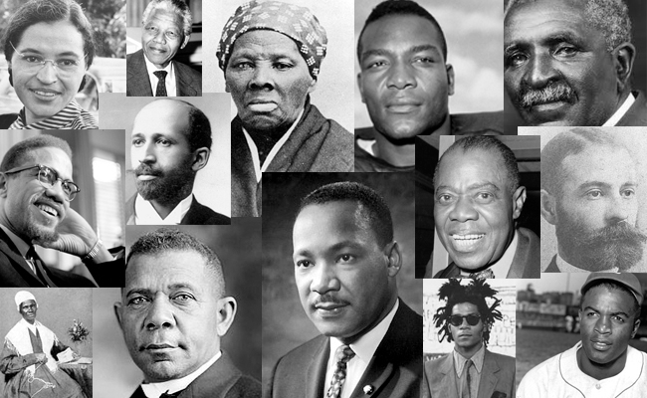
HISTORICAL SNAPSHOT

Slide 14
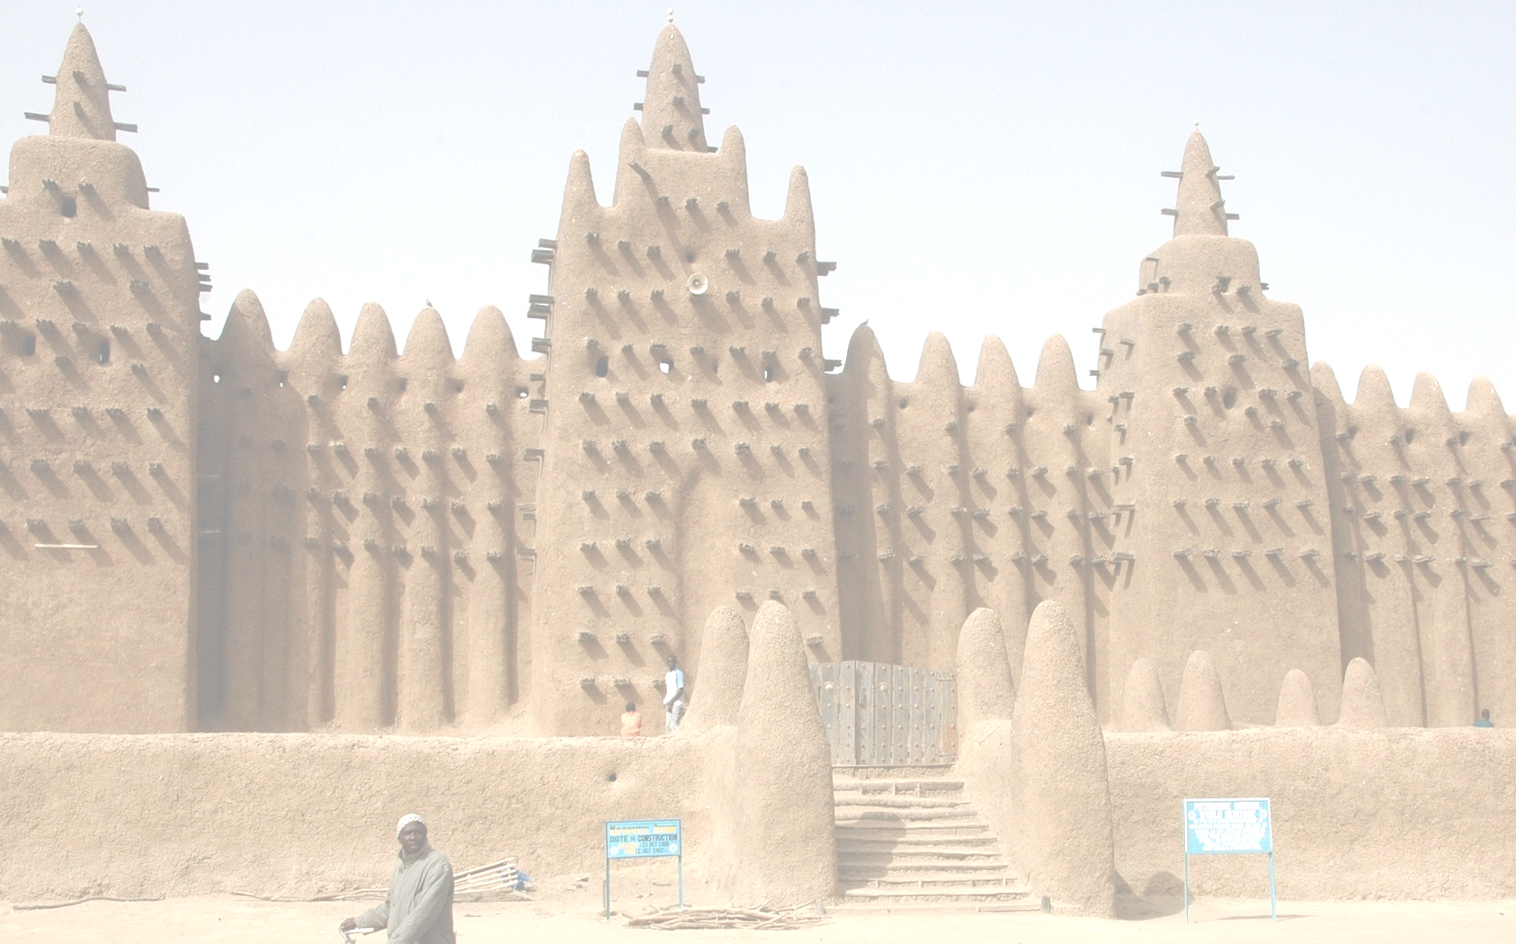
African American Educational History & Trajectory
The American community college system dates back to the early twentieth century … [it’s goal was] to train the [mostly White] workers who would enter the nation’s industries that were expanding rapidly. (Cohen & Brawer, 2008, p. 1)
No intentions for the formerly enslaved or other folks of color
A people loosing sight of origins is dead, a people deaf to purposes are lost. Under fertile rains under scorching sunshine there is no difference: their bodies are mere corpses, awaiting final burial. – Ayi Kwei Armah
Notes:
1 minute
Nzingha

Slide 15
Notes:
2 minutes
Nzingha

Slide 16
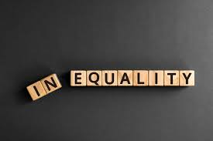
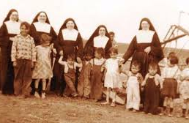
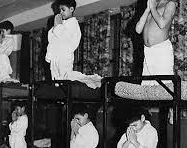
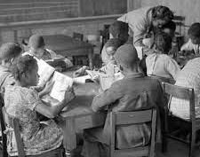
Notes:
Inequality Embedded in Practices, Behavior and Codified in Law – 1619 to the 1970s
Native American border schools
African American Black Codes and Jim Crow
Chinese Exclusion Act

Slide 17
WHITE SUPREMACY IN THE ACADEMY AND THE CLASSROOM
Notes:
2 Minutes - Nzingha
Our Premise – The Premise of the Workshop.

Slide 18
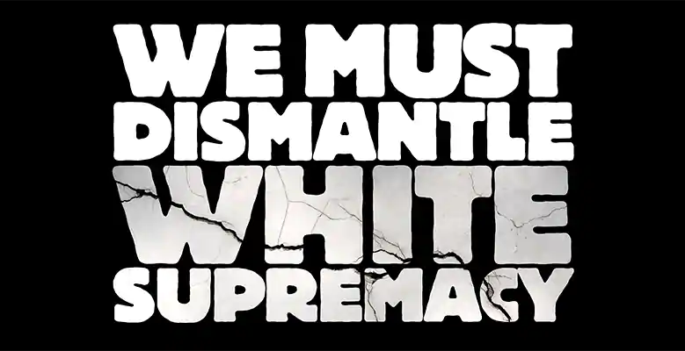
WHITE SUPREMACY CULTURE IN THE ACADEMY
Architectural or Structural: what a university is, the cultural
foundation, governance and academic
structure
Compositional: who gets access, the process, policies
and rules for inclusion
Curricular: what is taught and learned; who decides
standards and whose voices are heard
Editorial: who determines relevance, what is
rigorous and what works are worthy
Reference: Shaun Harper, presentation, Stop Sustaining White Supremacy
August 21, 2017.
Notes:
2 Minutes - Nzingha

Slide 19
How does it show up in the student experience?
WHITE SUPREMACY CULTURE IN THE ACADEMY
What are the top 3 issues of concern for Black, and other students of color?
Notes:
4 minutes
Nzingha’s Slide
1. Question: Top 3 issues that Black students say they face at PWIs or hostile environments. (Zharia)

Slide 20
EXPERIENCES IMPACTING ACADEMIC ENGAGEMENT
CAMPUS CLIMATE, CULTURE DISCONNECT, & ACCESS
Hostile Classroom & Structure
Racial bias from professors and peers
Curriculum and lack of inclusivity
Instructor training & knowledge base
Psychological pressure of proving yourself:
Imposter Syndrome (response to WSC)
Stereotype Threat (response to WSC)
Campus Climate & Culture
Discrimination
Targeted by campus police
Lack of solidarity from the administration about being pro-marginalized/pro-minoritized student
Notes:
4 minutes
Nzingha
The importance of being Pro-Black student
Being – All Lives Mattered
Pro-Black Student Frame
NYT published a series called the 1619 project (2019).
Readers were asked to recount their education of African Americans—
“We were taught that removing people from Africa and bringing them to America “saved” them from idolatry and damnation.”
Question from a 10th grade worksheet; “In what region did the African workers primarily settle?” The work sheet referred to enslaved people as “African workers,” as though it was voluntary.

Slide 21
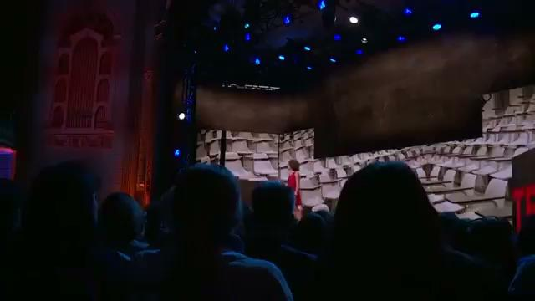
Dr. Dena Simmons
Director of Education at Yale School for Emotional Intelligence
Notes:
2 minutes

Slide 22
TEACHING STYLES & CLASSROOM SET UP WSF AS A CASTE AND COLONIAL SYSTEM
WHAT DO YOU SEE IN THIS PICTURE?
Notes:
Phyllis
1 minute

Slide 23
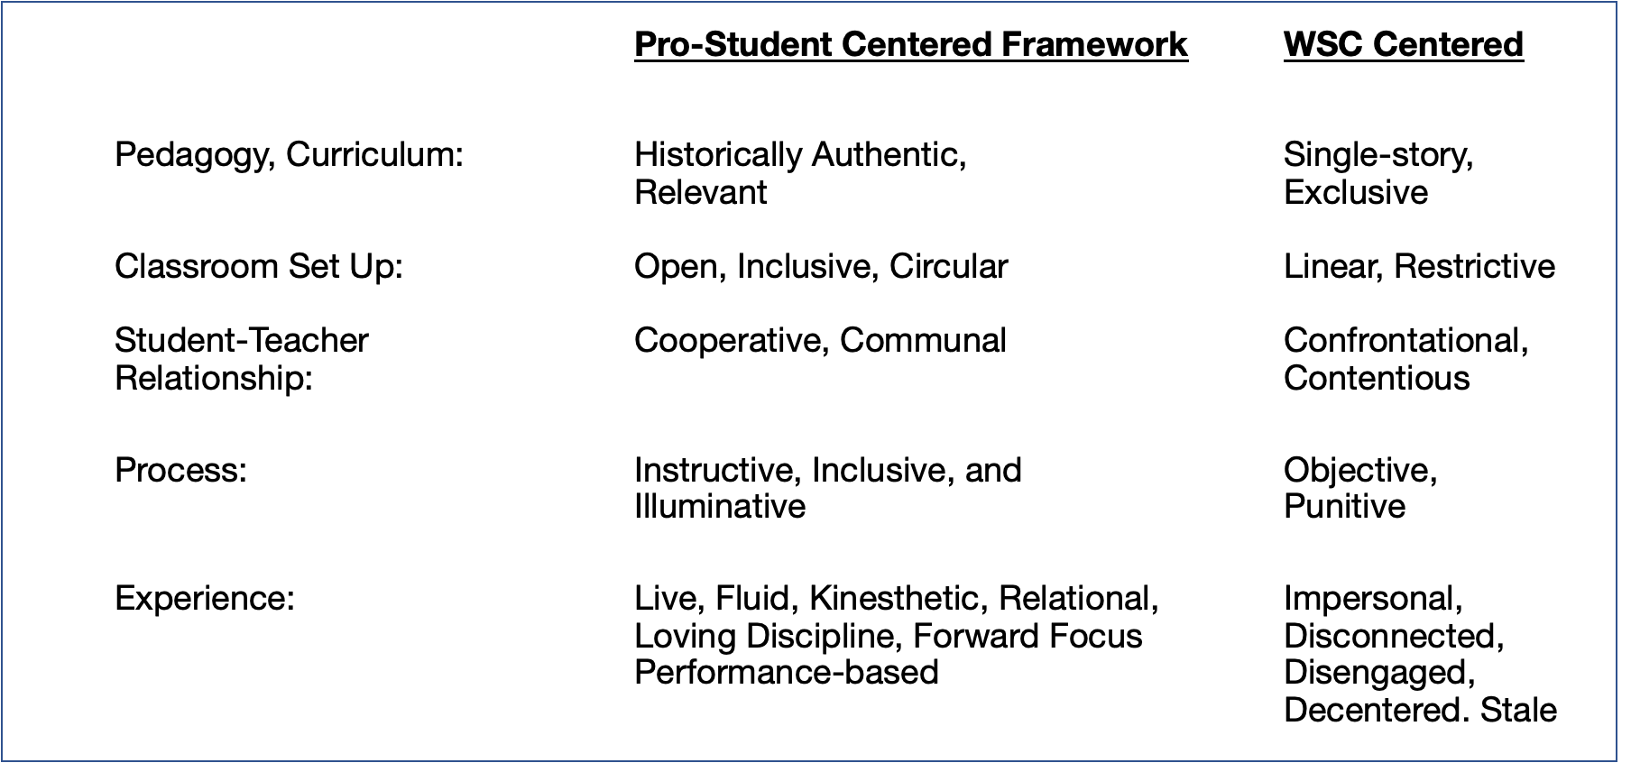
Teaching Intentions, Framework and Style
Reference: Nzingha S. Dugas©
Notes:
“With the historian it is an article of faith that knowledge of the past is a key to understanding the present.” -- Kenneth M. Stampp

Slide 24
DECONSTRUCT
Examine & Dismantle White Supremacy Framework
Query Harm Reduction Practices
Hope & Savior Syndrome vs. Systemic & Systems Change
RECONSTRUCT
Shift Mindset
Build Comprehensive Methodology for an Authentic Framework
Review and Reconstruct Curriculum & Lesson Plan
PROCESS FOR DISMANTLING
COLONIALISM
OR WSF IN T&L
Images - Shutterstock

Slide 25
White Supremacy Framework
Perfectionism
Sense of Urgency
Defensiveness
Quantity over Quality
Worship of the Written Word
Paternalism
Either/Or Thinking
Power Hoarding
Fear of Open Conflict
Individualism
Progress is Bigger, More
Objectivity
Right to Comfort
Reference: From Dismantling Racism: A Workbook for Social Change Groups, by Kenneth Jones and Tema Okun, ChangeWork, 2001

Slide 26
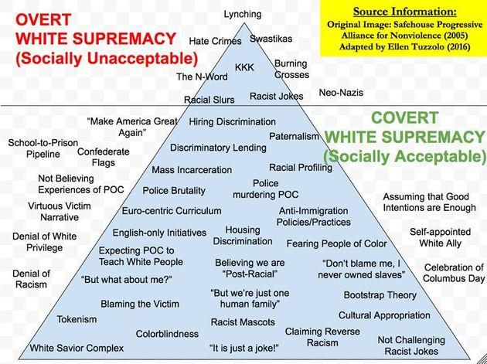
White Supremacy Framework: Culture, Practice and Behavior
Notes:
3 minutes

Slide 27
Harm Reduction Hope & Savior Syndrome
Deficit Model
When teachers or school leaders look at students as the problem, or “incapable of” rather than potential, and fails to provide the context. The teacher carries most of the cognitive load.
Students are deprived of the productive engagement to analyze and learn critical thinking
Deferential Leniency - Sentimentalist
Zaretta Hammond describes “The Sentimentalist”, as the loving teacher who builds rapport while consciously lowering expectations of students to protect them from failure.
Stereotype Threat
Internalized Oppression
The “Woke” Radical
Teacher: “If I simply discuss issues of oppression, read books about civil rights, their leaders, and people who worked against oppression, then my students’ cultural identity will be affirmed.”
“The current standard is the equivalent of an adolescent restricted to the diet of an infant.” - Poet: Saul Williams
Discussion of harm reduction, 2019 – Àdísà Àjàmú, PhD
Notes:
2 minutes

Slide 28
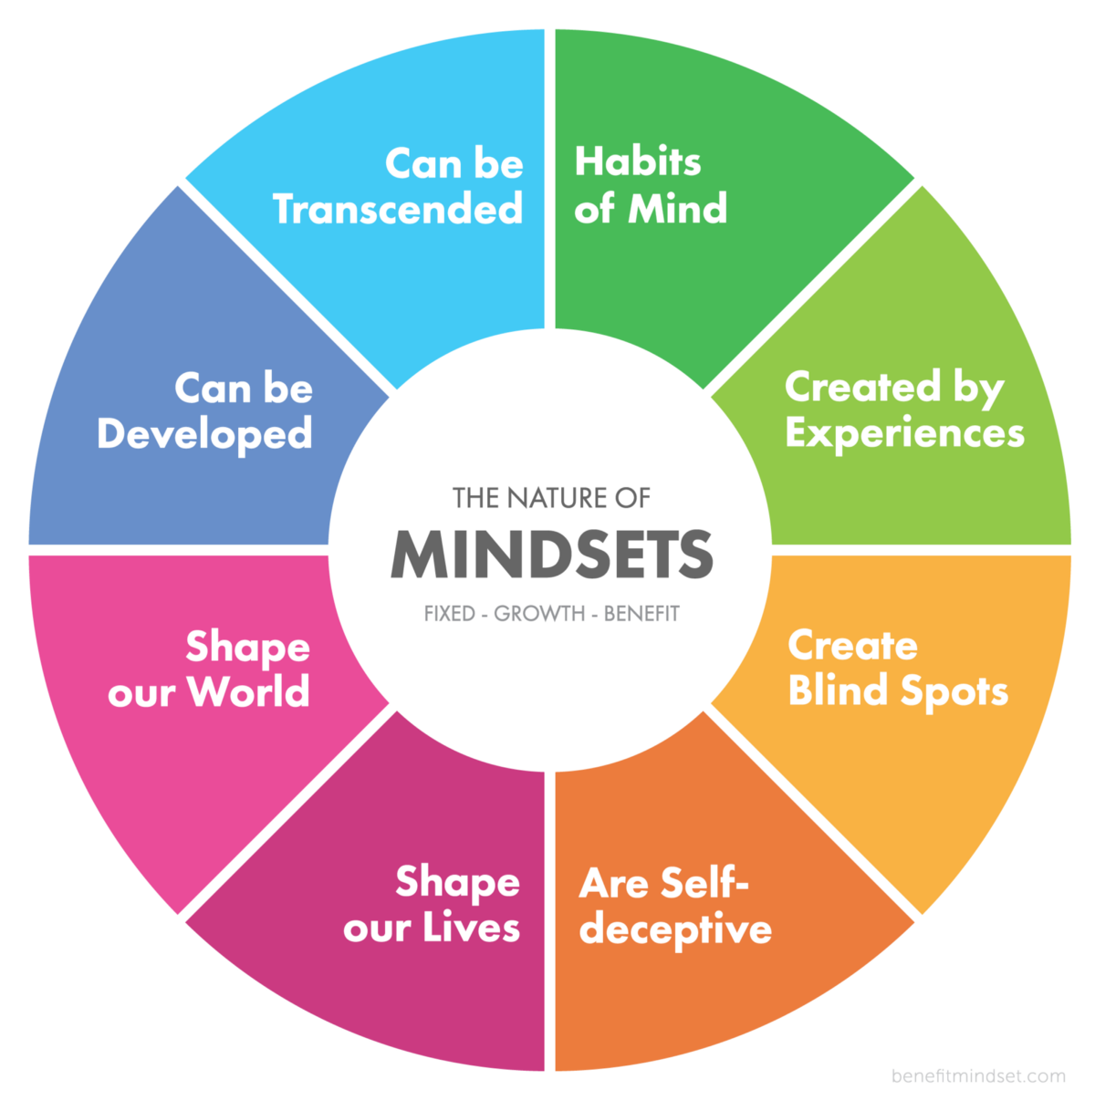
How Do We Get there? Mindset and Transformation In leadership & teaching
MINDSET
“A self-perception or ‘self-theory’ that people hold about themselves. People believe that their most basic abilities can be developed through dedication and hard work—brains and talent are just the start. This view creates a love of learning and a resilience that is essential for great accomplishment.”

Slide 29
Liberatory “Teaching students to transgress boundaries in order to achieve this freedom.” (hooks, 1994)
Teaching as a Revolutionary & Liberatory
Process and Practice
Illuminative The deep, profound and penetrating search, study, understanding and mastery of the illumination of the human spirit. (Nobles, 2013)
Cultural pedagogy creates a love of learning, resiliency and sense of accomplishment
Deep background knowledge, a wide array of topics and critical consciousness
This is a transformative process, and you will make mistakes
This model is healthy and healing for ALL students
Umoja Practices: Ethic of Love, Intentional and Deliberate, Mattering
Notes:
Wade Nobles teaches that illumination permeates everything.

Slide 30
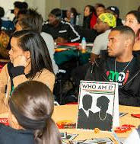
Critical Questions for Mindset & Transformation
What are the theoretical frameworks within your teaching and leadership?
What core values and belief systems inform your identity?
How do you encourage your college’s leadership, faculty and professional staff to be pro-minoritized/marginalized student?
What readings, examination are you doing to unravel miseducation?
Notes:
3 minutes
NZINGHA
What informs your mindset and therefore practice?
Dean, Chair – should provide the framework.

Slide 31
Resetting and Re-Designing the Classroom
Nzingha S. Dugas©
Deep Structure (Nobles) | Instructor Inquiry and Expectation | Student Expectation
Philosophical Framework | Curriculum Design What are you reading prior to designing your curriculum? What ways have you designed your curriculum to be reflective of the students and authentic history? How have you moved from infusion to saturation? What healing process is embedded in your teaching? What products, resources, tools are you using? | Authentic and reflective curriculum Are students of color part of the main meal, sides, or appetizers?
Teaching Methodology | What informs your teaching methodology and delivery? How is your practice both performance (engaging) and mattering (purposeful)? | I am able to take/use what I learn
Ontological Structure | What is the relation between the students and the instructor? What beliefs do you create about who the instructor is and who the students are? | What does the student believe about their learning?
Axiological Relation | What is the ecology of the classroom and the learning process? | Co-creation
Guiding Principles and Values | What responsibilities do the students have to each other? | Communal building and collectivity Interdependent learning processes
Belief Systems and Core Values | What are the co-created and understood values of the classroom? How are the values in alignment with the student’s culture? | Engagement, input, design
Behavioral Expectations | What are the performance expectations of the instructor? What are the performance expectations of the students. | Participation, Engagement, Learning
Notes:
10 minutes
Nzingha

Slide 32
INFORMING & (RE) CONSTRUCTING YOUR PRACTICE
Curriculum Material
Updating your materials to reflect full representation
From The Porch to an authentic Ethic of Love
Removing Sentimentalist Practices or Deferential Leniency to expectation believe, accountability, results
Tapping Intellectual Potential and Live Learning
Performative, Participatory, Improvisational
Communal Building/Communal Intelligence
Readying yourself for an illuminative learning, student-instructor-engagement and application of knowledge?
Notes:
5 Minutes

Slide 33
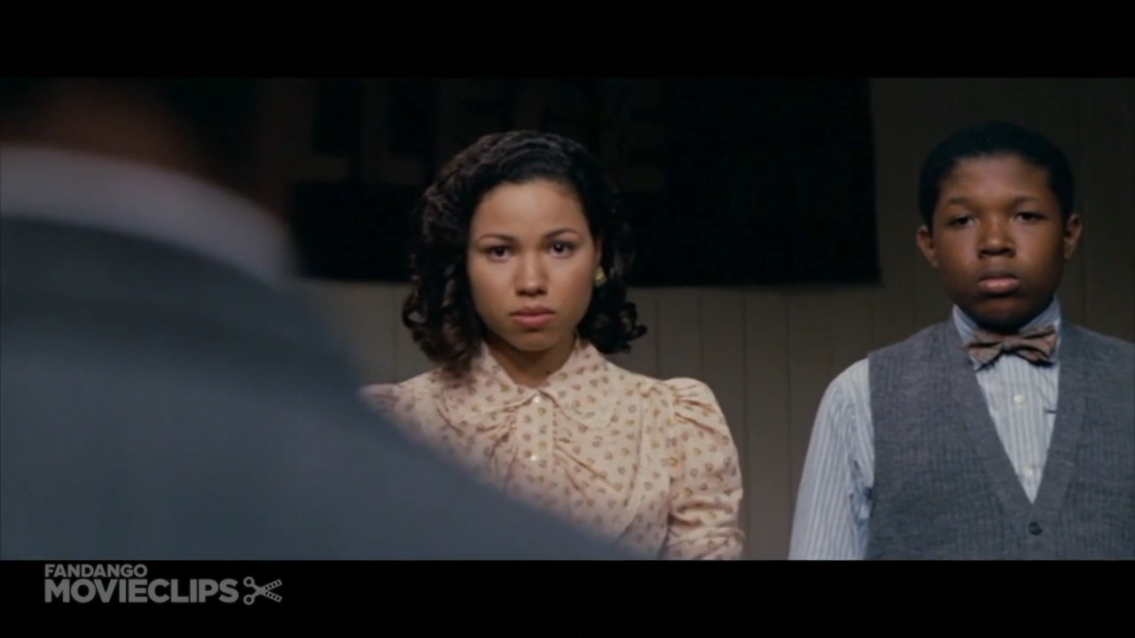
Clip: The Great Debaters
SANKOFA FRAMEWORK
“Return & Fetch It”
Changing Mindset
Reformation of your Framework
Examination of: Teaching Methodology
Curriculum Design
Notes:
1.5 minutes
Clip 27 Seconds
Commentary – 1 minute
Nzingha

Slide 34
Summary
Q & A
Reading References

Slide 35
References
From Dismantling Racism: A Workbook for Social Change Groups, by Kenneth Jones and Tema Okun, ChangeWork, 2001
Asante, M. K. (2003). Afrocentricity: The theory of social change. African American Images
Emdin, C. (2017). For White Folks Who Teach in the Hood ... and the Rest of Y'all Too: Reality Pedagogy and Urban Education. Beacon Press.
Fuller, N. (2016). The united-independent compensatory code/system/concept: A compensatory counter-racist code : a textbook/workbook for thought, speech, and/or action, for victims of racism (white supremacy).
DiAngelo, R. J. (2018). White fragility: Why it's so hard for White people to talk about racism. Beacon Press.
Hammond, Z. L. (2015). Culturally responsive teaching and the brain. Corwin Press.
hooks, bell (2017). Teaching to transgress: Education as the practice of freedom.
Hilliard, A. G. (1995). The maroon within us: Selected essays on African American community socialization. Baltimore, MD: Black Classic Press.
The Possessive Investment in Whiteness (1998).
Notes:
1 m

Slide 36
References
Nobles, W. W. (2006). Seeking the Sakhu: Foundational writings for an African psychology. Chicago: Third World Press.
Cartman, O. (2011). "The Development and Lived Experience of African Centered Identity: A Qualitative Investigation." Dissertation, Georgia State University. https://scholarworks.gsu.edu/psych_diss/97
Strayhorn, T. (2019). College Students' Sense of Belonging. New York: Routledge, https://doi-org.ccl.idm.oclc.org/10.4324/9781315297293
Wilkerson, I., & Miles, R. (2020). Caste: The origins of our discontents. Penguin Random House
Wong, A. “History Class and the Fictions about Race in America; The Atlantic, October 21, 2015.
The Demands (2016), from https://www.thedemands.org.
Jones, S. P. (2020) Ending Curriculum Violence. https://www.tolerance.org/magazine/spring-2020/ending-curriculum-violence
Notes:
0 minutes

Slide 37
The Student Perspective
In your experiences as a community college student and as a student of color, do you feel that your culture/experiences are represented in the courses you take?
Will you give us an example of how a professor in one of your classes helped to make you feel more included and represented in the course?

Slide 38
Resources
●Anti-Racism Education in California Community Colleges: Acknowledging Historical Context and Advancing Effective Anti-Racism Practices for Faculty Professional Development (2020)
●How to Start an Anti-racist Institution (April 2020)
●Rostrum-Black Voices and Perspectives (Summer 2020) 18 Articles
●Decolonizing Your Syllabus, an Anti-Racist Guide for Your College (ASCCC Rostrum, Nov 2020)
●Our Obligation to Equitable Hiring Practices: A Partnership Approach to Ensuring an Equity-Minded Selection and Recommendation Process (Rostrum, Nov 2020)
●Anti-Racism and Guided Pathways Implementation (Rostrum, Nov 2020)
●Academic Freedom and Equity (Rostrum, Nov 2020)
●Anti-Racism in the COR (Rostrum, Nov 2021)

