Slide 1
Student Engagement: Programs At-A-Glance—Designing Course Sequencing Flowcharts
As we ask our students to participate in creating their student educational plans, visual aids such as flowcharts to show sequencing of courses, including advisories and pre-requisites, can communicate faculty intent and program flow better, more quickly and more accessibly than time with a counselor. This practice can allow counseling sessions to be used to answer individual questions and issues. Such charting can also be used to determine larger curriculum solutions around over-all section and FTES planning and allocation. Attendees will be provided with examples from a number of colleges and hear from one college that is implementing this system for its curriculum and how it is being used.
Brook F. Oliver
Sierra College
Lead Counselor, Career Connections & Internships
Chair, Personal Development Dept.
ASCCC Appointment to SSPSC/Career / HBCU TAG Grant Committee
Former CTE Chair, Academic Senate President
Notes:
SSSP Brought us resources to do things we may have thought of, think of more, put them into place
Changed thinking to outcomes rather than recruitment
Put student needs in forefront
Challenged us to work smarter

Slide 2
Problem Statements:
A low percentage of students reach their stated educational goals in a timely manner, or at all. (lack of clarity in goals and process; poor scheduling/sequencing by college)
Comprehensive SEPs are required AND highest funded SSSP activity—and the most time-intensive and least completed at this point. (students need to fully understand importance of them and be ready to help create them)
College is an entirely new universe with its own language, culture and customs. (How can and do we converse with them about how to succeed?)

Slide 3
Face with Stuck-Out Tongue and Winking Eye
Cara sacando la lengua y guiñando
kidding, not serious
A face with one closed eye, one wild-looking open eye, open mouth and tongue sticking out. Wildly and crazy silliness. This emoji is a nut, potentially certifiably so.
Notes:
When we want to explain something regardless of culture, language or advanced knowledge, we use diagrams or flowcharts.
Simplify and teach
Done well, the legend is minimal and understanding is high—and establishes commonalities
When we want to describe/portray a process, we use flowcharts.

Slide 4
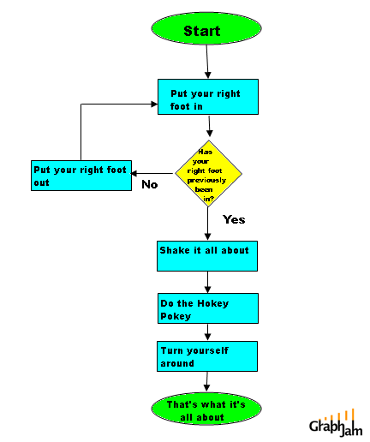

Slide 5
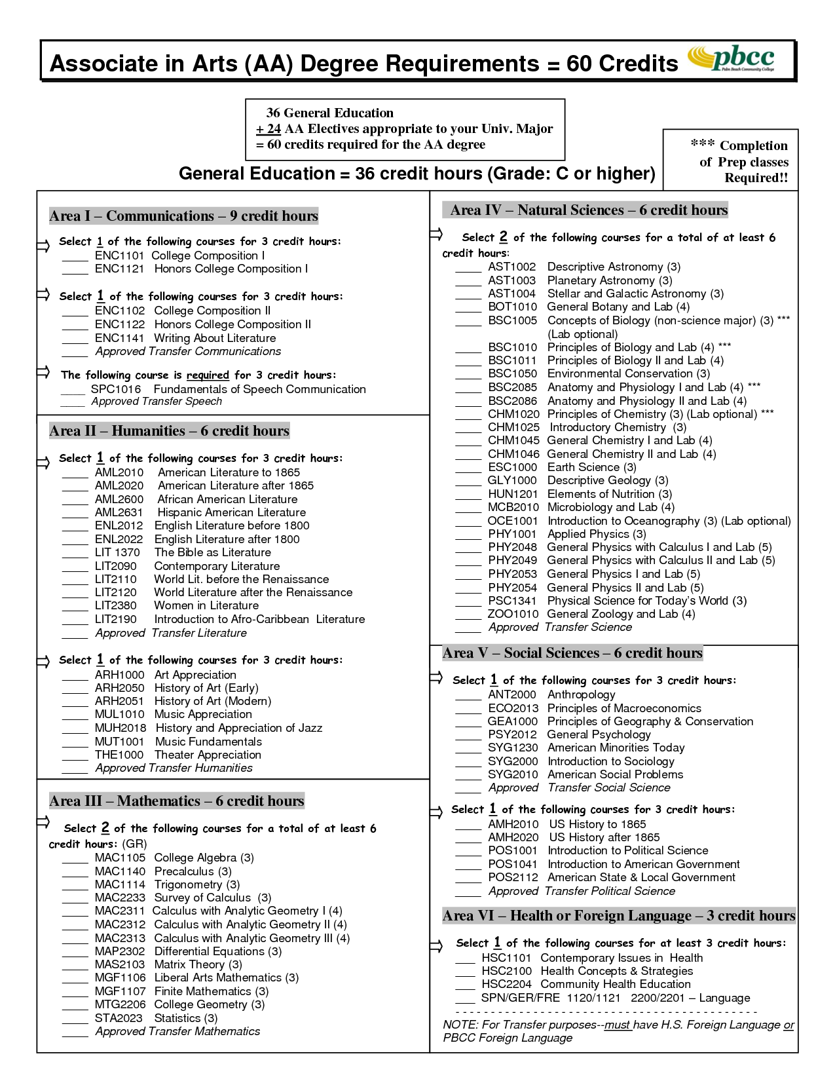
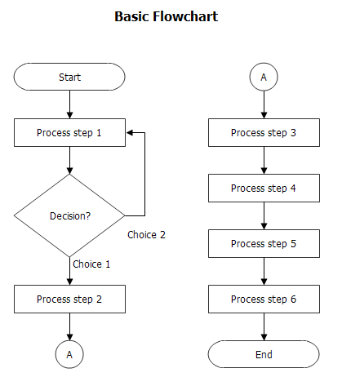
What if…
Notes:
Applied flowcharts to our programs?
Programs emphasizing progression already do this (MATH, some science)
CTE programs are easiest (usually) due to nature of training (foundation to specific to mastery)

Slide 7
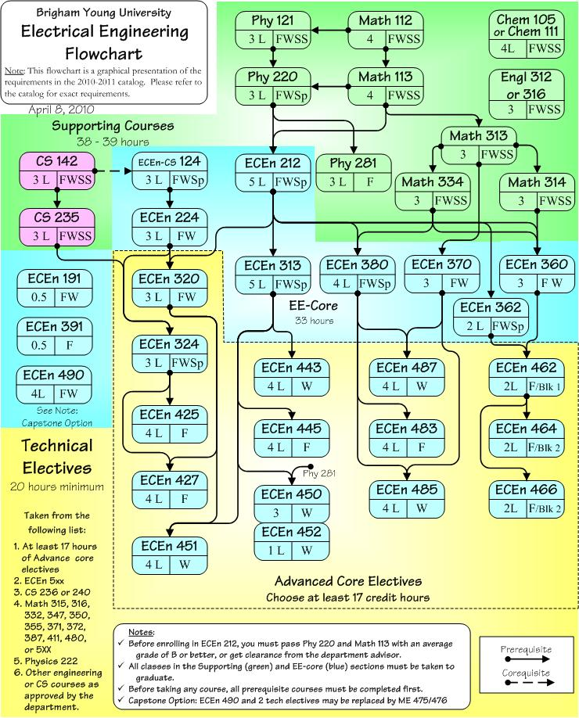
Just major classes but shows relationships

Slide 8
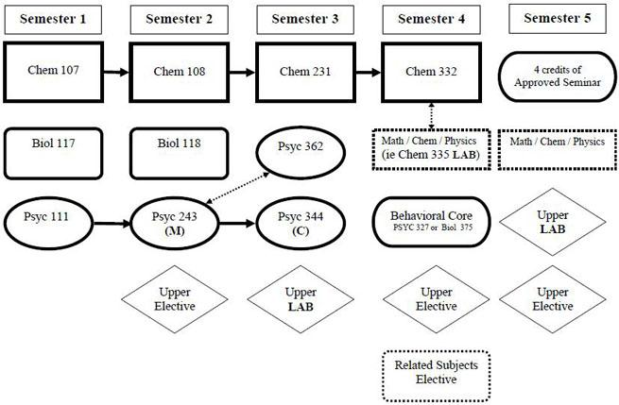
Term by term,
major classes only

Slide 9
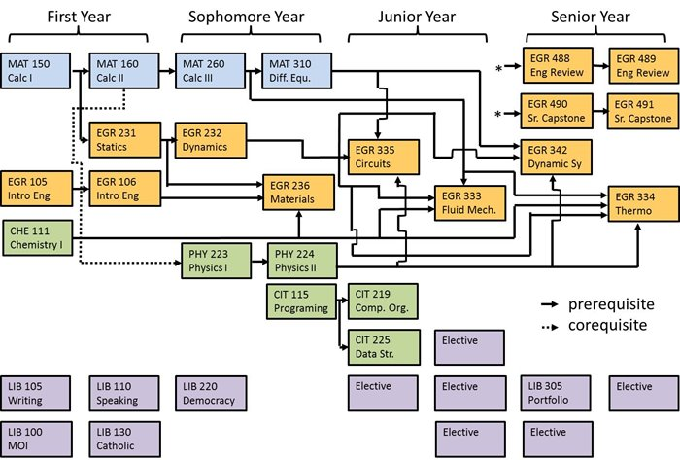
One version of
term by term
major AND GE

Slide 10
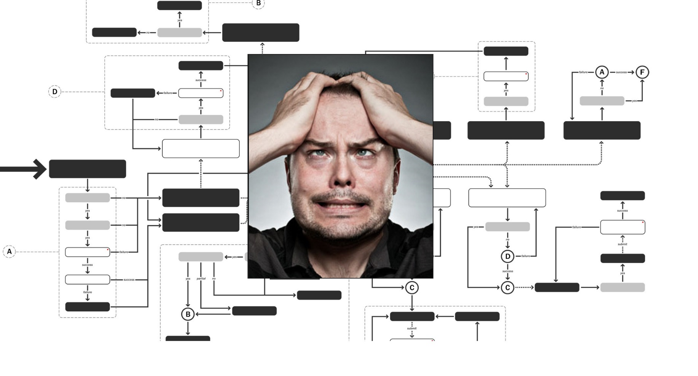
CC students have with the options of short term certificates, long term certificates, “terminal” AA degrees, transfer + AA degree, ADT, and transfer without AA degree all as options.
Notes:
Hard for anyone and everyone—students, counselors, parents, administrators, public
Almost incomprehensible to map all these possibilities…
Ah ha! Don’t have to—or at least to begin with.
Bite off the largest portion of students and deal with the alternatives later.
Leaving flowcharts for right now—but imaging students being able to clearly see and understand sequencing, advice and expectations through easy access to visual depictions of their program.

Slide 11
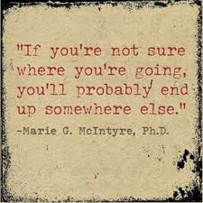
Notes:
Sierra is exceeding every SSSP benchmark—except COMP SEP.
Ed goal/Course of study required
Need informed decisions to save waste of resources by student and college alike
General belief that these decisions just happen—magically—I say by a visit from the career fairy but nowhere in our educational system do we spend specific time on asking, RESEARCHING AND AFFIRMING and answering that essential question “What are you going to be when you grow up?
No easy solution, no single test, time of life that this happens
But there is a proven process, not long term therapy, that can move students forward in making these informed decisions

Slide 12
Notes:
Forcing them to choose
wasted time, money, classes, counselor appointments, lack of motivation
With SSSP timelines, max units, Financial Aid clock etc.

Slide 13
WHAT ARE STATED Student GOALS?
11,000 (60%) TRANSFER to CSU or UC
+ 1,600 ( 8%) EARN degree or certificate
TOP Majors (as of 9/22/15)
Undecided | 5,200
Nursing | 4,000
Business | 3,600
Biology | 2,300
Psychology | 2,000
Computer Science | 1,400
Engineering | 1,100
Notes:
That’s over 8000 students in search of a program—lots of opportunity for instruction and student services to work together to get students into majors and grow programs.
Lots of exploring—lots of COMP SEPs to be written---and re-written.
Realistic loads and clear sequences would help them ‘see’ whats ahead and plan for it or something else.

Slide 14
What happens to Our Students
3% complete 30 units 1st Year
10% who start in Math 581 pass Math D
2% eventually earn certificates
9% who want to transfer actually do
10% of the students who want a degree earn one
50% leave every year
Notes:
We have to do better.
When we are talking about the low-hanging fruit and what is within our control, information and support are integral.
We need to turn counseling appointments into true interaction; and provide the info only pieces before and on-going.
Simplify, inform, poke and confirm…

Slide 15
Which GE sheet?
Working or not?
Major
Ed Goal?
Timelines?
Why spend time on course sequences?
Why not include GE suggestions?
Why not give info to students?
SEP
Transfer?
Assist.org
Unit load?
Assessment results?
Parental/personal expectations?
UC/CSU/Private/OOS?
AP/IB scores
Notes:
So many pieces to building an effective SEP—off-load whatever we can to work by student before and after.

Slide 16
First iteration:
Visual “chart” of our catalog information

Slide 17
Color helps but needs to also work if printed B&W
Good learning tool that shows where complexity is—usually shows where confusion reigns
Notes:
Key elements:
Consistent formatting
Plain speaking
Color works well but need to adjust to use if printed black & white
This example helped show the faculty where too many options lead to unclear sequence for counselors and students alike.

Slide 18
Next iteration based on new goals: term by term “map”
Program faculty will determine sequence, especially when
pre-reqs don’t.
Notes:
Formation of Re-engineering taskforce, asking for consideration of guided pathways.

Slide 19
Counselors will train faculty on assist.org/GE sheets
Program faculty will meet with GE-providing faculty to delineate recommended choices for each program.

Slide 20
STEP 1: confirm template
STEP 2: Program faculty decide sequence
STEP 3: Faculty across curriculum decide GE options
NEXT STEPS?:
SEPs could drive schedule/sections
Offerings will align with student needs

Slide 21
Big Ideas for Student-focused Re-engingeering
Make navigating the institution user-friendly to all students
Help students understand, explore, and choose appropriate educational goals
Give students clear and efficient paths to reach those goals
Ensure those paths are available
Provide support and resources to keep students on those paths
Measure institutional progress toward/success at these goals and respond accordingly
Notes:
Easy to understand programs, expectations, etc.
Clearly see commitment and timeline for stated goal and track progress.
SSSP/Financial Aid/Veterans etc. are imposing timelines that will preclude many from wandering too much, too long.

Slide 22
Successes so far:
Huge buy-in and support from across campus. Instructional faculty can infuse their expertise and advice; counselors feel more confident; students understand better
Heightened instructional faculty awareness of GE requirements and how they fit (or don’t)
Non-threatening way to point out convoluted sequencing or expectations
Programs with charts in place have seen significant rise in certificate and degree attainment (students know how far along they are and when to petition)
Marketing of programs is assisted, especially those with a less than 2 year timeline; building blocks are readily apparent.

Slide 23
NEXT STEPS:
Complete CTE program sequencing with GE (non-transfer) recommendations by end of Spring ‘16
ADT degrees are next (Fall -16)
Likely to adopt “meta-majors” to help with abbreviated SEPs and first semester course planning; adjust schedule to accommodate
As programs/recommendations roll out, create charts (MAP’s) for each type of award (full-time, transfer bound first, then other options)
Incorporate into on-boarding process with links/docs sent to students at time of entry or intervention

