Slide 1
Collaborative Efforts: General Education and Quantitative Reasoning
Ginni May, ASCCC North Representative
John Stanskas, ASCCC Secretary
January 2016 Instructional Design and Innovation Riverside, CA

Slide 2
Acronym Tutorial
ASCCC – Academic Senate for California Community Colleges
CCC – California Community Colleges
CSU – California State University
UC – University of California
CCCCO – California Community Colleges Chancellor’s Office
BOG – Board of Governors
GEAC – General Education Advisory Committee (to CSU Chancellor)
IGETC – Intersegemental General Education Transfer Curriculum

Slide 3
Outcomes
Clarify current CCC Associate Degree requirement for math.
Receive a history tutorial on math and Quantitative Reasoning requirements and various pathways to meet those requirements at both CCC and CSU.
Examine attempts at defining Quantitative Reasoning.
Discuss pros and cons of pathways to meet graduation/transfer requirements regarding Quantitative Reasoning.
Begin conversation on Quantitative Reasoning expectations of college degree holders at both the associate and baccalaureate levels.

Slide 4
History – CCC Math Requirement
Associate Degree Requirements increased to Freshman Composition and Intermediate Algebra in the CCC System:
Adopted by the Academic Senate in Spring 2005
Approved the Board of Governors in September 2006
Effective for all students admitted to CCC beginning Fall 2009

Slide 5
CCC Math Requirement
Title 5 § 55063
Competency in mathematics shall be demonstrated by obtaining a satisfactory grade in a mathematics course at the level of the course typically known as Intermediate Algebra (either Intermediate Algebra or another mathematics course at the same level, with the same rigor and with Elementary Algebra as a prerequisite, approved locally), or by examination;

Slide 6
CSU GE-Breadth Area B4 Mathematics and Quantitative Reasoning
Area B4 courses must emphasize the development of students’ mathematical and quantitative reasoning skills beyond the level of intermediate algebra. Courses in the history of mathematics, for example, are not acceptable for Area B4 because they are not focused on building students’ mathematical skills. Trigonometry and discipline-specific statistics courses are not acceptable for IGETC Area 2 but may be acceptable for CSU GE-Breadth Area B4. Courses in the other sub- areas of Area B emphasize the perspectives, concepts, principles, theories, and methodologies of the disciplines.
Area B4 courses must emphasize the development of student’s mathematical and quantitative reasoning skills beyond the level of intermediate algebra, which must be a stated prerequisite.
From CSU Office of the Chancellor, Guide for CSU Reviewers http://www.calstate.edu/app/documents/EO-595/Area_B.pdf

Slide 7
IGETC Area 2 Mathematical Concepts and Quantitative Reasoning
All courses must have an explicit prerequisite of Intermediate Algebra and build students’ skills beyond the level of Intermediate Algebra. Trigonometry and discipline-specific statistics courses are not acceptable for IGETC Area 2 but may be acceptable for CSU GE Area B4. Courses that are designed to serve a restricted range of disciplines but “emphasize the mathematical basis of statistics, probability theory and estimation, application and interpretation, uses and misuses, and the analysis and criticism of statistical arguments in public discourse” may be approved for IGETC Area 2A.
From CSU Office of the Chancellor http://www.calstate.edu/app/documents/IGETC/IGETC_Area_2.pdf

Slide 8
Quantitative Reasoning SLOs Example from a CCC
Upon completion of the A.A. or A.S. degree students will be able to demonstrate knowledge of quantitative methods and skills in quantitative reasoning.
Specifically, they will be able to…
extract, organize, and analyze quantitative data from information presented in various forms.
apply quantitative methods to problem solving and decision making
clearly communicate quantitative reasoning processes using appropriate terminology.
demonstrate an understanding of various quantitative methods, their relationship to one another and their application to multiple disciplines.
demonstrate facility with numbers, including orders of magnitude, appropriate use of precision versus accuracy in measurements, approximation, and multidimensional or multivariate problems.

Slide 9
Association of American Colleges and Universities
By one definition, quantitative reasoning (QR) is the application of basic mathematics skills, such as algebra, to the analysis and interpretation of real-world quantitative information in the context of a discipline or an interdisciplinary problem to draw conclusions that are relevant to students in their daily lives. It is not just mathematics. … The term numeracy is also used in conjunction with these skills.
From AACU - Quantitative Reasoning the Next “Across the Curriculum” Movement by Susan Elrod, 2014 https://www.aacu.org/peerreview/2014/summer/elrod

Slide 10
DQP (Degree Qualifications Profile)
At the associate level, the student
Presents accurate calculations and symbolic operations, and explains how such calculations and operations are used in either his or her specific field of study or in interpreting social and economic trends.
At the bachelor’s level, the student
Constructs, as appropriate to his or her major field (or another field), accurate and relevant calculations, estimates, risk analyses, or quantitative evaluations of public information and presents them in papers, projects, or multimedia events.
http://degreeprofile.org

Slide 11
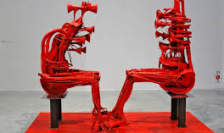
Why is this the focus of so much attention?

Slide 12
Statewide Remedial Math Equity Completion CCCCO (Datamart)

Slide 13
Statewide Remedial English Equity Completion CCCCO (Datamart)

Slide 14
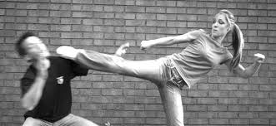
I feel like the guy on the left looking at data like this…

Slide 15
Efforts to increase Completion
RP Group released Basic Skills as a Foundation for Success in California Community Colleges in 2007 – AKA
The Poppy Copy http://rpgroup.org/content/poppycopy
Prepared by a team of researchers, faculty, and administrators
Lots of experimentation in the system
Bridge Programs
Compressed or Accelerated Learning
Contextualized Basic Skills
Two projects in Acceleration Emerged (among many)
Statway (Carnegie Foundation Model)
CAP (California Acceleration Project-3CSN)
Both involve fulfilling Quantitative Reasoning G.E. through Statistics

Slide 16
History – CCCs
Simultaneously, community college faculty have worked to identify pathways to associate degree and transfer level mathematics…
The Academic Senate has made it clear that they will encourage discipline faculty to identify, design and/or implement pathways, but have not take a position on any particular pathway…
The Academic Senate encourages faculty to work with discipline experts and organizations such as AMATYC and CMC³ to help determine effective and appropriate pathways.
CMC³ – California Mathematics Council of Community Colleges
AMATYC – American Mathematics Association of Two Year Colleges

Slide 17
AMATYC – Position Statement
The Appropriate Use of Intermediate Algebra as a Prerequisite Course
WHEREAS, The prerequisites of a mathematics course should be those appropriate to providing a foundation for student success in that course;
WHEREAS, The course description and learning outcomes of a mathematics course determine the level of mathematical literacy, skills, and knowledge necessary for successful completion of the course;
WHEREAS, The equivalent content in intermediate algebra courses is generally required to master the content of algebra-based courses that lead to calculus;
WHEREAS, The equivalent content in intermediate algebra courses is not required to master the content for most college-level mathematics courses that do not lead to calculus;
NOW, THEREFORE, It is the position of AMATYC that:
Prerequisite courses other than intermediate algebra can adequately prepare students for courses of study that do not lead to calculus.
Approved at the Delegate Assembly – November 15, 2014

Slide 18
History – CSU GEAC
The Statway project reported back to GEAC in
2014 – data set too small
2015 – better data, social science degrees
Statway now charges $25000 one-time fee to college adopters
GEAC also acknowledged that CAP was using existing Title 5 waiver of prerequisite forms for alternative pathway to statistics
Notes:
John, you need to do this one, I am unfamiliar with where this info came from

Slide 19
History – CSU GEAC
CSU Executive Order 1065 and 1100 – Explicit Prerequisite Requirement of Intermediate Algebra for Transfer level Mathematics
Executive Order 1065- September 2011
Executive Order 1100- February 2015
Exemption to Executive Order 1065
Waiver for 5 districts to offer a Statway model to transfer granted in 2010, a 6th district was added later
Track students through transfer and baccalaureate graduation
http://www.calstate.edu/app/GEAC/documents/2015/sept-2015/06-Statway-presentation.pdf

Slide 20
History – CSU GEAC
The CSU Council of Math Chairs reported to GEAC
Statway at the CSU does not prepare students for college level courses
Not scalable
Poor outcomes
Study results of other remediation completers ELM scores versus Statway completer scores
Indicated Statway completers performed significantly lower on ELM than student body at large or other forms of remediation
ELM – Entry Level Mathematics Test for all Freshmen at CSU
Arithmetic, geometry (area and volume), and beginning algebra skills
CSU Council of Math Chairs’ Statement on Entry Level Mathematics and Statway 30 April 2015

Slide 21
Recent History – CSU Academic Senate
At the request of GEAC, the CSU-AS passed Resolution AS-3230-15 http://www.calstate.edu/acadsen/Records/Resolutions/2015-2016/documents/3230.shtml
Establishing a Task Force on the Requirements of CSU General Education Mathematics/Quantitative Reasoning (B4) Credit
Recommends including UC, CCC, K-12, discipline experts in math, and a representative from CAP

Slide 22
Recent History – CSU Academic Senate
On the recommendation of GEAC, the CSU authorizes temporary recognition of statistics pathways curriculum in satisfaction of the Quantitative Reasoning requirement for transfer admission and completion of lower-division coursework in general education.
http://www.calstate.edu/app/geac/documents/statistics-pathways-in-csu-quantitative-reasoning-fall2015.pdf
Expires at the beginning of fall term 2019
Monitor efficacy of statistics pathways
Inform subsequent revision of permanent policy

Slide 23
General Education: Quantitative Reasoning
Quantitative Reasoning as part of the General Education pattern is the purview of all faculty,
We must engage in the intersegmental dialog – What are the expectations (in Quantitative Reasoning) for citizens holding a baccalaureate degree?
CSU Council of Math Chairs’ concern is that these pathways do not prepare students for college level courses and key content is missing.

Slide 24
General Education: Quantitative Reasoning
So where does that leave us? What are the skills and abilities needed for an Associate’s Degree? For a Bachelor’s Degree?

Slide 25
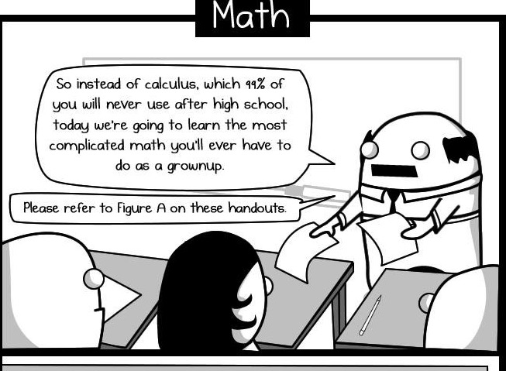

Slide 26
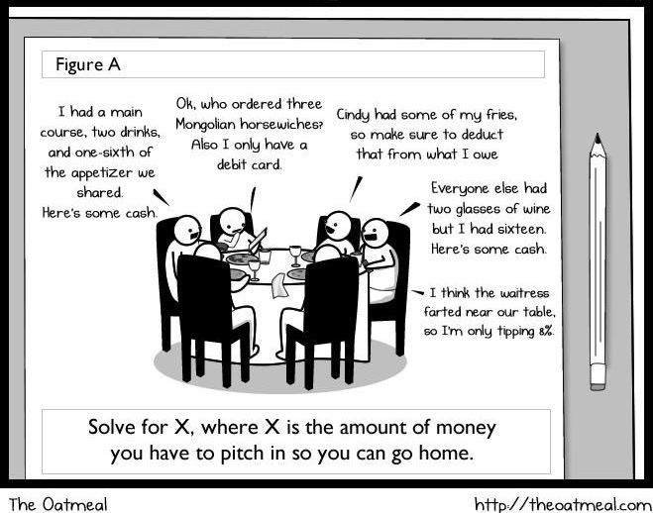

Slide 27
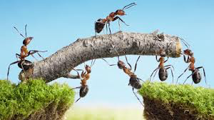
GE: Quantitative Reasoning
These next slides will be completed with the participation of the Breakout Session attendees.

Slide 28
We started a list GE: Quantitative Reasoning
We want graduates who can:
Perform basic math operations without a calculator: addition, subtraction, multiplication, and division on integers, fractions, and decimals
Understand, calculate, and manipulate ratios and percents
Calculate bulk cost per item
Determine interest rate penalties
Understand concepts of length, area, and volume
Calculate area of carpet, volume of a gas tank
Understand unit measurements such as
liters versus gallons,
miles versus kilometers,
Inches versus feet versus yards
Interpret graphical representations of data; pie charts, bar graphs, linear trends
social science data in popular media
Understand the difference between correlation and causation
Sense of numeracy:
detect fraud
estimate cost

Slide 29
GE: Quantitative Reasoning

Slide 30
GE: Quantitative Reasoning

Slide 31
GE: Quantitative Reasoning

Slide 32
GE: Quantitative Reasoning

Slide 33
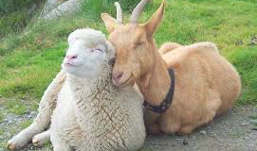
Thank you!!

