Slide 1
Common Course Design Issues
Dolores Davison, ASCCC Michelle Pilati, Online Education Initiative Anna Stirling, @ONE

Slide 2
What course design mistakes do you think are most common?

Slide 3
Common Mistakes
Cognitive Overload
Unclear Navigation
Death Scroll
Moving Furniture
Doomed Discussions
Accessibility Issues
Not effectively using CMS tools

Slide 4
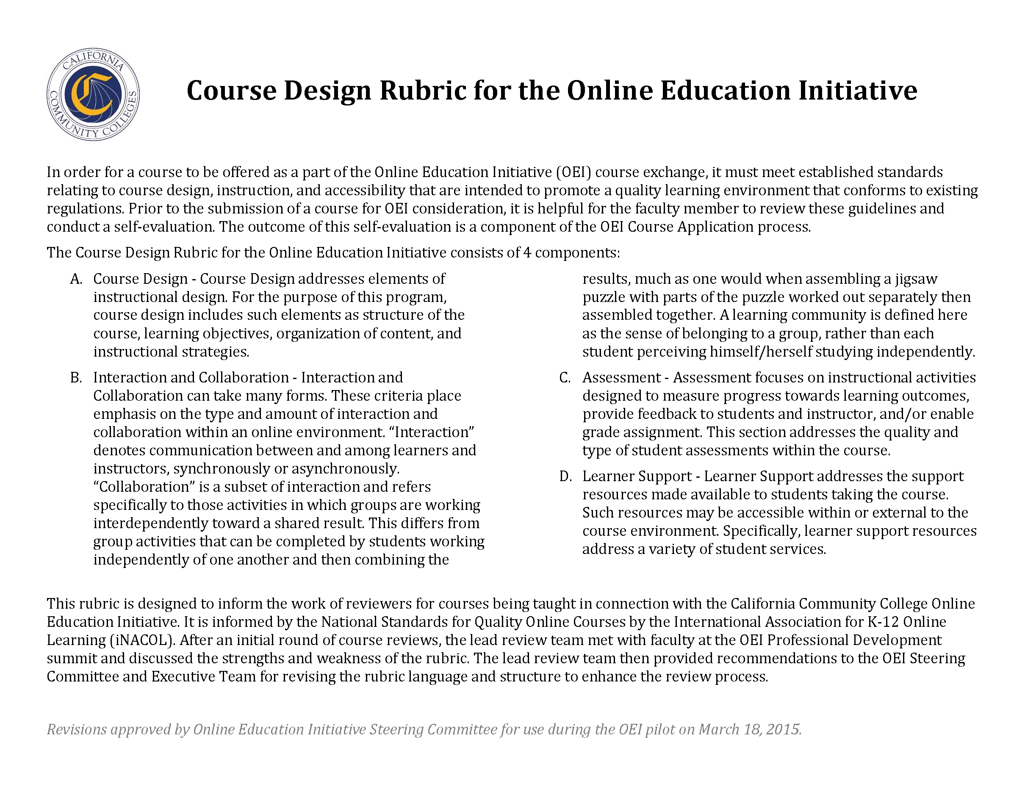
OEI Course Design Rubric
Integrates elements of good course design

Slide 5
Cognitive Overload
The goal of instruction is to reduce extraneous processing, manage essential processing, and foster generative processing.
https://magic.piktochart.com/output/7055620-design-principles

Slide 6
A. Course Design
Course Design addresses elements of instructional design.
Course design includes:
structure of the course,
learning objectives,
organization of content, and
instructional strategies.

Slide 7
A.1 Objectives
Objectives are made available in a variety of areas in the course (within the syllabus and each individual learning unit or module)
Objectives are clearly written at the appropriate level and reflect desired outcomes
Objectives are written in measurable outcomes (students know what they are expected to be able to do)

Slide 8
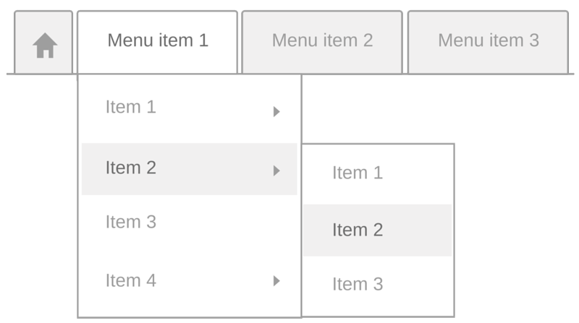
Unclear Navigation
How can you “test” your navigation?

Slide 9
Death Scroll/Unchunked Content
Death Scroll – a single page that goes on and on…. Reader has to scroll and scroll and scroll and scroll to get to the end.
Unchunked content – content is not presented in manageable units.

Slide 10
A.2 Content Presentation I
Content is made available or “chunked” in manageable segments (i.e., presented in distinct learning units or modules)
Navigation is intuitive and content flows in a logical progression

Slide 11
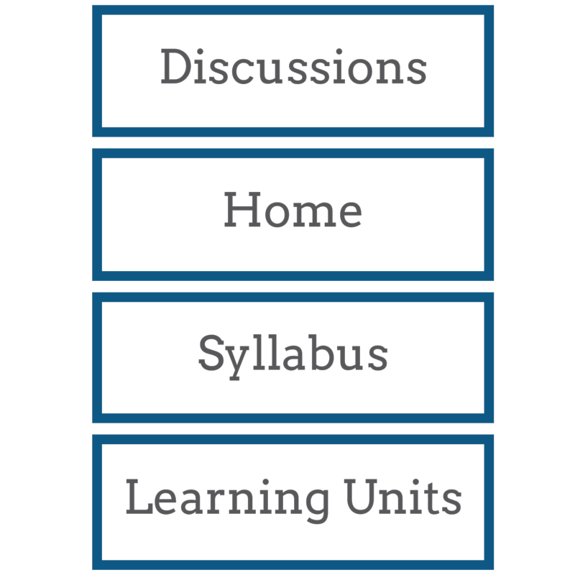
Moving Furniture
Do your students have to re-learn the online environment with every course module?
Is there consistency as they move from module to module, week to week, unit to unit?

Slide 12
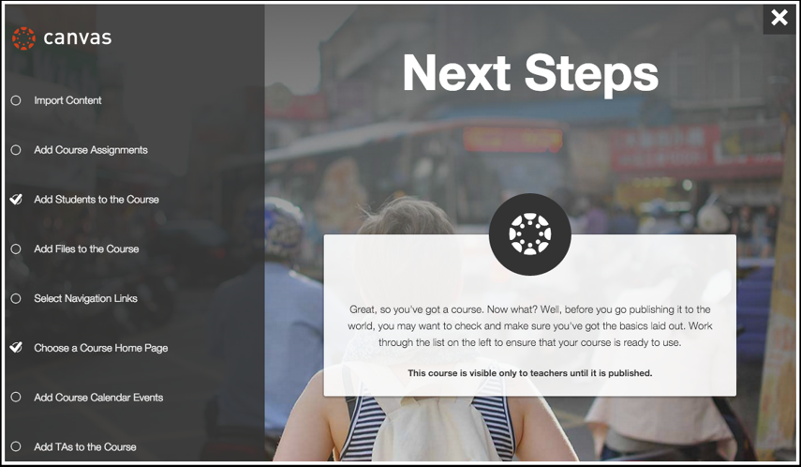
Effective CMS Use
Critical when moving from one CMS to another

Slide 13
A.2 Content Presentation II
CMS tools are used to reduce the labor-intensity of learning (e.g., providing links to needed resources where they will be used in the course, integrating publisher resources that are tailored to the course materials, and providing streamlined access to supplementary materials)
Clearly labeled tutorial materials that explain how to navigate the CMS and the specific course are included

Slide 14
Doomed Discussion
Do your discussion prompts promote actual discussion?
What are some characteristics of a good discussion prompt?
What are some characteristics of a bad discussion prompt?

Slide 15
B. Interaction and Collaboration
“Interaction” denotes communication between and among learners and instructors, synchronously or asynchronously.
“Collaboration” is a subset of interaction and refers specifically to those activities in which groups are working interdependently toward a shared result.
A learning community is defined here as the sense of belonging to a group, rather than each student perceiving himself/herself studying independently.

Slide 16
B.1 Communication Strategies
Expected response time for replies is included.
The instructor’s role within the course is explained.
There are plentiful opportunities for interaction, as appropriate.
Communication strategies promote critical thinking or other higher order thinking aligned with learning objectives.

Slide 17
Basic Principles
Clear and complete communication – about expectations and how the course works.
Purposeful activities and interaction.
Promoting connection – to course content, to other students.

Slide 18
Accessibility Issues
Lack of alt tags on images.
PPTs or PDFs that are not accessible.
No captioning or bad captioning of videos.
Do you know how to check your course for accessibility?
Do you know who to ask for assistance?

Slide 19
Accessibility Resources
Accessibility Webinars
Your Online Course Usability: 10 Ways to Kick It Up a Notch
Captioning Considerations
Creating Accessible PDF Documents with MS Word and Acrobat Pro
Evaluating Web Content for Accessibility
Creating Accessible Online Presentations
@ONE Resources
Format text using appropriate styles & headers
Create captions for videos
Format images with appropriate alt tags
Ensure color contrast ratios are within tolerances
Create usable URL link text

Slide 20
D.3 Technical Accessibility
Course materials are compliant with Section 508 and WCAG 2.0 (AA) and can be effectively used with equal ease by all students.

Slide 21
B.2 Development of Learning Community
Instructors have a plan for initiating contact prior to or at the beginning of class and at regular intervals during the course.
Communication activities are designed to help build a sense of community among learners.
Student-to-student interactions are required as part of the course.
Students are encouraged to initiate communication with the instructor.
Collaboration activities (if included) reinforce course content and learning outcomes, while building workplace-useful skills such as teamwork, cooperation, negotiation, and consensus-building.

Slide 22
B.3 Interaction Logistics
Guidelines explaining required levels of participation are provided.
Expectations regarding the quality of communications are clearly defined.
A rubric or equivalent grading document is included to explain how participation will be evaluated.
The instructor plans to participate actively in communication activities, including providing feedback to students.
The instructor plans to use communication tools effectively to provide course updates, reminders, special announcements, etc.
Notes:
Guidelines explaining required levels of participation (i.e., quantity of interactions) are provided
Expectations regarding the quality of communications (e.g., what constitutes a “good” answer) are clearly defined
A rubric or equivalent grading document is included to explain how participation will be evaluated
The instructor plans to participate actively in communication activities, including providing feedback to students
The instructor plans to use communication tools effectively to provide course updates, reminders, special announcements, etc.

Slide 23
C. Assessment
Tied to outcomes
Match the ability of the online platform
Multiple Measures of Assessment (authentication)
Use samples and rubrics
Why?

Slide 24
D. Learner Support
Supplemental Software and Resources
Course and institutional policies and support
Technical Accessibility
Accommodations
Notes:
D.1 trips up many faculty and is very easy to address – if you require students to use any sort of software, you need to ensure that they have that software when they need it.

Slide 25
More Information
OEI Website CCCOnlineEd.org
@ONE Website Onefortraining.org
Anna’s E-Mail astirling@onefortraining.org
Michelle’s E-Mail mpilati@ccconlineed.org

Slide 26
5 Common Mistakes to Avoid During Online Course Design
You don’t allow enough time to design and build your course.
You give in to fear.
You try too many new things at once; you don’t try anything new at all.
You transfer your course online rather than transform your course online.
You don’t use rubrics.
Notes:
http://facultyecommons.com/online-course-design/
While some of these are rather obvious, the final 2 are things to keep in mind…

Slide 27
Transform…
Multimedia—Avoid recording hour-long lectures, which fail to maintain students’ attention.
Interaction—Don’t assume that interaction will automatically take place like it does in a face-to-face classroom.
Organization—Since you don’t have traditional class time to clear up confusion and make announcements, you must be explicit and organized in your course design (e.g., navigation) and communication (e.g., directions, assignment expectations, due dates).
Notes:
Suggestions to avoid #4.. How long should online “lectures” be? 4-5 minutes

Slide 28
Why Rubrics?
Rubrics are vital in an online environment because they:
give clear direction for students when completing assignments and discussions.
prevent confusion among students.
prevent your inbox from filling up with assignment questions.
ensure consistency when grading the same assignment.

Slide 29
9 ELearning Course Design Mistakes
Target audience not clearly defined.
Too much text.
Navigation is confusing.
Examples aren’t realistic or relevant.
Ineffective (poor) narration.
Information overload.
Poor selection of authoring tools.
Too many grammar mistakes.
Assessments are too easy.
Notes:
http://www.learndash.com/9-common-elearning-design-mistakes/
While some of these are not clearly relevant to the CCC environment, they are all things to consider.

Slide 30
Five Common Pitfalls of Online Course Design
Upload your course materials, then call it a day.
Let the CMS drive your thinking.
Insist on being the “sage on the stage.”
Expect your students to consume knowledge rather than create it.
Ignore the ways students learn from each other.
Notes:
http://www.facultyfocus.com/articles/online-education/five-common-pitfalls-of-online-course-design/

