Slide 1
All About Building Bridges: Developing Strategic Partnerships and Campaign Overview
Presented by:
Amanda J. Davis, Program Manager,
“I Can Afford College” Campaign

Slide 2
Campaign Overview
Statewide initiative funded by Proposition 98
Started in 2003-04 academic year due to fee increase concerns
Annual campaign budget of $2.8 million
Requested additional $1.5 million for 2015-16 academic year; however, the request was not approved
Directed and managed by the California Community Colleges Chancellor’s Office

Slide 3
Per Budget Act language, the campaign promotes the following key messages:
California community colleges remain affordable
Financial aid is available year round
Financial aid professionals are available and can provide free one-on-one assistance

Slide 4
The campaign’s key target audiences are low- to middle-income:
High school juniors and seniors
Recent high school graduates
Current community college students
Re-entry students
Influencers
San Bernardino Valley College

Slide 5
Campaign activities
Media relations
Advertising
Legislative and community outreach
Social media
Partnerships
Ohlone Community College

Slide 6
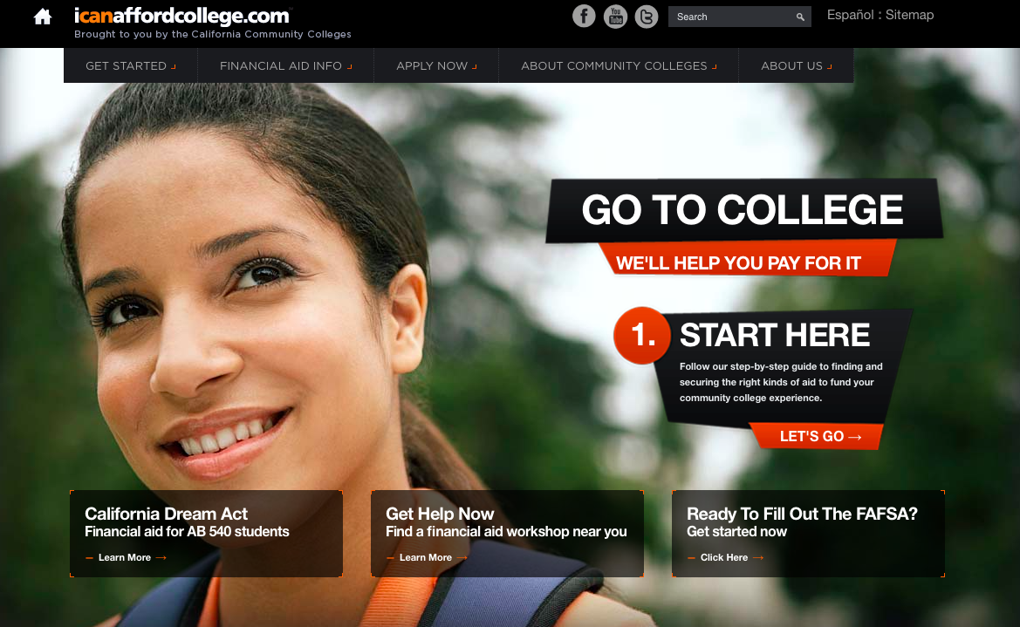
All activities drive people to the heart of the campaign, icanaffordcollege.com Key features of the website include:
Contact information for financial aid offices
Bilingual English/Spanish
Types of financial aid
How to apply
Responsive design
Direct links to applications
Student success stories
Financial Aid Office locator

Slide 7
Collateral & Informational Materials
Available items include:
Brochures
Posters
Folders
Bookmarks
Order through icanaffordcollege.com

Slide 8
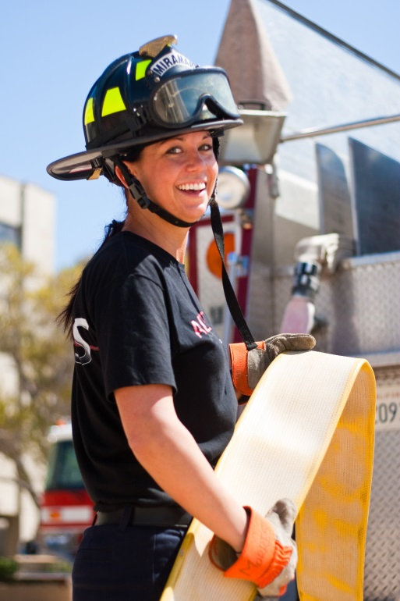
It’s Working!
Since the campaign launched in 2003-04:
More than 2.5 million people have visited the “I Can Afford College” website
Number of community college students receiving some type of financial aid has increased by nearly 70 percent
San Diego Miramar College

Slide 9
Why is this important information for the classroom?
First contact
Many students do not seek counseling
Students must have financial support to succeed
Trusted source
What was your experience with paying for your education?
Can you share any stories from your classroom?

Slide 10
Partnerships are key!
Cost effective
Build bridges into and between communities; create a pipeline
Sustainability!
College of the Desert

Slide 11
“I Can” Campaign Partners
Statewide
County Welfare Directors Association of CA
Taco Bell
iHeart media
CA Youth Connections
Local/Regional
Closing the Gap
Girls, Inc.
PUENTE
Valley Vision’s “Scholarship Sacramento” Program
High schools

Slide 12
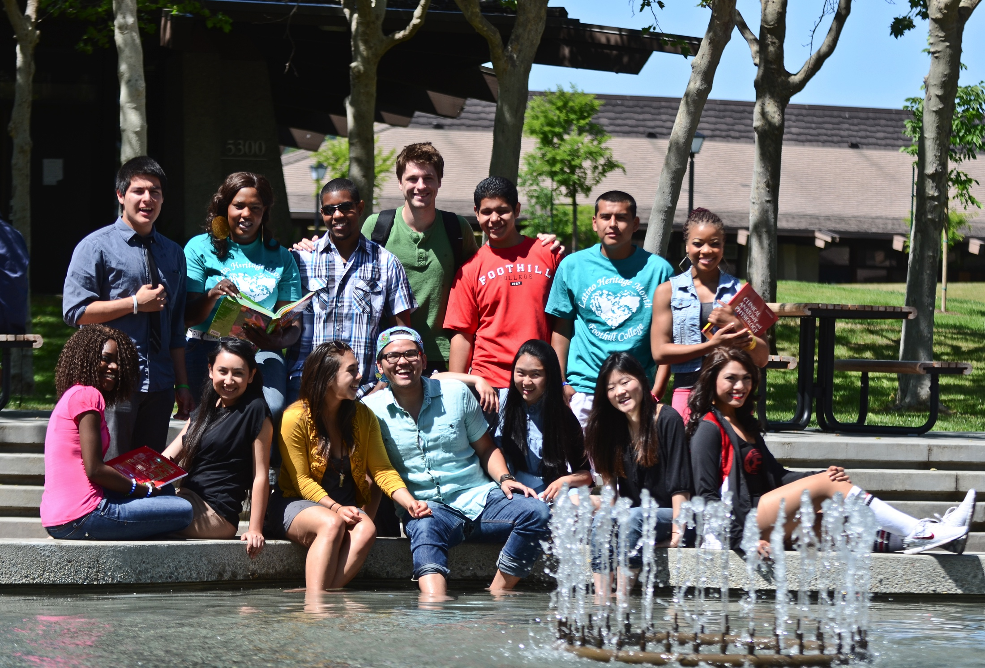
Research potential partners
Target audience
Size of audience
Current partners
Channels used to reach target audience
Identify possible conflicts of interest

Slide 13
Outreach to potential partners
Brief overview of your program
Discuss what can be provided to the partners and partnership activities
Be sure to also ask for your partner’s ideas and resources

Slide 14
Establishing and Maintaining Partnerships
Stay connected
Respond to partners’ activities
Provide relevant news information
Share positive results of the partnership
Ohlone Community College

Slide 15
Maintaining Partnerships - Activities
Newsletter article placement and sharing
Free “I Can” collateral distribution
Event participation
Social media
PSAs
Web content sharing
Mission College

Slide 16
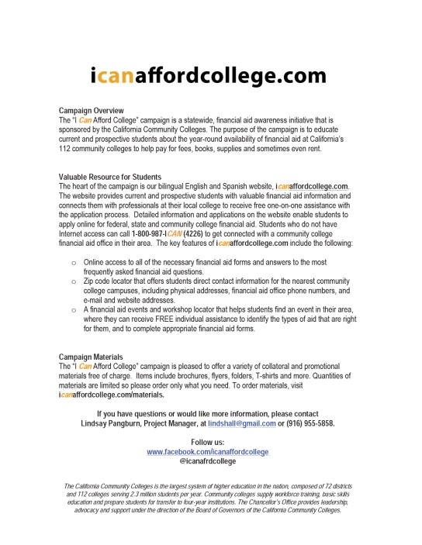
Newsletters
Article placement
Newsletter distribution

Slide 17
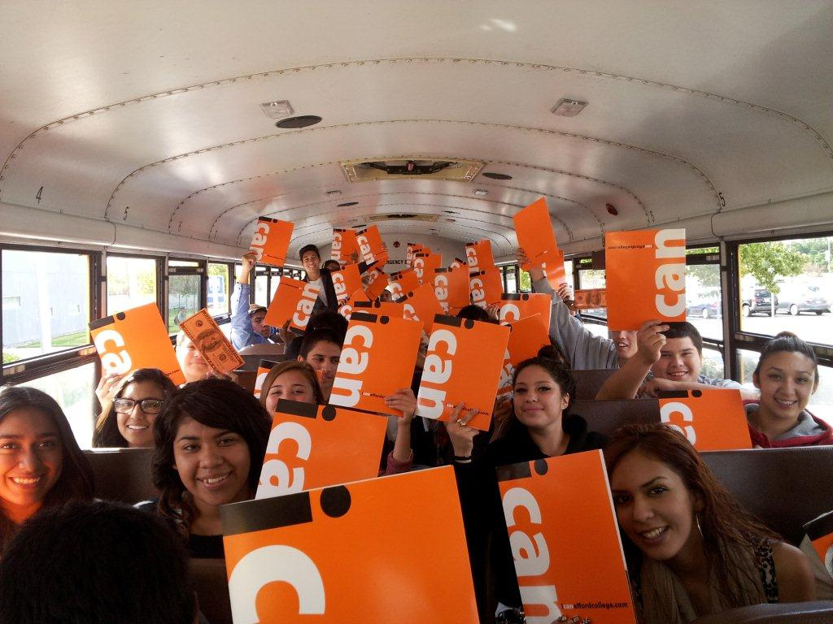
Collateral
Free
Informational vs. promotional
Set criteria (audience, quantities, etc.)
Be creative!
Irvine Community College

Slide 18
Events
Workshops
Presentations
Trainings
Community events
Cultural events
Media opportunities

Slide 19
Social Media
Share messages
“Follow”/”Like” pages
Increase reach
Networking
Cost effective
Quick
Must be maintained

Slide 20
PSA’s
Share information with local stations
Offer to promote partner’s brand
Invite stations to your events
Los Angeles Pierce College

Slide 21
Web content sharing
Links on partner sites
Provide web banners
Promote partner events

Slide 22
Campaign Results in 2014-15
500,000 unique visitors to website
137.2 million impressions from online advertising
156.6 million impressions from radio advertising
18,500 current and potential students connected with their local community college financial aid office through website and toll-free phone line
890 college financial aid workshops promoted
140,000 current and potential students reached through booths at community events and on high school campuses
240,000 collateral pieces provided to high schools, colleges and community-based organizations statewide

Slide 23
Connect with us!
Campaign Website
icanaffordcollege.com
Social Media
http://twitter.com/icanafrdcollege
www.facebook.com/icanaffordcollege
http://instagram.com/icanaffordcollege
www.youtube.com/user/ICANAFRDCOLLEGE

Slide 24
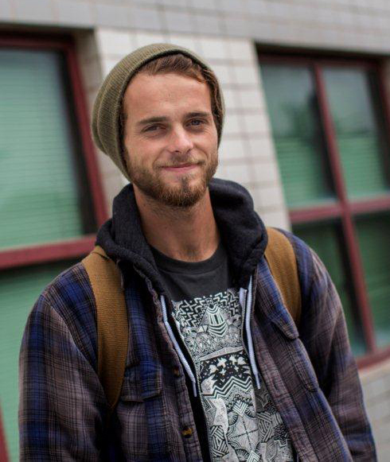
Campaign Contacts
Paige Marlatt Dorr
Director of Communications
California Community Colleges
Chancellor’s Office
PDorr@cccco.edu
(916) 327-5356 office
(916) 601-8005 mobile
Amanda J. Davis
Program Manager
“I Can Afford College” Campaign
amandajdavis10@gmail.com
(916) 320-1469 mobile
City College of San Francisco

Slide 25
Thank you for coming!
Questions?

