Slide 1

Institutional Effectiveness Partnership Initiative (IEPI) Partnership Resource Teams (PRTs) and Accreditation
Christy Karau, Sierra College, Accreditation Committee
Andrew LaManque, Associate Vice-President of Instruction, Foothill College
Ginni May, ASCCC Area A Representative, Accreditation Committee Chair
Gohar Momjian, Vice-President, ACCJC
Theresa Tena, CCCCO Vice-Chancellor of Institutional Effectiveness
February 24, 2018, 10:15 am-11:30 am, Garden Grove, CA

Slide 2
Overview
California Community Colleges: Vision for Success
Institutional Effectiveness Partnership Initiative (IEPI)
Partnership Resource Teams (PRTs)
ASK: Applied Solution Kit
PRTs and Accreditation Visiting Teams
Accrediting Commission for Community and Junior College (ACCJC)
Academic Senate for California Community Colleges (ASCCC)
Collaborative Efforts: Past, Current, Future

Slide 3

Goal 1:
CA Community Chancellor’s
Office: Vision for Success
Increase by at least 20 percent the number of CCC students annually who acquire associates degrees, credentials, certificates, or specific skill sets that prepare them for an in-demand job.
Goal 2:
Increase by 35 percent the number of CCC students system-wide transferring annually to a CSU or UC, necessary to meet the state’s needs for workers with baccalaureate degrees.
Goal 3:
Decrease the average number of units accumulated by CCC students earning associates degrees from approximately 87 to 79 total units—the average among the top 5th of colleges showing the strongest performance on this measure.
Notes:
COMPLETION
TRANSFER
STUDENT TIME TO DEGREE
WORKFORCE
ELIMINATE THE ACHIEVEMENT GAP / DISPROPORTIONATE IMPACT

Slide 4
Goal 4:
CA Community Chancellor’s
Office: Vision for Success
Increase the percentage of exiting CTE students who report being employed in their field of study, from the statewide average of 60% to 69%--the average among the top 5th of colleges showing the strongest performance on this measure.
Goal 5:
Reduce equity gaps by 40% across all of the previous measures through faster improvements among traditionally underrepresented students, closing the gap within 10 years.
Goal 6:
Reduce regional achievement gaps across the previous measures through faster improvements among colleges located in regions with the lowest educational attainment of adults, with the goal of closing the gap within 10 years.
Notes:
COMPLETION
TRANSFER
STUDENT TIME TO DEGREE
WORKFORCE
ELIMINATE THE ACHIEVEMENT GAP / DISPROPORTIONATE IMPACT

Slide 5
  Institutional Effectiveness Partnership Initiative(IEPI)
  Initiative funded by the Legislature
  Partnership
    CCC Chancellor’s Office
    College of the Canyons, Foothill College & Chabot-Las Positas CCD
    State Academic Senate
    Success Center for California Community Colleges
    Workgroups with representatives from 22 statewide organizations
Notes:
Briefly describe ASKs and how they came about…
Top requested items from Colleges seeking PRTs
“Many California community colleges are seeking guidance on how to implement new approaches designed to increase institutional effectiveness. To support these efforts, the California Community Colleges Chancellor’s Office (CCCCO), the Institutional Effectiveness Partnership Initiative and the Research and Planning Group for California Community Colleges (RP Group) are teaming up to create a series of Applied Solution Kits (ASKs) on key approaches. Current topics include integrated planning, data disaggregation, and strategic enrollment management, with new ASKs to be added as additional topic areas are developed.
Each individual ASK offers a standalone compilation of concrete resources, tools, and effective practices—including case studies and vetted examples currently used on campuses—for pursuing that approach on campus and weaving it into your college operations. At the same time, we have designed these ASKs as a coherent and interdependent set that we recommend implementing together to optimize their effectiveness and maximize their impact on your college’s culture and student success. To promote this integration, we have linked each ASK to the others so that as you work with one kit, you are prompted to use tools and resources from its companion kits.”

Slide 6
  Institutional Effectiveness Partnership Initiative (IEPI)
  IEPI 2.0
Notes:
Briefly describe ASKs and how they came about…
Top requested items from Colleges seeking PRTs
“Many California community colleges are seeking guidance on how to implement new approaches designed to increase institutional effectiveness. To support these efforts, the California Community Colleges Chancellor’s Office (CCCCO), the Institutional Effectiveness Partnership Initiative and the Research and Planning Group for California Community Colleges (RP Group) are teaming up to create a series of Applied Solution Kits (ASKs) on key approaches. Current topics include integrated planning, data disaggregation, and strategic enrollment management, with new ASKs to be added as additional topic areas are developed.
Each individual ASK offers a standalone compilation of concrete resources, tools, and effective practices—including case studies and vetted examples currently used on campuses—for pursuing that approach on campus and weaving it into your college operations. At the same time, we have designed these ASKs as a coherent and interdependent set that we recommend implementing together to optimize their effectiveness and maximize their impact on your college’s culture and student success. To promote this integration, we have linked each ASK to the others so that as you work with one kit, you are prompted to use tools and resources from its companion kits.”

Slide 7
IEPI Partnership Resource Teams (PRT)
A Technical Assistance Team that is assigned to institutions that expresses interest in receiving assistance to improve institutional effectiveness.
The team visits the institution at least three times, for initial clarification of issues, development of strategies and timelines, and follow up.
Grants of up to $200,000 in seed money are available to institutions that receive team visits, to accelerate implementation of improvement plans

Slide 8
IEPI Partnership Resource Teams (PRT)
Supported by a pool of more than 400 subject matter experts from within CCC system to populate PRTs.
Receive consistent training:
  Trained in the “IEPI Way” and in Appreciative Inquiry.
  Utilize Applied Solution Kit (ASK) materials on college visits.
  ASK materials provide models to support IE improvement and institutional quality which are a foundation for Accreditation.

Slide 9
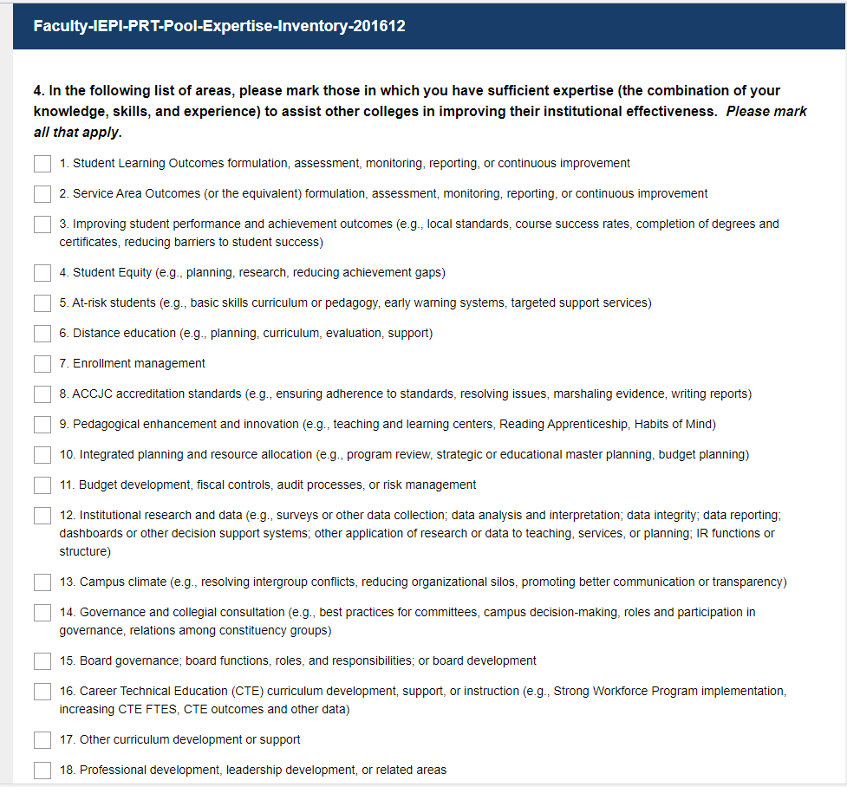
IEPI Partnership Resource Teams (PRT)
Colleagues Helping Colleagues
Volunteer faculty and non-faculty interested in serving on a team participate in an online survey:
http://iepi.cccco.edu/prt
The survey asks faculty to identify areas of expertise.
Volunteers are then matched to the areas of focus identified by the client institution.

Slide 10
  IEPI Partnership Resource Teams (PRT)
PRT part 1:
https://www.youtube.com/watch?v=rpJTyHSBfEw
PRT part 2:
https://www.youtube.com/watch?v=MDYDA4uNy_Y

Slide 11
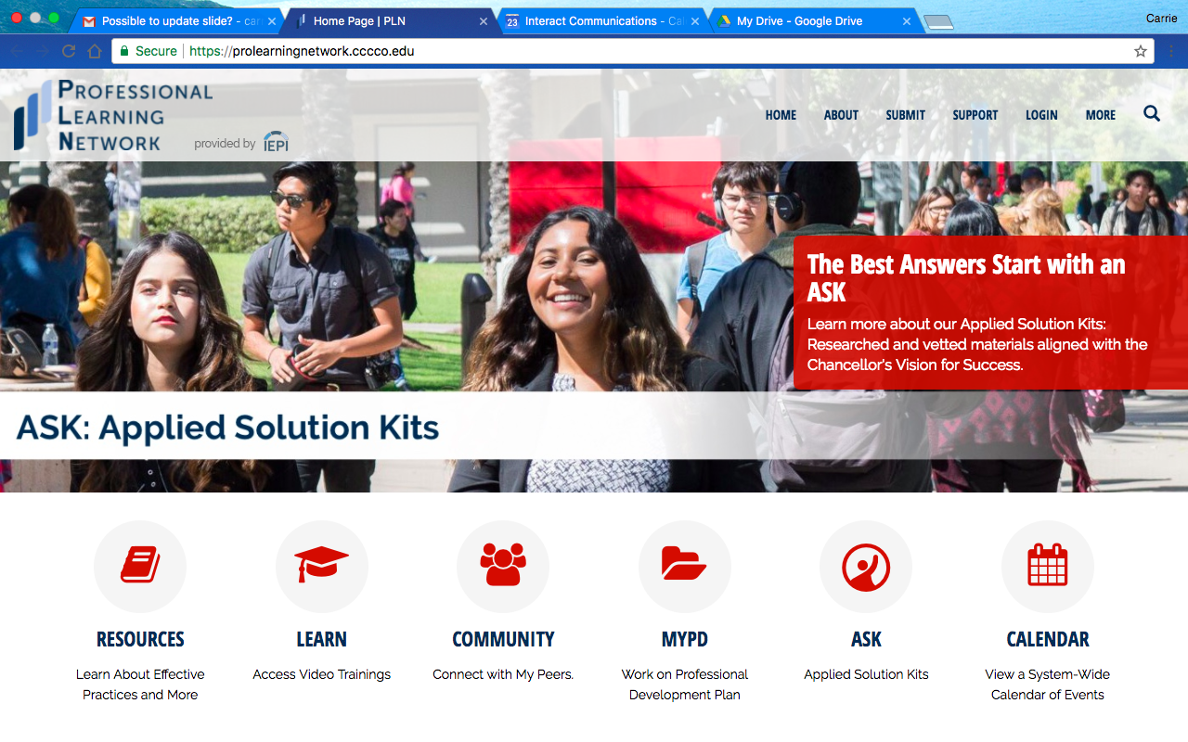

IEPI / Professional Learning Network
  ASK: Applied Solution Kit
RESOURCES
Promising Practices
Emerging Practices
Lynda
Skillsoft
Link to ASK
https://prolearningnetwork.cccco.edu/ask
Notes:
Theresa

Slide 12
ASK: Applied Solution Kit
Developed by IEPI in collaboration with the partners
The ASK is housed on the PLN
ASKs are designed to improve institutional effectiveness at colleges and/or districts and positively impact student achievement
Vetted resources to help develop integrated solutions to multi-disciplinary institution-wide challenges
    Currently Available on the PLN
      Integrated Planning
      Data Disaggregation
    ASKs in Development
      Guided Pathways
      Change Leadership
      Strategic Enrollment Management
      Noncredit

Slide 13
PRTs and Accreditation Visiting Teams
PRTs: Voluntary – Colleges, Districts must request a team
Accreditation Visiting Teams: Voluntary – if colleges want their institutions accredited…
  Federal Financial Aid
  Transfer units to other accredited institutions
  Certificates and Degrees recognized by employers

Slide 14
PRTs and Accreditation Visiting Teams
PRTs
Accreditation Teams
Peer to Peer review to assist institutions in improving institutional effectiveness and signaling quality
Review performance based on Standards
Peer to Peer review to assist institutions in improving institutional effectiveness
Provide advice based best or effective practices
Provide feedback on institutional plans for addressing identified areas of focus
Provide feedback on long term plans included in QFE

Slide 15
ACCJC New Directions, New Philosophy
Accrediting Commission for Community and Junior Colleges (ACCJC)
Mission: The Accrediting Commission for Community and Junior Colleges works with its member institutions to advance educational quality and student learning and achievement. This collaboration fosters institutional excellence and continuous improvement through innovation, self-analysis, peer review, and application of standards.
ACCJC Core Values: Integrity; Quality Assurance; Institutional Improvement; Peer Review; Student Learning and Achievement; Collegiality
Strategic Plan & Goals

Slide 16
Strategic Plan – Continuing Work & Great Strides
Accrediting Commission for Community and Junior Colleges (ACCJC)
  Educational Programming - Redesigned training model with peers from field; New Peer Reviewer Training; Advanced ISER Training; First-ever ACCJC annual conference with sold-out participation
  Communications - New staffing and VP model to support colleges, redesigned website, partnering with organizations
  Strategic Planning and Evaluation – implementation and monitoring of progress; using feedback to make changes for improvement

Slide 17
Strategic Plan – New Directions
Accrediting Commission for Community and Junior Colleges (ACCJC)
Align accreditation processes and structures to support the dual purposes of institutional quality assurance and improvement
  Outcome 1: Support member institutions’ efforts to increase student achievement and address low performance as identified by the US Education Department
  Outcome 2: Create and implement strategies to support institutions assessed to be in financial risk
  Outcome 3: Develop a new taxonomy of standards to enable a more holistic institutional review

Slide 18
Academic Senate for California Community Colleges (ASCCC)
Title 5 §53206 – Recognized by the Board of Governors as the representative body of the college academic senates
Partnership with IEPI
  Steering Committee
  Advisory Committee
  Appoints faculty to serve on all committees, workgroups, PRTs

Slide 19
Collaborative Efforts: Past, Current, Future
ACCJC Training now includes peers from field
IEPI and ACCJC
ASCCC and ACCJC
ASCCC and IEPI

Slide 20
Transformational Strategies
Central
Workshops for self-assessment and planning
Institutes
Tool development
Collaborative platform
Facilitation
Local
Identify leaders at all levels
Use student voice
Strategize funding
Develop support
Engage resistance
Regional
Develop a community of practice
Coordinate with local segments
Share experiences and successes
Collaborate on planning
Grow local capacity

Slide 21
Questions?
How do we leverage our strengths to support our colleges?
What challenges do we still face?
What are new opportunities?
Practical steps to take and meaningfully shape partnerships for our common cause – student success
More…?
THANK YOU!

Slide 22
RESOURCES
ASCCC: https://asccc.org
IEPI: http://iepi.cccco.edu
ACCJC: https://accjc.org

