Slide 1
Imagining the Future
Dolores Davison, ASCCC Secretary
Jarek Janio, ASCCC Accreditation Committee
Lisa Marchand, ASCCC Accreditation Committee
Catherine Webb, Monterey Peninsula College

Slide 2
SLOs Drive Improvement
A look at the present
Why SLOs?
What our students take away and what their employers expect: a never-ending dialogue
SLO assessment versus grading
SLOs and course improvement, leading to program improvement, leading to institutional improvement
Closing of the assessment loop redefined

Slide 3
Course/Activity Design
Improvements
Implementation
Research
Assessment
Analysis

Slide 4
Program Design
Improvements
Implementation
Research
Assessment
Analysis

Slide 5
Program

Slide 6
The
Unit

Slide 7
The College

Slide 9
Today’s SLO-Based Integrated Planning Model

Slide 10
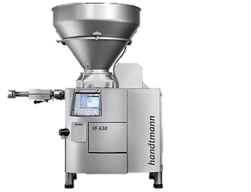
The Unit Plan & Funding Requests
DIVISION or UNIT
PLO
assessments
PLO
assessments
PLO
assessments
Program Learning Outcomes
Program Learning Outcomes
Program Learning Outcomes
SLO
assessments
SLO
assessments
SLO
assessments
Courses in Program A
Courses in
Program B
Courses in
Program C
SLOS
SLOS
SLOS
STUDENTS & THEIR LEARNING

Slide 11
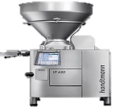
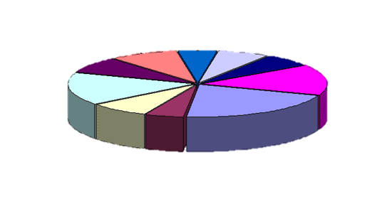
THE BUDGET

Slide 12
Suppose Our Colleges Were Organized Differently…
Students
Support
Learning
Cross-Disciplinary Team of Faculty, Student Services, Tutors, IT specialists, Support Staff, Administrator

Slide 13
SLO Assessments
Relevant Support & Learning Environment
Evidence Based Instructional Design

Slide 14
SLO Assessment and Integrated Planning The Academy Model…
Curriculum
Discipline specific → a cluster of related majors
Comprehensive range of courses meeting transfer and grad. requirements
Accelerated basic skills embedded in required courses
Faculty & Staff
A collaborative cross-functional team--a microcosm of college personnel
Teachers and counselors
Tutors
Support staff
A manager
No Departments or Planning Silos (teachers, counselors & staff plan together)
No “turf” issues! (e.g. the current model causes departments within divisions to vie for FTE allotted to a division)

Slide 15
Student Learning Outcomes
The Academy of
Meta-Major Alpha
Administrative & Institutional Infrastructure

Slide 16
Administrative & Institutional Infrastructure

Slide 17
Appreciate your mistakes for what they are: precious life lessons that can only be learned the hard way.
Unless it’s a fatal mistake, which, at least, others can learn from.
(Al Franken)

Slide 18
What are we learning?
Engagement is higher when assessment tasks are perceived to be:
Meaningful for the individual
Beneficial for the department and/or institution
Supportive rather than punitive
Engagement is affected by confidence in ability to carry out the task
Professional development and training
Interface, ease of use

Slide 19
How is this helping us improve?
Reinforcing individual and institutional meaning
Building on parts of the process that are already considered to be meaningful
Emphasizing individual ownership
Strengthening explicit connections to other institutional effectiveness processes
Supportive processes that build confidence in task ability
Colleagues helping colleagues
Professional development and ongoing support
Improvements to the assessment system/process
Professional development and ongoing support

Slide 20
How can we help others learn from our experience?
Resources:
Further reading on moving SLOs from compliance to improvement: https://goo.gl/6uhuYo
MPC’s SLO Assessment Toolkit: https://goo.gl/PQMXo8

Slide 21
Thank You!
Dolores Davison (davisondolores@foothill.edu)
Jarek Janio (Janio_Jarek@sac.edu )
Lisa Marchand (marchal@CRC.losrios.edu )
Catherine Webb (cwebb@mpc.edu)

