Slide 1
Evaluating Implicit Bias in Organizational Structures
Mayra Cruz, ASCCC Area B Representative
Dr. Luke Lara, Mira Costa College
Eugene Whitlock, Esq. ACHRO
Notes:
Session Description
Numerous barriers to improved diversity and opportunity are rooted in Structural Inequalities and Implicit Bias. Every system is created to resist change and reflect the cultural biases of the time. Many of our college programs, processes and practices have embedded bias; bias that is often implicit and unintentional yet still equally harmful. How can we surface systemic biases and address them for today’s standards and tomorrow’s students? This session will provide an opportunity to engage in authentic dialogue about the difficult conversations required to surface implicit bias and tools for assessment

Slide 2
Outcomes of the Session
By the end of this session, participants will:
Engage in authentic dialogue about the difficult conversations required to surface implicit bias and tools for assessing organizational structures.
Clarify terms, concepts and processes of implicit and systemic bias.
Apply a tool to assess systemic bias.
Plan one action to do at your campus.

Slide 3
Community Agreements
Be true to yourself.
Commit to learning from each other.
Acknowledge each other’s experiences.
Trust that others are doing the best they can.
Challenge the idea and not the person.
Speak your discomfort.
Step Up, Step Back.
Page 2 of the Program: Adapted from the University of Michigan Program of Intergroup Relations, IGR

Slide 4
Definitions and the Neuroscience of Implicit Bias
Click on picture to play YouTube video

Slide 5
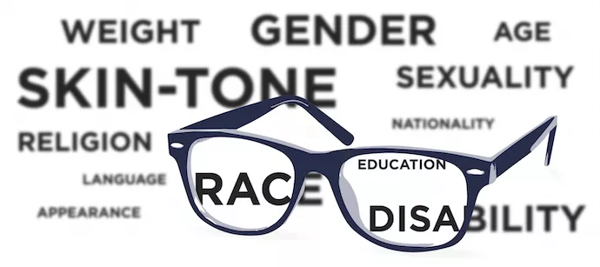
What is Unconscious Bias?
Unconscious biases are stereotypes about certain groups of people that individuals form outside their own conscious awareness. Everyone holds unconscious beliefs about various social and identity groups, and these biases stem from one's tendency to organize social worlds by categorizing. Implicit biases are not accessible through introspection.

Slide 6
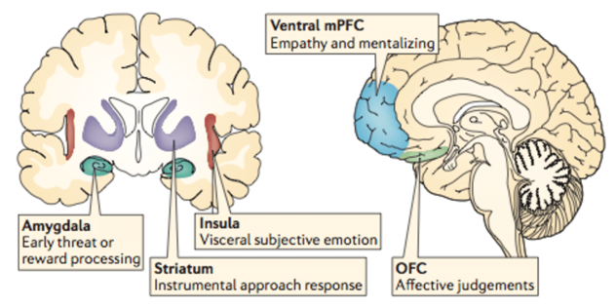
Are brains our biased
Anterior Cingulate Cortex
Link between Pre Frontal Cortex and Limbic System

Slide 7
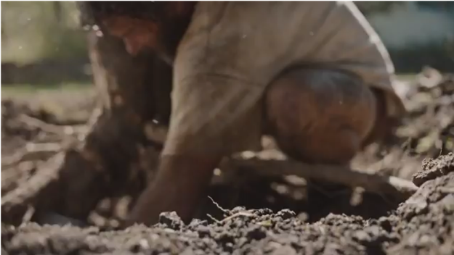
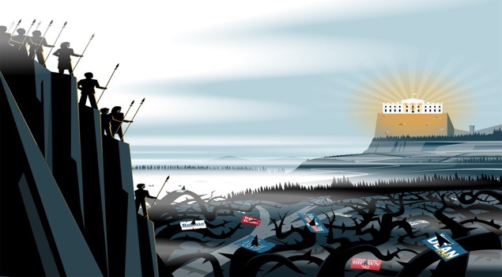
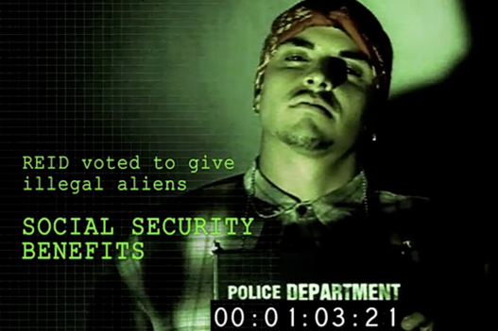
Influences on the Unconscious Mind
Hornbach’s reply: Our ad is not racist. View the ad as a discourse on the increasing urbanization and decreasing quality of life in cities. The smell of the spring only available in vending machines. For everyone. Not only asian people.
Click on picture for Youtube video

Slide 8
Bias in Organizational Structures
“Unconscious bias can affect workplaces and organizations. It can introduce unintentional discrimination and result in poor decision-making. Unconscious Bias can be a huge setback in creating a truly diverse and inclusive workplace. It has been shown that such biases can have an impact on recruitment, mentoring and promotions. This can hamper equal opportunities for women in terms of selection and progression to a high-level management and leadership role.”
Lack of training for “staff in recognizing and acknowledging implicit and ingrained cultural and social conditioning that can affect their decision-making and attitudes towards others”
https://www.forbes.com/sites/pragyaagarwaleurope/2018/08/26/here-is-why-organisations-need-to-be-conscious-of-unconscious-bias/#2fdc7ffe726b

Slide 9
Tools for Assessing Bias
1) Identify the structures to assess
2) Label and name the types of biases that can occur. Discussing these biases and naming them can make them more explicit and transparent and transform organizational culture
3) Re-organize structures and systems to create a truly diverse workplace
Rigorous training of the staff
A regular diversity audit
Anonymous resume audits, surveys of current and previous employees, and focus groups are helpful, where the discussion is framed around fairness and inclusivity
Allowing anonymous complaints process
Peer mentoring
https://www.forbes.com/sites/pragyaagarwaleurope/2018/08/26/here-is-why-organisations-need-to-be-conscious-of-unconscious-bias/#2fdc7ffe726b

Slide 10
Systemic Implicit Bias
Six Dimensions of Institutional Equity
Adopted from University of Southern California’s Center for Urban Education (CUE) and The Community College Equity Assessment Lab (CCEAL)

Slide 11
Six Dimensions of Institutional Equity
1. Policies – principles of action that are ratified by an institution to govern programs, matriculation, course delivery, and resource allocation.
2. Attitudes and Dispositions – the way a person thinks and feels about a particular situation or a group of people.

Slide 12
Six Dimensions of Institutional Equity
3. Politics and Power Dynamics – relationships and interactions between units and actors
4. Structure – the ways in which the institution is designed and arranged.

Slide 13
Six Dimensions of Institutional Equity
5. Institutional Culture – the collective norms, rituals, values, and embedded patterns of behavior that create the essence of an institution.
6. Data Practices – practices that shape how data are collected, analyzed, disseminated and used to inform institutional decision-making.

Slide 14
Institutional Issues
Recruitment, Hiring & Retention of __________
Culturally relevant curriculum for ____________
(Disproportionately Impacted student group) outcomes
Promoting ___________ into Administration
Safe spaces for __________
Others?
Notes:
Examples for Blank Spaces:
*Faculty of Color
*LGBTQ

Slide 15
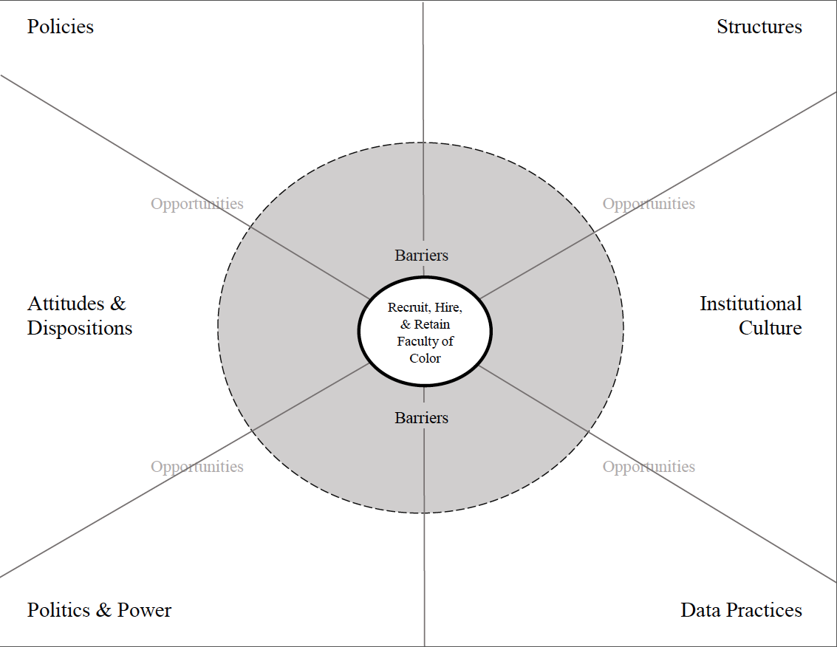

Slide 16
Breakout Exercise Instructions
Select one institutional issue
List barriers
Explore turning barriers into opportunities
List other opportunities
Draw relationships/connections across domains

Slide 17
Work with AS and Union to ensure equity in tenure
Work with FOC to learn how to transform physical spaces
Robust EEO Training & Practices
FOC experience different expectations in Tenure Process
Color-evasive policy and laws
No cultural centers, no visible art – sterile
Reduce Taboo in Talking about Race
Resist discussing race and racism
Admin & Faculty do not believe it is important
Pay attention to having people of color on committees
Take Steps to Disrupt Culture
Faculty and Admin Leadership dominated by white people
Hiring demographic data and trends is not shared prominently
Invite Faculty of Color to be on a Planning Body
Have data available to EEO reps throughout process

Slide 18
Action Steps to take Back to Your Campus
What can you take back to your campus?

Slide 19
Reflections

Slide 20
For more information contact:
Mayra Cruz
cruzmayra@deanza.edu
Dr. Luke Lara
llara@miracosta.edu
Eugene Whitlock, Esq. ‎
eugene.whitlock@gmail.com

Slide 21
Resources
http://occa17.com/data/documents/Equity-Assessment-Instructions-and-Worksheet-for-COCC.pdf
http://www.racialequitytools.org/plan/informing-the-plan/organizational-assessment-tools-and-resources

