Slide 1



Information is Power
The ABCs of Plenary and ASCCC Resources at Your Disposal
A Brief Guide to First Time Attendees and Delegates
Relations with Local Senates Committee
Sam Foster, ASCCC South Representative
Lara Baxley, Cuesta College
Curtis Martin, Modesto Junior College
Julie Oliver , Cosumnes River College
Fall Plenary 2016
Costa Mesa, CA

Slide 2

Overview of this Session
Make connections with other first time attendees and delegates
Role of the ASCCC and Plenary Session
Resolutions, Voting and Discussion: Who participates in each?
Resources: Local Senates Handbook, website
Define Common Acronyms
ASCCC Awards
Academic Senate Foundation
Find someone to sit with at lunch ☺

Slide 3

Making Connections
Introduce yourself to at least two people around you and tell them why you came to this breakout.

Slide 4
Mission of ASCCC
fosters the effective participation by community college faculty in all statewide and local academic and professional matters;
develops, promotes, and acts upon policies responding to statewide concerns;
and serves as the official voice of the faculty of California Community Colleges in academic and professional matters.
The Academic Senate strengthens and supports the local senates of all California community colleges.

Slide 5
Purpose of Plenary
to be apprised about hot topics,
to receive new training to bolster the effectiveness of their senate,
to select representatives and officers,
and to determine Senate positions and provide the Executive Committee its direction through the resolution and voting processes.
Notes:
The Academic Senate strengthens and supports the local senates of all California community colleges.

Slide 6

I’m a new delegate…what do I do at Plenary?
Attend the Area meetings at plenary
Read session resolutions packets…they are revised daily.
Debate and vote on resolutions - represent your local senate’s positions
Vote in executive committee elections
Part of a team? Spread yourselves around to different breakouts
Network!
  Get to know your Area Representative and the entire Executive Committee…they’re here to help!
And remember – have fun!
Notes:
Slides 6-10 are regarding new delegates. John S. need to let us know if these need any changes, since this is his 20-30 minute section of the breakout.

Slide 7
We Can Provide Some Clarity
Attend the Area meetings at plenary
Read session resolutions packets…they are revised daily.
Debate and vote on resolutions - represent your local senate’s positions
Vote in elections
Part of a team? Spread yourselves around to different breakouts
Network!
  Get to know your Area Representative and the entire Executive Committee…they’re here to help!
And remember – have fun!
Notes:
Slides 6-10 are regarding new delegates. John S. need to let us know if these need any changes, since this is his 20-30 minute section of the breakout.

Slide 8

Saturday is Voting Day - Resolutions
Resolutions are debated and voted…anyone can debate
Arguments are made at the pro and con mics.
  Debate continues until no one is at a mic, or until time for debate expires
  (15 minutes)
Parliamentary mic is for making motions, parliamentary inquiries to the chair, etc.
Votes are voice votes…only delegates vote!
  If voice vote inconclusive, division of the house is done
  If division of the house inconclusive…serpentine vote!
Notes:
Slides 6-10 are regarding new delegates. John S. need to let us know if these need any changes, since this is his 20-30 minute section of the breakout.

Slide 9

Academic Senate Foundation for California Community Colleges
A nonprofit organization whose purpose includes raising funds to support academic and professional matters in regard to professional development and research:
  scholarships for part-time faculty to attend ASCCC events;
  the Professional Development College;
  receptions, contests, dinners at ASCCC events,
  research projects in Academic and Professional Matters (Title 5 §53200).
  Academic Senate Foundation for California Community Colleges website - asfccc.com

Slide 10
AS Foundation Elections
      Beginning this fall:
      Three AS Foundation directors will be elected from eligible faculty
        one for a 1-year term,
        one for a 2-year term,
        one for a 3-year term,
        terms are staggered—after this process is fully phased in, each elected director will have a 3-year term.
        Each year of an elected term will begin January 1 and end December 31.
        Process will be same as spring Academic Senate election – except no speeches will be required.

Slide 11
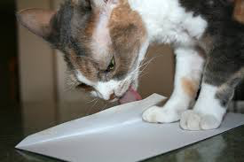
Elections
      How to Vote:
Fill out your ballot - pick, lick and stick!
Sign your ballot and give to the teller…signature must match the delegate book!!!
Notes:
Slides 6-10 are regarding new delegates. John S. need to let us know if these need any changes, since this is his 20-30 minute section of the breakout.
NEED UPDATES FOR THIS SLIDE.

Slide 12

Resources for Local Senates and Delegates
Resources for Delegates
Local Senates Handbook
ASCCC Website
Relations with Local Senates
Committee (that’s us!)
Notes:
Slides 6-10 are regarding new delegates. John S. need to let us know if these need any changes, since this is his 20-30 minute section of the breakout.

Slide 13
Local Senates Handbook
www.asccc.org/sites/default/files/local_senates_handbook2015-web.pdf
Part I – A Brief History
Part II – Roles and Responsibilities of the Senate
Part III – Duties as a Local Senate President
Part IV – Ensuring the Effectiveness of the Local Senate
Part V – Linking Local Senates
Online version includes helpful hyperlinks!

Slide 14

The ASCCC Web Site http://www.asccc.org/
Notes:
Take a few minutes to review the web site. Past resolutions, past papers, Rostrum Articles, links to Title 5, Curriculum, SLO’s, future events, Disciplines List and Minimum Qualifications, request site visit, other???

Slide 15
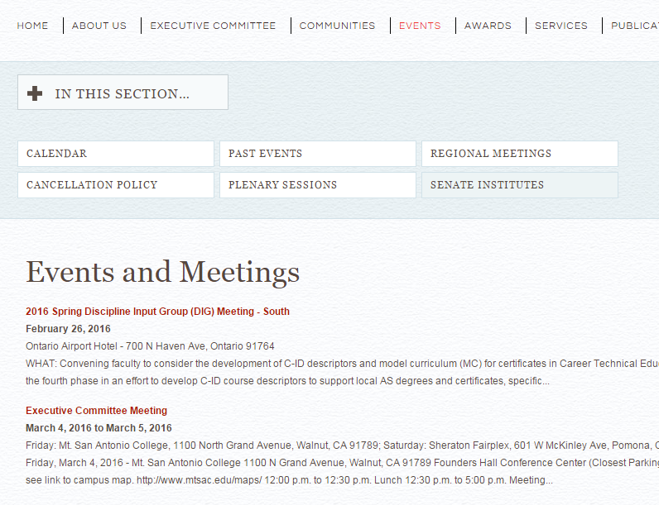
Institutes and Meetings
Plenary Sessions
Curriculum Institute
CTE Institute
Leadership Institute
Academic Academy
Regional Meetings
Area Meetings
and others
See web site for more details

Slide 16
Important Senate Resources for Delegates
About the Academic Senate - http://www.asccc.org/about
“Roles and Responsibilities for Delegates”: http://www.asccc.org/sites/default/files/Senate%20Delegates%20Roles%20%26%20Responsibilities_0.pdf
Resolutions Handbook: http://www.asccc.org/papers/resolution-handbook
Senate resolutions web page (searchable): http://asccc.org/resources/resolutions
Session Resources (Includes election information…click the “Resources’ tab) http://www.asccc.org/events/2015-04-09-070000-2015-04-11-070000/2015-spring-plenary-session-0
ASCCC Bylaws: http://asccc.org/about/bylaws
Notes:
Slides 6-10 are regarding new delegates. John S. need to let us know if these need any changes, since this is his 20-30 minute section of the breakout.

Slide 17







Common Acronyms
http://asccc.org/acronyms
Notes:
Slides 6-10 are regarding new delegates. John S. need to let us know if these need any changes, since this is his 20-30 minute section of the breakout.

Slide 18

ASCCC Awards
Exemplary Program Award: Recognizes
outstanding community college programs.
The Hayward Award: Honors Outstanding
community college faculty who have a track record
of excellence both in teaching and in professional activities and have demonstrated commitment to their students, profession, and college.
Stanback-Stroud Award: Honors faculty who have made special contributions addressing issues involving diversity.
Notes:
Slides 6-10 are regarding new delegates. John S. need to let us know if these need any changes, since this is his 20-30 minute section of the breakout.

Slide 19
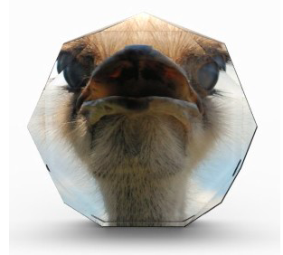

Academic Senate Foundation
Area Competition
The Area that raises the most money
through crowdrise wins the coveted trophy.
You can donate anytime until Saturday
(Last Day of Fall Plenary) at:
https://www.crowdrise.com/FoundationAreaCompetition/
Notes:
Slides 6-10 are regarding new delegates. John S. need to let us know if these need any changes, since this is his 20-30 minute section of the breakout.

Slide 20

Questions?
Thank you,
and have a great plenary session!
Our Contact Information
Sam Foster, SFoster@fullcoll.edu
Lara Baxley, lbaxley@cuesta.edu
Curtis Martin, martinc@mjc.edu
Julie Oliver , oliverj@crc.losrios.edu

