Slide 1
Creating a Path to Success for Incarcerated Students

Slide 2
Why Educate Inmates?

Slide 3
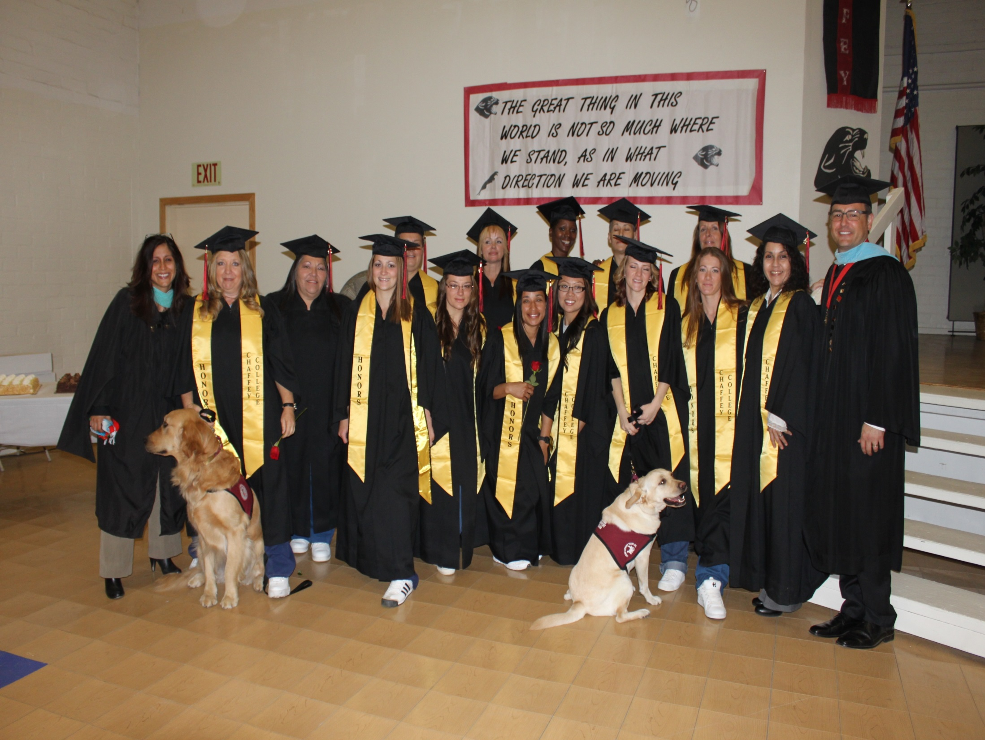

Slide 4
Unique Challenges of Beginning an Inmate Education Program
College support at all levels
Faculty flexibility and interest
Admissions issues
Programmatic options
Technology, space, and custody
Evaluation
Training for staff and faculty
Cultural clashes

Slide 6
Unique Opportunities in Inmate Education
Commitment that develops
Reward of supporting those eager to learn
Revitalized social justice mission
Partnerships with other colleges
Improves processes for traditional students
Partnerships with community
Mutual education

Slide 7
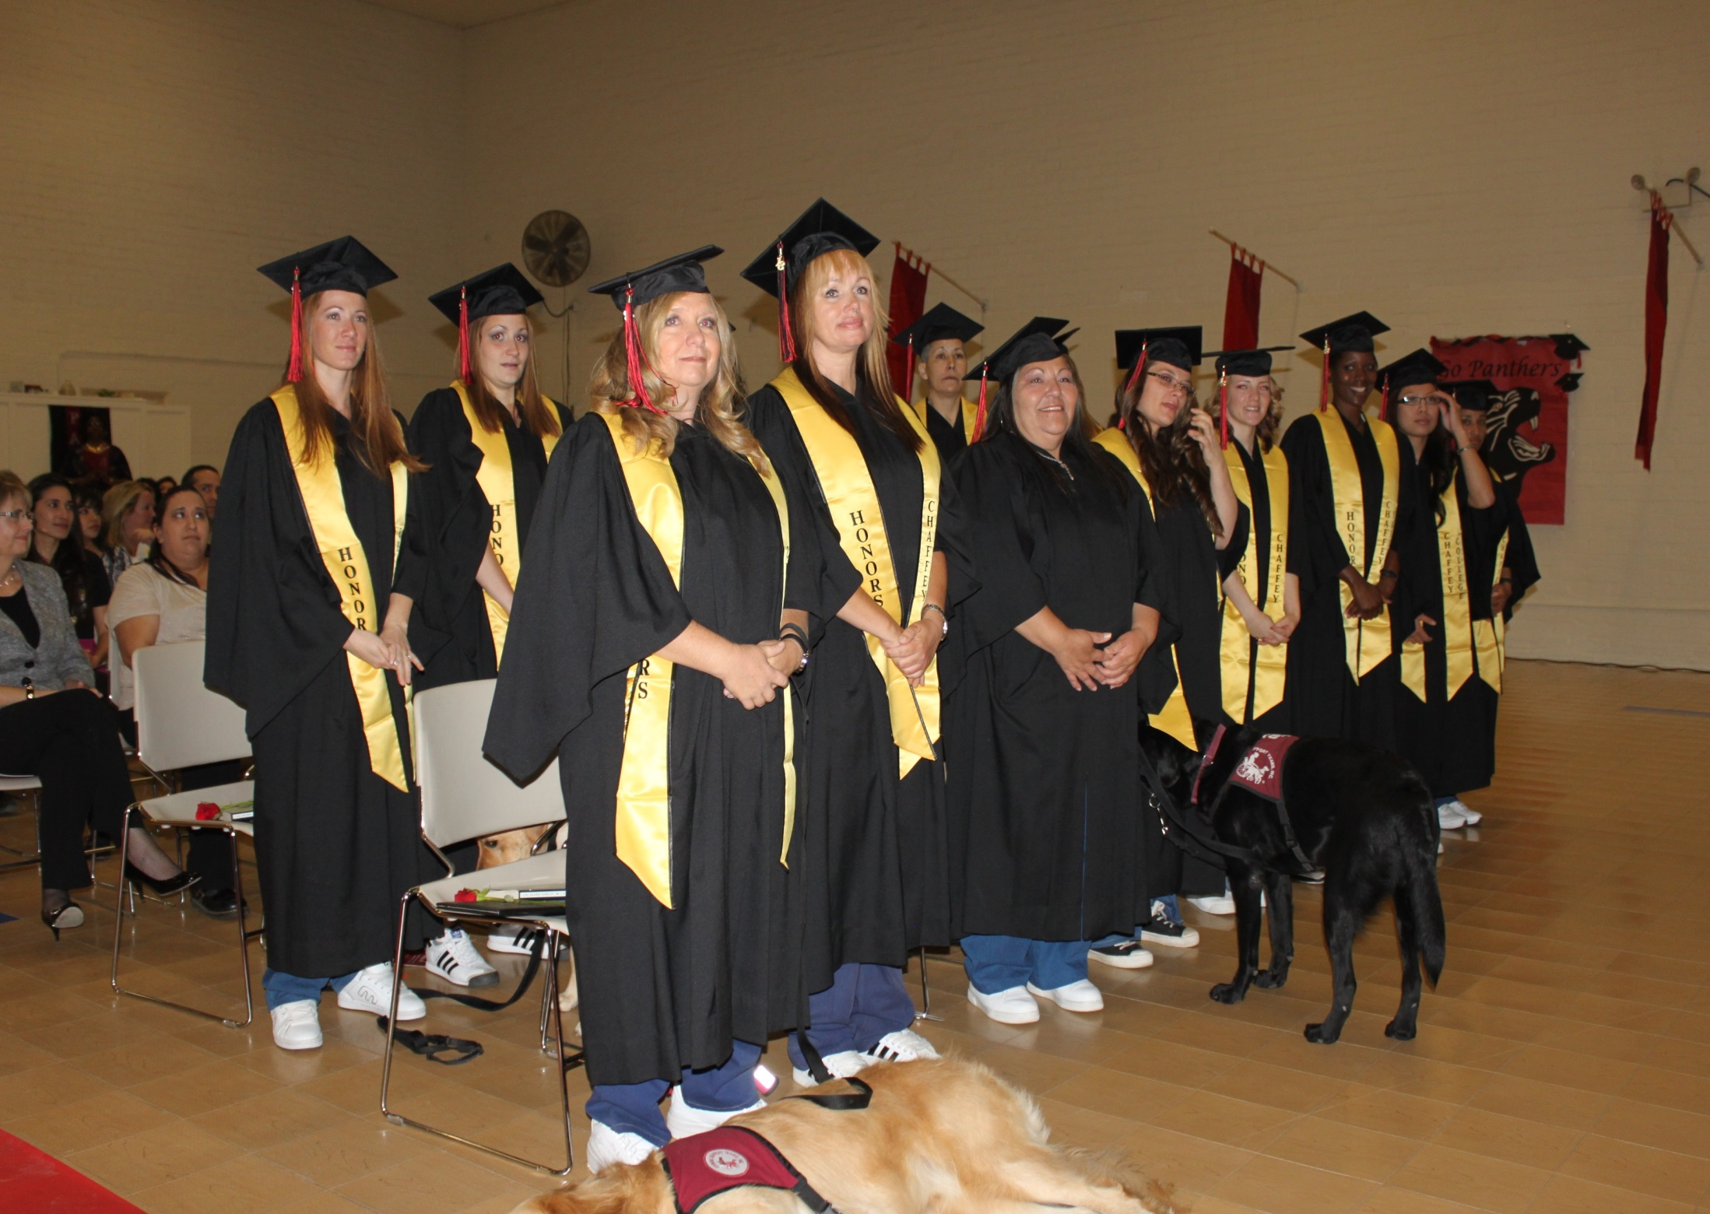

Slide 8
Uniquenesses of an Incarcerated Student Population
Traumatized
Cultural references
Limits to access
Power dynamics
Motivation

Slide 9
How Can You Get Started?
Connect to pilot colleges for dialogue or a tour
Connect to local prisons, jails, or re-entry hubs
Engage the dialogue on campus

Slide 10
Other Opportunities
County Jails
Re-entry Hubs
Reintegration Programs on College Campuses
New Budget Allocations (CTE)

Slide 11
Future Training Opportunities
Regional Workshops
Northern, CA March 2016
Southern, CA April 2016
Summer 2016 Inmate and Re-entry Summit (Southern, CA)

Slide 12
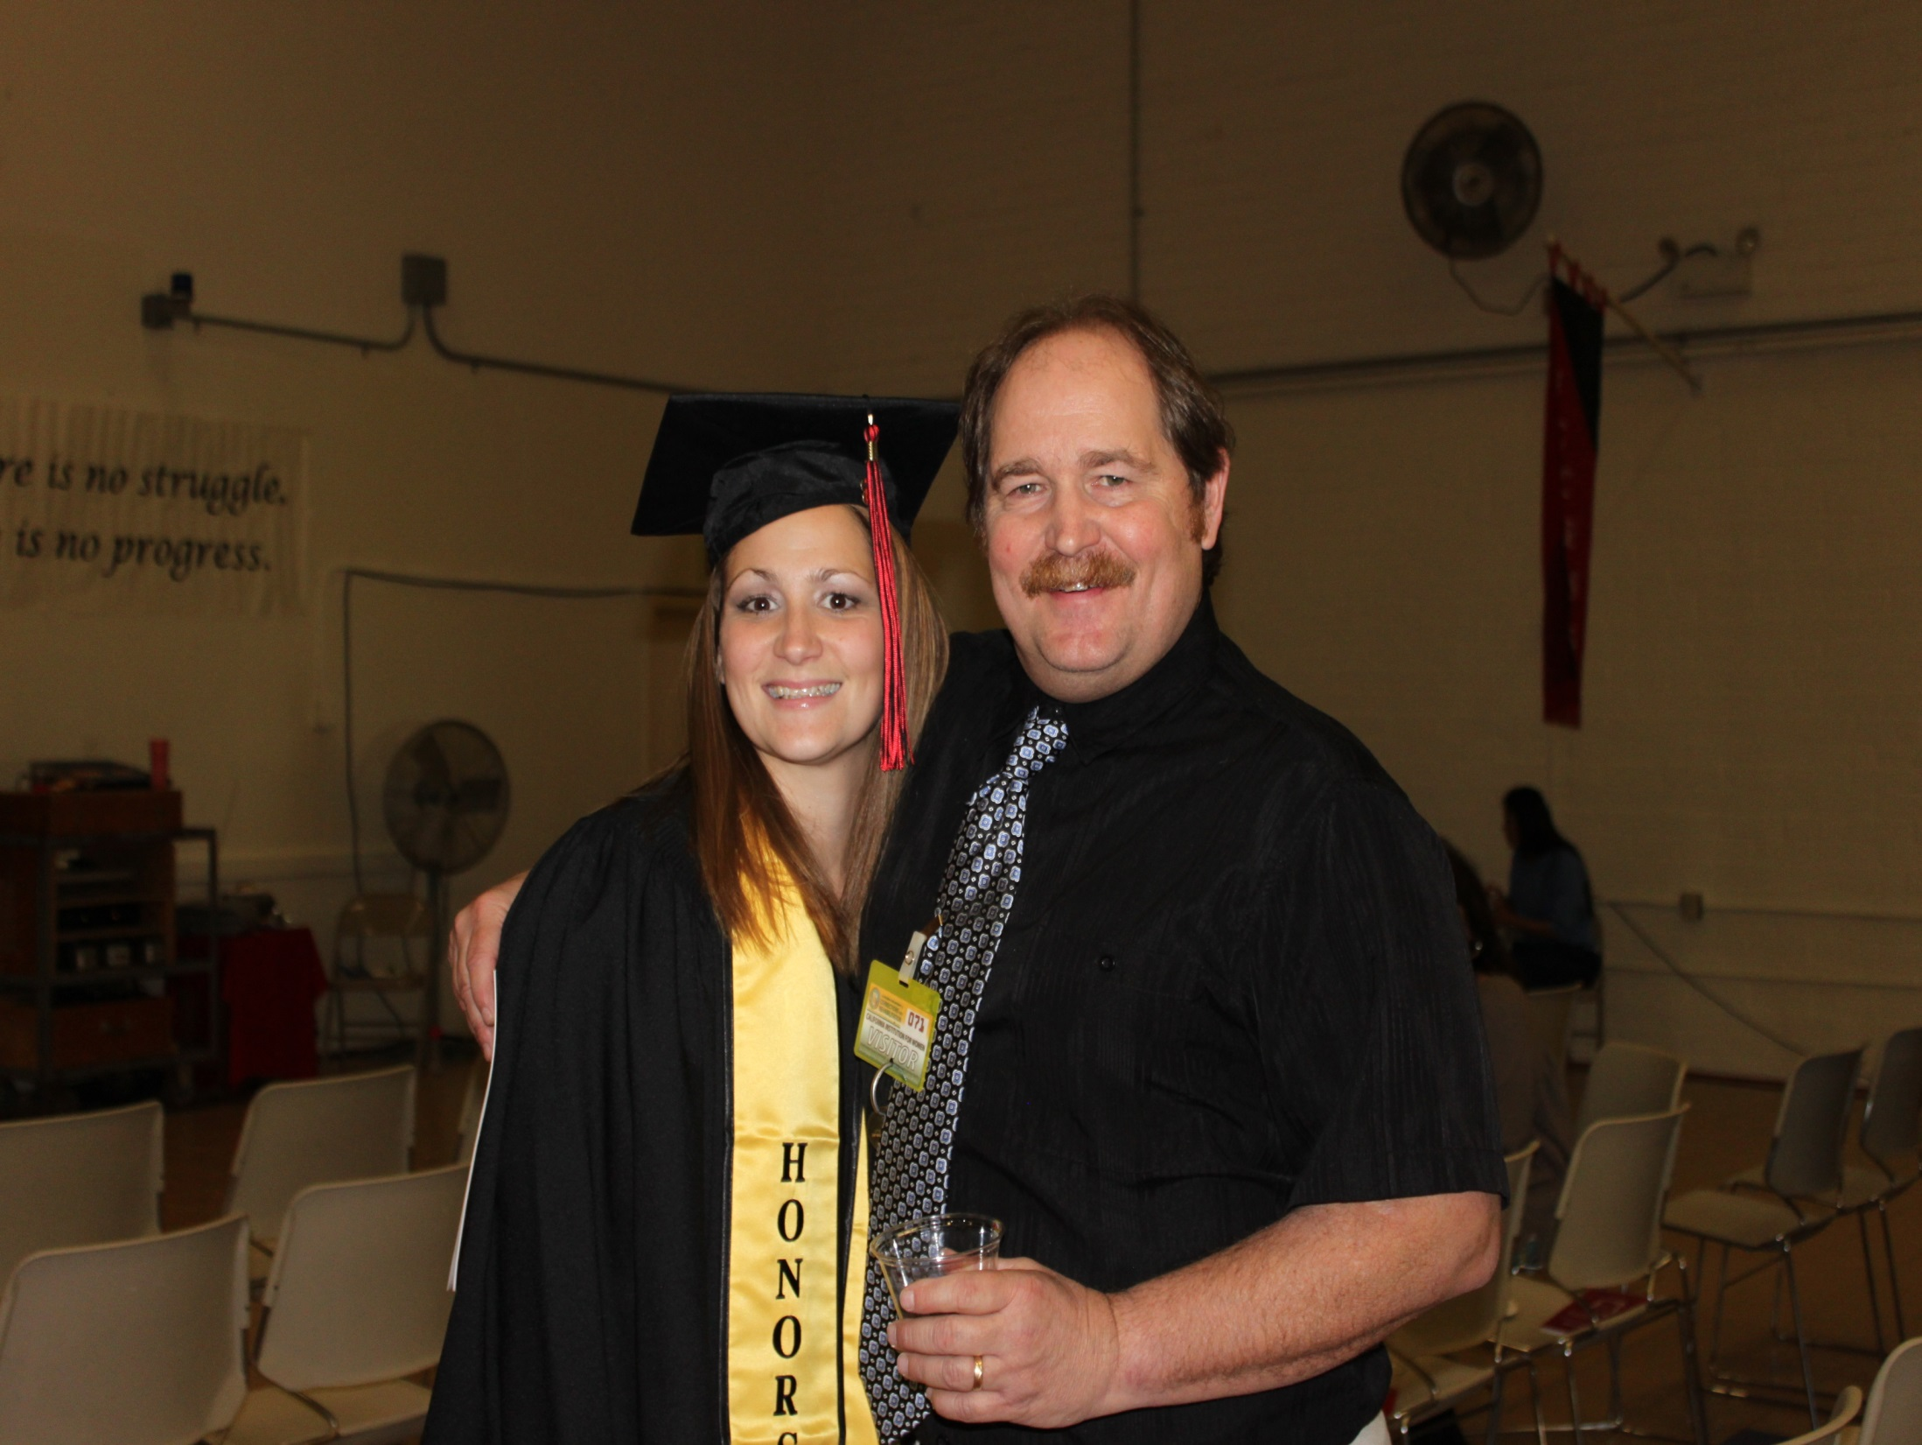

Slide 13
Contact Information
B. J. Snowden
California Community College Chancellors Office
916-327-5910
bjsnowden@cccco.edu
Laura Hope
Chaffey College
909.652.6133
laura.hope@chaffey.edu

