Slide 1
Student Engagement: Working
Holistically with Your Students Using
Starfish Degree Planner
ASCCC Instructional Design and Innovation Institute
Cynthia Rico, Renee Craig-Marius, Robyn Tornay
January 22, 2016

Slide 2
Session Goals
Provide a a general overview of the Initiative
Provide a general overview of the platform capabilities
Hear from one of the Pilot colleges on their progress and approach to implementation of the software
How can your college get involved

Slide 3
Summary
CCCTC went out for RFP on an education planning tool in late 2014
Hobsons acquired Starfish in February 2015
CCCTC and Hobsons signed contracts and are implementing the Starfish Enterprise Success Platform in colleges currently throughout the state
Three products come with the platform: Degree Planner, Early Alert and Connect

Slide 4
Overview
  Starfish Enterprise Success Platform
  The solution is geared to assist students in mapping a multi-year educational plan while balancing their daily lives with the commitments they have outside of the classroom.
  The colleges will be able to identify students who are struggling in their courses and breakdown the communication silos so faculty, staff, and students can interact with one another on a more proactive basis.

Slide 5








8 Pilot Districts (13 Colleges)

Slide 6
Pilot College | Degree Planner | Early Alert | Connect | GoLive
City College of San Francisco | X | X | X | Spring 2016
Los Medanos College | X | X | X | Spring 2016
Contra Costa College | X | X | X | Summer 2016
Diablo Valley College | X | X | X | Summer 2016
Fresno City College | X | X | X | Spring 2016
Reedley College | X | X | X | Spring 2016
Clovis Community College | X | X | X | Spring 2016
El Camino College | X | X | X | Spring (EA)/Summer (DP) 2016
Victor Valley College | X | X | X | Summer 2016
Santa Barbara City College |  | X | X | Summer 2016
Crafton Hills College | X | X | X | Summer 2016
San Bernardino Valley College | X | X | X | Summer 2016
Santa Rosa Junior College | X | X | X | Spring 2016

Slide 7

A Comprehensive
Student Success Solution

Slide 8
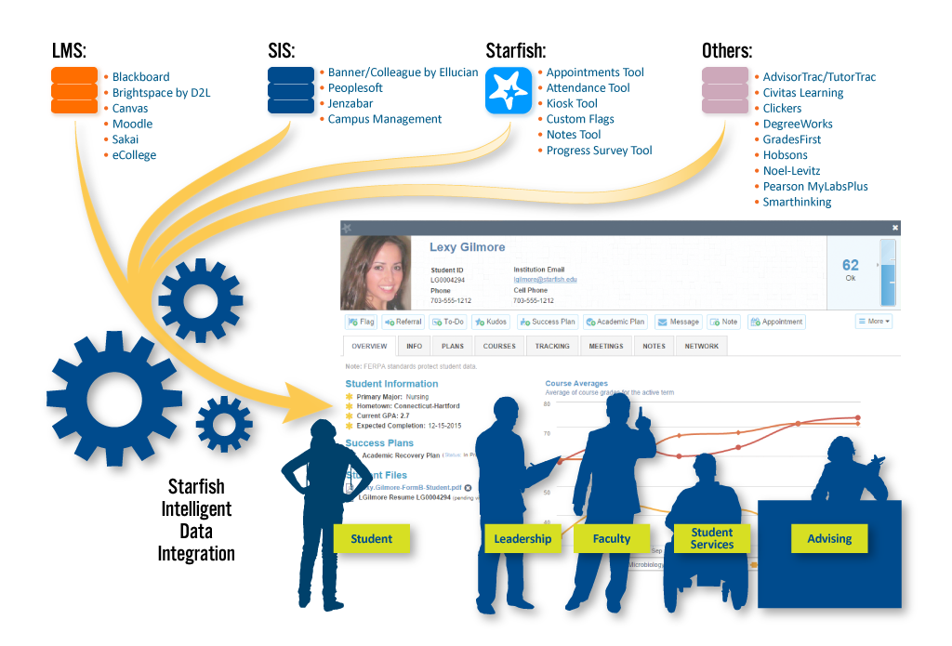
Create a Holistic Picture of Every Student
Data Integration with SIS, LMS, and More
Notes:
Under the hood of the Starfish platform is this data integration that brings everything together – not separated by the systems in which it’s stored, but aggregated in a way that is FOCUSED ON THE STUDENT.

Slide 9
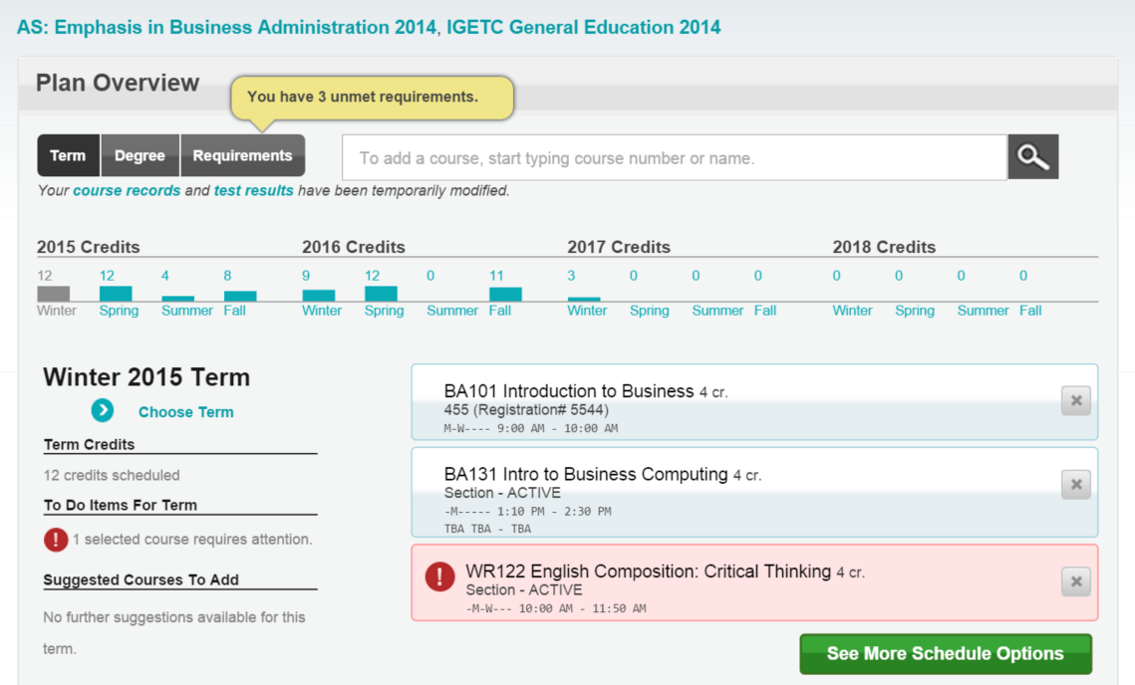
Student View of Degree Plan
Notes:
Here is Regina’s Ed Plan. The screen shows the plan taking entire recipe into effect.
You can see the “Light at the end of the tunnel.” She’ll complete early in 2017.
You can see her course load – gray bar is current semester.
It will show warnings, and choices for student to empower them to make decisions.
She can click on links and make decision w/o asking.
Allows her to be self-directing.

Slide 10
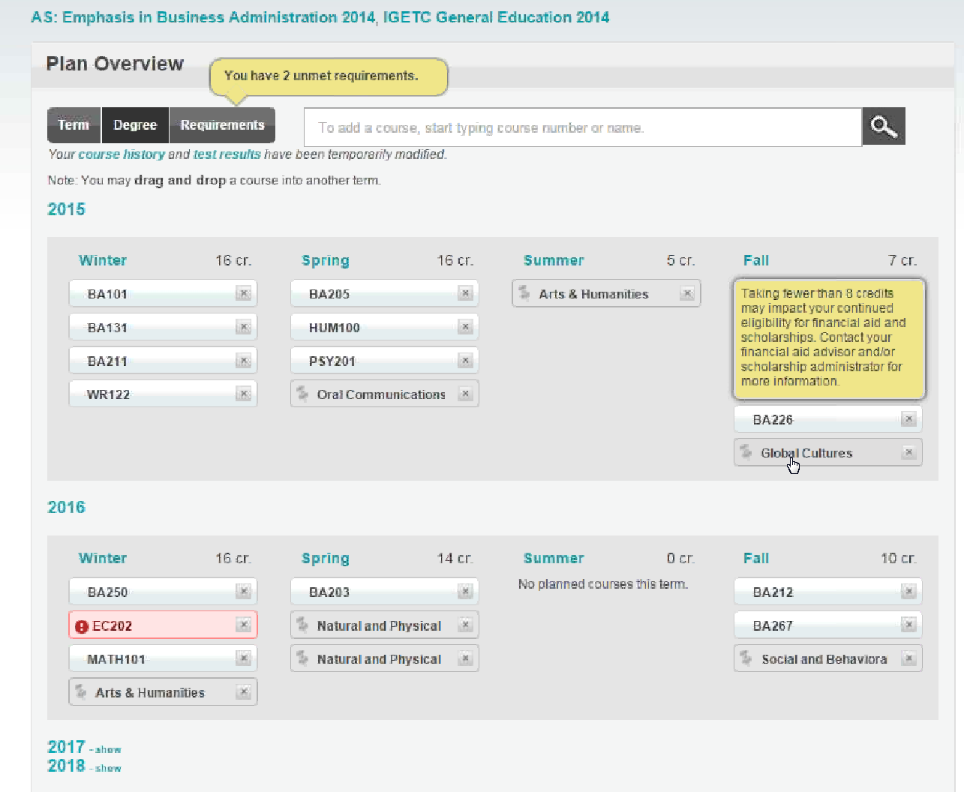
Course Forced Choices & Warning Messages
Warning messages customizable by program
Elective class ‘placeholders’ with forced choices
Visual Indicator that this course needs Regina’s attention
Notes:
She can also see her courses in semester-by semester manner, this is allows full drag & drop & is 508 compliant.
It will show if she’s having to take several pre-reqs in earlier semesters, before she can even get to the one that’s degree granting, etc. Then, she can drag & drop items around and show the consequences of making such a change.
This could then prompt a Starfish flag, which then prompts her to go back to original plan.
Classes can be removed, but a pop-up warns the student that removing them could impede him/her from graduating on time as well as informs him/her of the next term in which the removed class will be offered.
Warning Message e.g’s,: “Course over-enrolled” or “Pre-reqs not met.”
The student can view alternative combinations, of courses.
Courses that have not been scheduled appear in gray and the student has the option to either schedule it or request an override
By clicking ““Make Active” sends the selected plan to Counselor, which is used for demand forecasting and projecting future enrollment.
Only one Active Plan (approved plan) at a time, but everything else is available.

Slide 11
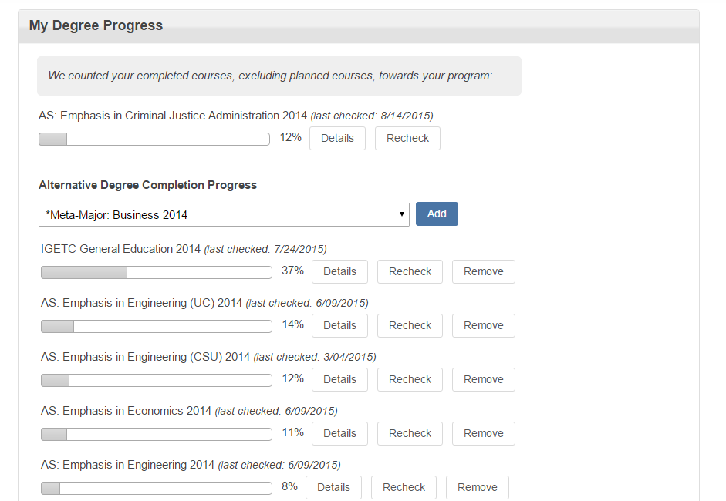
Progress Towards Alternative Degrees
Notes:
This screen automatically shows Regina her progress towards alternative degrees based on her completed courses.

Slide 12
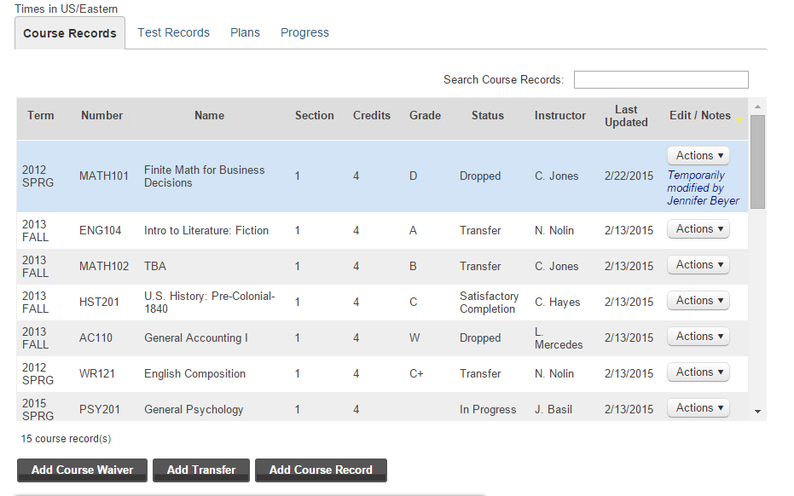
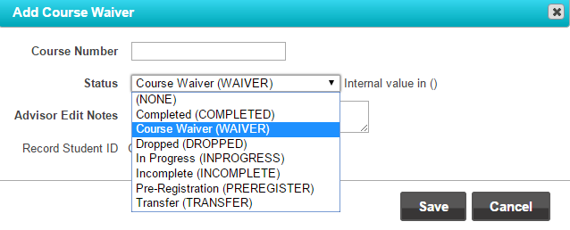
Counselor View – Student Course Work
Notes:
As a counselor I can see Regina’s course work up to this point.
I can add a course waiver, transfer credit, or a course record while meeting with her - and that will immediately change her plan as we are working together.
This allows us to speed through what can otherwise be a barrier to continuing the conversation about her plan.

Slide 13
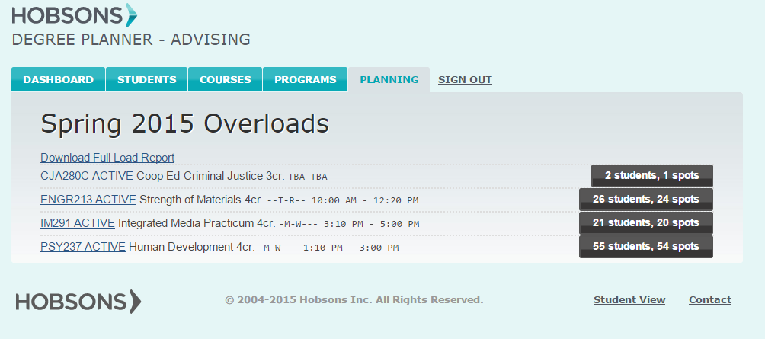
Course Demand Reporting
Notes:
Term by term, reports are available for download to help with course demand forecasting

Slide 14
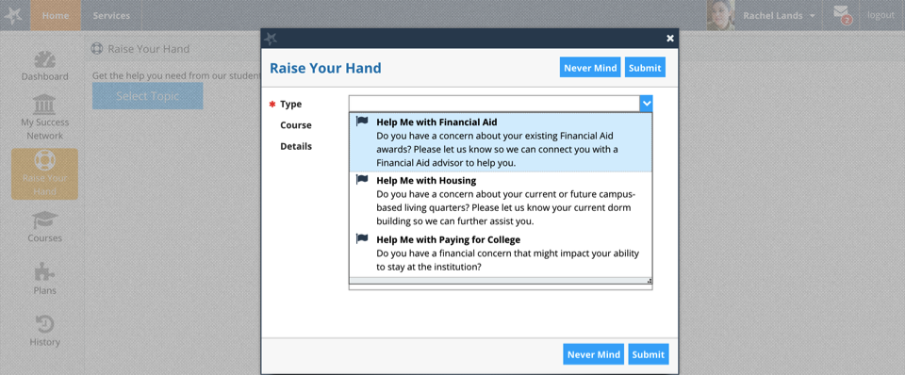
Let Students Initiate Their Own Help-Seeking
Customized Student-Raised Alerts

Slide 15
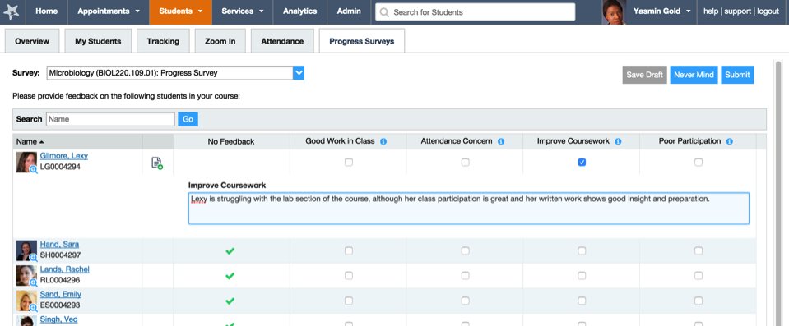
Facilitate Faculty Participation
Simple Progress Surveys

Slide 16
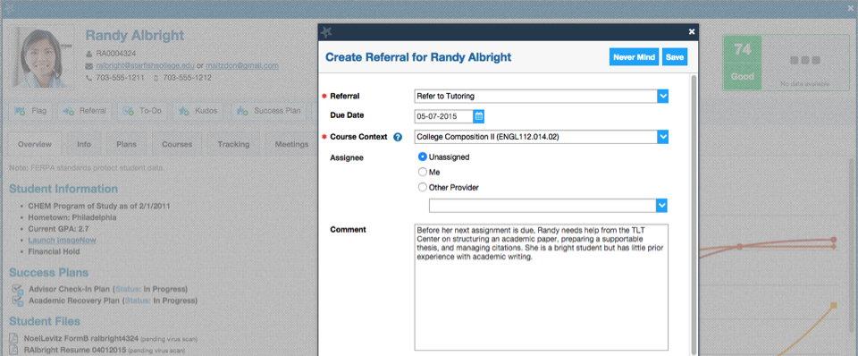
Encourage Cross-Team Collaboration
Instant Referrals and To-Do Tasks

Slide 17
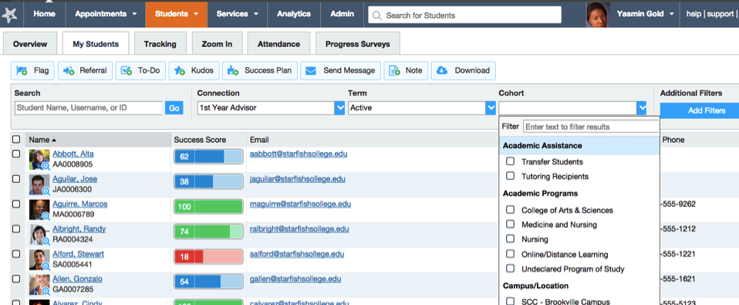
Match Outreach to the Level of Concern
At-a-glance Case Management Tools

Slide 18
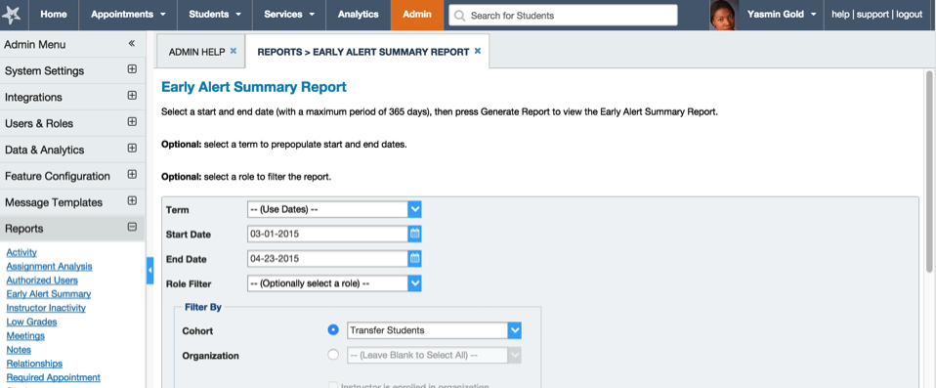
Use Data to Review and Assess Initiatives
End-User and Administrative Analytics

Slide 19
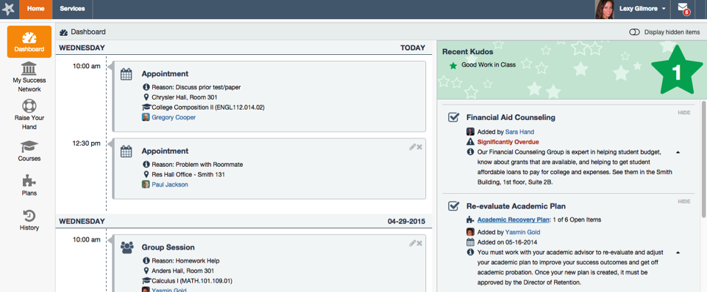
Highlight a Student’s Specific Next Steps
Student-Friendly Interfaces

Slide 20
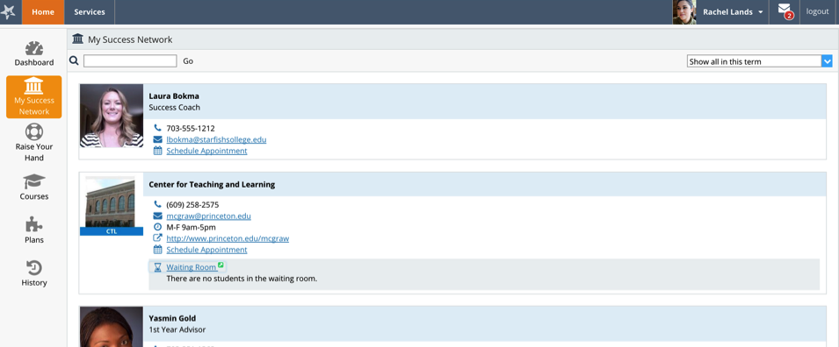
Remove Obstacles Between Students and Resources
Personalized Success Networks with Online Scheduling

Slide 21
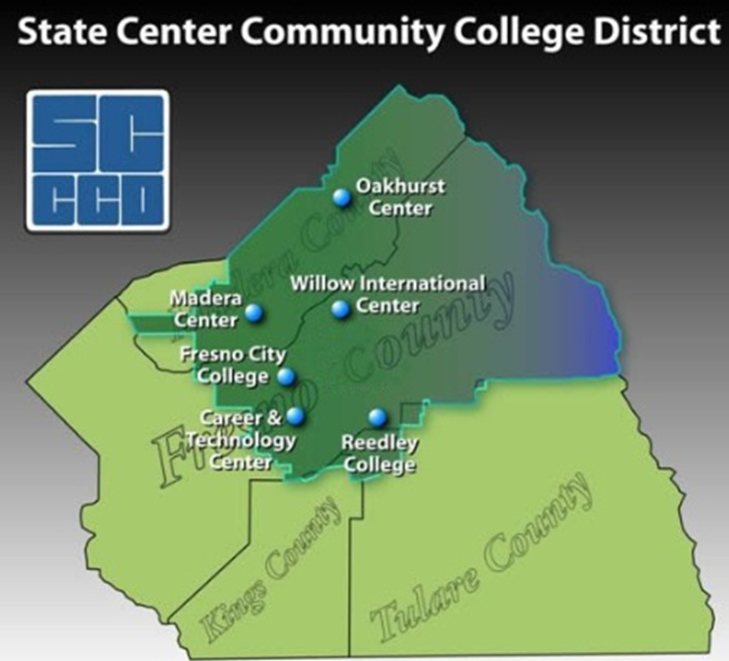
Notes:
District is in the Central Valley – half way between SF and LA
FCC – the oldest - urban
CCC – the newest college - suburban
RC – has centers – Oakhurst, Madera - rural

Slide 22
SCCCD Enrollment
2014-15
Fresno City College | 33,185
Reedley College | 9,575
Clovis Community College | 9,020

Slide 23
Why SCCCD Wanted to Be in the Pilot
Have been unsuccessful in the past to implement technology-based education planning
Strong administrative and District commitment
Student access to education planning tools
Tracking/monitoring of students toward goal attainment
Enable counseling sessions to be more efficient and meaningful
Help us with cross-enrolled students and differences in requirements from college to college
Make data driven decisions regarding course offerings and enrollment management
Notes:
SCCCD and its colleges are pilots for all 4 statewide projects (OEI, CAI, EPI, and Portal)
Have tried to implement on a large scale many times but not enough resources to scale up (counselor resources, A&R resources, faculty buy-in – Title V Coop, various grants
Anything we do related to degree planning needed to be district wide because our degree audit and registration system is district wide
Administrative support, district commitment, Organizational structures – former Title V Coop grant receipient in online counseling; teams at various campuses to implement; District wide matriculation team
Students asking for access to SEPs and progress toward goals, special programs and counselors desire to track/monitor student progress
Counselors struggling to complete SEPs in 30 minute appointments with so much of time is spent filling out major and GE sheets; little counseling/advising takes place; sessions are hurried; no idea what student is bringing with them to session

Slide 24
Current Structure/Delivery of Counseling Services Offered at Fresno City College
Centralized counseling for general student population
20 F/T Counselors and 35 adjuncts + Special Program Counselors
Individual counseling appointments, workshops, group, online, Q&A station, special programs, one-stop-shop events, early alert services, probation, online orientation, career counseling
30-minute individual appointments on a same-day basis
2013-14 – provided 17,047 in-person counseling appointments
Top 3 reasons students visit a counselor – SEPs, help with selecting courses, Transfer planning
Notes:
Use Datatel and students use webadvisor
20 f/t counselors and 35 adjunct counselors – includes general counseling, Transfer, Career Center, Dream Center, Outreach, Articulation, division liaisons – most have major projects or programs they oversee so this limits their direct counseling contact hours with students; also have special program adjunct counselors; other programs such as EOPS, Veterans, DSPS, etc have their own counselors
Offer services on individual basis; group (Ram Success, SEP events); Online counseling via chat room, FAQ database, Extreme Registration events
30 minute same day counseling appointments – just moved to a 45 minute appointment in general counseling; same day means students call or go online using eSARS to schedule an appointment; appointment slots fill up within 15 minutes of opening
special programs can see students longer; Q&A triage and same-day appointments

Slide 25
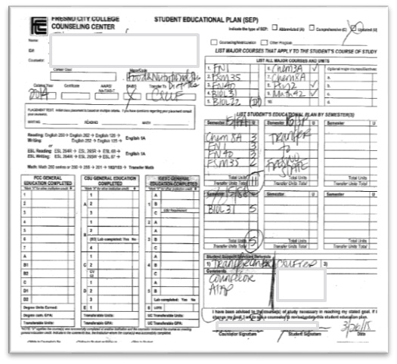
Current Delivery of Education Planning Service
Paper/Pencil Student Education Plans (SEP) completed during appointments or small groups
Abbreviate and comprehensive SEPs
Students can receive multiple SEPs from different counselors
Limited coordination between programs and academic divisions to address student needs
Notes:
SEPs are completed in triplicate form or single sheet paper/pencil format; some areas have electronic fillable forms that can be saved and printed out; students do not have electronic access to SEPs; other departments don’t have access to the student’s multiple SEPs
Student is given copy of SEP and counselor copy is scanned onto shared drive and/or copy in a student file folder
Notes entered into Datatel at FCC; at RC and CCC, notes are entered into SARS and then populates Datatel – but this upload has been inconsistent
Students are then confused by the multiple SEPs they receive from various counselors
No connection between active SEPs and the student’s major in Datatel – makes it difficult for academic divisions to provide targeted marketing and outreach to students in a specific major

Slide 26
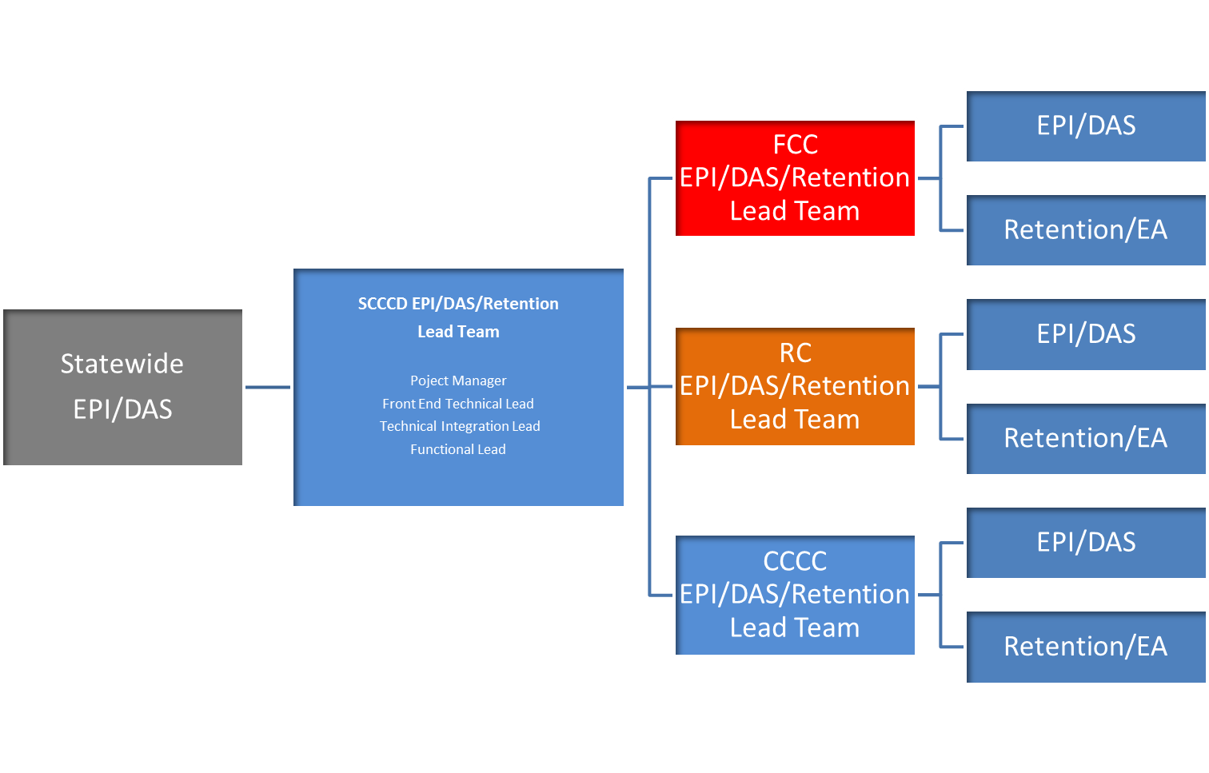
Implementation Team Structure
Notes:
One of the first things we did was develop our team structure
Statewide EPI/DAS pilot college team
SCCCD Lead Team – Vice Chancellor of Enrollment, Dean of Students (formerly A&R), District Director of Technology, SSSP Coordinator now Dean of Student Success & Learning
Each campus has their own lead team for both DP and Early Alert and these individuals meet weekly with Hobsons
Then there is the campus implementation team made up of key people from

Slide 27
FCC Team Roles
VP Student Services
Deans – Counseling, Instruction, Student Success
SSSP
IT
Admissions and Records
Counseling
Special Programs
Research
Marketing/PIO
Outreach
Early Alert
Probation
Student
Instructional Faculty
Academic Support/Tutorial
Notes:
The instructional and counseling faculty and student on this team will be the ones to test the system

Slide 28
Implementation Progress
Pre-Planning Meeting – May 2015
Discover documents to Hobsons – Summer 2015
Campus Opening Day Presentations – August 2015
District Kick-Off – August 2015
FCC Campus Kick-Off – September 2015
Senate presentations – September 2015
Weekly District Team meetings with Hobsons
Monthly FCC team meetings
Notes:
Pre-planning meeting in May 2015 – EPI staff was present and included teams and stakeholders from all three campuses – should have had it in person
District wide Kick Off meeting with campus teams – August 2015 led by Hobsons
Provided presentation to campus opening day with EPI t-shirts for all faculty
FCC campus team kick off
Presentations to Academic Senate, student government, etc.
We currently have weekly district team meetings with Hobsons and monthly campus team meetings; once testing begins, the campus team will meet more often

Slide 29
Education Planning Implementation
Identifying small student pilot groups
Uploading of program requirements
Validating programs
Testing degree planner with pilot students
Notes:
This is the process we will undertake
We identified student pilot groups to do our first round of testing -
Uploading of documents and programs, etc.
Reviewing program requirements for each degree, certificate and ADT – FCC has almost 300 programs
Validating programs using user cases (real student profiles that will be loaded into the test environment to see if ed plans can be built for the students) – Transfer to CSU; in lieu of course scenario where FCC takes a course in a GE area but RC doesn’t accept it for local GE - the course has same name/number; external courses coded in the system but doesn’t show up in degree audit;
Testing DP with student pilot groups
Groups – Football, Women’s Soccer, Basic Skills Math cohort, Social Sciences majors (blend of new, returning, probation, degree and certificate students)
Groups were selected based on the counselor assigned and their time and commitment; diversity of student population; ability to test various majors; cohorts that need flags; students with academic support needs

Slide 30
Benefits of Online Education Planning
Preliminary goal planning before meeting with counselor
Time spent in session more productive and can be spent on student concerns and needs
Quick view of student progress toward completion
Student ownership in education planning; increase student responsibility
Student increased understanding of their program requirements
Sharing of education plans across departments and campuses to reduce duplication and increase accuracy
Quality control
When integrated, will provide robust comprehensive system for students
Notes:
Student aware of where they are and not reliant on counselor to tell them
Student takes responsibility for planning their education and courses; reduce the comment “but my counselor put me into those classes”
We use two sheets to explain a student’s program requirements – GE sheet and major sheet – electronic SEP will enable student to have an integrated view of what they are to do; students understand the totality of what they need to do
Hoping the tool will assist in student self-efficacy in making plans – won’t address the psychosocial needs the students have but f2f sessions can be more directed to these issues

Slide 31
Challenges/Concerns
Counseling Faculty
Changing entire work flow of a counselor’s day
Counselor work schedules
Counselor training
Resources needed in counselor time and level of technology skills
Fear of unknown
Students
Use of ease for students and training of students to use the tool
Students changing majors
Student Training and buy-in
K-12 Partners
Notes:
Counseling faculty have been discussing the following issues/concerns – no answers yet…still too early for much of this
45 minute appointments – to allow more time but this has increased the wait time to see students; hopefully with online ed plan and drafts of SEPs done in advance, will only need to take 30 minutes?
Counselors will have to schedule time to see students individually but also to monitor SEPs and student contacts via the DP tool; will this reduce the number of SEPs actually completed?
Concerned about the amount of training for both counselors, staff and students – we are trying to get use to the system right now and it isn’t complete user friendly; how will we get student and counselor buy-in?
Technology skills of counselors is important
Fear of what the DP and Early Alert will really look like – we are making lots of suggestions and recommendations to Hobsons, but not sure what it will eventually look like in the end
Students
Will the tool be user friendly for students when they change their major and have to build a plan and then change their mind again
Will students be scared to change their mind and need more reassurance?
Not sure what student training will look like; also plan to implement with our feeder high schools during our RTG process

Slide 32
Challenges/Concerns
Instructional/Academic Faculty
Faculty and administration buy-in to use for advanced course planning
Faculty use of early alert
Communication and feedback loop for programs using early alert
Communication
Keeping implementation on track for District wide implementation – requires a lot of collaboration
Sharing progress with stakeholders and marketing the tool
Notes:
Communication - Staying on track as a District – takes a lot of coordination and communication – has its good points and bad points – can delay the process sometimes
Staying on top of communication to stakeholders – administration, faculty, students, Board – without a real system showing what this is going to do for our students, it’s hard to sell it
Faculty
For the tool to work effectively, course schedules need to be loaded in our SIS at least 1 year in advance; we barely schedule our courses about 6 months in advance – based on need for FTES
Faculty don’t use our current EA system; not sure if they will buy-in and use the new system; the real problem will be the work flow process of the other services to serve students needs – e.g. Tutorial, Psych Services, Counseling, special programs – there will need to be follow up and tracking

Slide 33
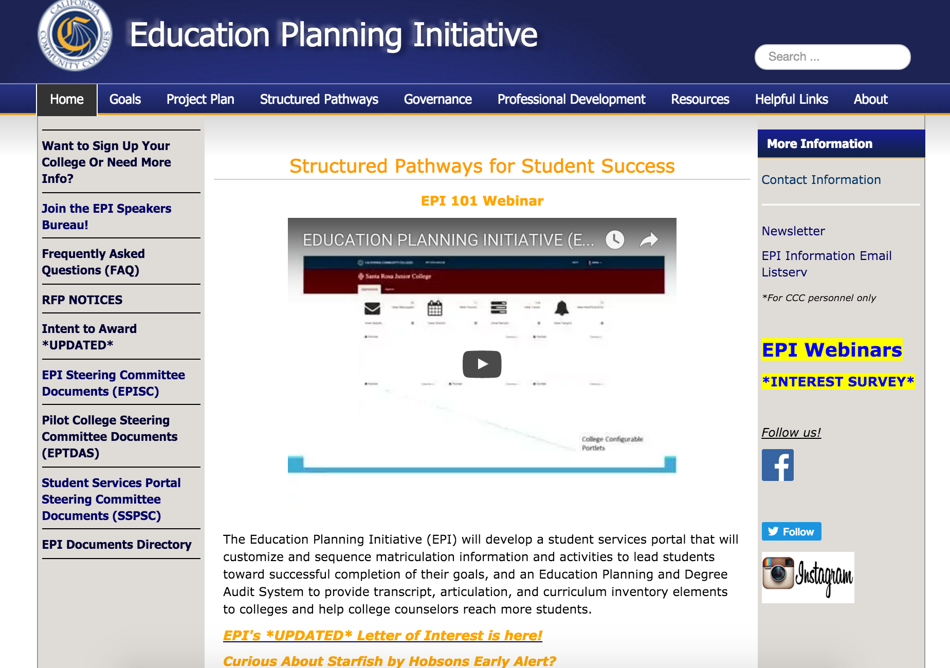
How do I get involved?
Deadline
January 22

Slide 34
Thank You!
www.cccedplan.org
If you have additional questions, post them at:
https://www.ccctechnology.info

