Slide 1
Innovations in Curriculum: Addressing Equity and Achievement Gaps
David Morse.
President, ASCCC
Jarek Janio
Faculty Coordinator, Santa Ana College
James Todd.
Interim Vice President, Student Services
Modesto Junior College
Notes:
David

Slide 2
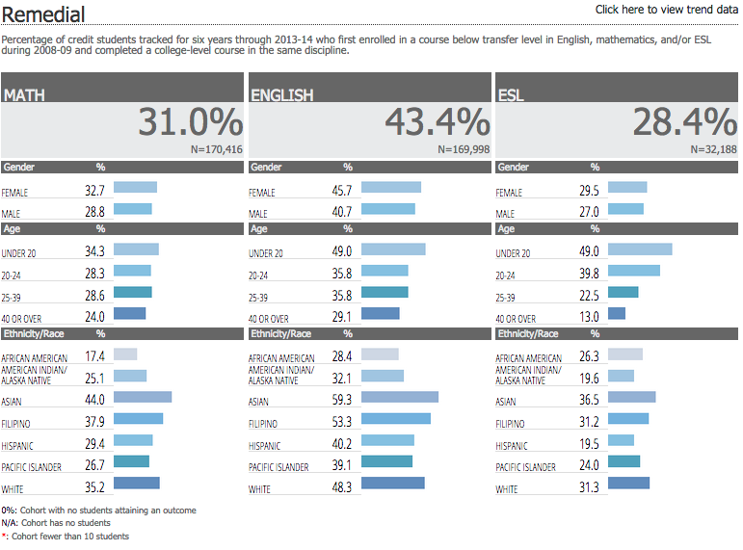
Equity in Context
Notes:
James

Slide 3
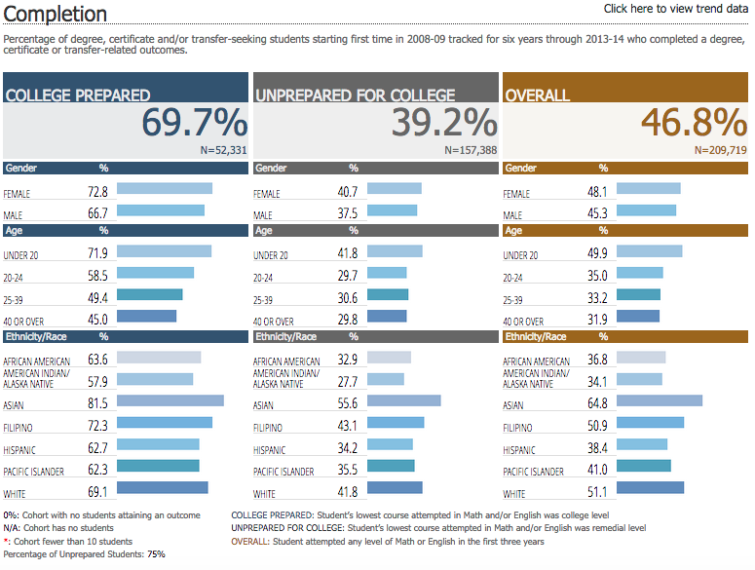
Equity in Context
Notes:
James

Slide 4
Equity in Context
Equity, curriculum, pedagogy, and support go together
Student Equity planning as strategic
The challenges for basic skills and beyond
Integration of Student Services/Support and Instruction
Notes:
James

Slide 5
Some of the Many Ways We Already Address Equity and Achievement Gaps
First Year Experience/First Time in College
Summer Bridge Programs
Learning Communities
Embedded Counseling
Tutoring, Supplemental Instruction, Peer Mentoring
Writing Centers, Writing across Curriculum
Categorical Programs
Course Redesign/Restructuring
Notes:
James

Slide 6
Insight into Innovation and Empowering Faculty: Curriculum Committee and the Academic Senate
Academic Senate role is the process level
The senate should not micromanage or interfere in curriculum committee work
The senate should work to ensure that the conditions exist that allow faculty to have open dialogue at the department and the college levels
The senate should work with administration to remove institutional barriers to innovation
Notes:
David

Slide 7
Insight into Innovation and Empowering Faculty: Curriculum Committee and the Academic Senate
Curriculum Committee
Should facilitate and encourage discussions of innovation at the department level
Should help to ensure that departments are arriving at decisions using good data and information
Must keep the broader perspective of what is best for the institution, not just for the individual department.
Notes:
David

Slide 8
Insight into Innovation and Empowering Faculty: Having Courageous Conversations about Curriculum and Equity
Sharing and discussing equity data as an institutional and cross-disciplinary concern
Making Equity a Priority (Carving out Institutional Time and Space)
Promoting Professional Development
Strengthening your Ed Master Plan, Strategic Plan through Equity
Piloting and Scaling
Incorporating Equity into SLOs and Program Review
Notes:
James

Slide 9
Balancing Quality and Efficiency
What are your priorities? What are you trying to achieve? Speed or success?
What data are you using to make your decisions?
What adjustments might you need to make to existing models to make them fit your situation?
Do not assume that what worked at another institution will work at yours
Do you have the resources in place to support and sustain the innovation?
Note that students will still need options, Even within an institution, one model will not be likely to work for all
Notes:
James

Slide 10
Some recent trends in curriculum innovation and basic skills
Course Restructuring – reducing the time necessary to fulfill developmental education requirements, either by
Compressed courses
Paired courses (e.g., a writing course paired with a literature course)
Curricular redesign – reducing the number of courses students have to take (often by eliminating redundant content or through a modular approach).
Mainstreaming – student move directly on to college‐level courses, either by
Supplemental Support – students are placed directly into college‐level courses, and are provided additional support through companion classes, labs, etc.
Contextualization – basic skills instruction is integrated into college‐level courses.
Edgecombe, N. “Accelerating the Academic Achievement of Students Referred to Developmental Education.” Community College Research Center, February 2011.
Notes:
James

Slide 11
Some recent examples of innovation
“Acceleration”
Accelerated Learning Project and CAP
Acceleration in Context
Also, see:Acceleration: An Opportunity for Dialogue and Innovation”
Statway
https://vimeo.com/89349344
Path2Stats
Non-STEM Algebra
Noncredit

Slide 12
Innovation in Noncredit: The Noncredit Student
Often the neediest, most underserved members of our communities
Open access for students with diverse backgrounds and those seeking ways to improve their earning power, literacy skills and access to higher education
First point of entry into college for immigrants, economically disadvantaged and low-skilled adults
“educational gateway,” “portal to the future”
Notes:
Jarek

Slide 13
Innovation in Noncredit: The Role of Faculty
Who should be involved in the decision to make courses Credit or Noncredit?
Curriculum issue
Faculty need to be not just at the table, but influencing the decision in terms of what students need.
Notes:
Jarek

Slide 14
Innovation in Noncredit: Engaging Faculty
Faculty should lead in the creation of a shared vision for curriculum development.
Identify funding sources to support faculty in taking leading roles in curriculum changes and full participation at the local level
Ensure faculty oversight of all new curriculum collaborations
Ensure curriculum and program changes drive funding conversations
Notes:
Jarek

Slide 15
Innovation in Noncredit: Benefits to Students
Affordable (free!)
Focus on skill attainment, not grades or units
Repeatable and not affected by 30-unit basic skills limitation
Open Entry/Exit
Accessible to nearly all students
Elementary level skills to pre-collegiate
Bridge to other educational/career pathways
CTE: Preparation, Practice and Certification
Entry level training leading to career pathways
Notes:
Jarek

Slide 16
Innovation in Noncredit: Opportunities for Students
Multiple pathways for transfer and non-transfer students
Students have many options if they are not eligible for financial aid.
More flexible scheduling.
Students can prepare and get ready for credit programs.
Access to information about new academic and/or career opportunities and pathways.
Provides access to counseling and matriculation services.
Courses have immediate positive impact on students’ lives and communities.
Notes:
Jarek

Slide 17
Innovation in Noncredit: Opportunities for Curriculum
No repeatability limits!
More options for students who are struggling with passing credit courses.
Students can develop the requisite skills to be successful in credit courses.
Successful completion of noncredit courses can be part of multiple measures assessments.
Incentivize students to move into credit programs.
Notes:
Jarek
Repeatability issue: No state aid or apportionment may be claimed on account of the attendance of students in noncredit classes in dancing or recreational physical education.” (California Code of Regulations, Title 5, § 58130). While the courses may still be approved and offered under the current noncredit course approval policies; they may not be included in attendance data for apportionment purposes.

Slide 18
Innovation in Noncredit: Opportunities for the Community
Create and innovate new courses to meet student needs.
Noncredit can be a place to pilot and try out new curriculum.
Dual delivery system
Similar courses can cover the same subjects for different skill levels.
More freedom to tailor curriculum in response to community and occupational needs
Notes:
Jarek

Slide 19
Innovation in Noncredit: Barriers to Address
Differential Pay
Differential Teaching Load
Concern over program health
Full-time faculty needed
Increase in workload for course development and changes in preparation
Credit faculty lack of knowledge about noncredit
Notes:
David

Slide 20
Questions and Comments?
Thank you for listening
Jarek Janio <janio_jarek@sac.edu>
David Morse <dmorse@lbcc.edu>
James Todd <toddj@yosemite.edu>
Notes:
David

