Slide 1
Strategic Planning for Equity at Diablo Valley College: 2014-2017

Slide 2
Presenters
Dr. Andy Barlow, Professor of Sociology, DVC and, with Ted Wieden, leading the implementation of DVC’s Strategic Plan.
Ted Wieden, Executive Dean for Planning, Evaluation and Accreditation, DVC
Joan Symonds, Professor of Early Childhood Education and Director of the Center for Early Childhood Education, DVC

Slide 3
DVC’s Strategic Plan Overview
Written by a workgroup of campus leaders as the culmination of a two year process of conversations across the campus (2012-2014).
Single directive: DVC will increase student success
Values: Excellence, Student Learning, Equity

Slide 4
Excellence, Learning and Equity
Excellence
Equity
Learning

Slide 5
But how do you do it?
Shrinking the equity or achievement gap sounds straight forward, but it can manifest itself in very different ways
Gregory Stoup, Senior Dean of Research for the Contra Costa Community Colleges District, examined the evidence for all California community colleges. His findings:

Slide 6
100%
Success by Cohort
95%
Scenario #1: Rising Tide
90%
85%
80%
75%
Average Success Rate increases but the Achievement Gap remains unchanged
70%
65%
60%
55%
An illustration
(not actual data)
Rising Tide interventions help all groups equally
50%
Base Year
Outcome Year

Slide 7
100%
Success by Cohort
95%
Scenario #2: Zero-Sum
90%
Average Success Rate remains unchanged but the Achievement Gap decreases
85%
80%
75%
70%
65%
60%
55%
Zero-Sum interventions help the bottom but harm the top
An illustration
(not actual data)
50%
Base Year
Outcome Year

Slide 8
100%
Success by Cohort
95%
Scenario #3: Bottom-up
90%
85%
80%
75%
70%
Average Success Rate increases and the Achievement Gap decreases
65%
60%
Bottom-up interventions help the bottom and hold the top harmless
55%
An illustration
(not actual data)
50%
Base Year
Outcome Year

Slide 9
100%
Success by Cohort
95%
Scenario #4: Win-Win
90%
85%
80%
75%
Average Success Rate increases substantially and the Achievement Gap decreases
70%
65%
60%
55%
Win-Win interventions help everyone but raise the bottom more than the top
An illustration
(not actual data)
50%
Base Year
Outcome Year

Slide 10
Equity work at DVC
In the past, equity work was siloed (Puente, Umoja, MESA) and college-wide planning did not focus on equity, but was focused on excellence and student learning.

Slide 11
The state of equity work at DVC in 2015
Excellence
Equity
Learning

Slide 12
The Challenge
To develop a college-wide framework in which to increase equitable student success, i.e. integrated planning and resource allocation through the directive and values of our Strategic Plan.

Slide 13
Implementing our Strategic Plan (I): First Innovation Process (February-April, 2015)
•Ad hoc process, initiated by Strategic Plan implementation work group.
•The college leadership (AS, co-chairs of governance committees and college VPs) asked the college for proposals to advance student success based on the college’s three values. 86 proposals were received.
•Ten were selected for their potential to equitably increase student success in a short time period.

Slide 14
Lessons from First Innovation Process
DVC faculty and staff have many good ideas about how to increase student success through the lends of student learning and excellence..
Only a small number of proposals were focused on increasing success for students from under-represented/under-served groups.
This highlighted the need for a clearer understanding of the relationship between equity, excellence and student learning.
Many of the projects were conceived as siloed activities, not as college-wide ones.
Developing ideas into operational activities and programs proved to be too time consuming for most faculty and staff.
This process pointed to the need for focused innovation that would impact the entire college, that was equity driven, and was adequately supported to be achievable.

Slide 15
Implementing our Strategic Plan (II): Reconfiguring Governance May, 2015
College governance: Academic, Classified and Associated Student Senates
College Council
Setting annual priorities for college innovation
Allocating resources based on these priorities
Transparency in decision-making, including resource allocation
Research, Planning and Evaluation Committee
Program Review Committee
Consequence of change: enabled DVC to focus on innovations at the institutional level

Slide 16
Access to Community College Education and Student Success

Slide 17
Success Rates
# of Students Completed 12 Units ECE and 12 Units ESL
89/109
82%
# of Students Continued Education
69/89
78%
# of Students with Jobs
64/136
47%

Slide 18
Fall 2015 Success Rates
# of Students Successfully Completing Fall ECE and ESL Courses
19/31
61%
# of Students with Jobs in the 2015 semester
29/31
94%

Slide 19
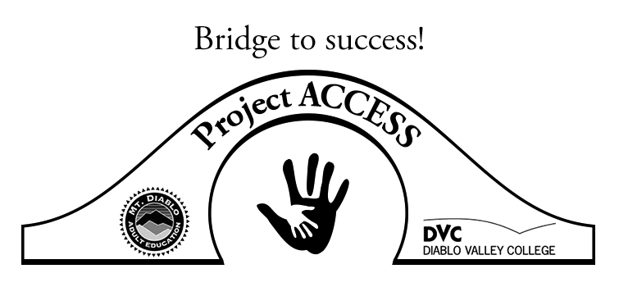
Mt. Diablo Adult Ed.
Transition to DVC
DVC Learning Community
Recruitment
Intake
Contextualized ESL Course
Computer Skills
Assessment
College Application
Financial Aid Application
College Orientation Class
Instructor Collaboration
Supplemental Instruction Leaders
Study Group
Linked ECE & ESL Courses

Slide 20
Elements for Success
Instructor Collaboration
Linking the Curriculum
Professional Learning Communities
Sharing Knowledge
Study Group with Supplemental Instruction Leaders
Supporting Basic Skills

Slide 21
Sustaining the Vision

Slide 22
Emerging framework for institutional innovation
Student success depends on developing pathways into, pathways through, and pathways out of the college.
(Bailey, Johnson and Johnson, Redesigning America’s Community Colleges)
Student success depends on inclusion in college programs and activities
(RP Group Student Success (Re)Defined)

Slide 23
Student Support (Re)-Defined (RP Group)

Slide 24
College-Wide Equity Work
Pathways activities (such as First Year Experience, high school to college programs) need to target specific populations from Equity Plan, set desired outcomes, align activities with these populations, and continuously evaluate the activities.
Inclusive activities (such as pedagogy, classroom activities, learning communities, campus art and music, student clubs) need to target specific populations from Equity Plan, set desired outcomes, align activities with these populations, and continuously evaluate the activities.

Slide 25
College-wide Innovations with Equity Targets
Support for innovative projects will require these elements:
The project will have an impact on college priorities (developing pathways, for example).
It must target groups in Equity Plan
It must align activities with the needs of these targeted students.
It must specify desired outcomes
It must evaluate activities and outcomes
Professional development will be aligned with these needs

Slide 26
Student Success
Student success requires colleges to support under-served students to become empowered actors.
This transformative process requires the institution to transform itself to create the condition for equitable student success.
For DVC, this transformation is based on the recognition that we can only improve student success and maintain our tradition of excellence with equity at the center of our integrated planning and resource allocation.

Slide 27
Contact Information
Ted Wieden, Executive Dean of Planning, Evaluation and Accreditation:
twieden@dvc.edu
Andy Barlow, Strategic Plan Implementation Workgroup
abarlow@dvc.edu
Joan Symonds: Project ACCESS, Early Childhood Education
jsymonds@dvc.edu
THANK YOU!

