Slide 1
Flipping the Classroom A Campus Faculty Inquiry Group Experience
Sarah Gaete and Donna Greene
College of the Desert, Palm Desert, CA
ASCCC Instructional Design and Innovations Conference
San Jose, CA 2017
Notes:
College of the Desert’s mascot is a roadrunner. I often feel like my students are the coyote and the knowledge and skills I want them to master are like the elusive roadrunner. I see my task as trying to get them to use critical thinking skills to enhance their learning.

Slide 2
We can’t keep doing what we have always done.
Why do we need to practice active learning for adults?
How do children learn?
If our students have been taught sitting in lecture halls, taking notes, taking quizzes and exams and writing papers- how do we expect them to know how to implement play-based hands-on learning for children?
Students seem to lack the critical thinking skills to get what they want out of school.
Looney Tunes
Notes:
All humans learn through play. We have to be models of active, hands-on learning in our classrooms for our students to be able to go on and promote this type of learning with children. Doing more of the same just gets us where we have always gotten.

Slide 3
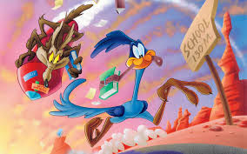
I went back to the books. How do my adult students learn? Andragogy vs. Pedagogy
Knowles (1968) – Assumptions about adult learners:
Self-Concept: As a person matures, he or she moves from dependency to self-directness.
Experience: Adults draw upon their experiences to aid their learning.
Readiness: The learning readiness of adults is closely related to the assumption of new social roles.
Orientation: As a person learns new knowledge, he or she wants to apply it immediately in problem solving.
Motivation (Later added): As a person matures, he or she receives their motivation to learn from internal factors.
Notes:
I did what I always do when confronted with a dilemma. I went to my books. Some of my favorites, Carter and Curtis, Training Teachers; Betty Jones, Teaching adults revisited. The andragogical model proposed by Knowles nearly 50 years ago defines assumptions about the adult learner and how she/he is different from the child. What do your students look like? Are they self-directed? Mine are not very much. They do draw on their experiences and they very much enjoy applying new learning immediately. Motivation, my students range from very deeply motivated to having to be pushed by their parents to go to school. I do ask them at the beginning of each semester, I poll my students, why are you here? I seek to hear their stories and tell them mine. It helps them to tell me who they are and why they are there and to understand my background. Those personal connections strengthen our community.

Slide 4
7 Research Based Principles for Smart Teaching- Dr. Michele DiPietro
1- Prior knowledge can help or hinder learning
Old incorrect knowledge may supersede new knowledge
2-Organization of knowledge
Experts have rich complex mental structures-students have sparse superficial
3-Motivation
How will this help me be successful?
4- Mastery
Students must acquire skills, practice integration, know when to apply
5-Goal-Directed Practice coupled with explicit feedback enhances learning
Driving and the expert blind spot
6-Students level of development and social climate interact to impact learning
Accepting, resisting , passive- marginalizing, centralizing
7-Self-directed learners are self-aware
Metacognitive strategies- assess a task, self evaluation, plan, apply strategies, monitor performance, reflect and adjust – (students don’t do any of these)
Notes:
How Learning Works; 7 research-based principles for smart teaching. Ambrose, Bridges, DiPietro, Lovett & Norman. We had Dr. DiPietro come to speak at COD and he reviewed these seven principles. It was an excellent presentation and I learned several new principles;

Slide 5
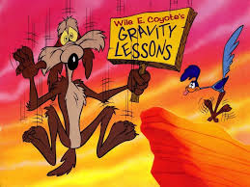
I Needed More Time in Class Working on Critical Thinking Skills
Kolb furthers the second definition of experiential learning by developing a model which details learning process through experiences. Kolb and Fry's (1975) experiential learning model is a continuous spiral process which consists of four basic elements:
Concrete experience
Observation and reflection
Forming abstract concepts
Testing in new situations
Immediate or concrete experiences are the basis for observation and reflections. These reflections are assimilated and distilled into abstract concepts from which new implications for action can be drawn (Kolb & Fry).
According to Kolb and Fry (1975), the adult learner can enter the process at any one of the elements. The adult learner moves to the next step once he or she processes their experience in the previous step.
Notes:
Then I fell back on Kolb and fry’s experiential learning model- after my review I realized that I needed more time in my classrooms to work on critical thinking skills. How do I help my students to move from the concrete, observe and reflect, to forming those abstract concepts to be able to test out those concepts.

Slide 6
Betty Jones- Teaching Adults Revisited
Adults learn complex tasks and concepts by doing them, then reflecting and dialoguing about them
Teaching-learning relationships are build in small groups over time
Teaching-learning partnerships are based on mutual respect
Adult learners need to take initiative, make choices, act and react
Learners should be doing more talking than the teachers
Ask questions that you do not know the answer to
Be clear about goals and expectations
Assist learners in setting their own goals
Pay attention to the needs of your learners
Value diversity
Students needs support and challenge to grow
Use journal activities to allow everyone time to process thoughts
The environment must feel safe for all

Slide 7
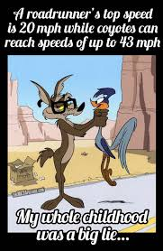
The Questions
What are the tasks that I expect of my students that should be taught using adult learning strategies example?
How do I integrate the correct amount of “play” with the more focused learning adults need?
How do I help my students learn to blend the lessons in my classrooms into hands-on play-based activities for children that promote learning?
I began implementing a flipped classroom model.
Notes:
Around the same time as I was researching ways to increase critical thinking, I began hearing about the flipped classroom model for adults.

Slide 8
The Work Group Idea Takes Off
Around the time I was embracing Flipping and was presenting all around the country, our college came into some funds from our foundation for innovative practices for faculty.
Some of those funds went to develop our Berger Faculty Innovation Center.
I requested some funds to start a Flipping the Classroom Faculty Inquiry Group. I submitted a request for 21 IPads and 20, $25.00 ITunes gift cards, along with IPads in Education For Dummies Books.
The request was granted and we began meeting once a month on Friday afternoons to both explore ways to use our IPads and Flipped Activities.
We began meeting in Spring of 15 after a Flex Presentation to roll out the idea.

Slide 9
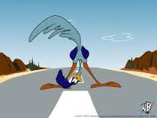
Looking Back and Forward
Some faculty were really not interested in Flipping and just wanted to join to use an Ipad.
Some faculty did not attend meetings, yet kept the Ipad.
One faculty member was teaching fully online ( I missed that).
We have revised our membership parameters.
However, several core faculty are still involved and are developing new and better practices around flipping.
We have a course shell in Canvas where we share ideas and resources.
I have asked for five more IPads to expand the group.
As the Instructional Designer, I have been the core facilitator but am seeking to move that role to other faculty within the group who have been committed and attending for a while.

Slide 10
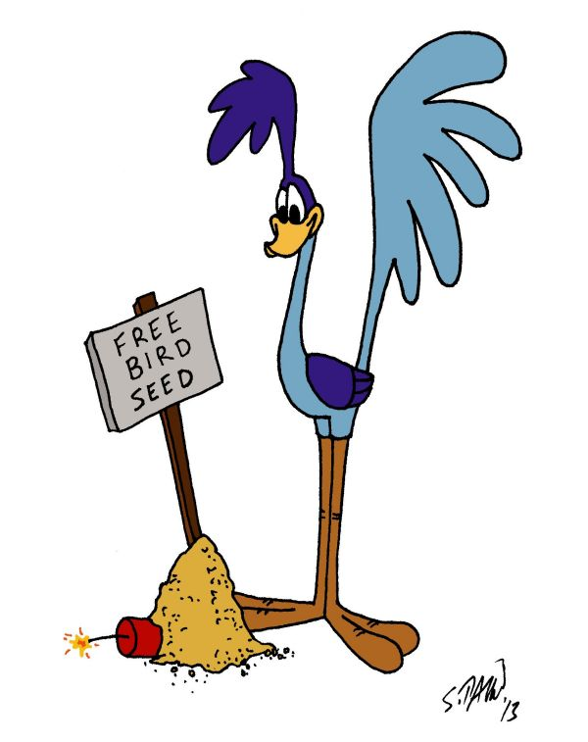
Embracing Flipping
22 years of lecturing and testing was getting very old!
•5 years overhead transparencies-Glad those days ended!
•15 years Powerpoints
•how much to they learn if they don’t take their own notes?
•3 Semesters ago I learned about flipping:
I saw my role change from professor to facilitator.
My job was not so much to teach, but empower the students to learn independently and as groups, collaboratively.

Slide 11
Get Flipping
Just keep it simple the first semester! Grow from there!
Flipping takes time and planning
Be patient. Some things will work and some may not. It is OK! Students see you trying and are grateful you are not just a talking head
Begin with small activities, not heavily weighted, while they get comfortable with their own contributions, and familiar with group members.

Slide 12
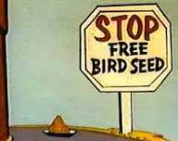
Just Flip It!
Students and groups may need a few flipping activities under their belt before they understand your expectations.
It is important to guide and advise much and often throughout these first activities to ensure their success.
Try using textbook resources and tools that are available to reinforce learning. Examples of resources I use:
Chapter Learning Objectives
Pre and Post Learning Assessments
Critical Thinking Questions
Discussion questions on a video or Ted Talk
Notes:
Example: MicroBiome activity

Slide 13
How to Build Flipping Proficiency
Build LMS to ensure, using due dates and deadlines, that content is reviewed outside of class, and prior to scheduled Success Group activities during class time. Examples:
•Assign reading of text.
•Pre- and Post Assessments are completed
•Case Studies completed
•Supplemental or outside reading is completed

Slide 14
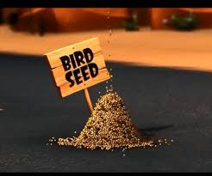
How to Build Flipping Proficiency
Build Success Group Activities in LMS
•Set expectation for outside learning and preparation for classroom activities
•State the general expectation for the outcome of the activity
•Offer suggestions, but encourage creativity and independence…you will be so pleasantly surprised!

Slide 15
Syllabus Statement
It is important to preload students with what will happen in your class.
About this Class:
- I employ something called a “Flipped Classroom Model”. What that means is that much of the traditional “homework” assignments are completed in class.
- You will be assigned to a Success Team on the first day of class. Your Success Team will work together to complete the five team assignments and will complete all in class activities together. When you enter the classroom, please come to the front of the class and check in with the instructor. Sit with your success team. During check in, there will be a Poll Everywhere slide on the screen. Answer the Poll prior to beginning class.
- This is a very active class with lots of student talking and working together. Do not expect to sit and have me lecture about the chapter readings while you take notes!!
- The chapters are assigned each week for the following week. You must complete the reading and chapter quizzes by Saturday the week before we will discuss in class. Since these are online quizzes, you can do them anytime during the week. I need to see your results before class so I know what might need additional work.
- Sign out with the instructor at the end of class. In class points are recorded each week after class. If you leave early or come late, you will not earn in-class points for the week.

Slide 16
Success Group Work and Self Evaluation
Success Group work time in class:
•Preparation has been clearly defined in LMS
•Students are encouraged to come with phone or electronic device for work in class
•Group work time: Time depends on the project, but usually about 20-30 minutes
•Presentation time: Most presentations are about 5-10 minutes, but may be shorter with the first couple of assignments.
Notes:
My classes are usually about 40-43 students. I used to have only 5 groups, but they were too large. I now start with about 8 groups with 4-5 students each. I merge groups as needed if students drop through the semester. This is hard because they have bonded with their group!
•Monitor group size and participation, shuffle groups for better productivity as needed.

Slide 17
Group/Self Evaluation
•Use Rubrics for Presentations
•Allow each group member to complete a self evaluation
Example: I use 0-4 scale
4 = Full participation, they get a point for each of the following.
•Fully prepared prior to group activity (reading, research, etc).
•Participated fully in group class work
•Communicated fully with all group members
•Present and participated in Group Presentation to the full class
Notes:
• All group members complete the same self eval form, so they all see they are accountable to each other.
•Group members are allowed to speak to me privately if someone is not truthful, but I make it my job to know this myself.

Slide 18
Group/Self Evaluation
•All group members complete the same self eval form, so they all see they are accountable to each other.
•Group members are allowed to speak to me privately if someone is not truthful, but I make it my job to know this myself.

Slide 19
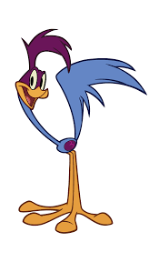
Flipping Outcomes
Student Engagement
Higher participation
Course content becomes more meaningful and purposeful
Students apply what they are learning at a higher level
Active learning
Student Retention
Day or night classes, students have greater accountability
On time, prepared, stay in class (especially 3 hour sessions
Higher numbers completing classes

Slide 20
Flipping Outcomes
Teacher-Student Connection
Opportunity to connect and know students
Students ask me more questions from smaller group
Students feel I am more interested in them as I walk around talking to each group offering individual help.

Slide 21
Let’s Flip Together!
Practice Flipping here and now with 2-3 of your neighbors.
•Label Reading Activity:
•Use the 2 labels provided on the next slide

Slide 22
Compare Nutrition Facts Labels

Slide 23
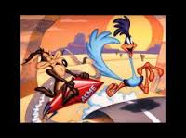
These are just some of the many!
Tools for Flipping the Classroom
Flipped Learning Network.
http://oncourseworkshop.com/
TED Ed Lesson on Flipping the Classroom
The Flipped Institute
Edutopia’s Flipping the Classroom Lit Review
Five Free or Low Cost Tools for Flipping the Classroom
Canvas Commons: COD's Flying Flippers
I have found that my students do better work, are more engaged and earn better grades since I began flipping the classroom. (Donna)

Slide 24
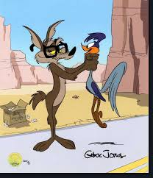
Questions?

