Slide 1
Integrated Planning: Guided Pathways in the Institutional Landscape
Randy Beach, ASCCC Guided Pathways Task Force, Southwestern College
Jeff Burdick, ASCCC Guided Pathways Task Force, Clovis College Michelle Pilati, ASCCC Guided Pathways Faculty Lead, Tool Development

Slide 2
Description
Colleges plan constantly: educational master plans, facilities master plans, enrollment management plans, distance education plans, and more. But how do these plans serve the design and implementation of your college’s guided pathways framework? This workshop will explore the various planning documents that impact a college’s instructional mission and how these plans support the four principles of guided pathways. This is a preliminary companion to the interactive workshop on Integrated Planning and Guided Pathways: Guided Pathways as an Organizing Framework in the 2nd workshop session.
ASCCC Academic Academy September 14-15, 2018 San Francisco, CA

Slide 3
What brings you to this breakout? What do you hope to learn?
ASCCC Academic Academy September 14-15, 2018 San Francisco, CA

Slide 4
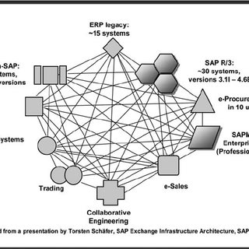
Integrated Planning
What does this mean?
Why is it necessary as an element of implementing guided pathways?
What plans/planning does your college engage in?
When/how are faculty involved?
ASCCC Academic Academy September 14-15, 2018 San Francisco, CA
Notes:
Have tables work together to determine how many common plans they have?

Slide 5
Food for Thought
What does it mean for an institution to be a “Guided Pathways Institution?”
What recognized effective practices should be part of how we operate – and are critical to become a truly guided pathways college?
ASCCC Academic Academy September 14-15, 2018 San Francisco, CA
Notes:
Time to discuss. Put ideas into a parking lot

Slide 6
A Guided Pathways Institution is…
Transparent
Collaborative
Cross-functional
Student-focused
Awareness of student perspective
Process oriented
Student-ready
Holistic (student and college)
Adaptable
Not afraid of failure—no guillotine for the guys who fail
Easy to navigate
Equity minded
Innovative
Fearless
Forgiving
Transformative
Breaking down silos
Communicative
Data-driven (information-driven)
Resilient
Fiscally responsible with funds (with a Guided Pathways mindset)
Synergistic

Slide 7
Recognized Effective Practices
Data-driven decision-making
Integrated-planning
Continuous quality improvement
Effective participatory governance structures
ASCCC Academic Academy September 14-15, 2018 San Francisco, CA
Notes:
This will have been introduced in a general session - but that’s OK - here we are focusing on a different part
Add more here bvased on prvous slide oncverstaion
Student voices might be appropriate to add here: how are colleges discovering the student experience?

Slide 8
Plans
How are plans like puzzle pieces?
How are they not?
ASCCC Academic Academy September 14-15, 2018 San Francisco, CA
Notes:
We might want to talk about the disparity between our (faculty and admin) view of providing all sorts of great services and a fully integrated college vision -- and the students’ perceptions that we have just a whole bunch of unfindable stuff. The jig-saw puzzle analogy might be useful. Faculty recognizes that we value participatory governance so we seek additional voices around the table. Classified, admin, students. And all faculty (counseling, library, CTE, etc.). For the good of the institution.

Slide 9
What are the plans at your college?
Strategic Plan
Educational Master Plan
Facilities Master Plan
Student Equity and Achievement Program
Technology Plan
Enrollment Management
Human Resource / Staffing Plan
Distance Education Plan
What else? What local plans?
ASCCC Academic Academy September 14-15, 2018 San Francisco, CA
Notes:
We might want to talk about the disparity between our (faculty and admin) view of providing all sorts of great services and a fully integrated college vision -- and the students’ perceptions that we have just a whole bunch of unfindable stuff. The jig-saw puzzle analogy might be useful. Faculty recognizes that we value participatory governance so we seek additional voices around the table. Classified, admin, students. And all faculty (counseling, library, CTE, etc.). For the good of the institution.

Slide 10
Why do we have these plans?
To establish - achieve? the mission and broad goals of the college
To define and concretize an institution’s and a community’s values
To effectively utilize resources for the benefit of students
To comply with regulation or accreditation requirements
ASCCC Academic Academy September 14-15, 2018 San Francisco, CA
Notes:
Is “establish” the right word in the first bullet? I hate the word, but the first thing that comes to mind is “operationalize”
The mission/vision statements establish the goals, but the plans break them down into do-able steps with sub goals.

Slide 11
How do we integrate these plans? Where do we start?
ASCCC Academic Academy September 14-15, 2018 San Francisco, CA

Slide 12
The Strategic Plan
Seemingly obvious place to start
Wholly compiled from local values and goals
Often the result of collaborative and institution-wide dialog
Often reflects a partnership with the community
Drills down from broad goals to specific, measurable objectives
Typically three-five year duration
How easy or difficult would it be to revamp your SP around GP?
ASCCC Academic Academy September 14-15, 2018 San Francisco, CA
Notes:
A purpose for integrating the guided pathways framework inside the strategic plan is to fully integrate the functions of the college and to stabilize the plan for long term implementation. This avoids the lurching and restarts that a stand-alone plan might be subject to as personnel (especially admin) change -- or new initiatives get dumped into the mix.

Slide 13
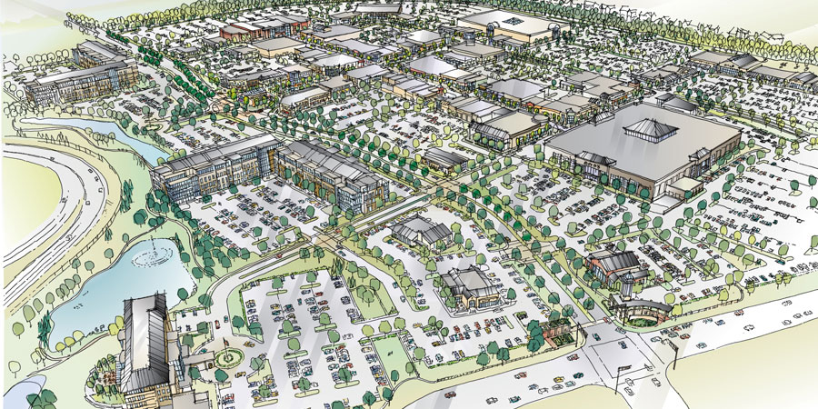
Major Plans
Educational Master Plan
Based on economic and workforce need indicators
Informed by shifts in industry and community needs
Responsive to changes in standards at the college and transfer institutions
Includes student support as well as academic planning
How easy or difficult would it be to revamp your EMP around GP?
ASCCC Academic Academy September 14-15, 2018 San Francisco, CA
Notes:
In our district, we are locked into a 10 year cycle for re-doing the ed master plan. I don’t know if that is usual. It may be because it is so expensive to produce.

Slide 14
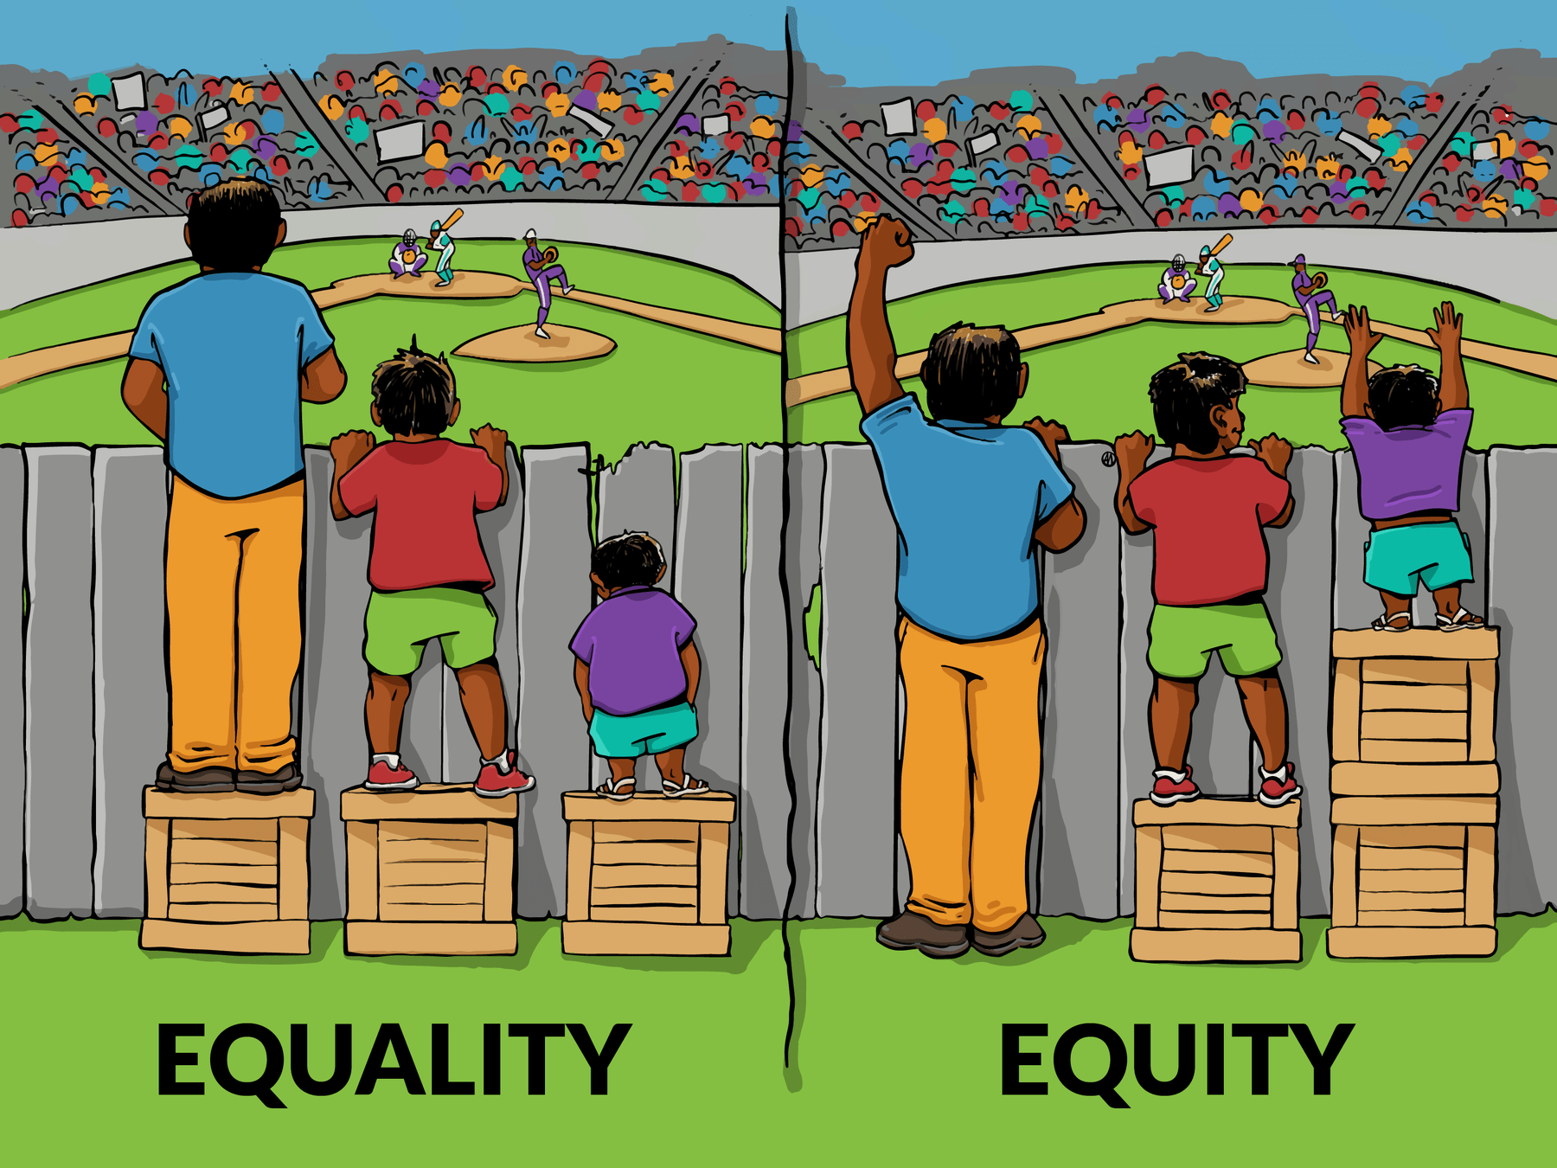
Major Plans
Student Equity and Achievement Program
Combines Equity, Basic Skills Initiative, and SSSP funding
Program created intently to support Guided Pathways
Encompasses the equity goals embedded in Guided Pathways
Provides opportunities for funding to enhance design and implementation efforts
ASCCC Academic Academy September 14-15, 2018 San Francisco, CA
Notes:
“Intently” ? or specifically?
Is the third bullet backwards? The gp framework is designed to reach the equity goals.
The last bullet might be interesting to explore a bit more broadly somewhere else in this presentation if there is time: What funding buckets can we draw on? GP came with no real operational $$, yet the plans people are designing require new resources.

Slide 15
And then there’s this… The CCCCO GP Work Plan
Colleges required to submit a work plan to qualify for funding
Includes 14 elements for assessment and planning
Requires a project management approach
Some pitfalls: Tendency to overcommitting / can be overwhelming
Goal is integration/institutionalization/sustainability/longevity
ASCCC Academic Academy September 14-15, 2018 San Francisco, CA
Notes:
We might want to present the idea of starting somewhere else besides the metamajor discussion, and why: many colleges seem to have jumped into the discussion and alienated much of their faculty. Why not start with consolidation of existing plans of support?
We might also talk about the long pathway to full “completion” of the work plan. This isn’t a one or two year effort.

Slide 16
The CCCCO GP Work Plan: The Elements
Cross-Functional Inquiry
Shared Metrics
Integrated Planning
Inclusive Decision-Making
Intersegmental Alignment
Guided Major and Career Exploration Opportunities
Clear Program Requirements
ASCCC Academic Academy September 14-15, 2018 San Francisco, CA
Notes:
I think we landed on guided pathways collaborative teams, so we might want to introduce that term.
Cross functional, which we would also have to mention, really doesn’t describe what these are.
With “inclusive decision making,” we should nail down the participatory governance and the faculty role specifically

Slide 17
The CCCCO GP Work Plan: The Elements
Proactive and Integrated Academic and Student Supports
Integrated Technology Infrastructure
Strategic Professional Development
Aligned Learning Outcomes
Assessing and Documenting Learning
Applied Learning Opportunities
ASCCC Academic Academy September 14-15, 2018 San Francisco, CA
Notes:
The integrated tech bullet is something that I keep hearing horror stories about from our own district, that things don’t work or aren’t available -- but that’s just hearsay. Perhaps, Randy, you can fill us in on what is actually available now?
Program and general ed learning outcomes are natural expansions of the 4th bullet.
And I think we need to explain “applied learning opportunities” because that really does sound like applied arts: CTE only.

Slide 18
The CCCCO GP Work Plan: More Food for Thought
What existing planning processes do you see embedded in the CCCCO work plan elements?
Does your work plan put you on the pathway to being a GP institution?
Can the work plan integrate with existing plans or do they all need to be aligned?
What committees and decision-making structures?
What are the senate’s roles?
ASCCC Academic Academy September 14-15, 2018 San Francisco, CA

Slide 19
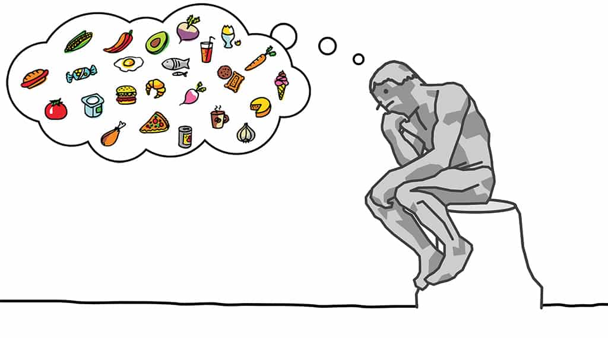
Food for Thought: Revisited
What does it mean for an institution to be a “Guided Pathways Institution?”
Being a Guided Pathways institution means integrating planning and funding sources to support student-centered operations and programs
ASCCC Academic Academy September 14-15, 2018 San Francisco, CA
Notes:
Time to discuss. Put ideas into a parking lot

Slide 20
Questions? Info@asccc.org
Randy Beach, ASCCC Guided Pathways Task Force, Southwestern College, rbeach@swccd.edu Jeff Burdick, ASCCC Guided Pathways Task Force, Clovis College, jeff.burdick@cloviscollege.edu Michelle Pilati, ASCCC Guided Pathways Faculty Lead, Tool Development, mpilati@riohondo.edu
ASCCC Academic Academy September 14-15, 2018 San Francisco, CA

Slide 21
Integrated Planning: Guided Pathways in the Institutional Landscape
Randy Beach, ASCCC Guided Pathways Task Force, Southwestern College
Jeff Burdick, ASCCC Guided Pathways Task Force, Clovis College Michelle Pilati, ASCCC Guided Pathways Faculty Lead, Tool Development

Slide 22
Description
College plans are often siloed both in their development and implementation. But what if your institutional plans could be designed to serve your guided pathways design framework and your collaborative vision of guided pathways? In this workshop, participants will discuss strategies for developing and revising institutional plans to support guided pathways vision while avoiding duplication, leveraging precious resources, and reducing conflict.
ASCCC Academic Academy September 14-15, 2018 San Francisco, CA

Slide 23
Even MORE Food for Thought
How do we plan as a GP institution?
What are the first steps to develop a planning process driven by GP with full involvement of faculty?
What does adequate involvement of faculty look like?
What changes to your decision-making structure should be implemented to support integration of plans under a gp umbrella?
What are effective communication strategies for breaking down silos to support integration of GP?
ASCCC Academic Academy September 14-15, 2018 San Francisco, CA
Notes:
Bring candy
I think I woudl move the last bullet to the #2 spot: plan → communication strategies. Then first steps ?
“Adequate” isn’t quite right here since we want optimal, especially since so much of this is 10+1. Maybe the slide that Juie did showing the four principles aligned with 10+1? Could go here.

Slide 24
Scenarios
Take 15 minutes with your group at your table to review the scenario provided and brainstorm possible ways to address and solve the issue.
Select a reporter to share after
Notes:
Write several scenarios related to GP; solve the issue in order to integrate GP into planning documents
How about writing a vision of the college in 5 years: what will the student experience be like in terms of integrated planning -- and show the steps, perhaps by taking a student through the gauntlet. Show how those steps would have been integrated into various plans to reach this goal.
A new president arrives and has a grand new idea of how guided pathways is to be done because he/she did it perfectly at the previous college and there is only one way. You already have a fine plan that fits your culture and that is well along. What now? What help would you find in your planning documents? And how might they be revised? E
Your college has decided that your guided pathways framework will be built as a whole-campus equity plan How would you reinterpret the principles and tasks to do that? And how would that integration show up in your plans? Yo
You have a new educational master plan (within two years) that projects a 10% growth in minority students over the next 5 years. How does this change the planning process? And what plans would be affected? How?

Slide 25
Questions? Info@asccc.org
Randy Beach, ASCCC Guided Pathways Task Force, Southwestern College, rbeach@swccd.edu Jeff Burdick, ASCCC Guided Pathways Task Force, Clovis College, jeff.burdick@cloviscollege.edu Michelle Pilati, ASCCC Guided Pathways Faculty Lead, Tool Development, mpilati@riohondo.edu
ASCCC Academic Academy September 14-15, 2018 San Francisco, CA

