Slide 1
The Full Time Interview Process: What to Expect Each Step of the Way
Sam Foster
ASCCC Area D Representative
David Morse
Long Beach City College

Slide 2
Applying and Interviewing
Overview…
The application process:
Completing the application
Additional materials
Tailoring your materials
Pitfalls to avoid
The interview process:
Preparing for the interview
Making a good first impression
Maintaining poise
Pitfalls to avoid

Slide 3
Applying and Interviewing
The Application Process…
Typically…
The application
Cover letter
Supporting materials

Slide 4
Applying and Interviewing
The Application…
Fill out completely or risk disqualification .
Even if already in the resume.
Avoid “ See resume”
When in doubt...

Slide 5
Applying and Interviewing
The Application…
Start the application process early
Work on your application over a number of days
Complete and submit on-line by the specified closing date and time
Check the deadline

Slide 6
Applying and Interviewing
The Cover Letter…
Distinguish yourself.
Tailor the letter.
Something about the college/district.
Address each qualification – minimum and preferred.
This is where you distinguish yourself
Be complete…but not a novel.
But what if I already work there?

Slide 7
Applying and Interviewing
Tips for an Effective Cover Letter…
Get to the point quickly. Cuteness and
cleverness may hurt more than help.
Do not overdo it. Generally two pages at most is sufficient.
Proofread carefully and ask others to review prior to submission

Slide 8
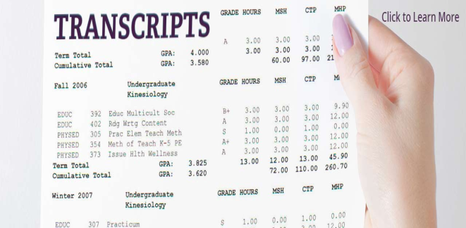
Applying and Interviewing
Additional Materials…
Transcripts
Unofficial transcripts usually acceptable
Check to verify
Show the degree (if any) awarded.
If a masters required
Include graduate AND undergraduate, usually
Other
Teaching philosophy
List of courses taken
Prior courses taught
Other requested paperwork
Materials not requested?
Avoid the urge…☺

Slide 9
Applying and Interviewing
Beyond the Degree…
Teaching/CC mission – a calling
Record of volunteerism and service
Team player
Life-long learning mentality
Student equity and cultural competence
Ability to connect
Ability to inspire
Passionate about their discipline
Authentic excitement about teaching
Pedagogical strategies breadth/depth

Slide 10
Applying and Interviewing
Preparing for the Interview…
Learn about the College/District
Learn about the students
Study the website
Summarize your strengths
Prepare your teaching demonstration
Check with college for technical support, what’s allowed, etc.
Practice interview questions!...

Slide 11
Applying and Interviewing
Additional Things to Consider…
Who is likely to be on the interview committee?
How long is the interview likely to be?
How much information will you be provided with in advance?
Will you be asked to complete a Writing Sample?
The interview is likely to be highly scripted, with pre-prepared questions.

Slide 12
Applying and Interviewing
Interview Day…
Dress professionally
Arrive early and relax
No uninvited visitors
Copy of your materials
Be your
authentic self

Slide 13
Applying and Interviewing
General Tips for Success…
Create a digital master file
Resume
List of Courses
Cover Letters
Modify to address the specific job opening
Learn something about the college…
And use that knowledge
Avoid the generic approach
Proofread……!

Slide 14
Applying and Interviewing
Questions…
Sam Foster: sfoster@fullcoll.edu
David Morse: dmorse@lbcc.edu

