Slide 1
Part Time Faculty Regional Meeting
Equity in the California Community College System
February 24, 2023

Slide 2
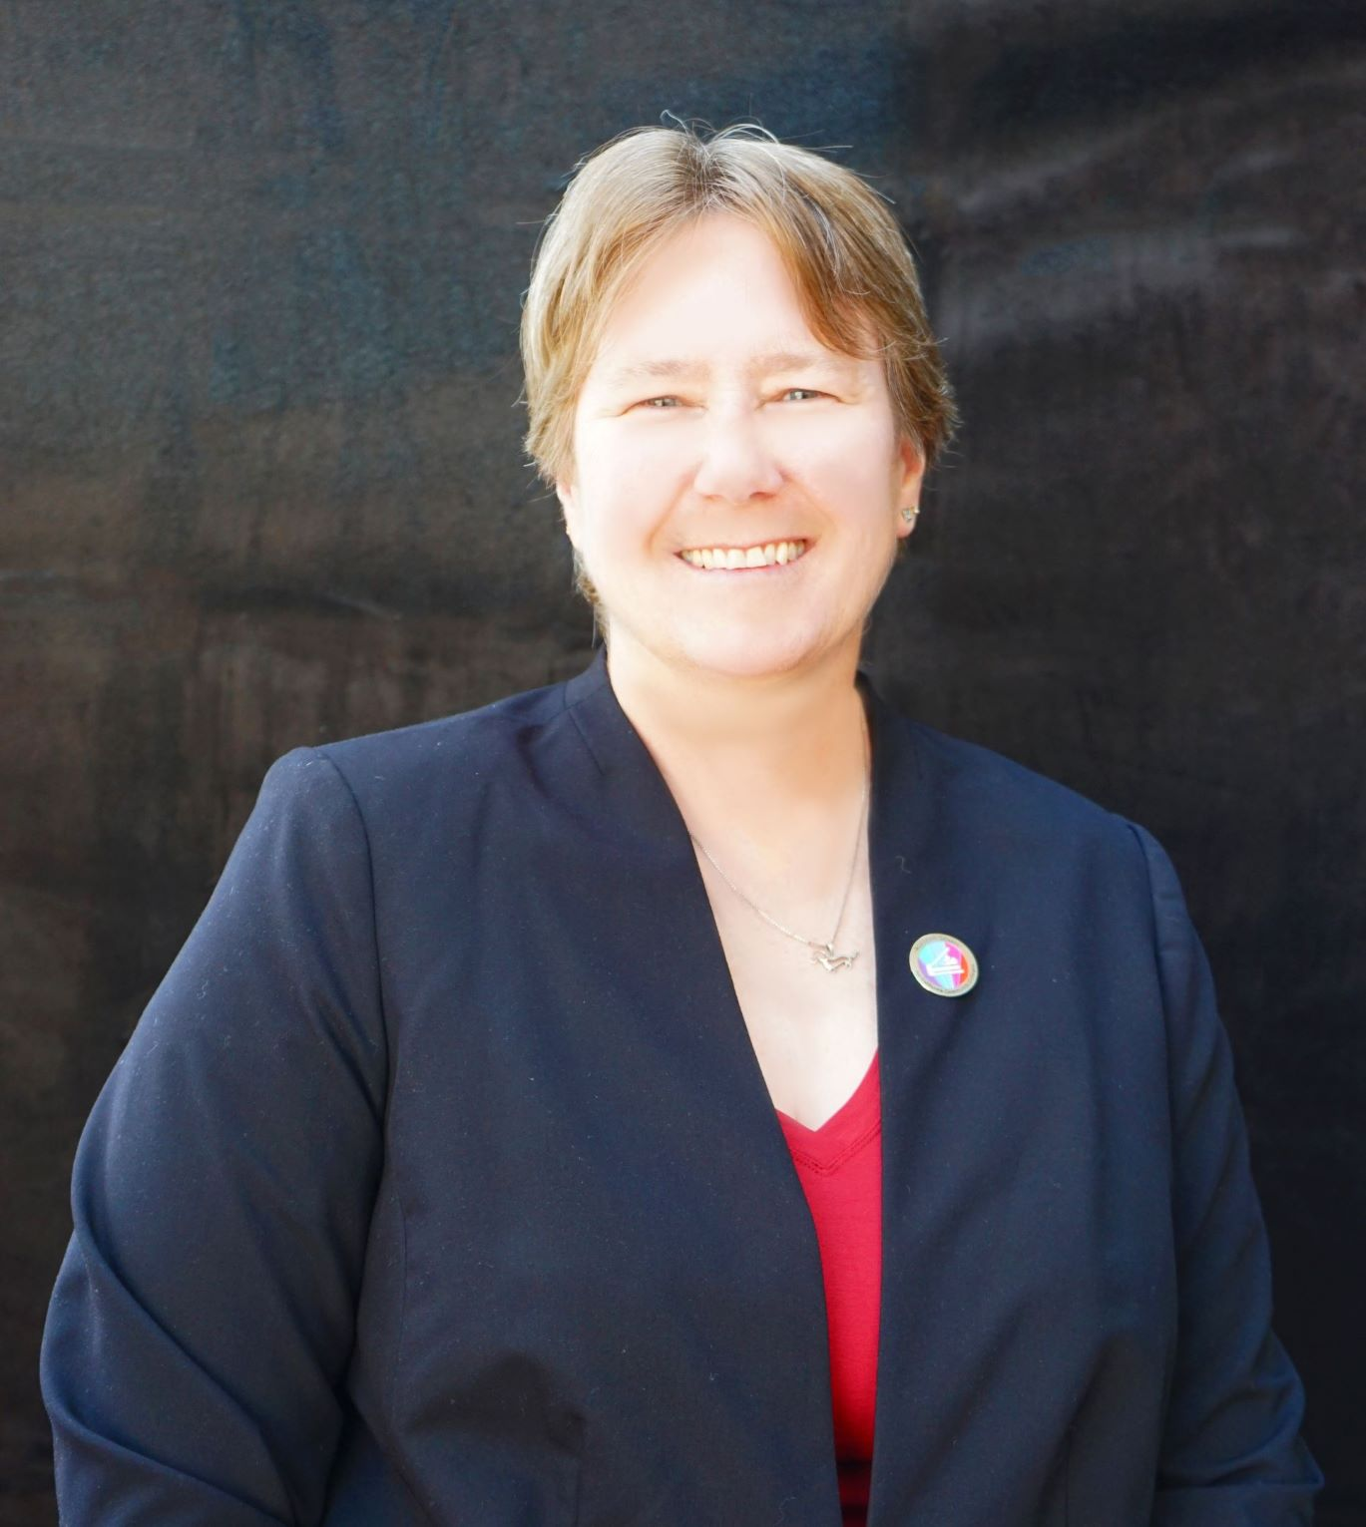
Welcome!
Cheryl Achenbach, ASCCC Vice President

Slide 3
Today's Agenda
I. Welcome- Cheryl Achenbach, ASCCC Vice President
II. Part Time Faculty Equity in the California
III. Part Time Faculty Survey
10 Minute Break
IV. Part Time Faculty Advocacy (Partnership with FACCC)
10 Minute Break
V. Part Time Faculty in Local and Statewide Governance and Curriculum
VI. Conclusion

Slide 4
Presenters and Partners
ASCCC Part Time Faculty Committee
•Joseph Ferrerosa
•Anastasia Zavodny
•Mussie Okbamichael
•Lindsay Weiler
•Lorraine Levy
•Sonja Downing
•Suji Venkataraman
•Elbina Rafizadeh
•Ian Colmer
•Robert L. Stewart Jr.
•Stephanie Curry
In Partnership with Faculty Association of California Community Colleges
Evan Hawkins, FACCC Executive Director

Slide 5
Sign up for FACCC
Become a member of FACCC here
https://faccc.memberclicks.net/index.php?option=com_mcform&view=ngforms&id=2053231#!/

Slide 6
ASCCC Resources
•ASCCC
•Part-Time Faculty: A Principled Perspective
•ASCCC Part-Time Committee
•Part-Time Nexus
•Resolution 19.01S21 Create a Paper on Part-Time Equity
•ASCCC Directory
•ASCCC Rostrum Feb 2021- An Open Letter: From an Adjunct Faculty Member to Full-Time Faculty
•ASCCC Part Time Faculty Listserv
Changing Community College Systems for Student Success

Slide 7
Upcoming Events
CTE and NonCredit Workshops
March 6, Laney College https://www.eventbrite.com/e/2023-cte-noncredit-north-regional-workshop-registration-483937589357
March 20, Compton College
https://www.eventbrite.com/e/2023-cte-noncredit-south-regional-workshop-registration-483967217977
Area Meetings A and B March 24, 2022- C and D March 25
2023 Spring Plenary (Hybrid Event) April 20-22, 2022
https://www.asccc.org/events/2023-spring-plenary-session
2023 Faculty Leadership Institute June 15-17, 2023
https://www.asccc.org/events/2023-faculty-leadership-institute
2023 Curriculum Institute July 12-15, 2023
https://www.asccc.org/events/2023-curriculum-institute-hybrid-event

Slide 8
Thank you for attending!
For future questions please send inquiries to info@asccc.org

