Slide 1

The 2024 Accreditation Standards
& Comprehensive Review Process
ASCCC Accreditation Institute
September 29, 2023

Slide 2

Principles Guiding the New Standards
  Align with Commission’s Eligibility Requirements, policies, and values
  Reflect current norms and practices within US higher education
  Focus on outcomes and improvement rather than processes
  Reflect the diversity of ACCJC member institutions
  Use clear language and minimize redundancies
  Balance accountability and improvement
  Emphasize equity and inclusion

Slide 3
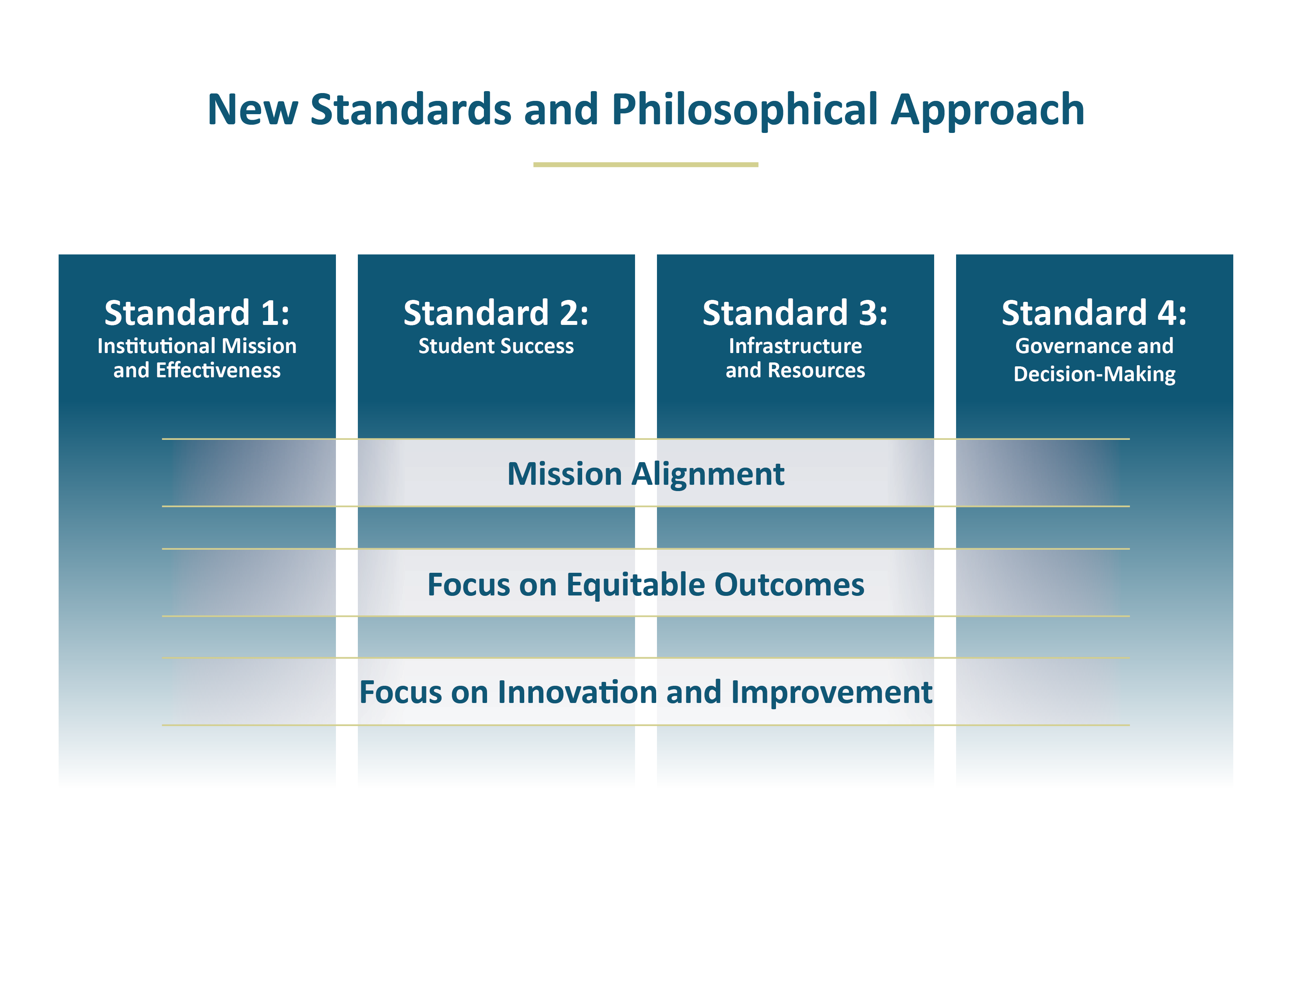
New Standards and Philosophical Approach

Slide 4
New Standards &
Holistic Institutional Approach
Address where relevant to the Standard:
  Technology and modality
  Baccalaureate degrees
  District’s role in multi-college districts

Slide 5
Overview of Major Changes in the Standards
FROM | → | TO
Repetitive and siloed | → | Streamlined and holistic
“do you have a process” | → | “what are the results, and how do you use them”
Narrative required for everything | → | Some documentation provided via checklist
120 Standards (127 for multi-college districts) | → | 30 Standards for all colleges

Slide 6
New Resources to Support the Changes
ACCJC Accreditation Handbook
Report templates with embedded guidance
Online certification modules for peer reviewers

Slide 7
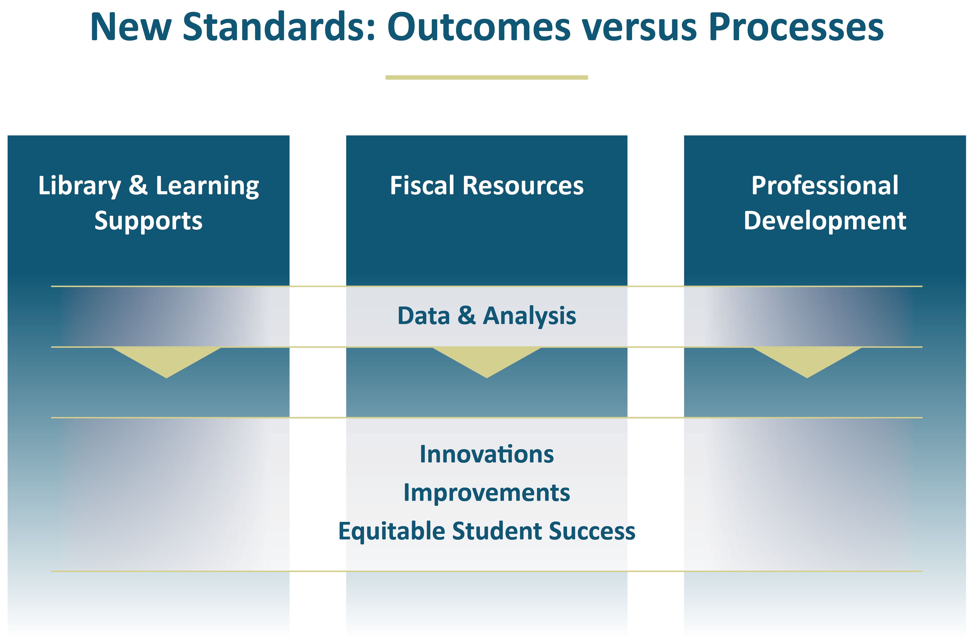
New Standards: Outcomes versus Processes

Slide 8
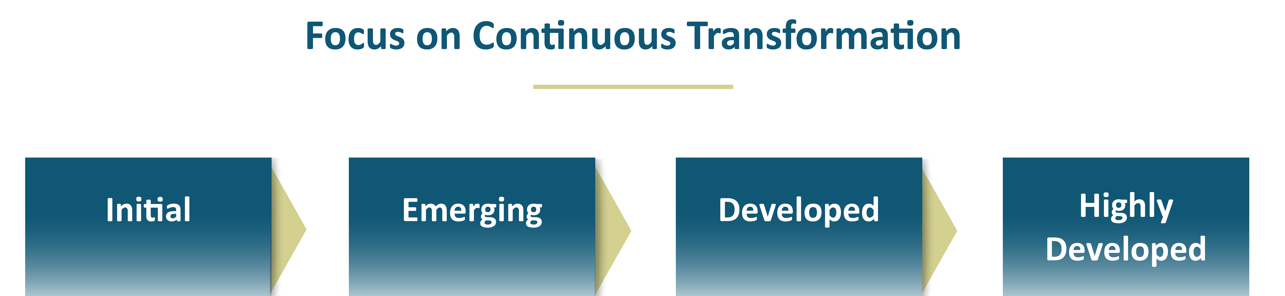
Focus on Continuous transformation

Slide 9
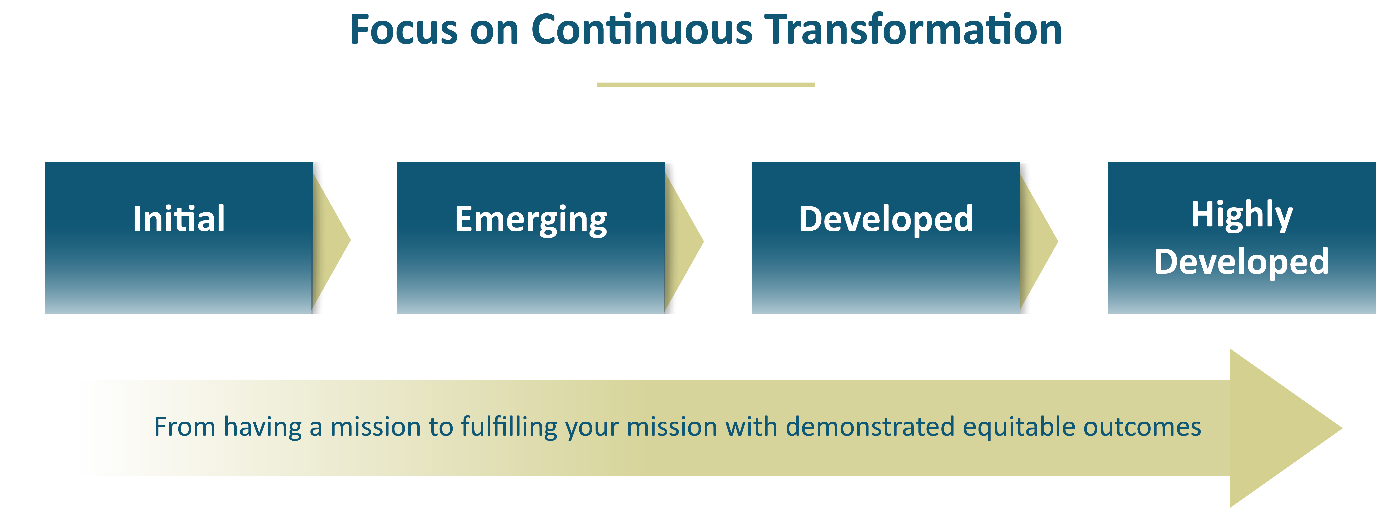
Focus on continuous Transformation 2

Slide 10


Institutional Self-Evaluation Report
Community
Public
Stakeholders
Campus
Students
Peer
Reviewers

Slide 11
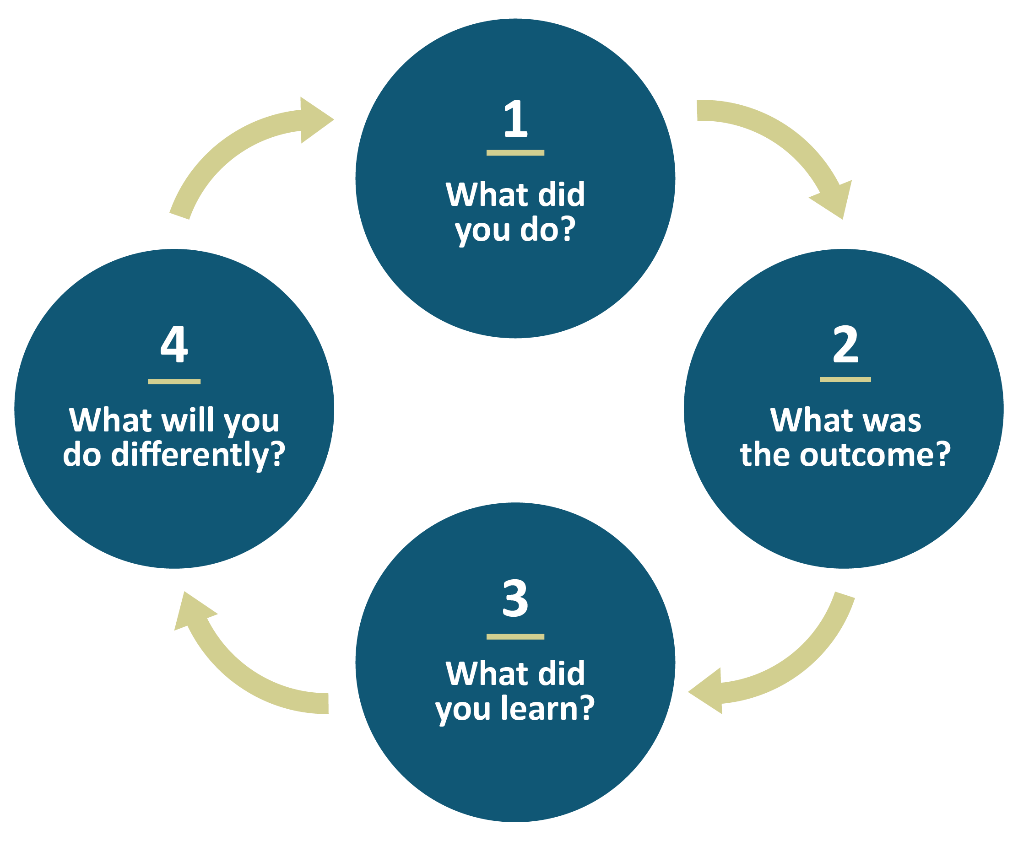
Forward-Looking Framework for Reflection

Slide 12
Evolving Expectations for
Institutional Self-Evaluation Reports
New ISER Template (embedded instructions for each section)
Major Sections in the Self-Evaluation Report | Suggested Length
Forward to the Institutional Self-Evaluation | 1 page
Introduction: Institutional Context | 2-5 pages
Institutional Self-Evaluation of Alignment with the Accreditation Standards | 60-70 pages
Required Documentation | (no narratives)
Appendices: 1 – Verification of Catalog Requirements 2 – Organizational Information 3 – Additional Approved Locations (if applicable) | (no narratives)

Slide 13
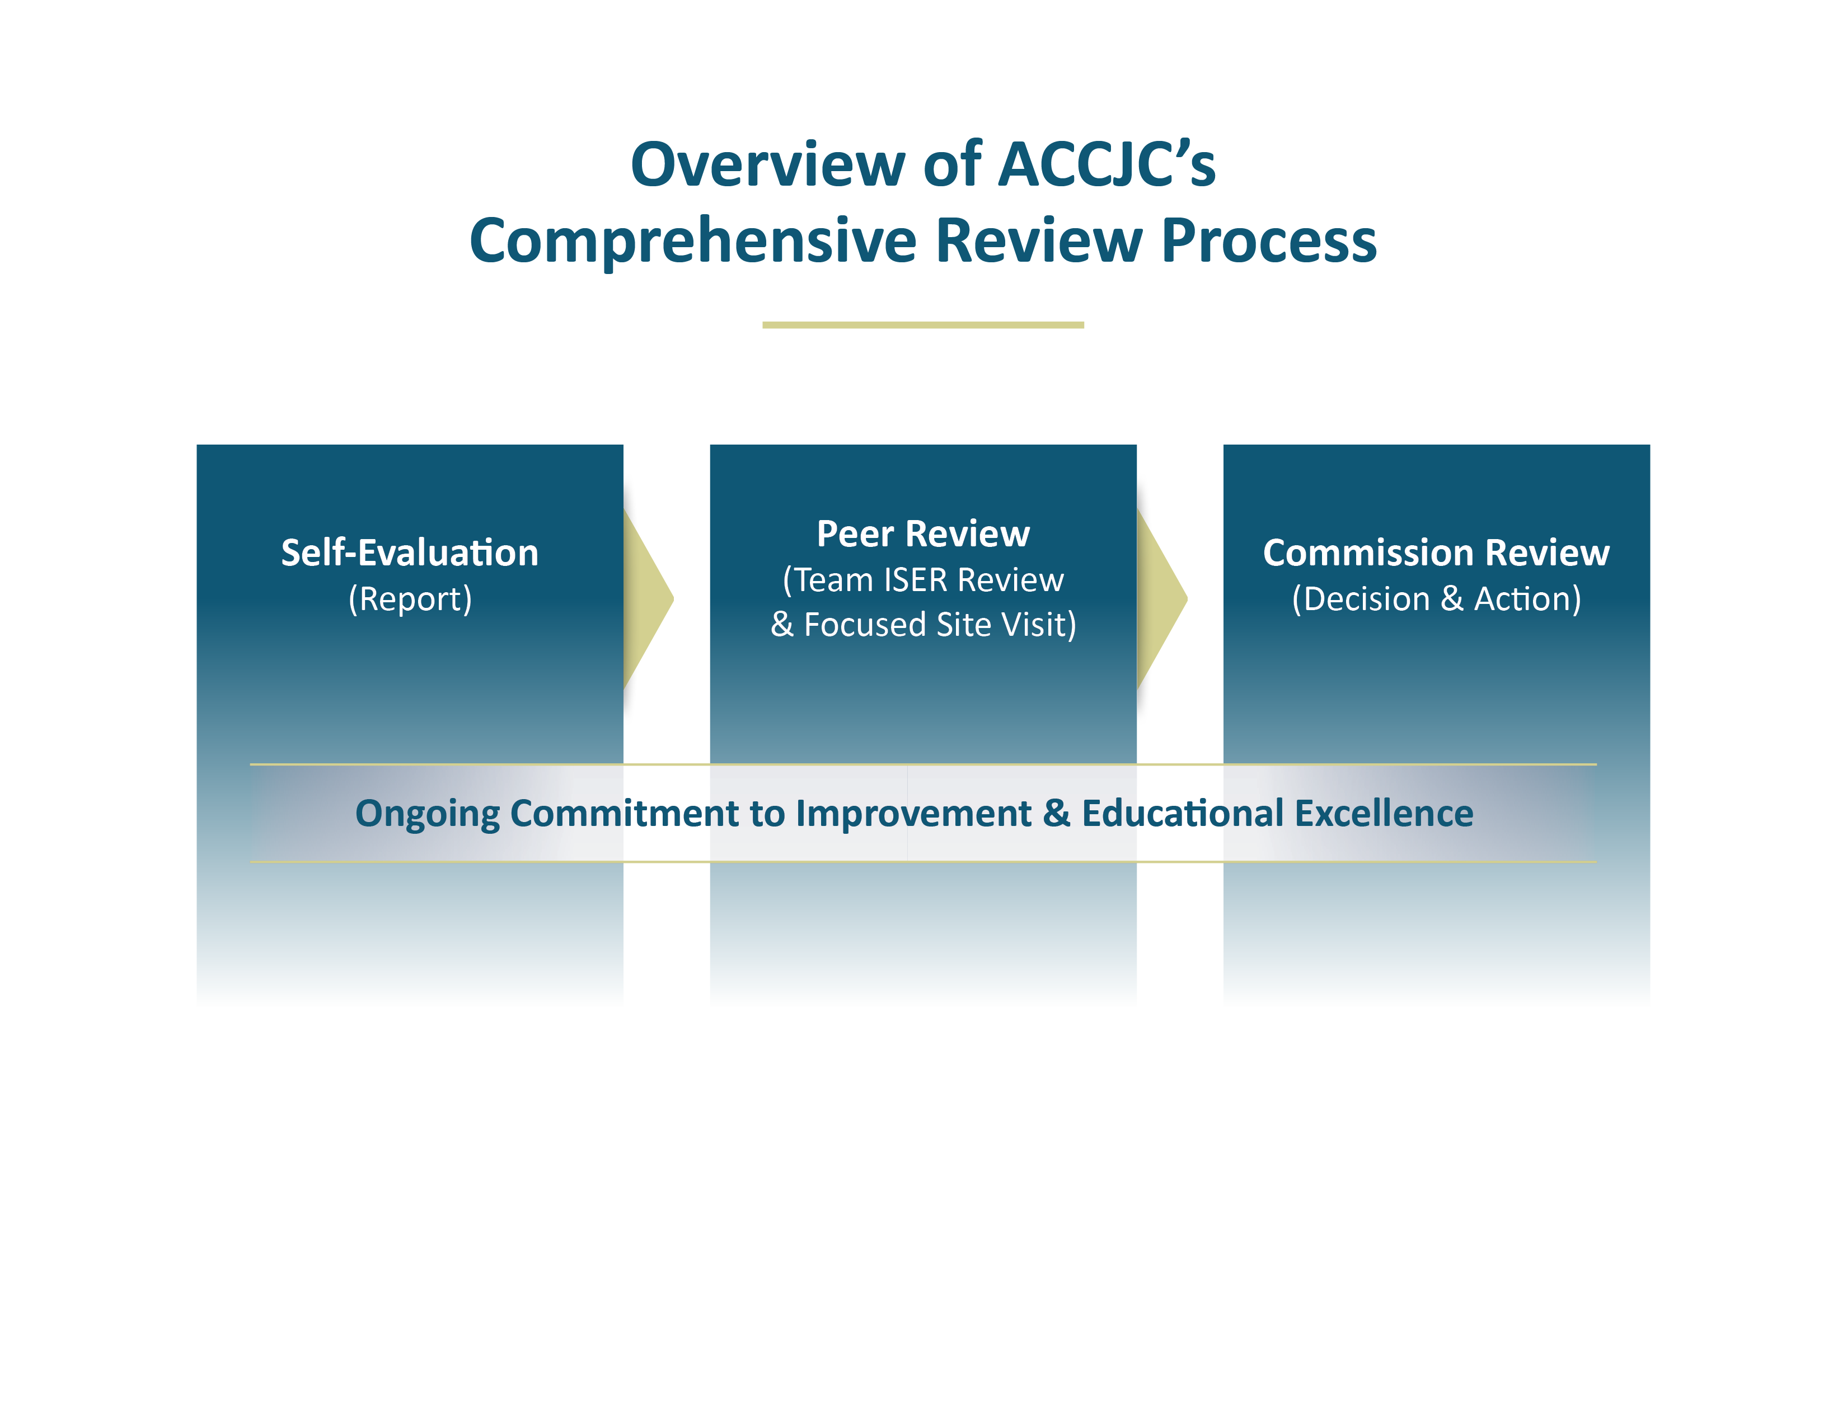
Overview of ACCJC’s Comprehensive Review Process
Notes:
4 major components from self evaluation, peer review, commission decision – with ongoing work throughout the accreditation cycle

Slide 14
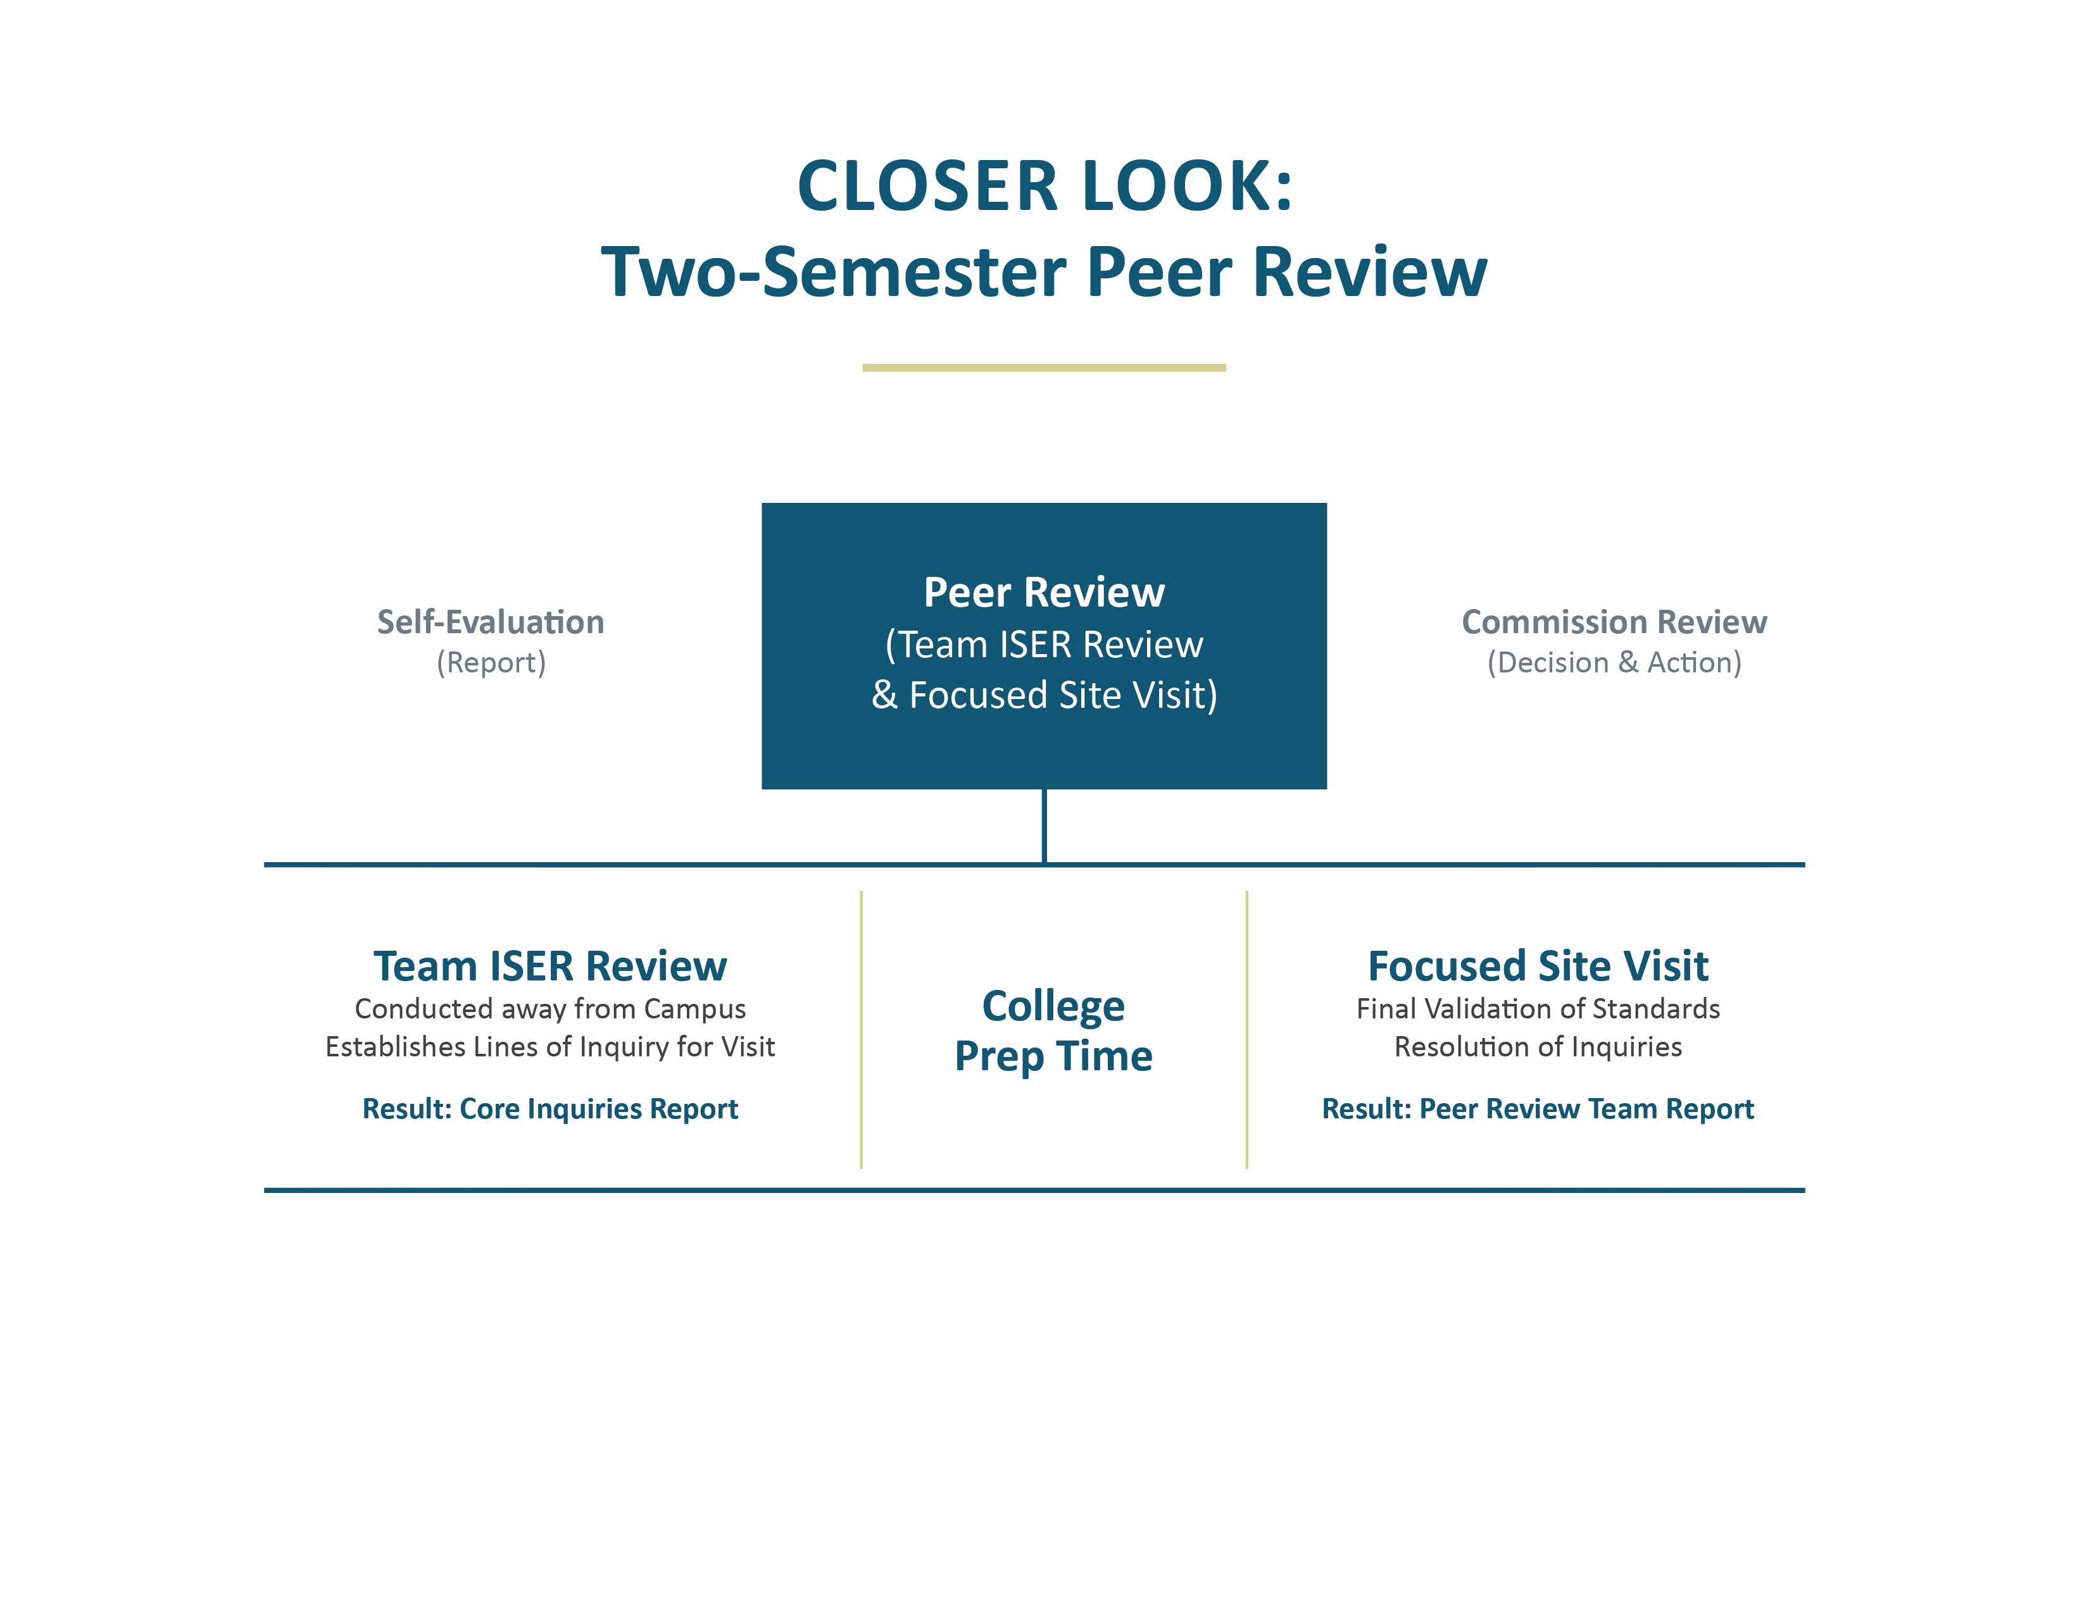
Close Look: Two-Semester Peer Review
Notes:
Peer review will occur over 2 semesters to enable teams to provide feedback to you with their core inquiries; provides time for you to prepare for visit –
Pause – if burning questions

Slide 15

Questions, Dialogue, and Feedback

Slide 16

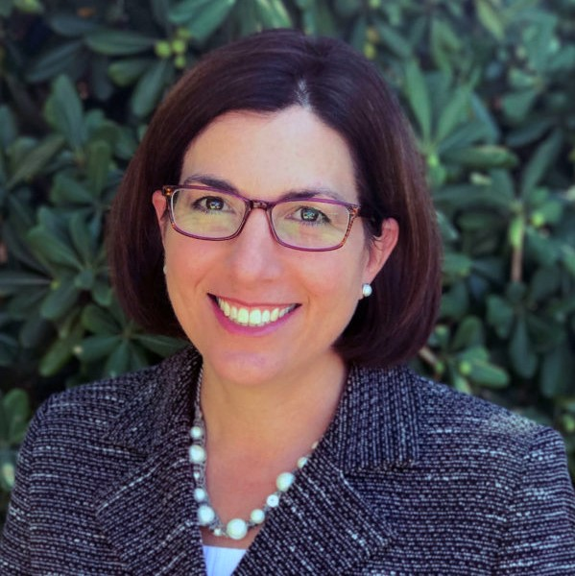


Contact Us
Kevin Bontenbal Vice President kbontenbal@accjc.org | Gohar Momjian Vice President gmomjian@accjc.org | Mac Powell President mac@accjc.org | Catherine Webb Vice President cwebb@accjc.org

