Slide 1
You Can’t Be What You Don’t See: Diversifying Our Academy Through Equity-minded Model Hiring Principles and Practices
Thursday, November 5 at 3:00 - 4:00 p.m.
Notes:
Michelle—intro (2 min)

Slide 2
Today’s Presenters
Michelle Velasquez Bean
ASCCC At-large Representative (she/her/hers)
Gregory Smith
Vice Chancellor of Human Resources, San Diego CCD (he/him/his)
Sam Foster
ASCCC South Representative
Emilie Mitchell
ASCCC Part-time Committee member and American River College Pride Center Faculty Coordinator (she/her/hers)

Slide 3
Session Description
Now is the time to interrogate and disrupt institutional and traditional views of hiring. How do we define the “best qualified” candidate to serve our diverse student communities? Join us to discuss creative approaches, principles, and practices that your campus could use to redefine the hiring and faculty retention processes through an equity-minded framework. We will discuss how to rethink our hiring systems during a period of political and economic disruption, how we can engage with each other to understand our diverse experiences, and how we can prioritize student success in every part of our employment processes including the hiring of part-time faculty hiring.

Slide 4
Today, we will discuss
State of the California Community College (CCC) System
CCC data
CCC mission statement
Making the invisible visible
Cultural humility and global citizenship
Economic imperative
Strategies and using the Canvas tool
Part-time hiring and mentoring programs
How to start the conversation on your campus
Notes:
Michelle (1 min)

Slide 5
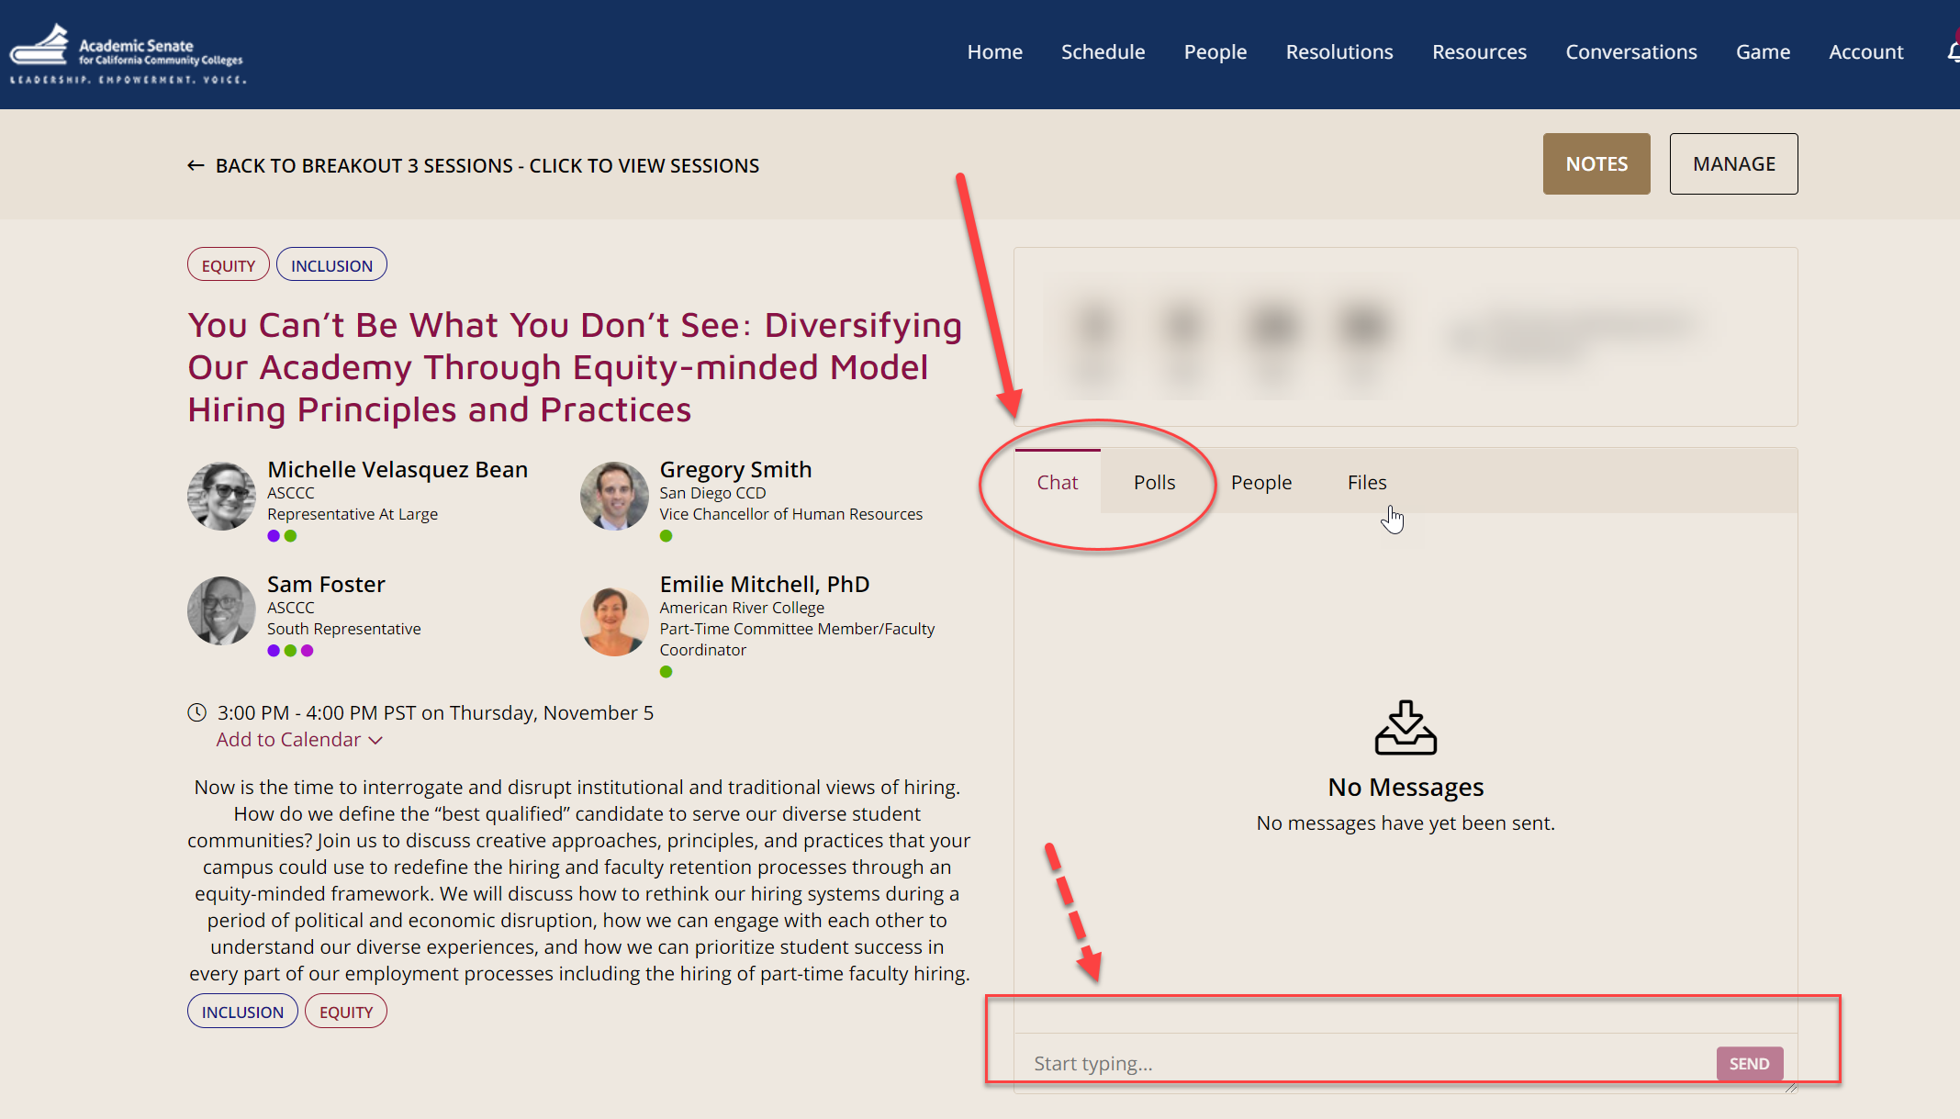
Use Pathable Chat for Your Questions
Notes:
Michelle and Emilie—chat captains

Slide 6
Quick Survey in Pathable
What is your level of expertise with anti-racism and equity-mindedness?
Novice--little experience (1-2 on a scale)
Proficient--some experience (3 on the scale)
Expert--very experience and knowledgeable (4-5 on a scale)
Notes:
Michelle –3 minutes

Slide 7
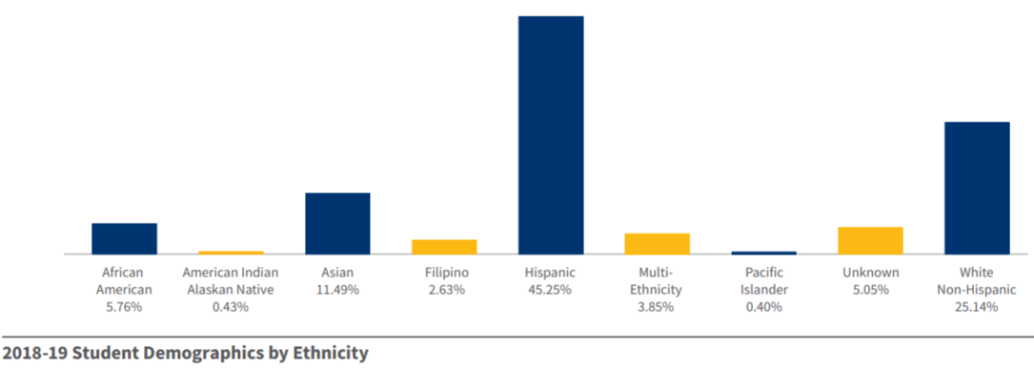
State of the System: Who We Serve
Student Demographic Data: 2020 State of the System Report
https://www.cccco.edu/-/media/CCCCO-Website/Reports/2020-sosreport-070620-a11y.pdf?la=en&hash=E7E8D6627C736FD9981E0CDCFE0C234C57F899B4
Notes:
Greg--3 min

Slide 8
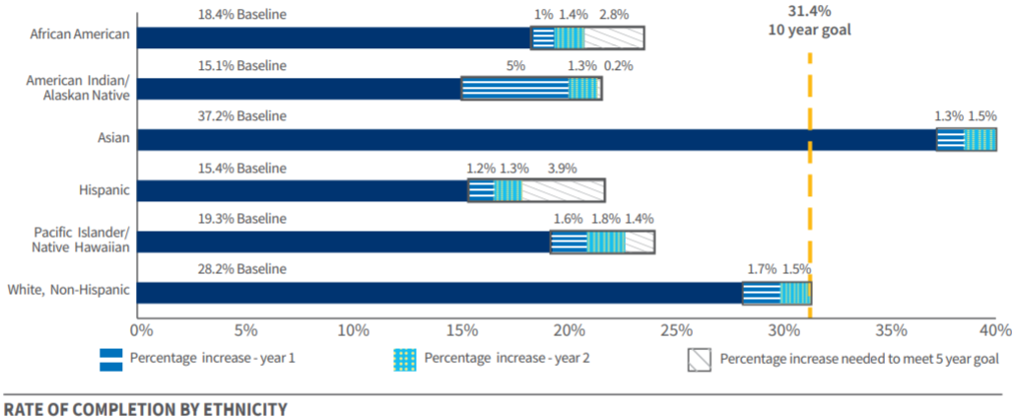
State of the System: Measuring Success
Student Completion Data: 2020 State of the System Report
https://www.cccco.edu/-/media/CCCCO-Website/Reports/2020-sosreport-070620-a11y.pdf?la=en&hash=E7E8D6627C736FD9981E0CDCFE0C234C57F899B4
Notes:
Greg

Slide 9
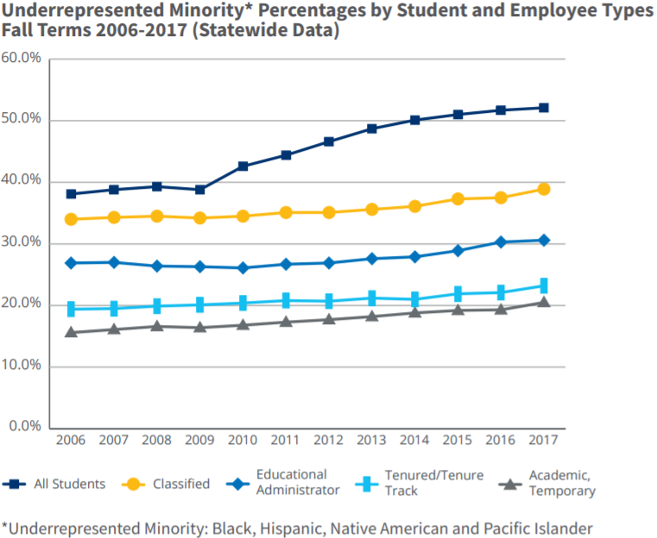
State of the System: The Diversity Disparity
2018 EEO Report
https://www.cccco.edu/-/media/CCCCO-Website/Reports/2019-cccco-eeo-report-final-web.pdf?la=en&hash=811F93AC7510F05001DE1BC2C85D88AEDEB00F41
Representation of communities of Black, Indigenous, and People of Color (BIPOC) among California Community College students has increased significantly since 2006 (approximately 12%)
During that same time, representation for BIPOC communities among all employee groups has increased only slightly (approximately 4%)
Notes:
Greg--2 min

Slide 10
Why This Work Is Vital
Notes:
Michelle--4 min
Dr. La Quisha Beckman Video Link (with her permission): https://youtu.be/_3_hqOT3a4Q
Alternate video (approx 4 min.):Titus Kaphar: Can Art Amend History: https://www.ted.com/talks/titus_kaphar_can_art_amend_history?language=en
Relevant section starts at 2:05 minutes and ends at 6:10 minutes

Slide 11
State of the System: Our CCC Mission Statement
“The mission and vision of the California Community Colleges is simple: putting students first.
The California Community Colleges will provide you with life-changing opportunities and a clear path to your goals.
Our vision is to the point: making sure you succeed in reaching your goals.
As the largest system of higher education in the nation, the California Community Colleges is positioned to help residents of all backgrounds improve their social and economic mobility.”
Notes:
Emilie--2 min
Source: https://www.cccco.edu/About-Us

Slide 12
Preparing Our Students
Cultural Humility
Global Citizenship
Notes:
Emilie--1 min (transition to Greg)
Picture Source & Copyright by Freepik

Slide 13
Making the Invisible Visible
Serving Students from a Global Citizen Framework
Cognitive Dimension: knowledge and thinking skills necessary to better understand the world and its complexities.
Socio-emotional Dimension: values, attitudes and social skills that enable learners to develop affectively, psychosocially, and physically and to enable them to live together with others respectfully and peacefully.
Behavioral Dimension: conduct, performance, practical application and engagement.
Notes:
Greg--3 min

Slide 14
The Economic Imperative
Student Centered Funding Formula (SCFF)
The SCFF metrics are in line with the goals and commitment set forth in the Vision for Success and can have a profound impact closing achievement gaps and boosting key student success outcomes
The SCFF directs state funds consistent with the Vision for Success and creates stronger financial incentives to support implementation of Guided Pathways
Notes:
Greg--3 min

Slide 15
The Economic Imperative (continued)
The SCFF goals are to 1) invest in progress toward the Vision for Success, 2) ensure that students who have faced barriers to success have additional support, and 3) make resources most useful to districts by making them stable, predictable, & flexible
With 30% of Total Computational Review dependent on serving Promise Grant, Pell Grant, and AB540 students and success outcomes, closing equity gaps is an imperative for fiscal stability and revenue growth
Notes:
Greg--2 min

Slide 16
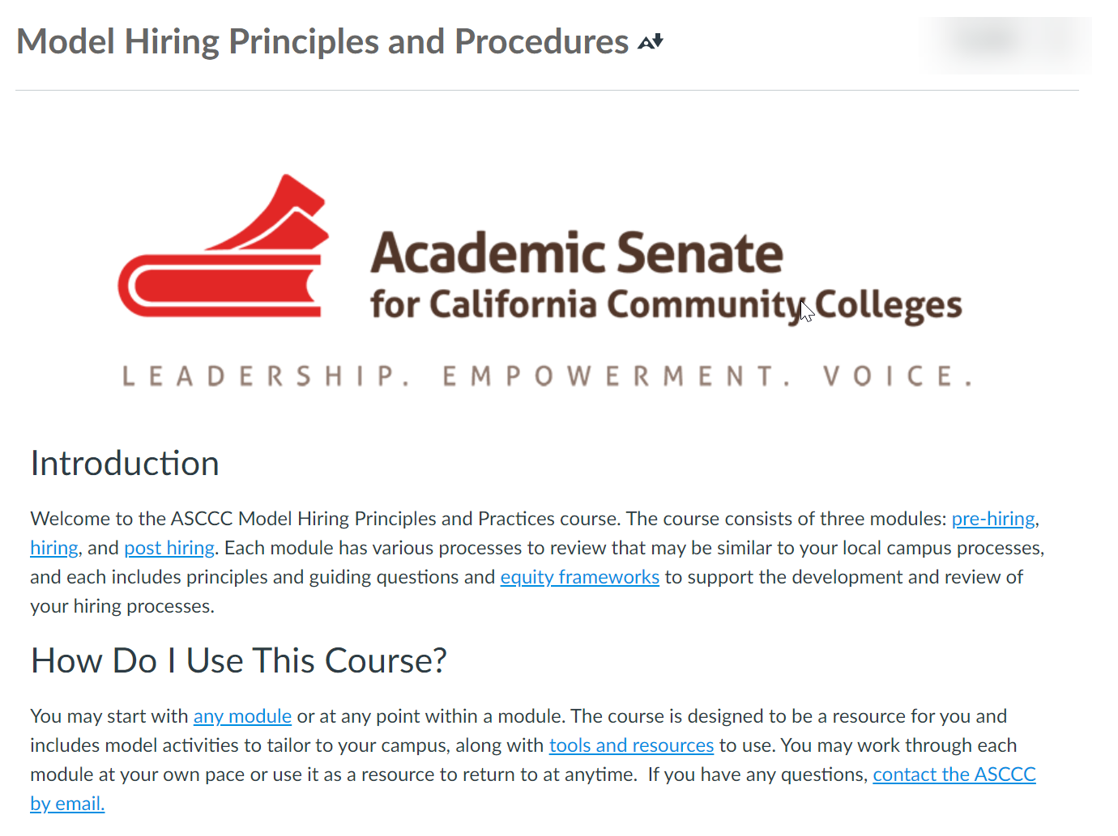
Using the ASCCC Canvas Tool
Notes:
Michelle--5 min
Link to Canvas: https://ccconlineed.instructure.com/courses/5733

Slide 17
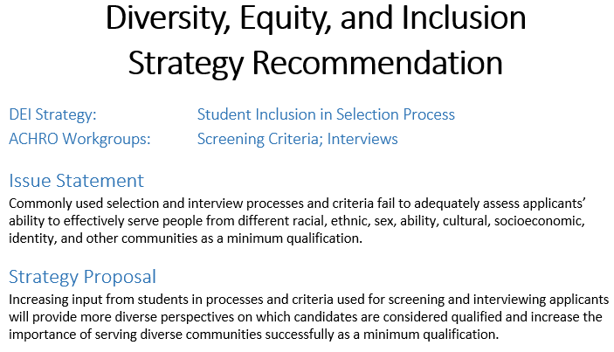
Example ACHRO DEI Strategy
Notes:
Greg--3 min

Slide 18
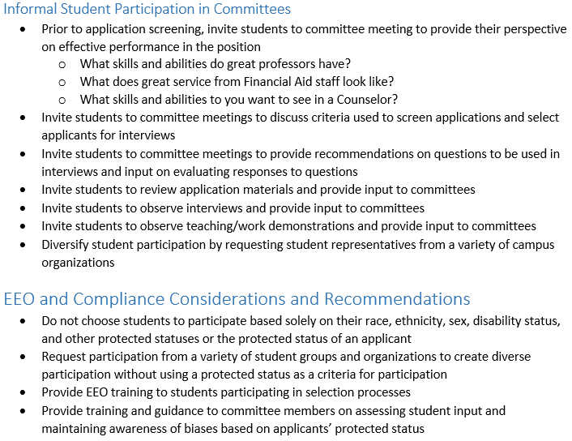
Example ACHRO DEI Strategy (continued)
Notes:
Greg

Slide 19
Expanding Your Toolbox
Design pipelines
Using existing networks, warm invitations, and warm handoffs
Intentional outreach
Create mentoring programs
New faculty academies
Employee resource groups
Continually and critically evaluate your institution
If faculty of color are not making tenure or leaving before obtaining tenure, you must ask yourself why
Remember: Every system is perfectly designed to get the results it gets!
Notes:
Emilie--3 min

Slide 20
Expanding Your Toolbox: Part-time Hiring
Key points
As of Fall 2019, part-time faculty make up 69% of the teaching faculty across the California Community College system
34% of part-time faculty are colleagues of color
Over half (54%) of part-time faculty are female
Be intentional with part-time hiring and seek diversity and inclusion
Part-time faculty have fewer opportunities
Provide opportunities for pipelines, internships, and shadowing
Invite part-time faculty to engage in shared governance meetings
Provide access to professional development
Have a codified hiring procedure for part-time faculty
Notes:
Sam--3 min

Slide 21
How to Start the Conversation
ASCCC Canvas module: folder with resources
Notes:
Sam--3 min

Slide 22
Questions
Notes:
5 min
Use the Q&A button
Michelle and Emilie (monitors of chat)--with all answering

Slide 23
For Further Information and Support
Email info@asccc.org
Always ask your local Human Resources or legal council
Contact Info:
mbean@riohondo.edu
mitchee@arc.losrios.edu
sfoster@fullcoll.edu
gsmith@sdccd.edu
Notes:
Michelle (1 min)

Slide 24
Other Helpful Resources
Remote/Virtual Interview Tips & Best Practices for Candidates
ASCCC Equity-mindedness for Virtual Hiring Webinar
How to Start Anti-racist Hiring Practices article
Vision Resource Center “Improving Equity in Campus Hiring”
Register for the VRC
Search for “Improving Equity in Campus Hiring”
Notes:
Michelle

