Slide 1
It’s Not Just About the Discipline - The Impact of Curricular Decisions Beyond the Classroom
Virginia Guleff, mendocino college
Vivian Varela, mendocino college
Michelle SampaT, Mt SAN Antonio College

Slide 2
An Overview
Requisites
Units
Resources
Overlap
Distance Learning, C-ID, General Education
Laws and Regulations

Slide 3
Adding or Removing Requisites
I Have to Take What?!?!?!
Potential Impacts:
Department
Scheduling
Enrollment Management
Student Success
Other?
Addressing Impacts:
Establishing a Process for Requisite Review
Communication: faculty and managers
Planning: scheduling and enrollment management
Maximizing Student Success
Other?

Slide 4
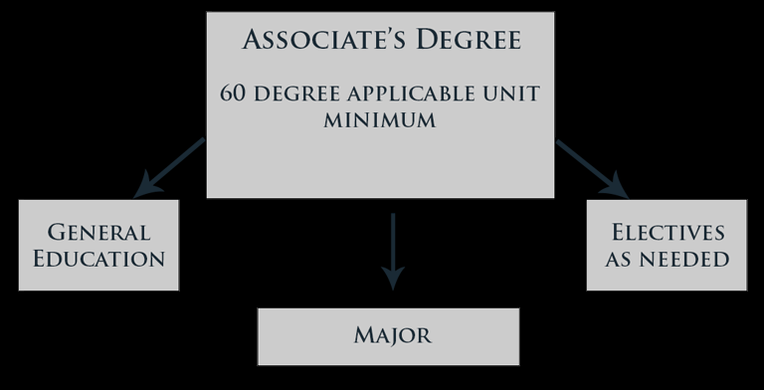
UNITS
That’s Going to Take 10 years to Finish!!!
Impacts
Programs
Load and Scheduling
Students
Addressing Impacts
Modifying Programs
Planning Ahead

Slide 5
RESOURCES
So you just approved a new drone program…but you don’t have drones and you don’t have faculty who can teach students how to fly drones. Oh dear!!!
Consider Resources
Faculty
Staff
Training
Facilities
Equipment

Slide 6
Connections
College Planning Documents
Strategic Plan
Educational Master Plan
Facilities Master Plan
Technology Master Plan
How are these developed on your campus? How can you connect your curriculum to these key planning documents?

Slide 7
OVERLAP
Hey!!! We already have that class!!!
Department Wars
Student Confusion
Destructive Competition or Smart Move?
How to Avoid Overlap

Slide 8
Distance Learning, C-ID, & General Education
Distance Learning: 51% Anyone?
Ensure Programs Don’t Cross the Threshold
C-ID: Take no Hostages
Your class may be holding up other Associate Degrees for Transfer
General Education: How Much is Too Much?
How many choices do students have?

Slide 9
Financial Aid
Show Me the Money!!!
Moving Courses From Credit to Noncredit
Noncredit: Free
Financial Aid Impact

Slide 10
Laws and Regulations
But It Would Be Sooooooo Much Fun!!!!
We Have to Adhere to the Following:
Laws
Title 5
Ed Code
Chancellor’s Office Requirements
Avoid Paying Back Apportionment!

Slide 11
Where Have You Been and Where Are You Going?
What kinds of problems have you had?
How does your college think broadly about curriculum?

