Slide 1
Keeping Meetings on Track: Ensuring Effective Participation
John Freitas, Los Angeles City College
Carol Kimbrough, Hartnell College
2015 ASCCC Curriculum Institute
Doubletree Anaheim-Orange County
July 9-11, 2015

Slide 2
In other words…
You want this!
Not this!

Slide 3
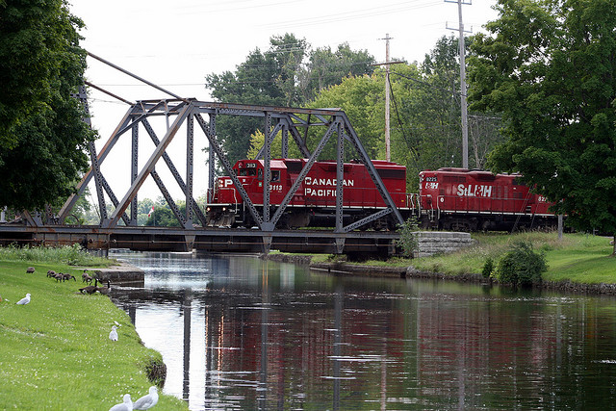
Overview
Building relationships
Planning meetings and creating agendas
Keeping the meeting on track
The Brown Act and Curriculum Committees

Slide 4
Ineffective Meetings
As difficult as it is to believe, there are many meetings that do not accomplish their intended goals
Each one of these meetings began with good intentions, but something caused them to become ineffective

Slide 5
Curriculum Chairs and Leadership: It’s All About Relationships
Want to be a good leader? Then you need to…
Build strong and respectful working relationships with your fellow faculty and with your administration
Strive to be fair and do what’s in the the best interests of your college and your students.
Be a consensus-builder
This doesn’t mean everyone is completely happy, but everyone can accept the compromise result

Slide 6
Relationships: Who’s On Board?
As a faculty leader, your greatest assets are the relationships that you build with all of your colleagues: faculty, administration and classified
These relationships can help you anticipate challenging conversations, address possible issues prior to a meetings, and to regain control of a meeting if things start to go badly

Slide 7
Relationships: Who’s On Board?
Chief Instructional Officer (CIO)
Schedule regular meetings with your CIO
Discuss (in advance) important issues that may impact agenda items
It is completely unproductive for the CIO and the Curriculum Chair to be disagreeing with each other during a committee meeting!
You and your CIO won’t always agree (shocking!)
Remember - Curriculum is a matter of faculty primacy and professional expertise (Ed Code §70902(b)(7) and Title 5 §53200)
However, your CIO has the responsibility to ensure compliance with legal and regulatory requirements, meets the college mission, etc. (see the CIO Manual, 1/e, July 16, 2012, pp. 18-19)

Slide 8
Relationships: Who’s on Board?
A Curriculum Chair and CIO need a good working relationship with each having mutual understanding and respect for the other’s roles:
when there is room for compromise
when there is need to defer to faculty
(know the 10 + 1)

Slide 9
Relationships: Who’s On Board?
Academic Senate President
Curriculum Committees operate under the umbrella of the Academic Senate
In some senates, the Vice President is the Curriculum Chair
Curriculum Chairs should regularly attend Academic Senate meetings
At a minimum, the Academic Senate President needs to be briefed on curriculum issues,
When possible, the AS President should attend Curriculum Committee meetings
Senate Presidents and Senates need to respect the work of the Curriculum Committee and not overstep boundaries

Slide 10
Relationships: Who’s on Board?
Faculty
Faculty may only get involved with curriculum when courses and/or programs are scheduled for review, or when they want to create a new class
Educate the faculty on new procedures and effective curriculum practice
Yearly professional development on curriculum software and review/approval procedures
Make yourself available to faculty to answer questions
When regulatory changes happen (like repeatability):
Get your CIO on board!
Meet with impacted faculty and explain what is going on and why

Slide 11
Before You Create Your Agenda:
Course Approval Process
Should involve the following individuals (at least):
Discipline faculty
Other faculty (especially similar content areas)
Articulation Officer
Area Dean
Library Resources
Others?
Technical Review
Work with your CIO, Articulation Officer, and classified staff to ensure you are as informed as possible and that appropriate questions have been asked and answered

Slide 12
Creating An Agenda
Discussion Items:
Include some background for discussion items (not just a series of attached files)
Establish time limits for each item to keep the discussions moving
Place updates on important items near the beginning of the agenda
Potentially influence the discussion for other agenda items
Examples include articulation, C-ID/TMC, accreditation, regulatory changes
Create an annual calendar of important curriculum dates/deadlines to be shared with all committee members at the start of the year.

Slide 13
Creating An Agenda
Consent Calendar
Use a consent calendar to approve course revisions with no substantive changes.
Agenda Items
First reading items (no action)
First reading items (action)
Second reading items (action)
Separate approval:
DE/Hybrid modality
Prerequisites/Corequisites
Units and contact hours
Others?

Slide 14
California Open Meetings Act… The Brown Act
Curriculum Committees are subject to the requirements of the Brown Act (G.C. §§54950-54963).
Meetings are open…to everyone!
Public must be allowed to make comments.
All action items must be clearly listed on an agenda that is publicly posted physically and online at least 72 hours prior to the meeting (must be accessible to public 24/7!)
Only a single reading is reading is required per the Brown Act
A good practice to ensure transparency and thorough review is to have action items go through two readings

Slide 15
The Brown Act
Action can only be taken on items listed on agenda for action (G.C. §54954.2).
Items listed for discussion or from public comments can only be acted on by 2/3 vote if 2/3 of voting members are present, or by unanimous consent if less then 2/3 present but with a quorum established (G.C. §54954.2(b)(2))…use sparingly!
All votes must be public and recorded in the minutes, i.e. how each person voted (or noes and abstentions if attendance is known at time of vote)…no secret ballots! (G.C. §54953(c)(1)

Slide 16
Brown Act Allowances for Actions Not Noticed G.C. §59954.2 (b)(1-3)
(b) Notwithstanding subdivision (a), the legislative body may take action on items of business not appearing on the posted agenda under any of the conditions stated below. Prior to discussing any item pursuant to this subdivision, the legislative body shall publicly identify the item.
(1) Upon a determination by a majority vote of the legislative body that an emergency situation exists, as defined in Section 54956.5.
(2) Upon a determination by a two-thirds vote of the members of the legislative body present at the meeting, or, if less than two-thirds of the members are present, a unanimous vote of those members present, that there is a need to take immediate action and that the need for action came to the attention of the local agency subsequent to the agenda being posted as specified in subdivision (a).
(3) The item was posted pursuant to subdivision (a) for a prior meeting of the legislative body occurring not more than five calendar days prior to the date action is taken on the item, and at the prior meeting the item was continued to the meeting at which action is being taken.

Slide 17
Managing the Meeting
As the Curriculum Chair, your role is to facilitate the meeting, manage the agenda, and provide additional information that the committee members will not have.
Whenever possible, make sure that you remain impartial.
Do not allow your committee to go down a path that could be problematic (like being out of compliance) for your college.

Slide 18
Managing the Meeting
Using Robert’s Rules as the basis for meeting procedures can make your meetings easier to manage. You might consider:
Time limits for each discussion and presentation item.
Time limits for each speaker during a discussion.
Allowing each speaker in a discussion to speak only once until everyone interested in commenting has had a chance to speak.
Keep conversations relevant, focused and within scope of committee responsibility.

Slide 19
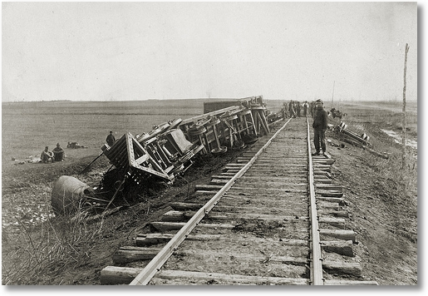
When Meetings Go Wrong
Things can go terribly wrong for new and experienced leaders!
Always try to remain calm. Everyone is looking for you to lead them and losing your temper will not help.
Heated arguments and circular discussions happen to all of us.
Expect a learning curve!

Slide 20
In Summary
Properly preparing BEFORE the meeting is essential and can help you identify and manage the tough situations.
Publish your agenda as early as possible.
Meet with folks before the meetings. See where they are coming from so you know what to expect.
Include some details on your agenda. Some background information will make it clear why you are having these discussions now.
Establish a standard start time to ensure a quorum is present.
Have established rules (Robert’s!) that allow you to regain control if things start to go south.
Remain calm and do your best!

Slide 21
Resources
Program and Course Approval Handbook, 5th Edition (6th Edition in development)
CIO Manual, 1st Edition, July 2012
Office of Administrative Law (www.oal.ca.gov)
For searching Ed Code and Title 5

Slide 22
Questions??
Thank you for joining us!
John Freitas– freitaje@lacitycollege.edu
Carol Kimbrough– ckimbrough@hartnell.edu

