Slide 1
Keeping Your Senate Involved, Engaged and On Course
John Freitas, Los Angeles City College, Area C Representative
Ginni May, Sacramento City College, North Representative
Faculty Leadership Institute
San Jose Marriott
June 11-13, 2015

Slide 2
Welcome!
As we go through this session, be thinking about the following:
What brings you here?
What would you like to
learn?
Notes:
On the next slide we will go through the Outcomes of this Breakout Session. As we do this, consider these questions. You can either write your responses on a 3 by 5 card, or voice them during the discussion.

Slide 3
Outcomes…
In this breakout session, you will learn about:
Senate Operations – some important roles and responsibilities of your local academic senate and academic senate presidents
Training and orienting your academic senate
Communication and Engagement – Working with committees, organizations, and other constituencies in your college/district and statewide
Asserting faculty primacy…collegially, of course!
The significance of the academic senate president’s signature

Slide 4
Senate Operations

Slide 5
Senate Operations
Governing Documents – constitution, bylaws, rules
Senate meetings – agendas, meeting materials, Brown Act
Senate committees – members and chairs
Delegation of work…don’t try to do it all!
Recommendations to president/chancellor/board
Do you have a local “10+1” agreement delineating “rely primarily” and “mutually agree”?
Notes:
Governing documents include your local Academic Senate Constitution and By Laws, the “10+1” in Title 5, a result of AB 1725 that was passed in 1988. The Power is defined in § 53200 and granted in § 53203.

Slide 6
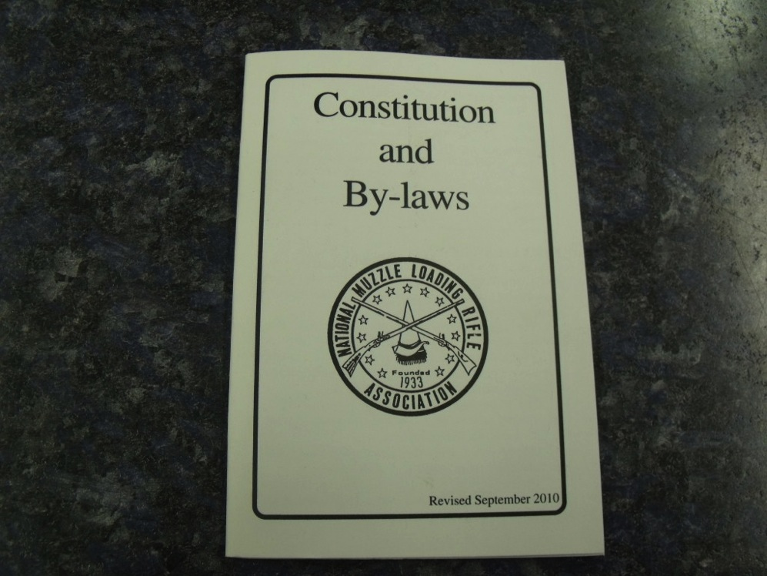
Senate Operations Governing Documents

Slide 7
Senate Operations Governing Documents – It’s up to Faculty!
Title 5, section 53202:
(c) The governing board of a district shall recognize the academic senate and authorize the faculty to:
Fix and amend by vote of the full-time faculty the composition, structure, and procedures of the academic senate.
Provide for the selection, in accordance with accepted democratic election procedures, the members of the academic senate.

Slide 8
Senate Operations Governing Documents
All senators (and administrators) should understand these:
Constitution
Broad-strokes, high-level document approved by the entire faculty
Provides the basic structure and authority of your senate
Bylaws
Provide the operational structure of the senate consistent with the provisions of the constitution and is approved by the senate
Standing Rules
Provides more detailed procedures (e.g. process for running elections) and are approved by the senate (majority)
Parliamentary Authority
Default rules of order, e.g. Robert’s Rules of Order Newly Revised
Notes:
Constitution – vote of the faculty body, 2/3 of ballots cast
Bylaws – 2/3 vote of the senate
Rules – majority vote of the senate
Consider drafting a senate handbook

Slide 9
Senate Operations
Governing Documents – constitution, bylaws, rules
Senate meetings– agendas, meeting materials, Brown Act
Senate committees – members and chairs
Delegation of work…don’t try to do it all!
Recommendations to president/chancellor/board
Do you have a local “10+1” agreement delineating “rely primarily” and “mutually agree”?

Slide 10
Senate Operations
Senate Meetings – when, where, how long, format, etc. the Brown Act
Senate Committees – establish Chairs and members, let the chairs do their work, but ask to be cc’ed so that you are informed.
Delegate!!! You have an Executive Committee and Senators for a reason!

Slide 11
Senate Operations
Governing Documents
Senate meetings – agendas, meeting materials, Brown Act
Senate committees – members and chairs
Delegation of work…don’t try to do it all!
Recommendations to president/chancellor/board
Do you have a local “10+1” agreement delineating “rely primarily” and “mutually agree”?
Notes:
Know your College/District policy and regulations regarding the delineation of “rely primarily upon” and “mutually agree”.

Slide 12
Senate Operations Collegial Consultation
Title 5, section 53203:
(a) The governing board of a community college district shall adopt policies for appropriate delegation of authority and responsibility to its college and/or district academic senate. Among other matters, said policies, at a minimum, shall provide that the governing board or its designees will consult collegially with the academic senate when adopting policies and procedures on academic and professional matters. This requirement to consult collegially shall not limit other rights and responsibilities of the academic senate which are specifically provided in statute or other Board of Governors regulations.
Notes:
Governing documents include your local Academic Senate Constitution and By Laws, the “10+1” in Title 5, a result of AB 1725 that was passed in 1988. The Power is defined in § 53200 and granted in § 53203.
Can you think of the “other rights and responsibilities”? Processes for administrator retreat rights, equivalency processes, faculty hiring processes, faculty appointments to colege/district committees. How about course approval by curriculum committees?

Slide 13
Senate Operations Collegial Consultation (“10+1” ) Agreements
Recommended practice that delineates which of the 10+1 are “rely primarily” and which are “mutual agreement.”
Without an agreement the board can choose the form of collegial consultation on a case-by-case basis
Established in board policies between the board and local senate
Multi-college districts – policies may vary depending on whether or not there is a district senate and may allow for separate agreements between college senates and college presidents
Agreements may also include
Process for reaching mutual agreement
Title 5 requirements for appointment of faculty to district and college committees (§53203(f))
Example – LACC Collegial Consultation Agreement

Slide 14
Train and Orient Your Senate
Professional Development for Your Senate
Senate retreats
Embedded training during senate meetings
Try activities like the ASCCC/CCLC participatory governance scenarios http://www.asccc.org/sites/default/files/Scenarios.pdf
Local Senate Visits
http://www.asccc.org/services/local-senate-visits
ASCCC Leadership Resources
http://www.asccc.org/communities/local-senates/leadership-resources
Attend ASCCC Plenary Sessions and Institutes
http://www.asccc.org/calendar/list/events

Slide 15
Communication and Engagement

Slide 16
Communication and Engagement Local
Provide reports to your college…not just to faculty!
Committee reports at senate…not just senate committees
Liaisons from other constituencies
Administrators at senate meetings
District updates
Notes:
Consider emailing senate meeting announcements, materials, reports etc. to the entire college (or links to web postings). Can use the bcc field in your email program

Slide 17
Communication and Engagement Statewide and Beyond
ASCCC - http://www.asccc.org/home
Newsletter listservs http://www.asccc.org/signup-newsletters
Participate statewide! http://www.asccc.org/content/application-statewide-service
Chancellor’s Office
Senate presidents receive daily news digests and press releases
Source for handbooks and guides such as PCAH, Minimum Qualifications, etc. http://www.cccco.edu
Accreditation
Ensure regular updates at senate meetings
Consider holding all-campus town halls and open forums
ACCJC information and publications http://www.accjc.org
Legislation
Consider a legislative liaison for your senate
Track current and research past legislation at http://leginfo.legislature.ca.gov

Slide 18
Asserting Faculty Primacy…Collegially

Slide 19
Asserting Faculty Primacy…Collegially
Educate your administrators
Hold regular consultation meetings
Recommendations on academic and professional matters are made by senates, not by other bodies, unless local policies/procedures state otherwise
College participatory governance committees – senate representation ≠ collegial consultation!
Engage staff and students for input on policies and procedures under senate purview
Staff and students have right to “participate effectively in district and college governance” (Ed Code §70902(b)(7), Title 5 §51023.5 and §51023.7)
Maintain good relations with your union colleagues
Understand your collective bargaining agreement – it has the force of law
Assert senate role, but be aware of rights your union had prior to AB 1725
Educate union leaders on the role of senates
Notes:
Ask about ways to ensure effective participation of staff and students. Faculty leaders should understand and support the role of staff and students in governance.

Slide 20
But wait, there’s more…
There is another important faculty group:
Your Faculty Union!
Work together on joint issues
Both groups are faculty advocates

Slide 21
Title 5 and Senate/Union Relations
Title 5 §53204
Nothing in this Subchapter shall be construed to impinge upon the due process rights of faculty, nor to detract from any negotiated agreements between collective bargaining representatives and district governing boards. It is the intent of the Board of Governors to respect agreements between academic senates and collective bargaining representatives as to how they will consult, collaborate, share, or delegate among themselves the responsibilities that are or may be delegated to academic senates pursuant to these regulations.

Slide 22
Senate President’s Signature

Slide 23
Senate President’s Signature
Reports to the state – Basic Skills, Student Equity, SSSP, others?
Reports to the ACCJC – Self-Evaluation Report, Follow-up and Midterm Reports, others?
Recommendations to president/chancellor/board
Formal letters to president, chancellor, board, CCCCO

Slide 24
Senate President’s Signature It has significance
A senate president’s signature signifies that the senate was consulted collegially or otherwise consulted appropriately in accordance with local policies and procedures
When a senate president signs a document, he/she is signing on behalf of all of the faculty at his/her institution. Therefore, a senate president should ensure that his/her signature on a document represents the will of the faculty.

Slide 25
Senate President’s Signature Last Minute Signatures?
The ASCCC Recommends the Following:
Inform the college faculty and administrators that materials calling for the senate president’s signature or approval must be submitted in their entirety to provide enough time for a full review of the academic senate in advance of the intended mailing or submission date.
Refuse to sign materials that are incomplete or are proffered in circumvention of the senate’s established process. Such a refusal is not unprofessional if administration has not followed proper procedure.

Slide 26
Senate President’s Signature Last Minute Signatures?
The ASCCC Recommends the Following:
Inform the faculty or administrators that materials requiring senate approval will be taken to the next senate meeting or officers' cabinet meeting as stipulated by senate bylaws or standing rules. "I will get back to you as soon as the senate has made its decision" is an acceptable and responsible statement.
If a document or report requiring the senate’s approval arrives late for what appear to be legitimate reasons and such late submissions are unusual for the local administration, then exploring a method to expedite the approval in this specific case can be the collegial action. In contrast, if the administration makes a habit of such late submissions, that habit is unlikely to change unless the senate insists on following proper procedures and withholds approval until the process has been followed.

Slide 27
Resources
Local Senates Handbook – ASCCC, Adopted Spring 2015
ASCCC Local Senates Leadership Resources http://www.asccc.org/communities/local-senates/leadership-resources
Participating Effectively in District and College Governance – ASCCC/CCLC, Adopted Fall 1998 http://www.asccc.org/sites/default/files/Participating%20Effectively%20in%20District.pdf
Scenarios to Illustrate Effective Participation in District and College Governance, ASCCC/CCLC joint publication http://www.asccc.org/sites/default/files/Scenarios.pdf
Office of Administrative Law – for looking up Ed Code and Title 5 citations (www.oal.ca.gov)

Slide 28
Questions?

