Slide 1
LAOCRC Noncredit Strong Workforce Project 2018 Career and Noncredit Education Institute
L.E. Foisia, Mt. SAC, Professor, Basic Skills
Dr. MadelyN Arballo, Mt. sac, Dean, School of Continuing Education
May 4, 2018

Slide 2
Round 1 – Noncredit Bootcamps
Maintained an engagement in LAOC Regional Consortium
Contextualized courses at Mt. SAC
Proposed as bootcamps/pre-college coursework
AEBG and emergence of the Regional Consortia for adult education
Unchartered territory
Notes:
Mad: and people were asking I,e healthcare math, ESU Welding, basic skills biology

Slide 3
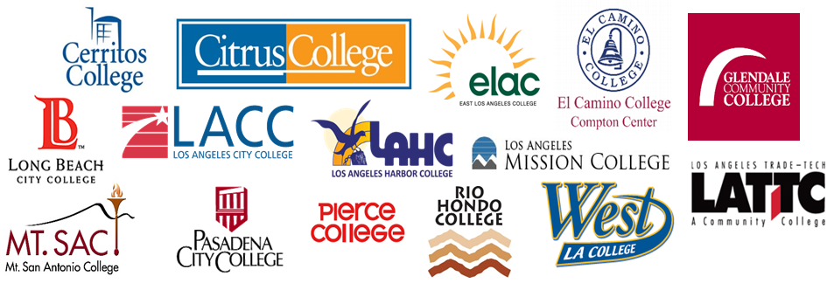
History of Project and Round 1
August 2016
Lead colleges Mt. SAC and Citrus
November 2016
Proposed the project as CTE Readiness Bootcamps to LA Regional Consortium; 11 colleges initially joined
January 2017
Approved as a noncredit curriculum project
March 2017
Project participation of 16 colleges
Notes:
Madelyn

Slide 4
Noncredit Benefits
Growth and enhanced funding (CDCP)
Building capacity for short-term vocational became the priority
Not one way to offer noncredit
Flexible scheduling, customizable, responsive to community, business and industry, and college need
Skill-building, competency-based
Offer as mirrored courses
Free
No “unit creep”, won’t affect financial aid
Notes:
Mad
LA County colleges different stages of development
CTE most underdeveloped for most colleges

Slide 5
Round 1 Project Progress
Met or spoke to representatives from all 15 colleges
Identified student needs and target sectors at each college
Organized colleges into sectors
Academic Senate curriculum training
Held summer LA Regional noncredit curriculum meeting
Wrote curriculum
Notes:
LE

Slide 6
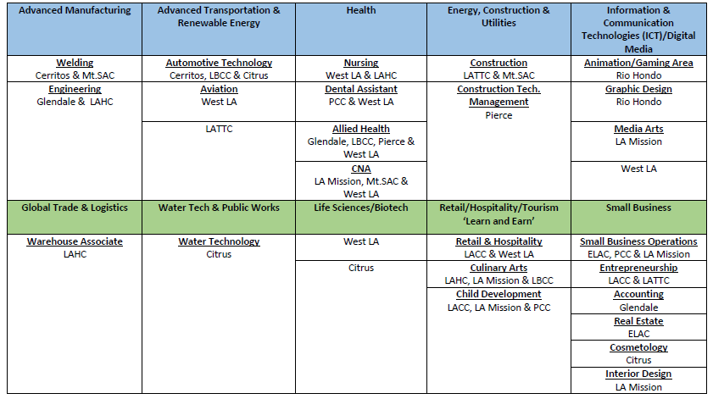
Regional Sectors
Notes:
LE

Slide 7
Noncredit Readiness Courses
Contextualized Courses
Reading & Writing
Regional Collaboration
Held regional faculty work group meetings to review the curriculum
Math
English for Special Uses
Career Development
Computer Skills
Worked with colleges to develop contextualized courses and Pre-CTE courses
Notes:
LE

Slide 8
Contextualized Course: West LA College Collaboration
Identified a need for a computer class to prepare students for different vocations
Computer skills: Microsoft Word, Excel, and PowerPoint
Collaborated with West LA faculty to develop course outline
Wrote the course to be general so that it could be contextualized to different disciplines
Computer Skills for the Workplace
Notes:
LE

Slide 9
Pre-CTE: Rio Hondo College Collaboration
Preparing students for credit CTE pathways
Noncredit Certificate: Career Exploration: Graphic Design
Course Prefix and Number | Title of Course
GDSN 291 | Graphic Design I: History
GDSN 292 | Graphic Design III: Academic Pathways
GDSN 293 | Graphic Design II: Process
GDSN 294 | Graphic Design IV: Career Paths
Notes:
LE

Slide 10
Pre-Apprenticeship in Noncredit
Notes:
Mad

Slide 11
Pre-Apprenticeship Certificate
Intro to Trades 1
Intro to Trades 2
Career Development
Introduction to the various building and construction trades
Essential topics related to various building and construction trades:
Career preparation, assessment, and interest inventory
Math for College & Career Readiness
Contextualized math course
Overview and history of the trades and unions
Basic components of a blueprint
Green construction
Financial literacy
Construction health and safety
Prepares students for successful transition to college, apprenticeships, and employment
Preparation for entrance into the apprenticeship programs and construction industry
Exploration of career fields and employment opportunities
Resume writing, cover letter, interview skills, and employment portfolio
Internet for use in career exploration
Notes:
Mad & LE

Slide 12
Moving on to Round 2
Go big and innovate
Notes:
Mad

Slide 13
Round 2
Round 1 project discussions and initial outcomes
Development of community of practice
Expansion of scope
Synergy generated within the first six months of Round 1
All 19 Los Angeles regional colleges committed to be part of the Round 2 project.
Project awarded $4M+ for Round 2, Year 1 and 2
Notes:
LE: Round 1 project discussions and initial outcomes demonstrated the need to expand work done in the noncredit realm

Slide 14
Round 2 Project Objectives
Expand capacity among the LA County community college noncredit Short-term Vocational programs
Contribute to the SWP purpose of producing a middle-skilled workforce
Some colleges have very developed noncredit vocational programs
Shared expertise among the regional faculty
Provide professional development
Notes:
Mad

Slide 15
Round 2 Workplan
Workplan Activities
Hire faculty liaison, project manager
Create noncredit pre-CTE coursework and certificates mapped to credit pathways and work
Identify CTE discipline experts within each college to provide context for the noncredit coursework
Create noncredit course materials: teaching modules and relevant course materials
Notes:
Mad

Slide 16
Round 2 Workplan
Workplan Activities
Develop webinars by noncredit faculty providing teaching strategies and use of materials for courses
Hold professional development activities for credit and noncredit faculty
In collaboration with K-12 adult school partners, this project will support Regional Adult Education plans
Notes:
Mad

Slide 17
Plan for Summer Professional Development (tentative topics)
State Academic Senate Noncredit Technical Visit – July 19, 2018
Noncredit curriculum development training
ASCCC faculty experts in curriculum development and CTE
Presentations and hands-on training (feedback on course outlines and create certificates)
Sharing of best practices
Request data from COE and gather labor market data to determine gaps across colleges and identify possible pre-CTE and contextualized courses
Notes:
Mad & LE

