Slide 1
Legislation in California: What Should I Know as an Academic Senate Leader? Breakout Session 2 | 11:45-12:45
Notes:
Ginni

Slide 2
Legislative and Advocacy Committee
Dolores Davison, ASCCC President
Ginni May, ASCCC Vice President, Chair
Adrienne C. Brown, Los Angeles Harbor College
Geoffrey Dyer, Taft College
Christopher Howerton, Woodland Community College
Alexis Litzky, City College of San Francisco
Notes:
ALL Ginni, Dolores, then alphabetical

Slide 3
Description
After an unprecedented ending to the 2019-20 two-year legislative cycle, what will happen during the next two-year cycle, 2021-22? During this session the presenters will include a review some of the highlights from 2019-20, a glimpse into what might be expected for the 2021-22 cycle, an outline of the legislative and budget processes, and a discussion on how academic senate leaders can leverage their roles to influence and impact statewide legislation through advocacy on academic and professional matters.
Notes:
Ginni

Slide 4
Overview
The California Legislative Cycle
The 2019-20 Legislative Cycle in review
The 2021-22 Legislative Cycle looking ahead
Budget Process
Advocacy on Academic and Professional matters
Statewide
Locally
Notes:
Ginni

Slide 5
The California Legislative Cycle
The Legislative Branch of the California State Government is composed of the State Assembly, the State Senate, and several other departments.
This branch of government holds the principal lawmaking powers of the state.
On average, the Legislature will propose, analyze, and debate over 5,000 bills in a two-year session.
Assembly Members and Senators are limited to introducing fifty and forty bills (each, respectively) per two-year session.
Possible 5,600 bills per two-year cycle (80x50+40x40=5600)
Notes:
Dolores <3

Slide 6
California Law
Other than the legislative process, laws are changed by:
State ballot
Initiative process – requires just over 50%
Constitutional Amendment – 2/3 majority
Budget process
Trailer Bill – AB and SB annual for each house
Notes:
Ginni

Slide 7
Curriculum in Legislation
Legislators increasingly interested in impacting education through legislation at all levels, including the California Community Colleges.
Examples of bills…
SB 850 (Block, 2014) – Baccalaureate Degrees
AB 1985 (Williams, 2016) – Advanced Placement Exams
AB 440 (Beall, 2009) – Transfer Degree
SB 1440 (Padilla, 2010), SB 440 (Padilla, 2013) – ADTs
AB 705 (Irwin, 2017) – English, Mathematics, ESL placement
AB 1460 (Weber, 2019) – Ethnic Studies in CSU
AB 1930 (Medina, 2020) – CSU/UC Student requirement changes
AB 3310 (Muratsuchi, 2020) – Ethnic Studies in CCC
Legislation in recent years has had significant curricular impacts.
Resolution for Consideration by the delegates: F20 6.01 Oppose Legislation of Curriculum without Inclusion of Academic Senate
Notes:
Dolores and Ginni

Slide 8
The 2019-20 Legislative Cycle in review
Bills in 2019
AB 30 (Holden, 2019) -- Expansion of Dual Enrollment (passed)
AB 968 (Garcia, 2019) – Naturalist Pathway Curriculum (died)
AB 1460 (Weber, 2019) – Ethnic Studies Requirement in California State Universities (two-year bill)
AB 1512 (Carrillo, 2019) – International Baccalaureate General Education Credit (two-year bill)
SB 462 (Stern, 2019) – Forestland Restoration Curriculum (died)
SB 484 (Portantino, 2019) – Auto awarding of degrees (died)
By the numbers in 2019 (January-September)
2625 bills introduced (166 in higher ed)
1042 sent to Governor (870 became law, 172 vetoed)
85 bills signed into law effect CCCs
Notes:
Dolores & Ginni

Slide 9
The 2019-20 Legislative Cycle in review
Bills in 2020
Passed:
AB1460 (Weber): CSU Graduation Requirement: Ethnic Studies
AB3137 (Voepel): College Promise: Members of the Armed Forces
AB3374 (Committee on Higher Ed): Nursing
Vetoed:
AB331 (Medina): Pupil instruction: high school graduation requirements: ethnic studies.
Died: 19 Bills (see last slide)
Augmented Cycle due to COVID-19
Priority was given to bills that:
Absolutely must pass this year;
Directly related to Covid-19;
Alleviates homelessness; or
Related to wildfire preparedness or response to PG&E bankruptcy.
Calendar (revised July 24, 2020):
August 31, 2020: Last day for each house to pass bills.
September 30, 2020: Last day for Governor to sign or veto bills
October 1, 2020: Bills enacted on or before this date go into effect January 1, 2021
Notes:
Christopher Howerton!

Slide 10
The 2021-22 Legislative Cycle looking ahead
Typical Cycle – Part 1
January – February
A bill is introduced by member of Senate (numbered as SB) or Assembly (numbered as AB).
March – May
Amendments – revisions, improvements
Committees hearings
Education, Appropriations (fiscal)
Last week of May
Bills that make it through go to the floor of the house for vote
Bills to Look for…
Amendments to Student Transfer Achievement Reform Act
Ethnic Studies
Baccalaureate Programs
Others…
Notes:
Adrienne *Remember, two-year CALENDAR years (not academic year)

Slide 11
The 2021-22 Legislative Cycle looking ahead
Typical Cycle – Part 2
June – August
Same process is repeated in other house
September
Concurrence
If both houses pass the bill, then it moves onto the Governor’s desk
October ☛ Governor’s Desk
Veto – reject the bill
Sign – make the bill into law
Ignore – bill becomes law**
House override – 2/3 vote of both houses
Bills go into effect 1 January unless otherwise noted
Committees to watch…
Assembly and Senate have similar structures
Committee on Higher Education
Multiple subcommittees on budget and other aspects of Higher Ed
Committee on Higher Ed and the Judiciary
Committee on the Budget
Appropriations
The Suspense File
Notes:
Adrienne

Slide 12
The Budget Process (July-July)
Release of Governor’s Budget
Legislative Analyst’s Analysis
Budget Subcommittee Hearings
Governor’s Revisions
Budget Subcommittee Final Actions
Conference Committee
Legislative Actions
Governor’s Consideration
Implementation
Agency Submittals of Requests to Department of Finance
Board of Governors Adoption of Budget and Legislative Request
Submission of Priorities from Stakeholders to Chancellor’s Office
Notes:
Geoffrey

Slide 13
The Budget Process (in a Typical Year)
Department of Finance
Prop 98 Money
Governor’s January Budget (drops by 10 January)
Trailer Bill Language
Governor’s May Revisions (the May Revise)
June 15 Deadline for Legislature -- Must be printed 72 hours ahead of deadline
Notes:
Geoffrey

Slide 14
Advocacy on Academic and Professional Matters: Statewide
Legislation and Advocacy Committee
Letters in Opposition or Support
Resolutions
Legislative Visits
Legislative Advocacy Day
Intersegmental Committee of Academic Senates (ICAS) Advocacy Day
Information to Local Legislation Liaisons
ASCCC President, Executive Director, Vice President legislative visits
Notes:
Dolores & Ginni

Slide 15
Advocacy on Academic and Professional Matters: Statewide
ASCCC Legislative Priorities for 2021 Session:
Transfer Pathways (from 2020)
Faculty Diversity (from 2020)
Expansion of Baccalaureate Degree Programs in Allied Health (from 2020)
Ethnic Studies Graduation Requirement
Notes:
Ginni & Dolores

Slide 16
Advocacy on Academic and Professional Matters: Locally
Be familiar with processes
Meet with local legislators and others involved with budget
Discuss legislative priorities with your Board of Trustees
Make sure your academic senate has a Legislative Liaison
Sign up for the ASCCC legislative liaison listserv by emailing info@asccc.org
Volunteer to serve on the Legislative and Advocacy Committee and other committees!
Center inclusion, diversity, equity and antiracism in all advocacy endeavors, ensuring we are not perpetuating inequities is vital to every effort
Notes:
Chris and Alexis (1st 3), Geoffrey (4 and 5), and Adrienne (last two)

Slide 17
Legislative Information
ASCCC Legislation Information:
https://www.asccc.org/directory/legislative-and-advocacy-committee
Under the “Resolutions” tab on this page, all ASCCC resolutions about legislation are listed.
Faculty Association for California Community Colleges (FACCC) information:
http://www.faccc.org/current-legislation/
http://www.faccc.org/2018-legislative-and-budgetary-priorities/
The Assembly Committee on Higher Education:
http://ahed.assembly.ca.gov
The Legislative Analyst Office (LAO):
http://www.lao.ca.gov
The Department of Finance Budget Page:
http://www.ebudget.ca.gov
Legislation Information, including bill status:
https://leginfo.legislature.ca.gov

Slide 18
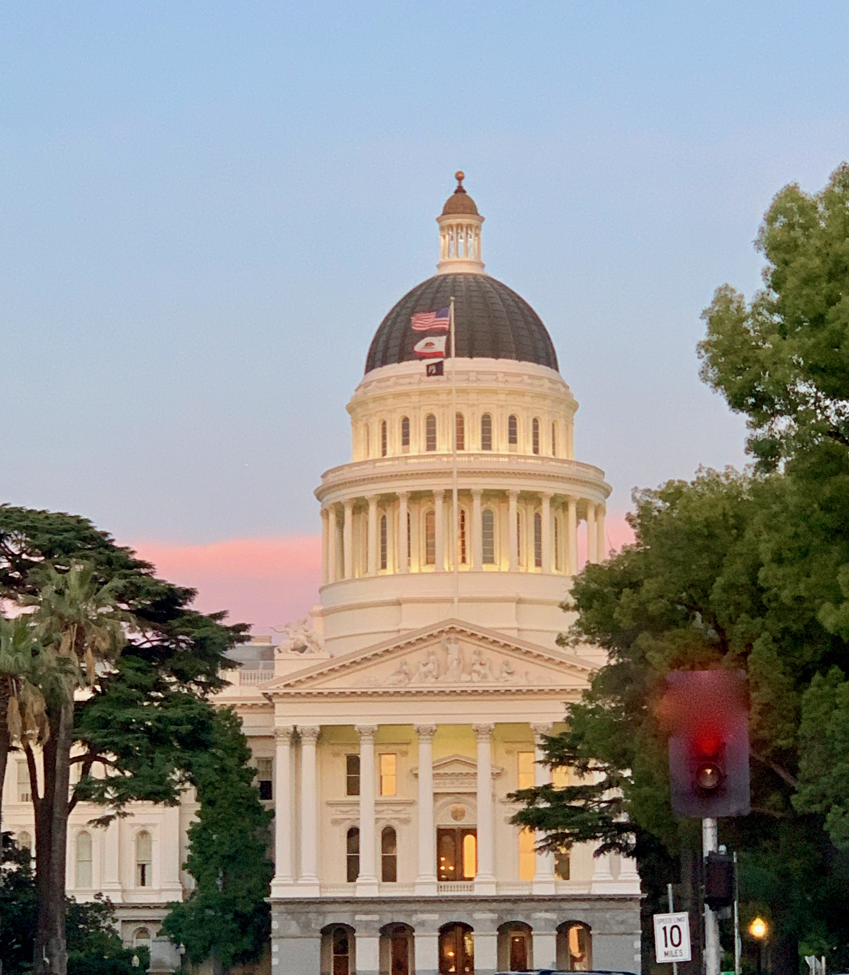
Questions?
Additional questions?
Email info@asccc.org
Thank You!

Slide 19
2020 Dead Bills
AB1862 (Santiago): CSU Tuition
AB1930 (Medina): Student Eligibility Requirements
AB1970 (Jones-Sawyer): Pilot Program for Free Tuition and Fees: Working Group
AB2009 (Cunningham): Human Trafficking Awareness Training
AB2019 (Holden): CCAP Agreements
AB2156 (E. Garcia): Concurrent award of associate degree and high school diploma
AB2335 (Rivas): Community Colleges: Student Equity Plans
AB2494 (Choi): Course credit for prior military education, training, and service.
AB2764 (Gloria): Waiver of Open Course Provisions: military personnel
AB2776 (Lackey): Statewide baccalaureate pilot program
AB2982 (Salas): Textbook Affordability
AB3000 (Frazier): Credit for Prior Learning
AB3310 (Muratsuchi): Ethnic Studies
SB874 (Hill): Baccalaureate Degrees
SB987 (Hurtado): Premedical Pathway Pilot Program
SB1026 (Wilk): Statewide Baccalaureate Degree Pilot Program
SB1083 (Pan): Mental Health Counselors
SB1104 (Hill): Statewide Baccalaureate Degree Program
SB1155 (Hertzberg): LACCD Pilot Program

