Slide 1
The Legislature Did What?!
John Stanskas, ASCCC Vice President
Wendy Brill-Wynkoop, College of the Canyons
Steve Cirrone, Sacramento City College
Academic Senate for California Community Colleges
Fall 2017 Plenary Session

Slide 2
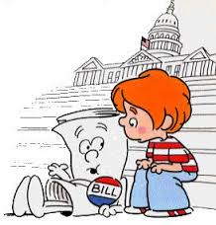
Overview
Legislative Cycle
Review of 2017 Term
ASCCC Priorities
Talking to Legislators
Notes:
What works better for student learning?

Slide 3
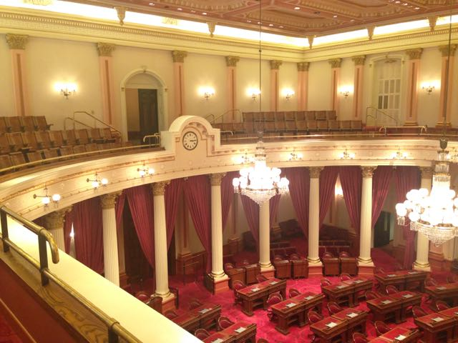
The Legislative Cycle
Two-year cycle (follows the election cycle)
Begins with an idea from community or organization
Member carries idea to house, and authors bill
Senate – 40 members
Assembly – 80 members
How to follow a bill
ASCCC, FACCC, Unions, etc.
http://www.legislature.ca.gov/port-bilinfo.html

Slide 4
The Legislative Cycle
January – February
A bill is introduced by member of Senate (numbered as SB) or Assembly (numbered as AB).
March – May
Amendments – revisions, improvements
Committees hearings
Education, Appropriations (fiscal)
Last week of May
Bills that make it, go to the floor of the house for vote

Slide 5
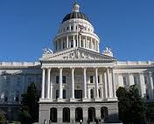
The Legislative Cycle
June – August
Same process is repeated in other house
September
Concurrence
If both houses pass the bill then it moves onto the Governor’s desk
Governor’s Desk – by October 15
Veto – reject the bill
Sign – make the bill into law
House override – 2/3 vote of both houses
State Proposition
50% of electorate change law or veto law

Slide 7
New Laws That Affect CCCs
Budget Bill
Base Funding Increase
Money for Guided Pathways
Veteran’s Resources
C-ID
AB21 (Karla) and others
Protections for undocumented students

Slide 8
New Laws That Affect CCCs
AB214 (Weber) Food Security
Eases CalFresh process for students
AB637 (Medina) Online Education
Allows cross-enrollment in online
education courses for students
from one college to another
college

Slide 9
New Laws That Affect CCCs
AB1018 (Reyes) Student Equity
Explicitly includes homeless students, former foster youth, and LGBTQI+ student reports in Student Equity Plans
SB12 (Beall) Foster Youth
Expands CAYFES grant from 10 to 20 CCCs

Slide 10
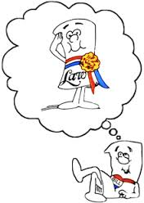
New Laws That Affect CCCs
ACR32 (Medina)
AB19 (Santiago)
College Promise Program
AB705 (Irwin)
Matriculation, Assessment for Placement, Curricular Re-design in Basic Skills

Slide 11
Bills that Failed
Bachelor’s Degree Expansions
Office of Higher Ed. Performance
and Accountability
AB 847 (Bocanegra)
Academic Senate Diversity – 2-year bill now

Slide 12
ASCCC Legislative Priorities
Audit Fee
Full-Time Faculty and Faculty Diversification
Permanent and Sustainable Funding for C-ID

Slide 13
ASCCC Legislative Priorities
Dedicated Professional Development Money for ASCCC to convene faculty discipline meetings to improve student success and completion*
Wrap-Around Student Support (Mental Health, Increased Direct Aid for Food and Housing Insecurity)

Slide 14
Influencing the Legislature
Create a Legislative Liaison position for your senate.
Garner support for position from other faculty groups.
Write letters of support or opposition to legislators.
Bring resolutions to ASCCC plenary sessions when concerns rise to a statewide level.
Visit legislator’s offices.

Slide 15
Influencing the Legislature – Meeting with Legislators
Meetings held at the Capitol or at field offices are the most effective way to establish relationships that may pay short and long-term dividends.
Goal – influence legislators and build relationships. Incremental progress is still progress!
Reality – you will likely meet with a staff member.

Slide 16
Influencing the Legislature – Meeting with Legislators
When planning a visit, it is important to keep the following effective practices in mind:
Make an appointment.
Research your legislator.
Have a plan for the meeting.
Have a brief introductory statement for the visit.
Get to the point early and have an immediate “ask.”
Have talking points for each part of the ask that are succinct relevant.
Have reasonable expectations for the visit. The goal is to influence legislators, not engage in philosophical discussions or immediately change minds.
Send a thank you note.

Slide 17
Questions and Thank You
John Stanskas: jstanskas@valleycollege.edu
Wendy Brill-Wynkoop: wendy.brill@canyons.edu
Steve Cirrone: steve.cirrone@ssc.losrios.edu

