Slide 1
Lessons from the Covid-19 Emergency How Can We Improve Planning for Addressing Long Term Emergencies that May Require Remote Teaching?

Slide 2
The Presenters
Sam Foster
ASCCC South Representative
Leigh Anne Shaw
Skyline College, ASCCC Educational Policies Committee
Robert L. Stewart, Jr.
ASCCC Area C Representative

Slide 3
Overview
While colleges had emergency plans, an extended absence from in-person activities was generally not part of those plans. Now, as colleges continue to explore returning to campuses, we must prepare for the possibility of similar future emergencies that may require campuses to shift to remote learning. This interactive discussion will focus on:
What can we learn from our shift during the current pandemic?
How do we translate those lessons into future planning for emergencies that may require campuses to close?

Slide 4
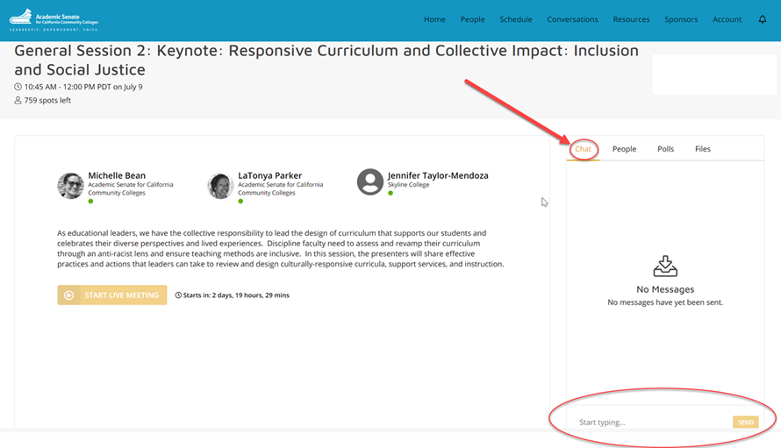
Use Pathable Chat to Engage in the Conversation

Slide 5
Some of the Initial Challenges We Faced
Training classroom instructors to deliver courses remotely
Remote assessment of students
Remote access to support structures (library, campus computers, student support services, learning support)
Equipment

Slide 6
Initial Challenges (Cont’d)
Supplies for remote teaching
Pedagogy support for remote teaching
Professional development including discipline specific needs
Retaining faculty consultation in the process of addressing other challenges
Others….

Slide 7
Let’s Put Our Heads Together
In breakout rooms we’ll discuss a few prompts including what we have observed and what we would do differently in future planning.
The data will be captured in Google docs that will be shared with participants.

Slide 8
Report Out from our Discussions
What were some themes that emerged from our discussion?
Some key observations of challenges we’ve faced
Some potential remedies to include in future policies

Slide 9
Considerations for Future Emergencies (now that we know what we know)
Make protocols to address remote learning
Guidelines for faculty consideration in determining method of remote delivery (promising practices for asynchronous vs. synchronous)
Support for counseling and student services and learning support services to expand for remote delivery
Guidelines for temporary campus closures in all emergencies (fires, catastrophe)

Slide 10
More to Consider…
Create rapid, nimble response to address emergency needs for students, staff, faculty, and administrators
Engage with student association to establish a means to keep sense of community, especially for most vulnerable students
Develop an emergency support plan that prioritizes continuity

Slide 11
Final Takaways
Assemble a collaborative team to review existing emergency plans
Take advantage of the lessons learned during the pandemic to adjust emergency plans with an equity lens
Make changes to emergency plans while the lessons are still fresh in our minds
Remember: There’s no predicting when the next emergency will occur so we must make sure to minimize any impact to our students

Slide 12
Thank You!
Additional Questions?
Info@asccc.org

