Slide 1
Minimum Qualifications, Equivalency, and Assigning Courses to Disciplines…Oh My!
Sam Foster, Representative At-Large
John Freitas, Treasurer
Conan McKay, Area B Representative
2017 Faculty Leadership Institute
June 15-17, 2017
Sacramento Sheraton Grand

Slide 2
Today, we will…
Review minimum qualifications requirement – focus on credit instructional faculty, counselors, and librarians
Define the term “discipline”
Provide an overview of what the disciplines list is and how it’s revised
Discuss equivalency principles and criteria
Provide an overview of assigning courses to disciplines

Slide 3
What You Need to Know – a Checklist
Minimum Qualifications
Know what the Disciplines List is and where to find it. The Disciplines List can be found at ASCCC.org under the “Resources” menu.
Be aware of the relevant Ed Code and Title 5 sections (provided in the Disciplines List publication).
Be aware of the ASCCC Disciplines List revision process.
Equivalency
Know what your equivalency process is, how it operates, and where to find it. Every district must have an equivalency process.
Know your roles and responsibilities in the equivalency process.
Know which human resources staff are responsible for working with your senate and equivalency committee and what their roles are.
Ensure there is regular training on the equivalency process.
Assigning courses to disciplines
Know the process for assigning courses to disciplines. (Hint: it shouldn’t be HR or administrators.)
Know where to find discipline assignments for courses.
And finally…
Be aware of all relevant Ed Code/Title 5 sections and assert faculty primacy as necessary!

Slide 4
Key Points About MQs and Disciplines
Minimum qualifications are about the minimum academic and professional subject matter expertise and preparation required to be faculty in the CCCs, not about skills or abilities as faculty.
Faculty must meet the MQs or the equivalent in a discipline in order to provide instruction or services to students. (Title 5 sections 53410 through 53417)
A course must be assigned to one or more disciplines in the Disciplines List – defines the MQs required to teach specific courses. (Title 5 section 53407)
“Discipline” refers to faculty academic and professional preparation, not department names our course title.
Revisions to the MQs in the Disciplines List originate from local senates or statewide faculty organizations. The ASCCC facilitates the process and makes the recommendations to the Board of Governors.
Districts must have equivalency processes established by mutual agreement with the senate and administration and approved by the board.

Slide 5
Minimum Qualifications “Hierarchy”
Faculty must meet minimum qualifications to work at a California community college.
“Basic MQs” for credit instructors, counselors, and librarians are the minimum degree and experience requirements specified in Title 5 §53410.
Discipline-specific MQs in the Disciplines List
Define the fields of study or professional experience to required to fit within a discipline.
Must conform to the degree and experience requirements of §53410.
Note: MQs for noncredit, health services professionals, apprenticeship, DSPS, EOPS, and learning assistance are established in specific Title 5 regulations, but are incorporated into the Disciplines List.

Slide 6
Minimum Qualifications “Hierarchy” (Sec. 53410 – credit instructional faculty, librarians, counselors)
Basic MQ
Master’s degree
Bachelor’s degree plus two years professional experience,
Associate’s degree plus six years professional experience
Discipline-Specific MQ
Humanities - Master’s in Humanities
Biotechnology - Bachelor’s in biological sciences, chemistry, biochemistry or engineering, plus two years of professional experience
Bookbinding – any bachelor’s degree plus two years/associate’s degree plus six years professional experience

Slide 7
Local Qualifications May Exceed State MQs
A district may establish additional qualifications that are more rigorous than the state-established MQs.
However, local MQs cannot be less rigorous than the state-established MQs.
Local decisions to exceed state MQs should be made based on sound pedagogical and curricular reasons, not “just because.”
Beware of unintended consequences!
The point is to get the broadest possible pool of minimally qualified candidates!

Slide 8
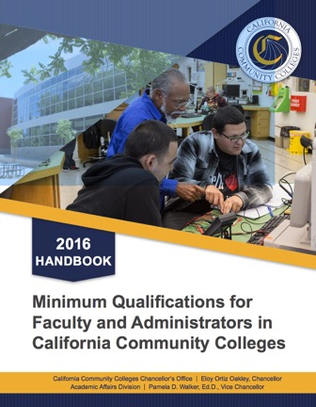
Discipline MQs and the Disciplines List
http://californiacommunitycolleges.cccco.edu/Portals/0/Reports/2016-Minimum-Qualifications-Report-ADA.pdf

Slide 9
Organization of the Disciplines List
Disciplines Index (New for 2016!) A-Z reference list of all disciplines, including associated Ed Code and Title 5 citations as appropriate, and the page number where found. There is no longer the ”blended list” that shows all MQs together.
Disciplines requiring a Master’s Degree, including relevant MQs for EOPS, DSPS, health services, and learning assistance/learning skills faculty.
Disciplines requiring a specific Bachelor’s or Associate’s degree plus the requisite professional experience, including noncredit MQs from Title 5.
Professional experience is always required, even with a master’s degree or higher.
Disciplines requiring any Bachelor’s or Associate’s degree plus the requisite professional experience.
Professional experience is always required, even with a master’s degree or higher.
All relevant Ed Code and Title 5 language on MQs, including for academic administrators.

Slide 10
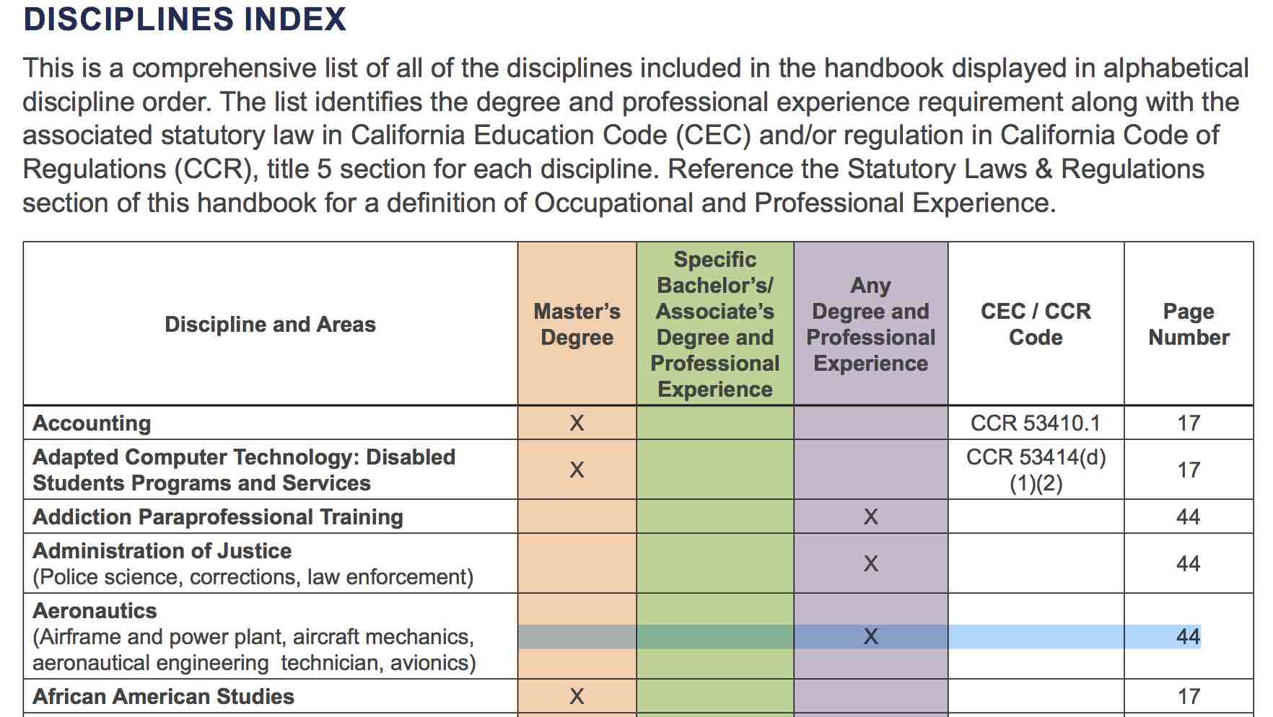
Disciplines List Index (New for 2016!)

Slide 11
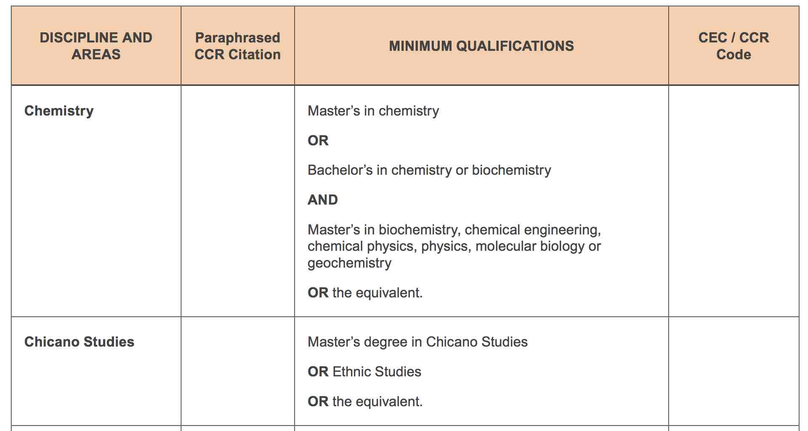
Master’s Degree List Sample

Slide 12
Non-master’s List - Specific bachelor’s or associate’s degree sample

Slide 13
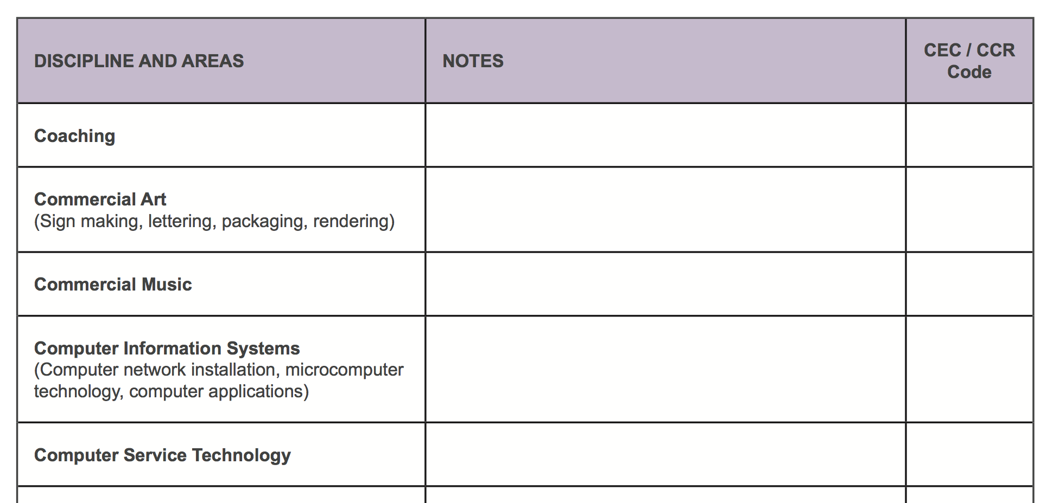
Non-master’s List - Any bachelor’s or associate’s degree sample

Slide 14
Process for Revising the Disciplines List
Revisions can be proposed by:
Local senates…should be initiated by faculty discipline experts.
Faculty through discipline or professional organizations.
Proposals must have a second from a senate from another district!
Proposals require consultation with statewide discipline organizations.
The ASCCC does not make proposals. It only facilitates the process.
Reviewed and revised annually (new!) – Proposals are submitted and received by September 30.
Proposals received after September 30 are held until the next revision cycle.
Proposals must go through two hearings – fall and spring plenary session.
Vote at spring plenary session.
ASCCC consults with CCC constituencies and makes recommendations to BOG.
Two readings by the BOG - BOG shall rely primarily on the ASCCC – Ed Code §87357.

Slide 15
Equivalency - Questions to Ponder
What is equivalency?
Why is equivalency permitted?
What are the benefits of equivalency?
Should it be common or rare?

Slide 16
Equivalency to the Minimum Qualifications
Governing boards may grant faculty equivalency to the minimum qualifications.
Every district must have an equivalency process, with process, criteria, and standards by which the governing board determines that faculty possess qualifications at least equal to the minimum qualifications (Ed Code §87359).
“The process, as well as criteria and standards…shall be developed and agreed upon jointly by …representatives of the governing board and the academic senate, and approved by the governing board” and “the process shall include reasonable procedures that ensure that the governing board relies primarily upon the advice and judgment of the academic senate…” (Ed Code §87359/Title 5 §53430).
Beyond that, there are no other specific requirements in Ed Code or Title 5.

Slide 17
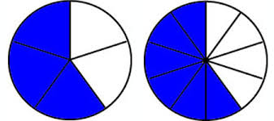
Equivalent Defined
Equal in value, amount, function, meaning, etc.
(Does this define the means by which the definition is met?)
Origin - Late Middle English (describing persons who were equal in power or rank): via Old French from late Latin aequivalent- ‘being of equal worth’, from the verb aequivalere, from aequi- ‘equally’ + valere ‘be worth’.
(https://en.oxforddictionaries.com/definition/equivalent)

Slide 18
Equivalency Principles
Equivalent to the minimum qualifications means equal to the minimum qualifications, not nearly equal, and not provisional.
The applicant must provide evidence he or she has attained the skills and knowledge equal to the degree and/or any required professional experience:
Evidence of required specialized coursework and/or requisite professional experience required for the degree listed in the Disciplines List.
Evidence that he or she has attained the breadth of coursework or experience equal to the general education component of an earned associate’s or bachelor’s degree.
For non-master’s disciplines, evidence that the requisite professional experience is equivalent to the required full-time experience required for the discipline.

Slide 19
Single Course Equivalency?

Slide 20
Single Course Equivalency Is Not Permitted
Ed Code and Title 5 refer to qualifications in terms of disciplines not courses or subject areas within a discipline (Ed Code §87357; Title 5 §53410 and §53430).
Legal Opinion L 03-28, Chancellor’s Office Legal Division reinforces that single course equivalency is not permitted.
Faculty are hired to teach within disciplines and are therefore deemed qualified to teach all courses assigned to that discipline.

Slide 21
Equivalency Process
Procedures established by agreement between local senates and boards of trustees for each district.
In multi college districts, the criteria for equivalency must be the same at all colleges in the district.
Discipline faculty can help determine discipline-specific equivalency criteria, but the senate makes the determination of equivalency.
Equivalency should be used to broaden the pool of qualified applicants, not restrict it.
Burden of proof belongs to the applicant, but…
Process needs to be clear, fair, and equitably applied.

Slide 22
Equivalency Process – Role of HR
Helping applicants navigate the process.
Collecting and forwarding equivalency applications to the senate or equivalency committee (local processes may vary).
Ensuring completeness of applications in accordance with the requirements of the local equivalency process.
Recording the outcomes of equivalency actions.
Help ensure continuity of process – institutional memory!

Slide 23
Equivalent to an Associate Degree?
Title 5 Section 55063 defines the components of the Associate’s degree as follows:
Competency in reading.
Competency in written expression at the level of Freshman Composition.
Competency in mathematics at the level of Intermediate Algebra.
At least 18 units of major preparation.
At least 18 units of general education in the areas of
Natural sciences
Social and behavioral sciences
Humanities
Language and rationality.
Are there methods of assessing equivalence to this for applicants who have not completed formal education? Could they be developed?

Slide 24
There’s more than just A.A. and A.S.
Associate of Applied Business (A.A.B.)
Associate of Applied Science (A.A.S.)
Associate of Applied Technology (A.A.T.)
Associate of Arts in Teaching (A.A.T.)
Associate of Business Administration (A.B.A.)
Associate of Electrical Engineering Technology (A.E.E.T.)
Associate of Electronics (A.E.)
Associate of Engineering (A.E./A.Eng.)
Associate of Engineering Technology (A.E.T./A.Eng.T.)
Associate of Forestry (A.F.)
Associate of General Studies (A.G.S.)
Associate of Industrial Technology (A.I.T.)
Associate of Nursing (A.N.)/Associate Degree Nurse/Nursing (A.D.N.)
Associate of Occupational Studies (A.O.S.)
Associate of Science in Computer Assisted Design (A.S.-C.A.D.)
Associate of Technology (A.T.)
Source: www2.ed.gov/about/offices/list/ous/international/usnei/us/associate.doc
Should individuals with these associate’s degrees be required to undergo equivalency?
What does Title 5 require for earned degrees to be valid?
What can you do if you aren’t sure a degree is valid?

Slide 25
Title 5 §53406 – Requirement for Accredited Degrees and Units; Definition of Accredited Institution.
“All degrees and units used to satisfy minimum qualifications shall be from accredited institutions, unless otherwise specified in this Article.
For purposes of this Subchapter, “accredited institution” shall mean a postsecondary institution accredited by an accreditation agency recognized by either the U.S. Department of Education or the Council on Postsecondary Accreditation*. It shall not mean an institution “approved” by the California Department of Education or by the California Council for Private Postsecondary and Vocational Education.
Determination of equivalency of foreign degrees shall be according to district rule.”
Be careful! Accreditors may not allow the “CHEA option.” (The Council on Postsecondary Accreditation is now called the Council for Higher Education Accreditation or CHEA).

Slide 26
Assigning Courses to Disciplines – Where Curriculum and MQs Meet
Identified in Title 5 section 53200 as an academic and professional matter within curriculum:
(c) “Academic and professional matters” means the following policy development and implementation matters:
(1) curriculum, including establishing prerequisites and placing courses within disciplines;
Determines the minimum qualifications necessary to teach a course.
Determined by local process, but local senates have regulatory authority.
Local process should include discipline faculty expertise with review and oversight by local Curriculum Committee, Senate, or both.
Curriculum Committee is often charged with overseeing this process, but other models exist.
Assigning courses to disciplines is not equivalency.
For more information, read “Who Gets to Teach That Course? The Importance of Assigning Courses to Disciplines” (ASCCC Rostrum, September 2016)

Slide 27
Course Assignment to Disciplines – an Illustration
Discipline
Defines required academic preparation and professional experience for faculty
Assignment of Course to Discipline Defines the MQs needed to teach the course.
Courses
What the faculty teach…curriculum!

Slide 28
Three Examples of Assigning Courses to Disciplines
Course assigned to a single discipline.
Example: ENGL 101 assigned to English. The minimum qualifications for English provides adequate preparation to teach the course content.
Course assigned to more than one discipline with an “or”
Example: ARTS 101 assigned to Art or Graphic Design. The minimum qualifications for either discipline provide adequate preparation to teach the course content.
Course assigned to more than one discipline with an “and”
HUMA 120 assigned to Humanities and Ethnic Studies. The minimum qualifications for both disciplines together provide adequate preparation to teach the course content.

Slide 29
Multi-College Districts
While some multi-college districts have common courses, others do not.
Since your district has one set of minimum qualifications, similar courses should be placed in the same discipline(s), even if they are called different things.
Your local process may be different than those in single college districts

Slide 30
Disciplines vs. Departments
Departments are locally defined organizational structures.
Instructional faculty teach courses assigned to disciplines, not departments.
Faculty must meet the MQs of the disciplines to which courses are assigned.
Example: The LACC Chemistry and Earth Sciences Department offers courses in Chemistry, Geology, Oceanography, and Geography. Who teaches which course?

Slide 31
Example: The LACC Chemistry and Earth Sciences Department offers courses in Chemistry, Geology, Oceanography, and Geography. Who teaches which course?
Courses Assigned Discipline(s)
Chemistry (all) Chemistry
Earth Science (all) Earth Science
Geology (all) Earth Science
Geography (all) Geography
Oceanography (all) Earth Science

Slide 32
Disciplines
Courses
EARTH 1
GEOL 1
GEOL 6
GEOL6
OCEANO 1
CHEM 60
CHEM 101
CHEM 102
CHEM 211
CHEM 212
CHEM 221
GEOG 1
GEOG 15
Earth Science
Chemistry
Geography
Courses Assigned to Disciplines

Slide 33
“The Academic Senate believes that faculty members must exemplify to their students the value of an education that is both well-rounded and specialized.”
Equivalence to Minimum Qualifications, paper adopted by the ASCCC
Spring 2016

Slide 34
Resources
Equivalence to Minimum Qualifications, ASCCC, adopted Spring 2016
ASCCC Disciplines List web page - http://asccc.org/disciplines-list
Additional Disciplines List resources, including an archive of past Disciplines Lists
Minimum Qualifications for Faculty and Administrators in the California Community Colleges, Chancellor’s Office (2016)
Guidance Document for Career Technical Education Minimum Qualifications and Equivalency (distributed January 31, 2017)
Disciplines List Revision Handbook, ASCCC (2014)
CCCCO Legal Opinion L 03-28 on single-course equivalencies.

Slide 35
Questions?
Sam Foster – sfoster@fullcoll.edu
John Freitas – freitaje@lacitycollege.edu
Conan McKay - cmckay@mendocino.edu
Thank you!

