Slide 1
Minimum Qualifications Tool Kit
Cheryl Aschenbach, Dianna Chiabotti, Dr. Lynn Shaw
ASCCC 2019 Career and Noncredit Education Institute
Notes:
Lynn describes the taskforce and areas of recommendations

Slide 2
25 Strong Workforce Recommendations Adopted by the Board of Governors in Fall 2015
Student Success
Career Pathways
Workforce Data & Outcomes
Curriculum
CTE Faculty
Regional Coordination
Funding
Notes:
Lynn describes recommendation 13

Slide 3
“Increase the pool of qualified CTE instructors by addressing CTE faculty recruitment and hiring practices.
Clarify legislative and regulatory barriers to hiring CTE instructors who may not meet existing college hiring standards, but possess significant industry experience.
Disseminate effective practices in the recruitment and hiring of diverse faculty and the application of minimum qualifications and equivalencies.
Develop pipelines to recruit community college faculty with industry expertise through collaborations with higher education, business, and industry professional organizations.
Establish a mentorship model that delineates pathways for industry professionals to intern at colleges to gain teaching skills, knowledge, and experience while pursuing an associate degree or an equivalent.”
Notes:
Lynn gives history of the Workgroup

Slide 4
Chancellor’s Office CTE Minimum Qualifications Work Group
Academic Senate
Chief Instructional Officers
College Presidents
Human Resources
California Community College Chancellor’s Office
Notes:
Grant gives content of Tool Kit

Slide 5
CTE Minimum Qualifications Tool Kit
Equivalency
Faculty Internship
Apprenticeship Minimum Qualifications
Notes:
Lynn

Slide 6
Components of an A.A. degree
Every A.A. or A.S. degree must include a minimum of 60 semester units including
Minimum 18 semester units of major preparation
Minimum 18 semester units of general education
If major preparation and GE don’t total 60 units, then a student may be required to complete additional elective units
For faculty applicants without a degree who are considered experts in their field, the equivalent of major preparation is rarely a concern. Instead, a lack of coursework in general education is often the barrier to qualification through equivalency.
Notes:
Cheryl

Slide 7
Why General Education?
Purpose of GE is to produce a citizen who can interact effectively with the world around them based on critical thinking and reasoning, sound oral and written communication, an applied understanding of other peoples and cultures, and applied experiences with science and its impact on people.
Notes:
Cheryl describes general education

Slide 8
What General Education is required for an Associate of Arts or Associate of Sciences?
GE for an AA degree includes demonstrated competencies in math and English along with 18 units in 5 areas:
A. Natural Sciences
B. Social and Behavioral Sciences
C. Humanities
D.1. Language and Rationality: English Composition
D.2. Language and Rationality: Communication and Analytical Thinking
Notes:
Cheryl talks about all the specific areas of the general education areas focusing on the cte examples

Slide 9
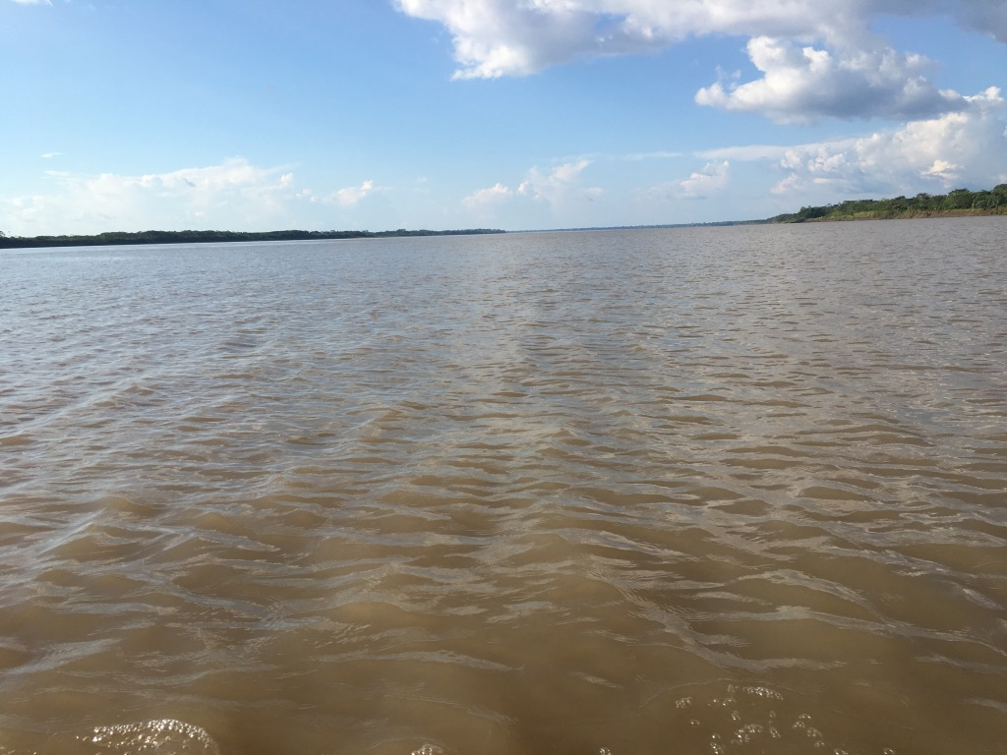
General Education Area A Natural Sciences
Example: Aviation (Certified Flight Instructor)
A certified recreational, private, or commercial must
understand and apply Newton’s Basic Laws of Motion
and Bernoulli’s Principle Ref: FAR 61.185(2)
Purpose for Including One Course in Natural Sciences for General Education
For students to develop the ability to examine the physical universe, its life forms, and its natural phenomena
For students to develop an appreciation of, understanding of, and ability to apply the scientific method
For students to develop the ability to understand the relationship between science and other human activities
Notes:
Cheryl talks about all the specific areas of the general education areas focusing on the cte examples

Slide 10
General Education Area B Social and Behavioral Sciences
Example: Culinary Arts/Food Production
A chef or culinary artist works within varied ethnic
foods and understands and applies an understanding
of foods and culture as well as historical food trends
Purpose for Including One Course in Social and Behavioral Sciences for GE
For students to develop an awareness of the methods of inquiry used by the social and behavioral sciences.
To stimulate students’ critical thinking about ways people act or have acted in response to their societies
To promote students’ appreciation of how societies and social subgroups operate
To develop or promote a students’ understanding and appreciation of ethnic groups (Title 5 §55063 (b)(2) requires a course in Ethnic Studies. It is most likely met through the course/experience/ability counted in Area B or Area C)
Notes:
Cheryl talks about all the specific areas of the general education areas focusing on the cte examples

Slide 11
General Education Area C Humanities
Example: Mortuary Science
Certified Funeral Service Practitioners complete
Celebrant training to develop an awareness of traditions
of different cultures and religions
Purpose for Including One Course in Humanities for GE
For students to develop an awareness of the way in which people throughout the ages and in different cultures have responded to themselves and the world around them in artistic and cultural creations.
For students to develop or demonstrate aesthetic understanding and an ability to make value judgements.
To promote a students’ understanding and appreciation of ethnic groups (Title 5 §55063 (b)(2) requires a course in Ethnic Studies. It is most likely met through the course/experience/ability counted in Area B or Area C)
Notes:
Cheryl talks about all the specific areas of the general education areas focusing on the cte examples

Slide 12
General Education Area D.1. Language and Rationality: English Composition
Example: Any Discipline
Publishing a peer-reviewed article
Writing of a market, technical or sales report or manual, or writing of a similar document within the work environment
Purpose for Including English Competency and One Course in Language and Rationality: English Composition for General Education
For students to develop the principles and applications of language toward logical thought, clear and precise written expression and critical evaluation of written communication in whatever symbol system the student uses.
For students to develop expository and argumentative writing skills (English Composition)
Notes:
Cheryl talks about all the specific areas of the general education areas focusing on the cte examples

Slide 13
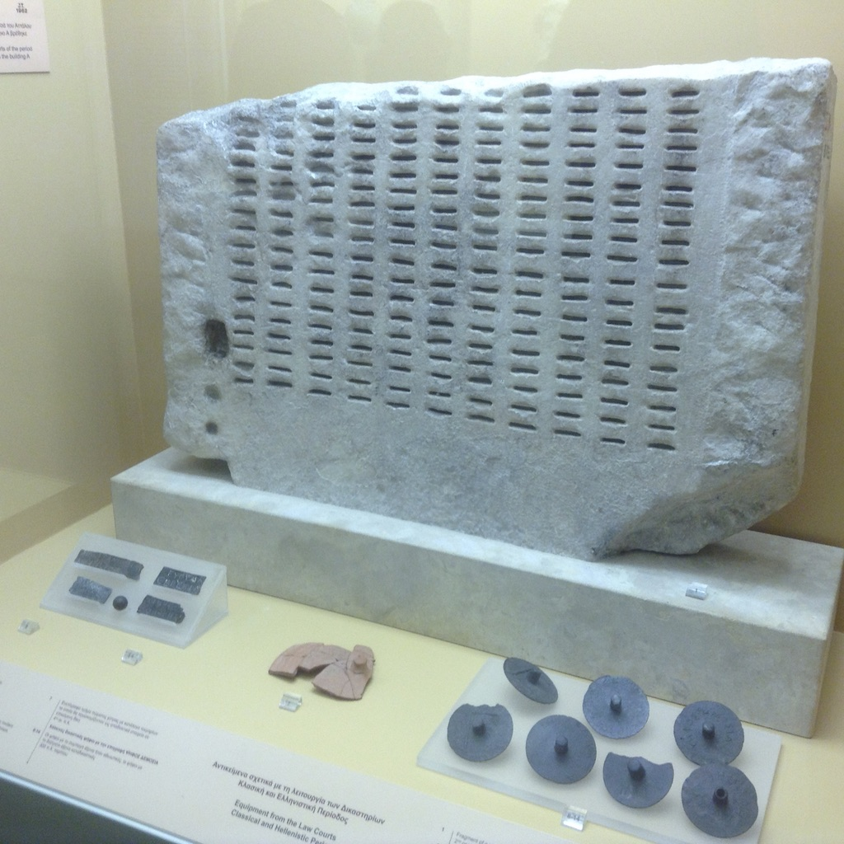
General Education Area D.2. Language & Rationality: Communication & Analytical Thinking
Example: Automotive Technology
A licensed automotive technician must use mathematical skills to manage and calculate ratios, measurements, comparisons, and specifications related to investigation of problems; may also use mathematical skills and reasoning to machine parts and tools to exact specification.
Purpose for Including One Course in
Language and Rationality for General Education
For students to demonstrate competence in mathematics at a level equivalent to intermediate algebra
For students to develop oral communication and analytical thinking skills
For students to develop skills interpreting and assessing data and statistics to draw conclusions.
Notes:
Cheryl talks about all the specific areas of the general education areas focusing on the cte examples

Slide 14
Career Technical Education Minimum Qualifications Tool Kit Activity You be the judge: Equivalency Case STUDY ACTIVITY
Notes:
Grant gives instruction on activity

Slide 15
Minimum Qualifications & Equivalency Committee Activity Directions
Imagine you are serving on your District Equivalency Committee.

Slide 16
Minimum Qualifications & Equivalency Committee Activity
There are general descriptions of the roles you will be assigned in this exercise. Please feel free to embellish as you like. Maybe you have had experience in an equivalency committee and want to change the viewpoint of your assigned character. Feel free!

Slide 17
Minimum Qualifications & Equivalency Committee Activity
You will be given a description of a candidate applying for equivalency. The description of the candidate is based on actual cases, with all identifying information changed.

Slide 18
Minimum Qualifications & Equivalency Committee Activity
Your job in this exercise is to determine if the candidate will be recommended for equivalency. Your internal process for the working of the committee is for you to decide.

Slide 19
Career Technical Education Minimum Qualifications & Equivalency Committee Roles
Senate President or designee
You chair the Equivalency Committee. Your concern is that the process is followed and that discipline faculty take the lead.

Slide 20
Career Technical Education Minimum Qualifications & Equivalency Committee Roles
Human Resources Director
You have worked at your District for 12 years and you have rarely seen an equivalency to minimum qualifications be approved. As a matter of fact, your college has a process on paper but you know that the unwritten policy is to not approve any equivalencies. The District has great concerns about accreditation and audits and does not want any risk by giving an equivalency.

Slide 21
Career Technical Education Minimum Qualifications &Equivalency Committee Roles
CTE Dean
You are hyper concerned about the unstaffed classes for next semester and beyond. You are feeling the pressure of the new funding formula and need enrollment. You know that the candidate is perfect for the classroom and have verified that what the candidate has in his/her portfolio of documentation is true.

Slide 22
Career Technical Education Minimum Qualifications & Equivalency Committee Roles
English or Math or General Education Faculty
You are concerned about the breadth of education that general education classes provide. You believe a transcripted course is the best way to show the deep understanding of learning. You do not understand why everyone cannot just get a degree like you did. After all we are only asking for an Associate Degree and you have a Masters or PhD or EdD.

Slide 23
Career Technical Education Minimum Qualifications & Equivalency Committee Roles
Faculty Candidate
You are a well-recognized industry expert with years of experience in your area. You have provided the committee with documentation that you feel easily meets or exceed the minimum qualifications required. You live in the local community and want to give back. You have a hard time seeing why you have to go through all this paperwork just to help your community.

Slide 24
Career Technical Education Minimum Qualifications & Equivalency Committee Roles
Faculty Champion
Your department desperately needs some new faculty with relevant current industry experience. All the current faculty in your department have not worked in industry in the last decade. Your candidate has served on both the local and regional advisory boards for the last three years. You know the candidate from when you both worked at the same company. While the candidate is not your friend, you have had a professional relationship over the last 10 years.

Slide 25
Scenario
Diesel Mechanics
Tanisha Drivetrain is actively managing one of the largest diesel repair facilities in the region. She has 15 years of experiences in diesel repair and maintains power plant certifications from Cummins, Detroit, Mack, Freightliner and Volvo. Tanisha is considered one of the region’s most highly respected diesel repair experts. Tanisha has extensive experience in training new mechanics and has established the first online, industry supported, professional development program in California for diesel professionals. Tanisha sits on the local college’s Green Diesel advisory board. She also provides education at Statewide training events, speaks at a statewide manufacturer’s conference and hires about 35% of the local program graduates. Tanisha ensures that her employer strongly supports CTE pathway efforts at several inner city high schools. Tanisha has been recognized by the High School Board of Trustees for her work with non-traditional students. Tanisha has a high school and certification from a private trade school.

Slide 26
What do you think?
Does your equivalency committee recommend Tanisha Diesel for equivalency in the discipline of Diesel Mechanics?
Why or why not?

Slide 27
Scenario
Health Information Technology (Medical record technology)
Debbie Datawinski currently manages an office of 5 staff at a regional Health Information Technology (HIT) company and has 15 years experience implementing HIT recommendations from California’s Department of Health Services. Debbie is has completed several industry recognized credentials. She is responsible for the staff development of her employees and has developed a training handbook as a resource. Debbie’s organization provides internships for the local community college’s HIT graduates. As an armed forces reserve soldier, Debbie recently returned from a 3-month deployment to Peru, where she actively trained HIT professionals from several state-run medical systems. Debbie speaks fluent Spanish. Debbie has a certificate of achievement in HIT from her local community college. She has no additional college credit.

Slide 28
What do you think?
Does your equivalency committee recommend Debbie Datawinski for equivalency in the discipline of Health Information Technology?
Why or why not?

Slide 29
Notes:
Lynn facilitates questions and comments

Slide 30
Next Steps
ASCCC Equivalency Regionals
April 29 @ Los Rios CCD
May 2 @ LA Trade Tech
May 3 @ Reedley College
May 8 @ Moorpark College
Webinars – mid-May
Technical visits, as requested (https://www.asccc.org/contact/request-services)
Release Toolkit via ASCCC, CCCCO, Vision Resource Center

Slide 31
info@asccc.org
Cheryl Aschenbach caschenbach@lassencollege.edu
Dianna Chiabotti dchiabotti@napavalley.edu
Lynn Shaw lshaw@cccco.edu

