Slide 1
Wait, Why Are We Doing This?: Making SLO Assessment Meaningful and Useful for Teaching Faculty
Gayle Pitman, Faculty Research Coordinator/SLO Coordinator
Sacramento City College
February 9, 2018

Slide 2
Let’s start with a question . . .
Why did you become an educator?

Slide 3
Why people pursue careers in education:
Intrinsic factors
I love my subject.
Teaching is fun.
The job is varied and enjoyable.
I learn a lot from my students.
Extrinsic factors
I get summers off.
The pay is good.
I get health benefits and a pension.
I couldn’t get a job anywhere else.
Altruistic factors
I want to help students succeed.
I care about student equity.
I want students to have access to a quality education.
Wait – we don’t become educators because we love
SLO assessment???

Slide 4
Case example: History
The problem:
They weren’t doing their SLO assessments!
Why?
I don’t know how.
I don’t have time.
I don’t care about SLO assessment.

Slide 5
The History solution?
Create SLOs that are more meaningful, and relevant to what instructors are doing in the classroom.

Slide 6
Before . . .
Upon completion of this course, the student will be able to:
identify and correctly use basic historical terminology, and distinguish between primary and secondary sources as historical evidence.
analyze multiple causes for an historical event, and properly evaluate why that event happened.
identify various interpretations used by historians to explain United States history up to the Civil War.
identify the major time periods and relevant geography of United States history up to the Civil War.
analyze and evaluate the major economic, social, political, and cultural developments in United States history up to the Civil War.
analyze and evaluate the experiences and conflicts of diverse groups of people, including “common people,” in United States history up to the Civil War.
analyze, describe, and explain the motives, settlement and organization of European colonies in North America, and the impact on the Native American environment and cultures.
trace the development of racial slavery in America, explain the reasons for its institutionalization, and analyze the influence of Africans and African culture on American society and institutions.
analyze the events of the American Revolution and the creation of the United States, including state and national Constitutions, and explain the rationale behind these developments.
analyze the philosophical, intellectual and cultural influences on the development of American political and social institutions.

Slide 7
. . . and after.
Upon completion of this course, the student will be able to:
identify, explain, and evaluate the major historical forces in United States history through Reconstruction. (ProLo 4)
generate significant open-ended questions about United States history, and critically analyze primary and secondary sources to construct oral and written historical arguments. (ProLo 3)
evaluate and analyze the diverse experiences and perspectives of multiple ethnic groups in United States history through an examination of conflicting narratives and power imbalances. (ProLo 1)
demonstrate an understanding of the interconnectedness between United States and global history to foster active civic engagement. (ProLo 2)
apply historical knowledge and historical thinking to contemporary issues. (ProLos 2, 3, 4)
collect, sift, organize, question, synthesize, and interpret complex material. (ProLos 1, 2, 3, 4)

Slide 8
Case example: Early Childhood Education
The problem:
They weren’t doing their SLO reports!
Why?
I don’t know how.
I don’t have time.
I don’t care about SLO assessment.

Slide 9
The Early Childhood Education solution?

Slide 10
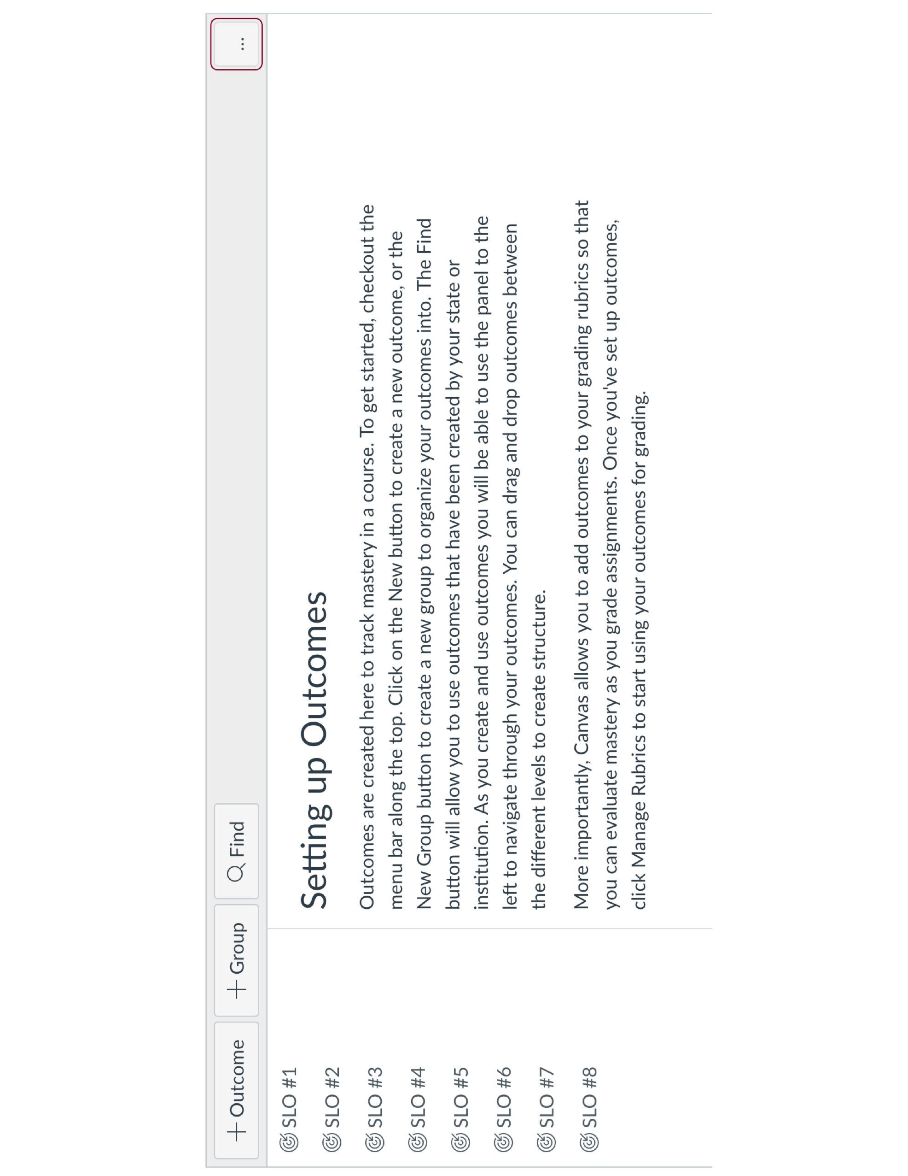

Slide 11
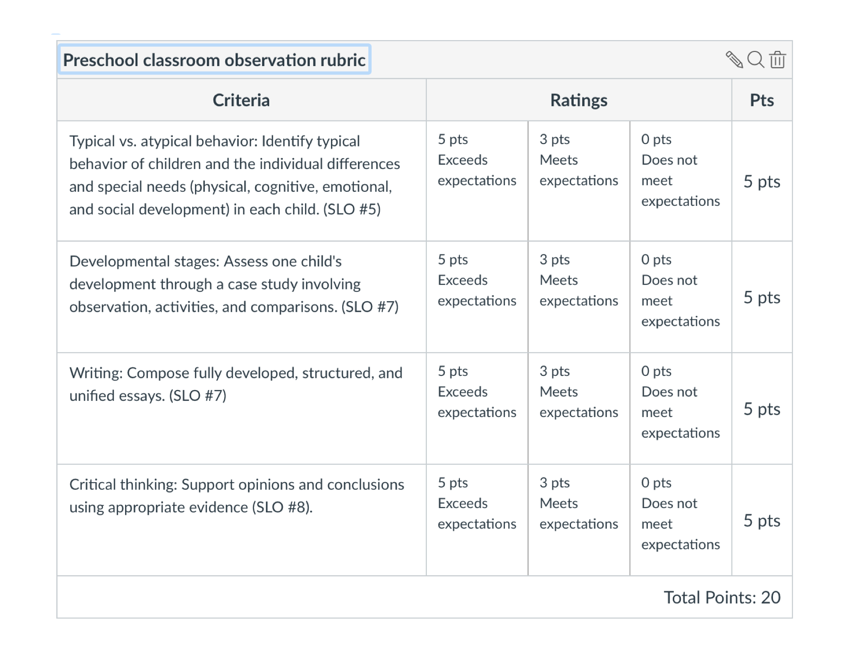

Slide 12
Case example: Math
The problem:
They were doing their SLO assessments!
And their SLO assessments indicated generally high or moderate achievement!
But . . .
They had low course success rates.
AND they had low morale.

Slide 13
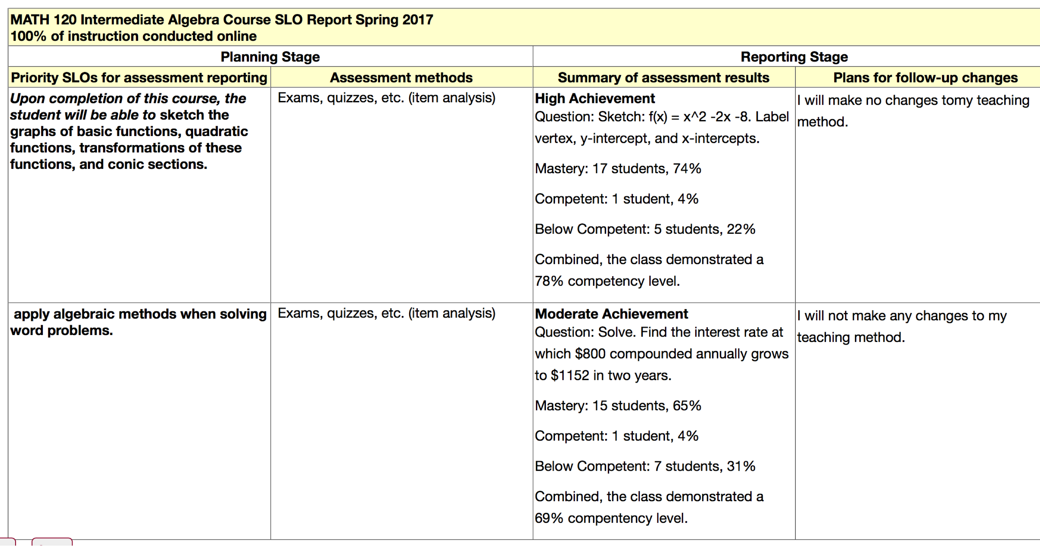

Slide 14
Despite such glowing findings . . .
Fewer than 50% of students were passing Math 120 with a C or better.

Slide 15
The Math solution?
Shift from points-based grading
to
Outcomes-based grading
Reframing what “grades” mean helped math faculty get on board with using SLO assessment results.
It also helped them be more effective with students.

Slide 16
Point-based grading systems
These grading systems are based on the assumption that the assignments and assessments facilitate and demonstrate the students’ achievement of the outcomes
In point-based grading systems, the relationship between achievement of outcomes and final grade is implied and indirect.
In some cases, there is no relationship between SLOs and grades.

Slide 17
Outcomes-based grading systems
Final grade tied to the level of achievement the student documents for each outcome;
Student has responsibility to provide evidence of achievement and to monitor his/her performance;
Grading criteria are very clear; and
Passing grade requires basic competence in every expected learning outcome.

Slide 18
In summary . . .
Find out what people are passionate about.
Ask faculty (in a non-judgmental way) why they’re not doing SLO assessment.
Then problem-solve using those two pieces of information.

Slide 19
Questions? Comments?

