Slide 1
Finding/Creating Meaning in SLO Assessment
Randy Beach, ASCCC South Representative,
Southwestern College
SLO Symposium, North Orange County Community College District
February 3, 2017

Slide 2
Description & Outcomes
Making assessment meaningful and relevant for faculty is often a challenge, yet even reluctant faculty are willing to give SLO assessment a chance when processes are simple and lead to useful results. This session will focus on important considerations for making SLO assessment more meaningful for faculty as they attempt to close the loop on outcomes assessment and create action plans based on assessment data.

Slide 3
So What Do You Want to Get Out of Today?

Slide 4
So What Do You Want to Get Out of Today?

Slide 5
So What Do You Want to Get Out of Today?

Slide 6
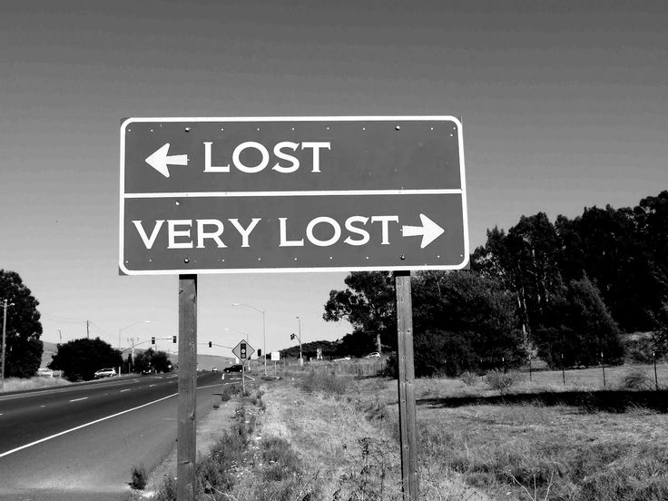
How
Do
You
Feel
About
SLOs???

Slide 7
SLO Coordinator

Slide 8
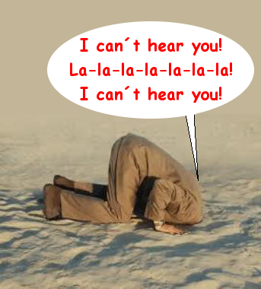
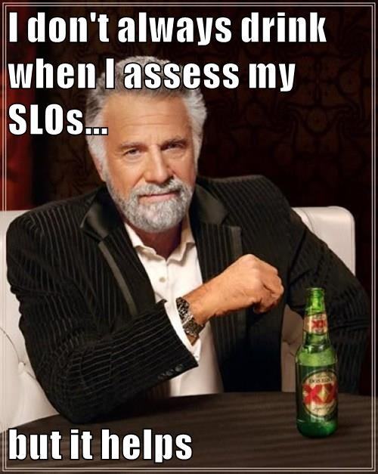

Slide 9
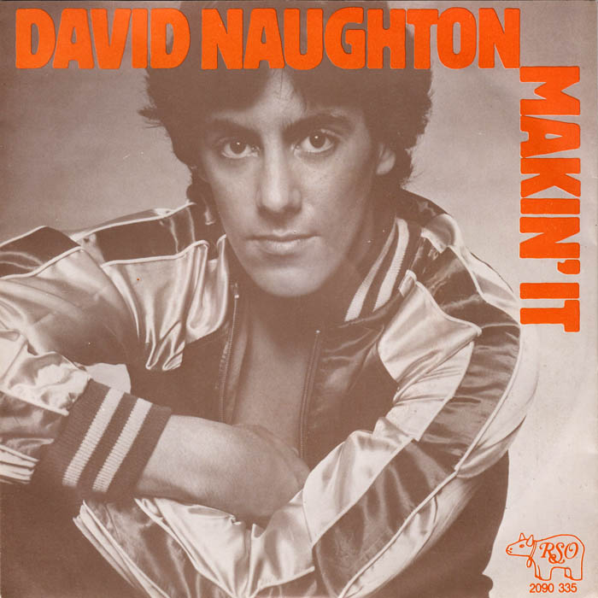
Making It …
Meaningful

Slide 10
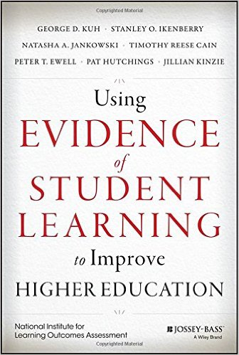
Making It Meaningful
The authors of Using Evidence of Student Learning to Improve Higher Education write, “...gathering evidence for student learning is not for compliance with external demands but, rather, an institutional strategy, a core function of continuous improvement, and a means for faculty and staff to elevate student success and strengthen institutional health” (Preface).

Slide 11
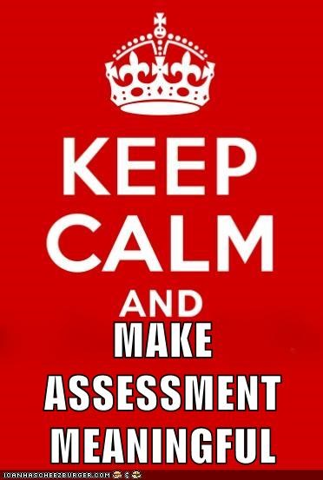

Slide 12
Making It Meaningful: SLO? I Still Don’t Get It
SLOs are action statements (read as commands)
What students will be able to think, know, feel or do as a result of an educational experience, often at different levels of that organized educational experience (course/program/institution)
Objectives are what we intend to teach
Outcomes are what students can do once taught
Course objectives are the BASIS of outcomes at the course level
CSLOS are synthesized to create Program Level Outcomes

Slide 13
To Make SLO Assessment Meaningful….
First write a
meaningful SLO

Slide 14
Objectives and Outcomes
Objective
Instructor will teach:
Effective use of the compare and contrast rhetorical mode for developing an argument
Student Learning Outcome
Student will be able to:
Write a paragraph using the compare and contrast rhetorical mode to create an argument

Slide 15
Where Do I Start to Write a Meaningful SLO?
Don’t think about content, but instead think about the life or work skills that students will use beyond the end of the course or the program.
Consider what students should be able to do with what they’ve learned. Make a concrete list.
Consider the higher-level thinking aspirations you have for students. Look beyond recitation or recall of content knowledge. (Don’t use the word “understand” – go for higher level skills.)

Slide 16
What Do I Ask When Writing a Meaningful SLO?
Do I require students to synthesize many separate skills? What can students do after they learn ALL these skills?
How will students demonstrate that new knowledge or ability? Be concrete and specific.
Is this SLO measurable? Are there degrees of performance?
Would a rubric be helpful?

Slide 17
Making It Meaningful: The Assessment
Now that you’ve written a kicking SLO, you need to measure it right?

Slide 18
WHAT IS ASSESSMENT? COURSE LEVEL
Outcomes assessment at the course level
continuous process of collecting, evaluating, and using information
determine if and how well student performance of outcomes aligns
course objectives, matches learning expectations, and is supported by teaching strategies and resources.

Slide 19
WHAT IS ASSESSMENT? PROGRAM LEVEL
Outcomes assessment at the program level:
continuous process of collecting, evaluating, and using information
affirm the courses in the program are supporting student proficiency in the skills and abilities that faculty desire for students
Determine if changes are needed to support student success.

Slide 20
What’s In It For Me?
Results, positive or negative, are used to stimulate meaningful dialogue between student and instructor about how instruction and non-instructional services can be utilized to increase student success
Results and actions must be documented and reviewed to be useful outside of that interaction

Slide 21
WHAT IS “AUTHENTIC” ASSESSMENT?
Assessment designed to assess student ability to apply standard-driven knowledge and skills to real-world challenges.
Authentic assessments typically ask students to generate ideas/products, rather than choose a response, to demonstrate what they know and can do.
Differs from Traditional which focuses on forced-choice measures of multiple-choice tests, fill-in-the-blanks, true-false, matching.

Slide 22
TRADITIONAL VS AUTHENTIC
Select a Response
Contrived Questions
Recall/Recognition
Teacher Structured
Indirect Evidence
Performing a Task
Real Life Situations
Construction/Application
Student-Structured
Direct Evidence

Slide 23
Making It Meaningful: Formative Vs. Summative
Formative
Short
Focused
Fluid for Feedback
Quick Turnaround
Student-Centered
Summative
Longer
Synthesizes many skills
Terminal/Recorded
Normed/Against a standard
Teacher-Centered

Slide 25
Making It Meaningful: The Assignment
Best to use something you already use, but align it with the outcome you want to assess
Identify formative and summative data points in the same assignment
Link the outcome to the assignment on your syllabus
An assignment is not always a test for a grade
Consider an assignment shared by all instructors
Develop a concrete rubric

Slide 26
Types of Assessment Tools: Course Outcomes
Multiple-choice, fill-in-the-blanks, true-false, matching
The breadth of the assessment tool depends on the breadth of the outcome
One tool to measure multiple outcomes
Item analysis
Multi-step project
Portfolio

Slide 27
Types of Assessment Tools: Course Outcomes
One outcome measured with multiple tools
Improves validity of your assessment

Slide 28
Types of Assessment Tools: Institutional or Program
Demonstrations of General and Specialized Knowledge
Portfolios, Projects, and Exit Exams Using Rubrics Usually in Capstone Courses
Employer Surveys and Interviews
Student and Alumni Interviews
Surveys (national, alumni, local)
External Judges

Slide 29
If a tree falls in the woods…?
Spurs dialogue-that’s a good thing, BUT...
Dialogue without action is wasted
Action not documented, resourced, implemented and assessed is busywork

Slide 30
To Recap...

Slide 31
The Takeaways...
Your SLOs have to be written well to give you good data. An outcome is NOT an objective.
Your assessments must allow students to give concrete examples of performance of the outcome

Slide 32
The Takeaways...
Formative assessments are the “in progress” assessments
Summative assessments are the data you really look at
Keep your students in the loop by linking assignments to outcomes on the syllabus

Slide 33
The Takeaways...
Type of assessment tool depends on the outcome’s purpose and “hugeness” of your outcome
Measuring an outcome in multiple ways gives you better data
Assessment without Action is Wasted Time

