Slide 1
Managing Conflict “The Improvement of our campus governance structures, through the usage of effective tools for conflict resolution” (Tools for Educational and Community Peace Building)
Silvester Henderson, ASCCC At-Large Representative Rebecca Eikey, ASCCC Area C Representative Mayra Cruz, ASCCC At-Large Representative
Faculty Leadership Institute 2018
San Diego Marriott Hotel & Marina
June 13-16
,

Slide 2
Presentation Highlights
Ten plus One - Lack of clarity
Institutional Practices & Differences
Statement From Association of Governing Boards (AGB)
Collegial Consultation
Communication Styles “Heart of the Problem” – Social practices, collaboration, & professional frustration.
Leadership Conflict Resolution Strategies “Care & Love” - Integrity, Creativity, & Wisdom

Slide 3
Ten Plus One Title 5 Section 53200
Curriculum, including establishing prerequisites
Degree and certificate requirements
Grading policy
Educational program development
Standards or policies regarding student preparation and success
College governance structures, as related to faculty roles
Faculty roles and involvement in accreditation processes
Policies for professional development activities
Processes for program review
Processes for institutional planning and budget development
Other academic and professional matters as mutually agreed upon.

Slide 4
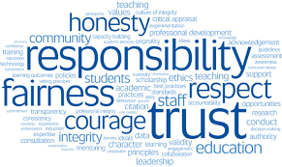
Institutional Practices and Differences
Participatory Governance | Shared Governance | Collegial Consultation
Sharing information without “authority”. Creates false imagery. Allows for varying interpretations. | Sharing information with consensus “authority”. Creates clarity. Clear roles and responsibilities. | Rely primarily upon Mutual agreement

Slide 5
Association of Governing Boards (A.G.B)
AGB (2010) - “Many presidents, governing boards, and faculty members believe that institutional governance is so cumbersome that timely and effective decision making is imperiled; factionalism, distrust and miscommunication, and lack of engagement among the parties can impede the decision-making process.”

Slide 6
Collegial Consultation Title 5 Section 53200
“ Rely primarily upon the advice and judgment of the Academic Senate.”
“The governing board, or its designees, and the Academic Senate shall reach mutual agreement.”
Faculty has been delegated authority.
Clear purviews
Governing Board Senate District agreement.
Collaboration between faculty and administration.
Consensus
Governing Board District Senate agreement policy ambiguity.

Slide 7
Communication Styles “Heart of the Problem”
Socialization practices & problem solving.
Barriers to collaboration.
Challenges surrounding institutional transformation.

Slide 8
Social Practices & Problem Solving
Notes:
What assumptions, perceptions and values do we have? How does non-verbal language contribute to these?
What type of experiences related to social practices that have you encountered that have created conflict?
Example of a social practice related to culture would be use of non-verbal communication to indicate time is up.
How do we resolve those?
Problem solving – listening to perspectives of different people, collaborative problem-solving for equity and justice (6-step model) from EdChange (http://www.edchange.org)

Slide 9
Barriers to Collaboration
Notes:
What type of barriers have you experienced related to collaboration? How have you overcome them?
The need to create safe environments for dialog.

Slide 10
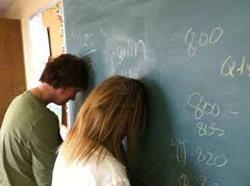
Challenges Surrounding Institutional Transformation
Notes:
Professional Frustration & Career Dissatisfaction
Holding on to status quo
Ownership
Fear of loss

Slide 11
Leadership Conflict Resolution Strategies - “Care & Love”
Integrity
Creativity
Wisdom
Notes:
Inclusion, integrity, creativity and wisdom

Slide 12
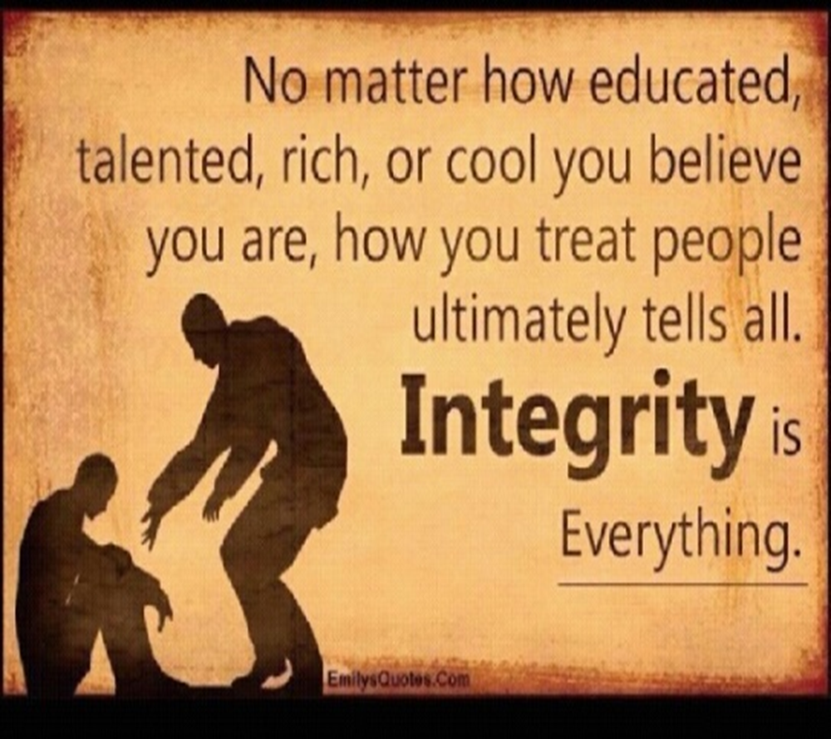
Integrity
Create an accessible environment for honesty and integrity.
Identify the issue types: conflict, interpersonal, & cross cultural.

Slide 13
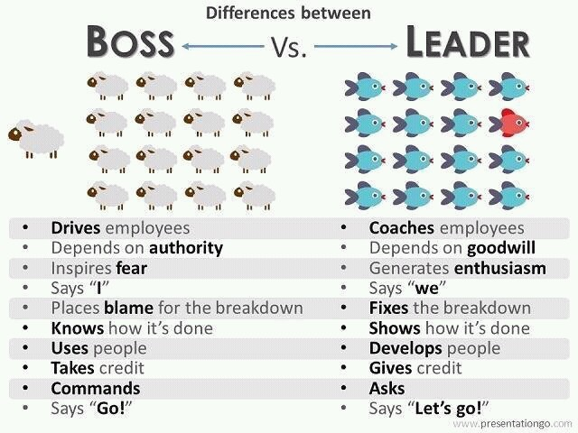
Creativity
Motivate discussions of issues.
Encourage authentic communication.
Practice a diversity of thought.
Remember to be a “Leader” and not a “Boss”.

Slide 14
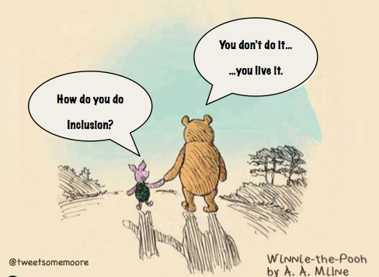
Wisdom
Speak your words with care!
Love and demonstrate respect for human value!
People speak their struggle and feel with their heart!
“Trust”, “Love”, and “Respect” are the Greatest Tools for managing conflict!
This creates Peace & Inclusion!

Slide 15
Questions & Comments
Please feel free to contact each of us for more information.
Silvester Henderson Shenderson@losmedanos.edu
Rebecca Eikey Rebecca.eikey@canyons.edu
Mayra Cruz cruzmayra@fhda.edu

