Slide 1
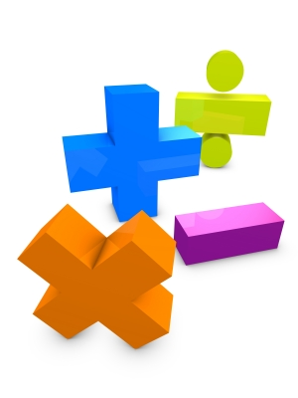
Math Requirements and intermediate algebra
Ginni May: ASCCC North representative, sacramento City College
Toni Parsons: Curriculum Chair, Math Professor, san Diego Mesa college
ASCCC Curriculum Institute
July 8-11, 2015
Anaheim, CA
Notes:
Ginni

Slide 2
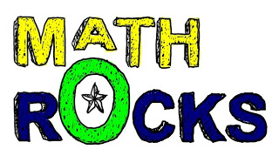
Outcomes
During this breakout you will:
Be informed about the math competency requirement in Title 5 for California Community Colleges;
Understand that a course meeting the math competency requirement does not (necessarily) mean the course satisfies the Intermediate Algebra requirement for CSUs and UCs;
Learn of some alternative courses that meet math competency requirement;
Be apprised of the C-ID plans and progress regarding intermediate algebra, elementary algebra, and/or courses that meet the math competency requirement or the intermediate algebra requirement;
Engage in robust discussion regarding the math competency requirement and/or the Intermediate Algebra requirement, and how we might support discipline faculty in exploring ways for students to meet those requirements.
Notes:
Ginni

Slide 3
History
The current math competency requirements for the associate degree in the California Community College System were:
Adopted by the Academic Senate in Spring 2005;
Approved by the Board of Governors in September 2006;
Effective for all students admitted to a CCC beginning Fall 2009.
Notes:
Ginni

Slide 4
Title 5 Math Requirements
Title 5 § 55063:
Competency in mathematics shall be demonstrated by obtaining a satisfactory grade in a mathematics course at the level of the course typically known as Intermediate Algebra (either Intermediate Algebra or another mathematics course at the same level, with the same rigor and with Elementary Algebra as a prerequisite, approved locally), or by examination;
Note that these are graduation requirements for the AA or AS, not requirements for a certificate.
Notes:
Ginni

Slide 5
Title 5 Math Requirements
Title 5 § 55063:
The competency requirements for written expression and mathematics may also be met by obtaining a satisfactory grade in courses in English and mathematics taught in or on behalf of other departments and which, as determined by the local governing board, require entrance skills at a level equivalent to those necessary for Freshman Composition and Intermediate Algebra respectively.
Note that these are graduation requirements for the AA or AS, not requirements for a certificate.
Notes:
Ginni

Slide 6
History
Alternative courses are permitted (encouraged) by Title 5:
Leading up to the 2006 vote, many on the BoG were reluctant to approve the change in graduation competencies because they feared it would simply become another barrier to students (especially CTE).
The Academic Senate of California Community Colleges made a commitment to the Board of Governors that it would actively encourage, support, and promote alternative courses.
That is, courses with content different from the traditional Intermediate Algebra curriculum may also be acceptable.
Notes:
Ginni

Slide 7
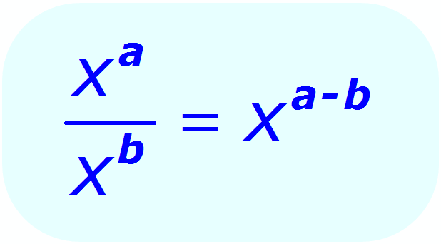
Today’s Focus
What alternative courses exist as a means of meeting the math competency requirements for the associate degree?
How can we as CCC faculty design and implement alternative courses without sacrificing or lowering standards and content level?
How do we successfully work with CSUs and UCs to accept those courses as prerequisites for the transfer level math?
Notes:
Ginni

Slide 8
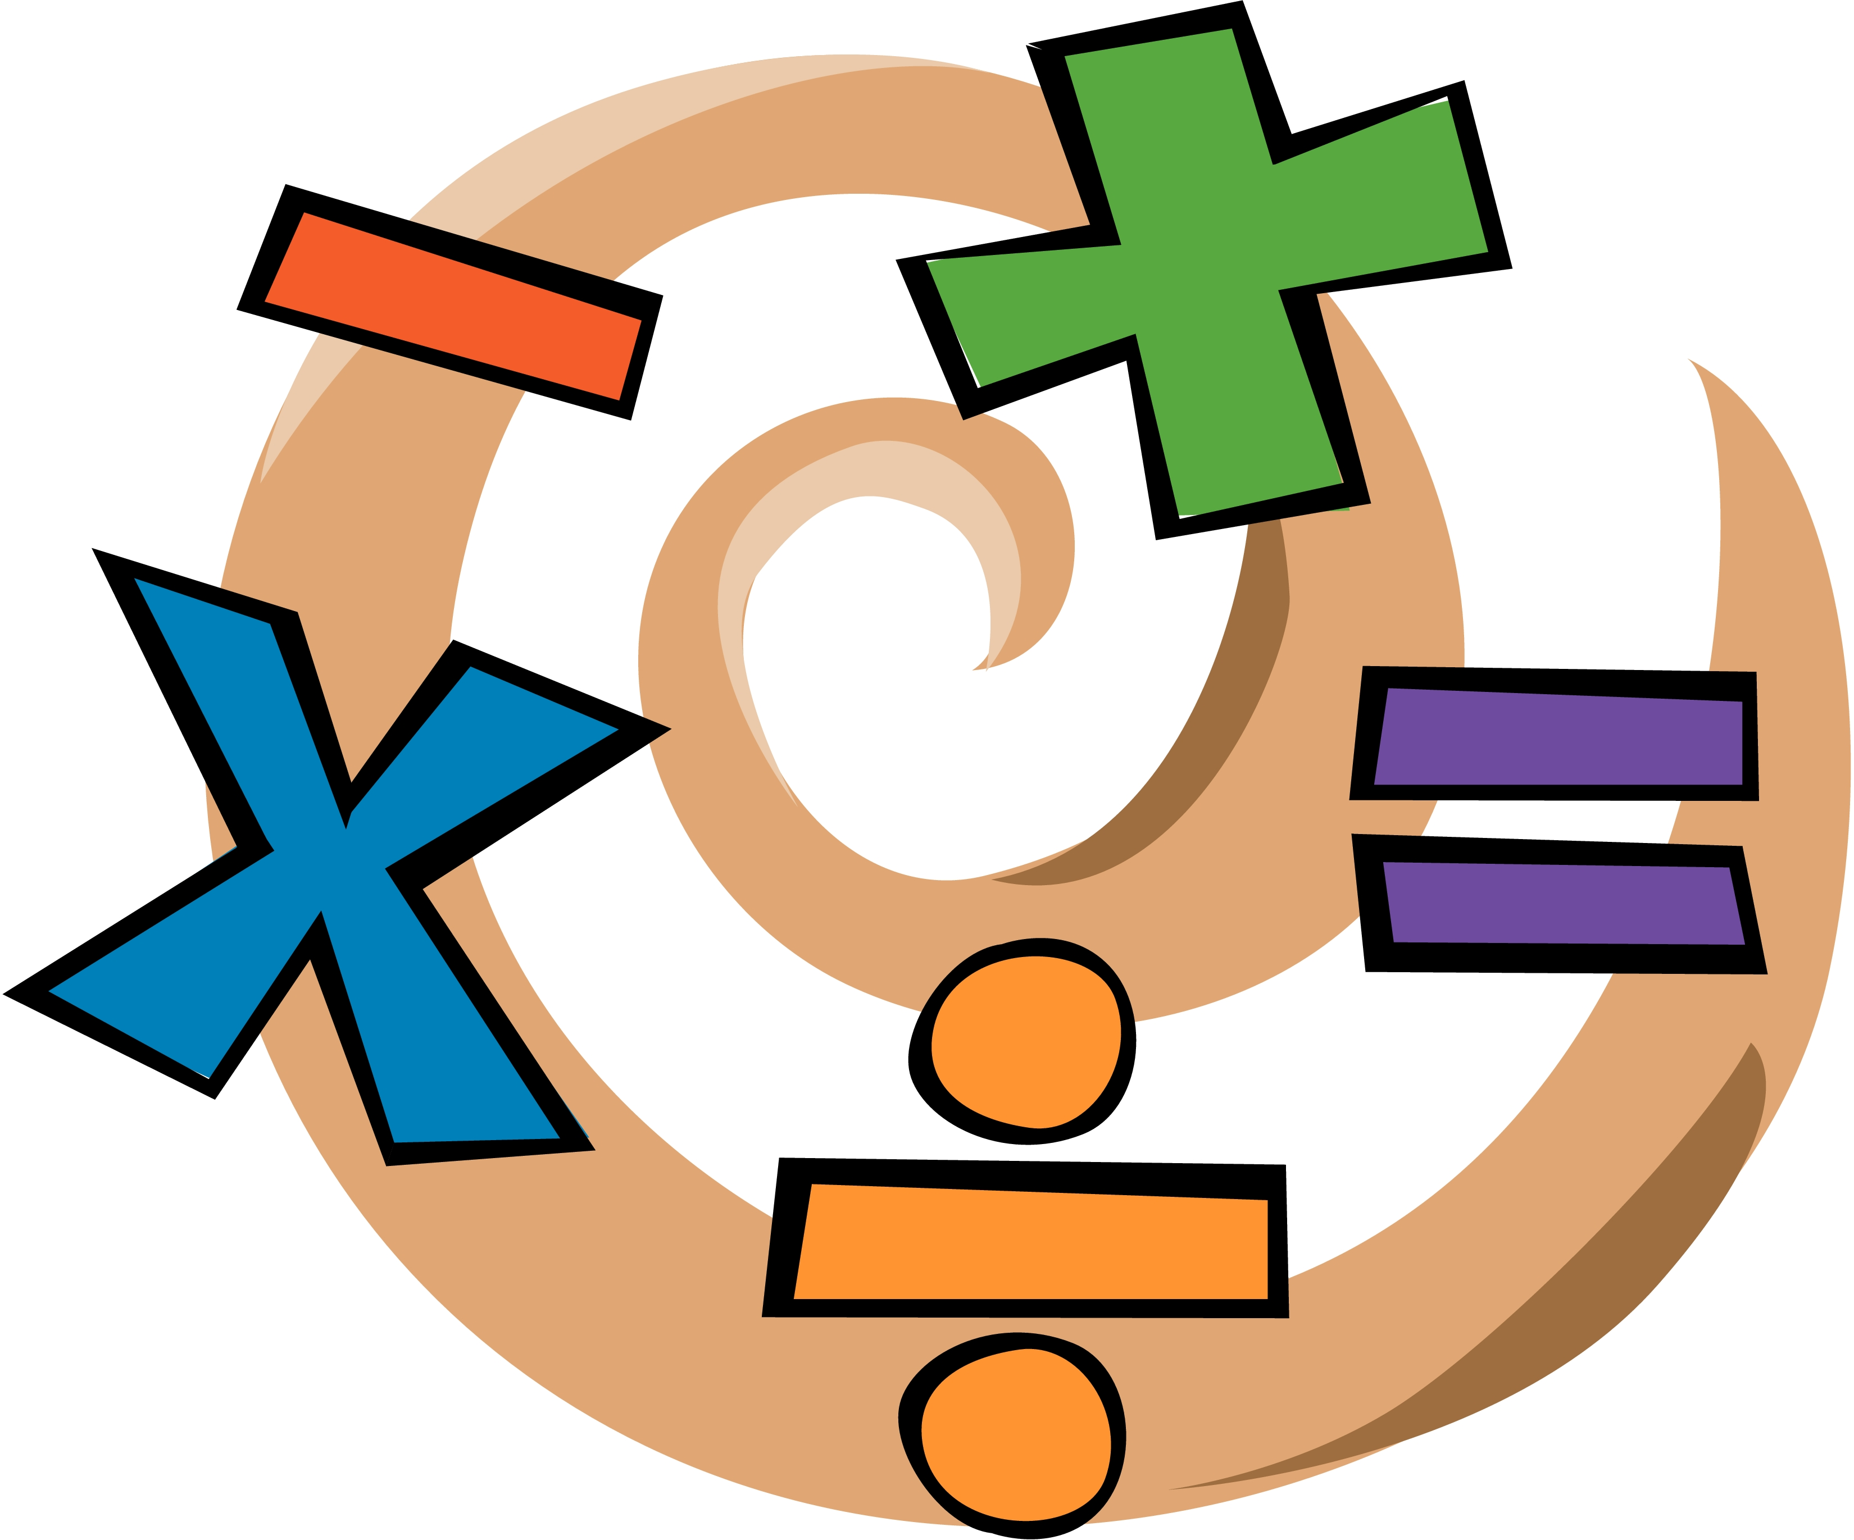
Examples (Sacramento City College)
Identifier: MATH 140
Title: Mathematics Competency (SCC under Mathematics Literacy)
Units: 4.00
Prerequisite: MATH 100 (Elementary Algebra) or 104 (Elementary Algebra, Part II) with a grade of "C" or better, or placement through the assessment process.
Hours: 72 hours lecture
Description: This course introduces students to everyday uses of mathematics. Mathematical literacy is necessary to fully participate in the democratic decision-making process. Topics will include measurement systems, reasoning and logic, elections, inflation and other indexes, chance and risk, and finances and may include other topics, such as environmental or health issues.
Associate Degree Competency: Mathematics Competency (approved June 1, 2009)
Notes:
Toni

Slide 9
Examples (Cosumnes River College)
Identifier: MATH 144
Title: Math for Contemporary Careers (CRC under Mathematics Literacy)
Units: 3.00
Prerequisite: MATH 100 (Elementary Algebra) or 102 (Elementary Algebra - Part II) with a grade of "C" or better, or equivalent skills demonstrated through the assessment process.
Hours: 54 hours lecture
Description: In the current information age, what mathematics should every person know? This course examines the contributions of mathematics in today's world. Students will explore mathematics' on-going role in society beginning with the need for and development of number systems, logical thinking, and current processes for coding and decoding data. A major focus of the course will be contemporary methods for analyzing data and interpreting statistics to make informed decisions. Students will conclude the course by selecting a module of mathematical interest from a list of available topics drawn from vocational programs and contemporary careers such as automotive technology, construction technology, film, digital media and broadcasting, medical records, pharmacy technology or other emerging career fields.
Associate Degree Competency: Mathematics Competency (approved Jan 1, 2011)
Notes:
Toni

Slide 10
Examples (san diego Mesa college)
Identifier: MATH 092
Title: Applied Beginning and Intermediate Algebra
Units: 3.00 – lecture, 1.00 – lab
Prerequisite: MATH 38 (Pre-Algebra) with a grade of "C" or better, or equivalent skills demonstrated through the assessment process.
Hours: 48 - 54 hours lecture, and 48 – 54 hours lab
Description: This course emphasizes real world applications in the development of beginning and intermediate algebraic topics. Topics include a review of fractions, decimals and percents, as well as the development of linear, quadratic, rational, radical, exponential and logarithmic functions. This course is designed for those students whose major and transfer institution requires only statistics or math for liberal arts as the transfer level math course for the degree.
Associate Degree Competency: Mathematics Competency (approved Oct. 10, 2013)
Notes:
Toni

Slide 11
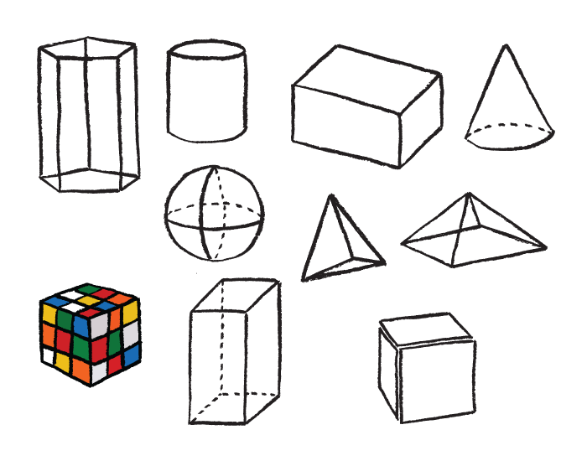
Examples (american river College)
Identifier: MATH 110
Title: Elementary Geometry (ARC under Geometry)
Units: 5.00
Prerequisite: MATH 100 (Elementary Algebra), 104 (Elementary Algebra, Part II), or 132 (Combined Algebra - Part II) with a grade of "C" or better, or placement through the assessment process.
Hours: 90 hours lecture
Description: This course covers aspects of elementary geometry. Topics include geometric terms and definitions, properties of parallel lines and parallelograms, congruent and similar triangles, properties of triangles, right triangles, basic trigonometry, properties of circles, geometric constructions, areas, and volumes. The course also emphasizes problem-solving strategies, elementary logic, and writing proofs.
Associate Degree Competency: Mathematics Competency (approved Aug 1, 1982)
Notes:
Toni

Slide 12
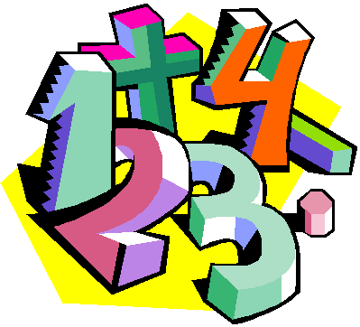
Examples
There are acceleration models such as:
Statway and Quantway – Carnegie Foundation
Statpath and Quantpath – Austin Community College
Path2Stats – California Acceleration Project
Others
Note, specific acceleration models are great topics for discipline specific groups such as CMC^3.
Notes:
Toni

Slide 13
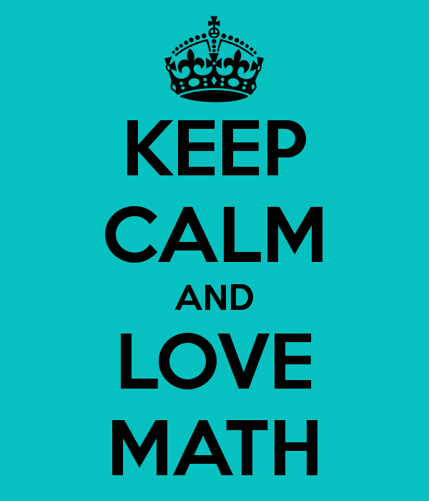
Discussion
What alternative courses exist as a means of meeting the math competency requirements for the associate degree for non transfer (such as CTE) programs?
Examples within the discipline…
Examples outside of the discipline (besides transfer level like Stat, Econ, Psych, etc.)?
What courses are at your colleges?
Notes:
All – in groups, then share their ideas

Slide 14
discussion
What alternative courses exist as a means of meeting the math competency requirements for the associate degree for students that plan to transfer to a CSU or UC?
STEM?
nonSTEM?
Notes:
same

Slide 15
C-ID Update
September 19-20, 2014, Basic Skills CB21 Meetings took place in the North and the South – discussions began regarding C-ID Descriptors for STEM and nonSTEM Intermediate Algebra courses.
The Basic Skills Math FDRG had their first meeting (via conference call) on March 11, 2015. Discussions began on STEM and nonSTEM Intermediate Algebra – they are working on a brief list of course objectives for STEM Intermediate Algebra.
Notes:
Ginni

Slide 16
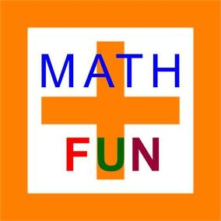
C-ID Update
The Basic Skills Math FDRG has draft descriptors for Intermediate Algebra for STEM and “traditional” Elementary Algebra
The Basic Skills Math FDRG will share the descriptors with the Transfer Math FDRG (which includes several CSU faculty) in fall 2015 before sending out to math faculty for vetting.
Go to c-id.net to get on the distribution list for vetting.
Notes:
Ginni

Slide 17
CSU update
California State University Council of Math Chairs’
Statement on Entry Level Mathematics and Statway
30 April 2015
4. We oppose the exemption of Statway from Executive Order 1065. In order for Statway courses to meet the standards for transfer articulation with the CSU, they must have an explicit prerequisite or co-requisite* that subsumes the content of ELM, and the students’ ELM competency must be verified by proctored examinations.
Notes:
Toni

Slide 18
CSU Update
California State University Council of Math Chairs’
Statement on Entry Level Mathematics and Statway
30 April 2015
5. We oppose the replacement of elementary or introductory statistics courses at CSU campuses by any program or pathway course lacking an explicit prerequisite or co-requisite* that subsumes the content of ELM. Such pathway courses include Statway. While the statistics content of Statway is totally aligned with the standard curriculum in elementary statistics, the pre-college mathematical content of Statway by itself does not meet the ELM standards and does not prepare students for college level courses. Hence Statway in its present form does not satisfactorily accomplish remediation and GE QR in a single track, thereby pointing to the need of having all ELM content in a prerequisite or co-requisite*.
Notes:
Toni

Slide 19
Amatyc
Position Statement of the American Mathematical Association of Two-year Colleges:
The Appropriate Use of Intermediate Algebra as a Prerequisite Course
WHEREAS, The prerequisites of a mathematics course should be those appropriate to providing a foundation for student success in that course;
WHEREAS, The course description and learning outcomes of a mathematics course determine the level of mathematical literacy, skills, and knowledge necessary for successful completion of the course;
WHEREAS, The equivalent content in intermediate algebra courses is generally required to master the content of algebra-based courses that lead to calculus;
WHEREAS, The equivalent content in intermediate algebra courses is not required to master the content for most college-level mathematics courses that do not lead to calculus;
NOW, THEREFORE, It is the position of AMATYC that:
Prerequisite courses other than intermediate algebra can adequately prepare students for courses of study that do not lead to calculus.
Approved at the Delegate Assembly
November 15, 2014
Notes:
Ginni

Slide 20
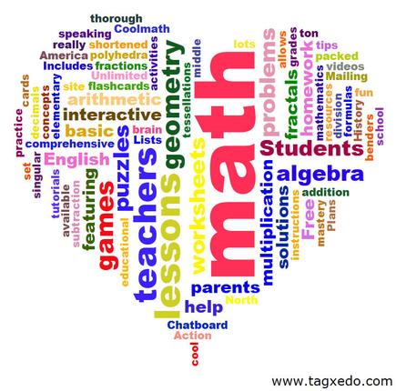
Discussion
How can we as CCC faculty support discipline faculty to design and implement alternative courses without sacrificing or lowering standards and content level, and the requirements of Title 5, CSU, and UC?
According to Title 5, the course must have a prerequisite of Elementary Algebra.
CSU…
UC…
Notes:
Same or possibly free flowing as a whole

Slide 21
Thank you!

Slide 22
Resources
ASCCC Rostrum, Ian Walton:Alternatives to Traditional Intermediate Algebra (Walton, 2013)
§ 55063. Minimum Requirements for the Associate Degree.
Basic Skills Initiative: http://www.cccbsi.org/about
http://www.calstate.edu/app/GEAC/documents/2015/04-csu-math-council-re-statway-april2015.pdf
Mary Legner, Riverside Community College, Basic Skills FDRG
AMATYC: http://www.amatyc.org/?page=PositionInterAlg
Ginni May: ginnimay1@gmail.com or mayv@scc.losrios.edu
Toni Parsons: mparsons@sdccd.edu

