Slide 1
Challenging Convention: Faculty Design and Implementation of Alternative Courses to Meet Math Requirements
Paul Steenhausen:
Executive Director, Success Center for California Community Colleges
Ginni May: Sacramento City College, ASCCC Curriculum Committee
Michelle Grimes-Hillman : Mt. SAC, Chair ASCCC Curriculum Committee
ASCCC Spring Plenary 2015

Slide 2
Outcomes
After this breakout session you should:
Understand the math competency requirement in Title 5 for California Community Colleges;
Understand that a course meeting the math competency requirement does not (necessarily) mean the course satisfies the Intermediate Algebra requirement for CSUs and UCs;
Have a few examples of alternative courses that meet math competency requirement;
Be apprised of the C-ID planning regarding courses that meet math competency;
Have had the opportunity to engage in robust discussion regarding courses that meet the math competency requirement and/or the Intermediate Algebra requirement.
Notes:
Ginni

Slide 3
History
The current math competency requirements for the associate degree in the California Community College System were:
Adopted by the Academic Senate in Spring 2005;
Approved by the Board of Governors in September 2006;
Effective for all students admitted to a CCC beginning Fall 2009.
Notes:
Paul

Slide 4
Title 5 Math Requirements
From § 55063:
Competency in mathematics shall be demonstrated by obtaining a satisfactory grade in a mathematics course at the level of the course typically known as Intermediate Algebra (either Intermediate Algebra or another mathematics course at the same level, with the same rigor and with Elementary Algebra as a prerequisite, approved locally), or by examination;
Note that these are graduation requirements for the AA or AS, not requirements for a certificate.
Notes:
Paul

Slide 5
Title 5 Math Requirements
From § 55063:
The competency requirements for written expression and mathematics may also be met by obtaining a satisfactory grade in courses in English and mathematics taught in or on behalf of other departments and which, as determined by the local governing board, require entrance skills at a level equivalent to those necessary for Freshman Composition and Intermediate Algebra respectively.
Note that these are graduation requirements for the AA or AS, not requirements for a certificate.
Notes:
Paul

Slide 6
History
Alternative are courses permitted (encouraged) by Title 5:
Leading up to the 2006 vote, many on the BoG were reluctant to approve the change in graduation competencies because they feared it would simply become another barrier to students (especially CTE).
The Academic Senate of California Community Colleges made a commitment to the Board of Governors that it would actively encourage, support, and promote alternative courses.
That is, courses with content different from the traditional Intermediate Algebra curriculum may also be acceptable.
Notes:
Paul

Slide 7
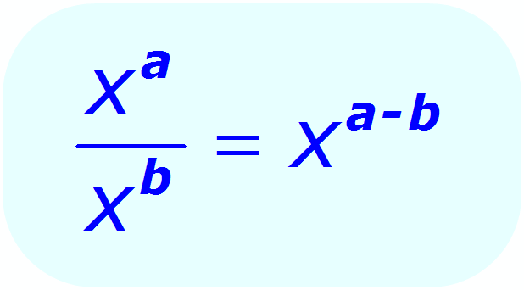
Today’s Focus
What alternative courses exist as a means of meeting the math competency requirements for the associate degree?
How can we as CCC faculty design and implement alternative courses without sacrificing or lowering standards and content level?
How do we successfully work with CSUs and UCs to accept those courses as prerequisites for the transfer level math?
Notes:
Ginni

Slide 8
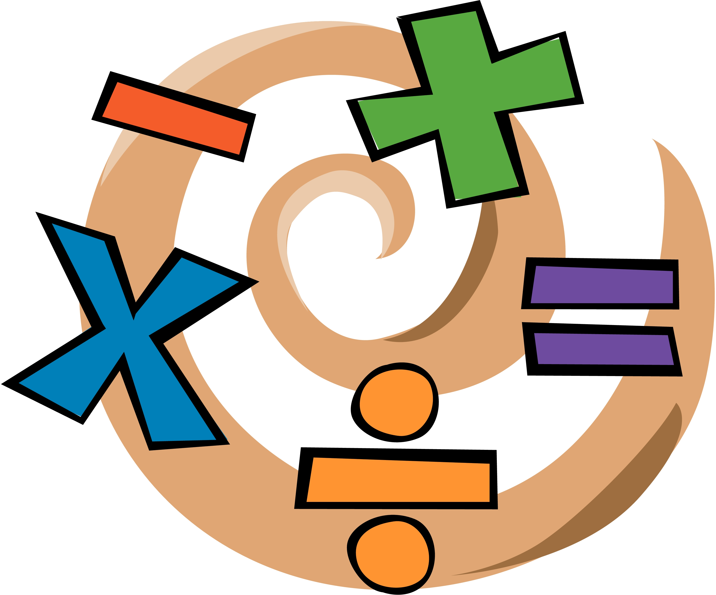
Examples
Identifier: MATH 140
Title: Mathematics Competency (SCC under Mathematics Literacy)
Units: 4.00
Prerequisite: MATH 100 (Elementary Algebra) or 104 (Elementary Algebra, Part II) with a grade of "C" or better, or placement through the assessment process.
Hours: 72 hours lecture
Description: This course introduces students to everyday uses of mathematics. Mathematical literacy is necessary to fully participate in the democratic decision-making process. Topics will include measurement systems, reasoning and logic, elections, inflation and other indexes, chance and risk, and finances and may include other topics, such as environmental or health issues.
Associate Degree Competency: Mathematics Competency (approved June 1, 2009)
Notes:
Ginni

Slide 9
Examples
Identifier: MATH 144
Title: Math for Contemporary Careers (CRC under Mathematics Literacy)
Units: 3.00
Prerequisite: MATH 100 (Elementary Algebra) or 102 (Elementary Algebra - Part II) with a grade of "C" or better, or equivalent skills demonstrated through the assessment process.
Hours: 54 hours lecture
Description: In the current information age, what mathematics should every person know? This course examines the contributions of mathematics in today's world. Students will explore mathematics' on-going role in society beginning with the need for and development of number systems, logical thinking, and current processes for coding and decoding data. A major focus of the course will be contemporary methods for analyzing data and interpreting statistics to make informed decisions. Students will conclude the course by selecting a module of mathematical interest from a list of available topics drawn from vocational programs and contemporary careers such as automotive technology, construction technology, film, digital media and broadcasting, medical records, pharmacy technology or other emerging career fields.
Associate Degree Competency: Mathematics Competency (approved Jan 1, 2011)
Notes:
Ginni

Slide 10
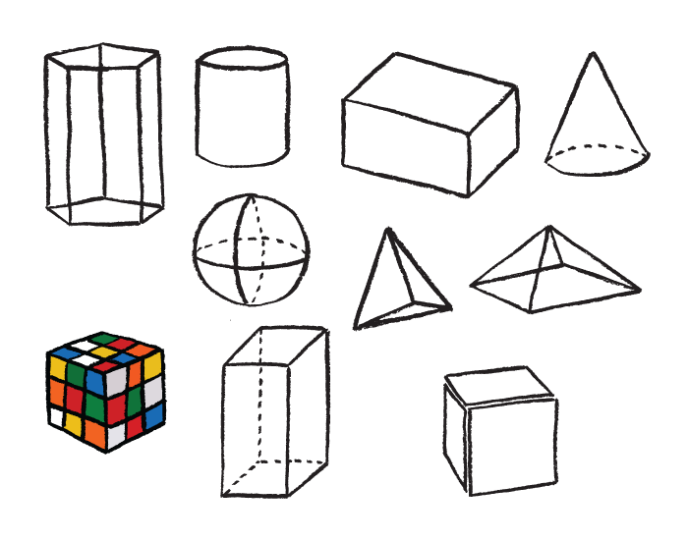
Examples
Identifier: MATH 110
Title: Elementary Geometry (ARC under Geometry)
Units: 5.00
Prerequisite: MATH 100 (Elementary Algebra), 104 (Elementary Algebra, Part II), or 132 (Combined Algebra - Part II) with a grade of "C" or better, or placement through the assessment process.
Hours: 90 hours lecture
Description: This course covers aspects of elementary geometry. Topics include geometric terms and definitions, properties of parallel lines and parallelograms, congruent and similar triangles, properties of triangles, right triangles, basic trigonometry, properties of circles, geometric constructions, areas, and volumes. The course also emphasizes problem-solving strategies, elementary logic, and writing proofs.
Associate Degree Competency: Mathematics Competency (approved Aug 1, 1982)
Notes:
Ginni

Slide 11
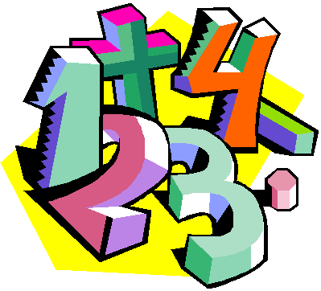
Examples
There are acceleration models such as:
Statway and Quantway – Carnegie Foundation
Statpath and Quantpath – Austin Community College
Path2Stats – California Acceleration Project
Others
Note, specific acceleration models are great topics for discipline specific groups such as CMC^3.
Notes:
Ginni

Slide 12
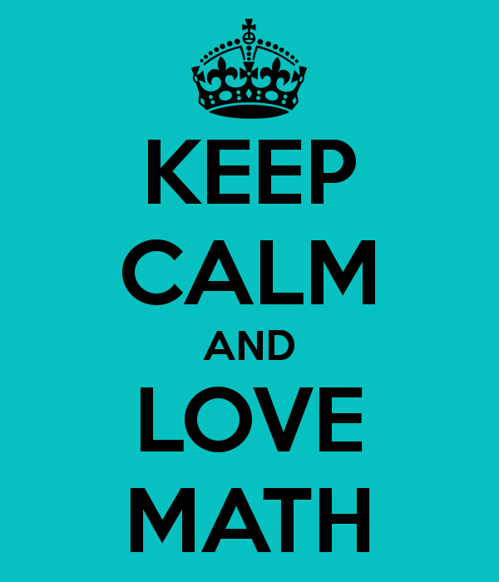
Discussion
What alternative courses exist as a means of meeting the math competency requirements for the associate degree for non transfer (such as CTE) programs?
We just saw some examples within the discipline…
A search of CCCs online showed much the same within the discipline…
What about courses outside of the discipline (besides transfer level like Stat, Econ, Psych, etc.)?
What courses are at your colleges?
Notes:
All – in groups, then share their ideas
Paul will bring flip charts and document.

Slide 13
discussion
What alternative courses exist as a means of meeting the math competency requirements for the associate degree for students that plan to transfer to a CSU or UC?
STEM?
nonSTEM?
Notes:
same

Slide 14
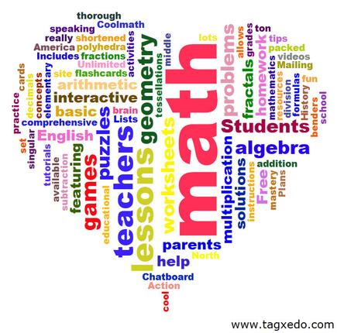
Discussion
How can we as CCC faculty design and implement alternative courses without sacrificing or lowering standards and content level?
According to Title 5, the course must have a prerequisite of Elementary Algebra.
Start with SLOs?
Start with Course Topics?
Start somewhere…
Notes:
Same or possibly free flowing as a whole

Slide 15
C-ID Update
September 19-20, 2014, Basic Skills CB21 Meetings took place in the North and the South – discussions began regarding C-ID Descriptors for STEM and nonSTEM Intermediate Algebra courses.
The Basic Skills Math FDRG had their first meeting (via conference call) on March 11, 2015. Discussions began on STEM and nonSTEM Intermediate Algebra – they are working on a brief list of course objectives for STEM Intermediate Algebra.
Notes:
Ginni

Slide 16
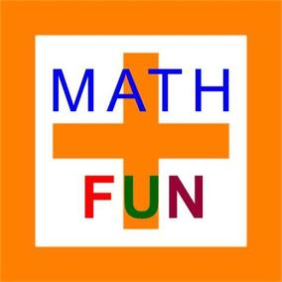
C-ID Update
Next, the Basic Skills Math FDRG will consider nonSTEM Intermediate Algebra and Introductory/Elementary Algebra descriptors.
The Basic Skills Math FDRG will share the descriptors with the Transfer Math FDRG (which includes several CSU faculty) for feedback.
Stay tuned for more…
Notes:
Ginni

Slide 17
Discussion
How do we successfully work with CSUs and UCs to accept those courses as prerequisites for the transfer level math?
C-ID Descriptors for STEM and nonSTEM Intermediate Algebra courses…
Engage input and recommendations from professional math organizations such as CMC^3…
Other ideas?
Notes:
Michelle

Slide 18
Resources
ASCCC Rostrum, Ian Walton:Alternatives to Traditional Intermediate Algebra (Walton, 2013)
§ 55063. Minimum Requirements for the Associate Degree.
Basic Skills Initiative: http://www.cccbsi.org/about
Mary Legner, Riverside Community College, Basic Skills FDRG

