Slide 1
Mentorship Programs as a Recruitment and Retention Strategy of Faculty of Color Thursday, November 5 at 10:15 a.m.--11:15 a.m.
Notes:
Michelle—intros (2 min)

Slide 2
Session Description
Empowering aspiring educators with mentorship, training, and exposure to the community college classroom is one way to increase the diversity of faculty. Mentor programs in particular have proven to be instrumental to attracting and retaining a racially diverse applicant pool. This session highlights existing effective and innovative mentor programs geared at incoming part-time faculty. Panelists will share insights and tools on how to establish a program on your campus through an equity-minded framework focused on the value and strength of our diverse backgrounds.

Slide 3
Today’s Presenters
Dr. Victoria C. Rosario, District Director of Human Resources and Support Programs, Los Rios Community College District (she/her/hers)
Michelle Velasquez Bean, ASCCC At-large Representative (she/her/hers)
Silvester Henderson, ASCCC At-large Representative
Chelsea Hull, Part-time Committee member, Santa Monica College (she/her/hers)

Slide 4
Today, we will
Discuss how to infuse and frame a mentor program in equity-mindedness
Discuss the value of data
Reimagine the hiring process and a pipeline for faculty of color recruitment
Review social components to create community
Discuss mentor program budgets and funding
Provide examples of retention programs
Identify champions of the work
Notes:
Michelle 1 minute

Slide 5
Questions in Pathable CHAT
Notes:
Michelle 1 min: Chelsea and Michelle moderate/monitor
Use the CHAT in Pathable

Slide 6
Pathable Poll
Regarding a mentoring program on your campus, where is your college?
My campus/district has a formal mentoring program
My campus/district has informal mentoring program(s)
My campus/district has no mentoring program, but I am interested in starting one
Notes:
Michelle (2 minutes)

Slide 7
Our Stories
From a faculty of color perspective
From an adjunct perspective
Notes:
5 minutes (Michelle and Chelsea)

Slide 8
Equity-Minded Framework
Notes:
Silvester (slides 8-11): 3 minutes

Slide 9
Equity Framework: Importance of Reviewing Faculty vs. Student Data
CCC Student Total Count—Fall 2019 |  | 2,324,788 | 100.00 %
 | African-American | 129,722 | 5.58 %
 | American Indian/Alaskan Native | 8,066 | 0.35 %
 | Asian | 264,519 | 11.38 %
 | Filipino | 65,063 | 2.80 %
 | Hispanic | 1,070,467 | 46.05 %
 | Multi-Ethnicity | 88,597 | 3.81 %
 | Pacific Islander | 9,284 | 0.40 %
 | Unknown | 140,660 | 6.05 %
 | White Non-Hispanic | 548,410 | 23.59 %
Notes:
Silvester

Slide 10
California Community College Faculty Fall 2019
Academic, Tenured/Tenure Track Total |  | 18,145 | 20.04 %
 | African-American | 1,121 | 6.18 %
 | American Indian/Alaskan Native | 110 | 0.61 %
 | Asian | 1,801 | 9.93 %
 | Hispanic | 3,088 | 17.02 %
 | Multi-Ethnicity | 275 | 1.52 %
 | Pacific Islander | 80 | 0.44 %
 | Unknown | 1,006 | 5.54 %
 | White Non-Hispanic | 10,664 | 58.77 %
Academic, Temporary Total |  | 41,230 | 45.54 %
 | African-American | 2,342 | 5.68 %
 | American Indian/Alaskan Native | 256 | 0.62 %
 | Asian | 4,330 | 10.50 %
 | Hispanic | 6,371 | 15.45 %
 | Multi-Ethnicity | 592 | 1.44 %
 | Pacific Islander | 157 | 0.38 %
 | Unknown | 3,109 | 7.54 %
 | White Non-Hispanic | 24,073 | 58.39 %
Notes:
Silvester

Slide 11
Establishing Goals and Tenets
Should be unique to your college campus
Mission, vision, and values statements
Student Equity and Achievement plans
Accreditation reports
Notes:
Michelle: 2 minutes
ACCJC Standard 3 and 4

Slide 12
Data to Inform Your Program
Notes:
Victoria: slides 12- 39 (20 minutes)

Slide 13
Los Rios District
Second largest public community college district in California
4 colleges, 10 outreach centers serving the greater Sacramento region
Enrolled 67,779 in Fall 2018
1,012 full time faculty (Fall 2018)
67 full time faculty openings (Spring 2019); 41 hired (Fall 2018)

Slide 14
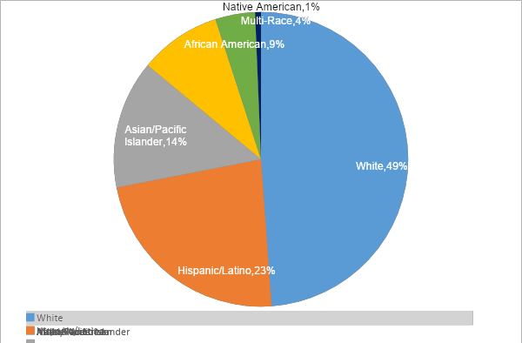
Our Region
Figure 1: Regional Diversity by Race/Ethnicity in Sacramento County, El Dorado County, and Yolo County in Fall 2018

Slide 15
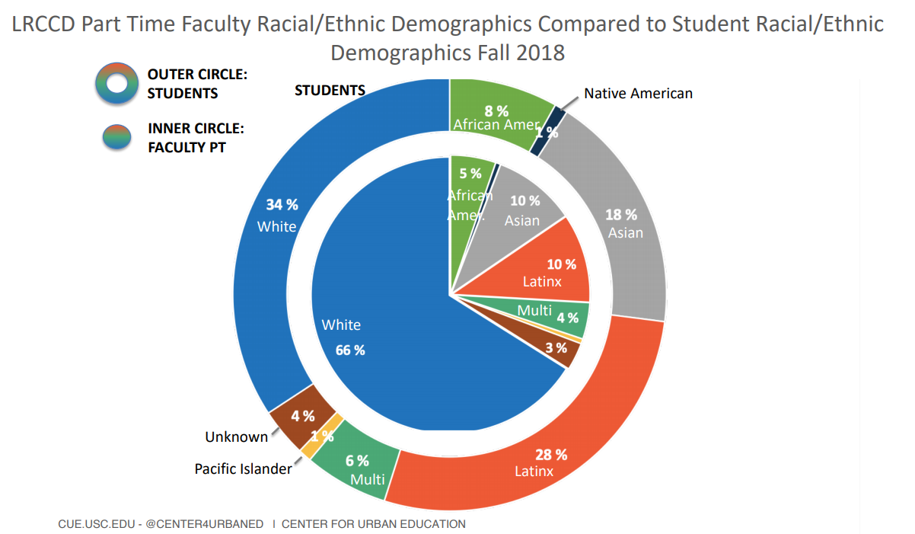

Slide 16
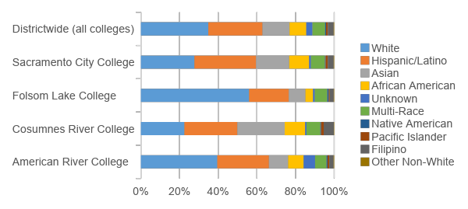
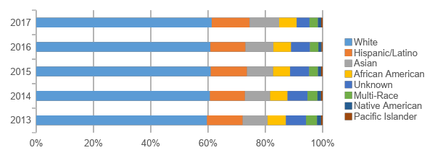
Race & Ethnicity
Students
Faculty
Figure 2: Total Percentage Unduplicated Student Enrollment by Race/Ethnicity, Fall 2018
Figure 3. Total Institutional Employment Tenured/Tenure-Track Faculty by Race/Ethnicity First Day, Fall Semester from 2013 to 2017
Source: Fall 2018 First Census Research Database, LRCCD

Slide 17
Total Eligible Applicants
Race/ethnicity | Classified: 9,057 | Faculty: 2,404 | Management: 1,491 | Total
American In/Al Nat | 0.6% | 0.5% | 1.6% | 0.7%
Asian | 15.4% | 11.7% | 9.5% | 13.5%
Black/Af American | 10.6% | 8.3% | 18.9% | 11.1%
Decline to state | 7.4% | 9.6% | 6.5% | 7.9%
Hispanic/Latinx | 21.6% | 14.0% | 16.7% | 18.8%
Native Haw/PI | 1.1% | 0.1% | 0.2% | 0.7%
2+ | 6.2% | 5.0% | 5.3% | 5.7%
White | 37.1% | 50.8% | 41.4% | 41.6%
Total | 100.0% | 100.0% | 100.0% | 100.0%
Notes:
One of the main responsibilities of HR is to recruit and facilitate the hiring of talented individuals that provide our district with a workforce that mirrors the demographics of our student body and community. This table highlights the recruitment efforts of the District during the 2017-2018 academic year to meet this goal.

Slide 18
Applicants Interviewed
Race/ethnicity | Classified | Faculty | Management | Total
American In/Al Nat | 0.8% | 0.4% | 2.2% | 0.9%
Asian | 16.4% | 11.2% | 13.0% | 14.7%
Black/Af American | 7.9% | 9.1% | 16.5% | 9.4%
Decline to state | 7.1% | 7.7% | 2.9% | 6.6%
Hispanic/Latinx | 19.9% | 16.8% | 20.3% | 19.2%
Native Haw/PI | 0.7% | 0.0% | 0.0% | 0.4%
2+ | 5.7% | 4.9% | 4.8% | 5.4%
White | 41.4% | 49.9% | 40.3% | 43.3%
Total | 100.0% | 100.0% | 100.0% | 100.0%

Slide 19
Applicants Hired
Race/ethnicity | Classified: 201 | Faculty: 41 | Management: 43 | Total
American In/Al Nat | 0.6% | 1.9% | 0.0% | 0.8%
Asian | 19.9% | 9.4% | 14.7% | 16.9%
Black/Af American | 9.0% | 15.1% | 11.8% | 10.7%
Decline to state | 4.5% | 1.9% | 0.0% | 3.3%
Hispanic/Latinx | 19.9% | 13.2% | 26.5% | 19.3%
Native Haw/PI | 0.0% | 0.0% | 0.0% | 0.0%
2+ | 4.5% | 3.8% | 5.9% | 4.5%
White | 41.7% | 54.7% | 41.2% | 44.4%
Total | 100.0% | 100.0% | 100.0% | 100.0%

Slide 20
Reimagining the Hiring Process
HIRING MANUAL—Los Rios Community College District
Notes:
Victoria

Slide 21
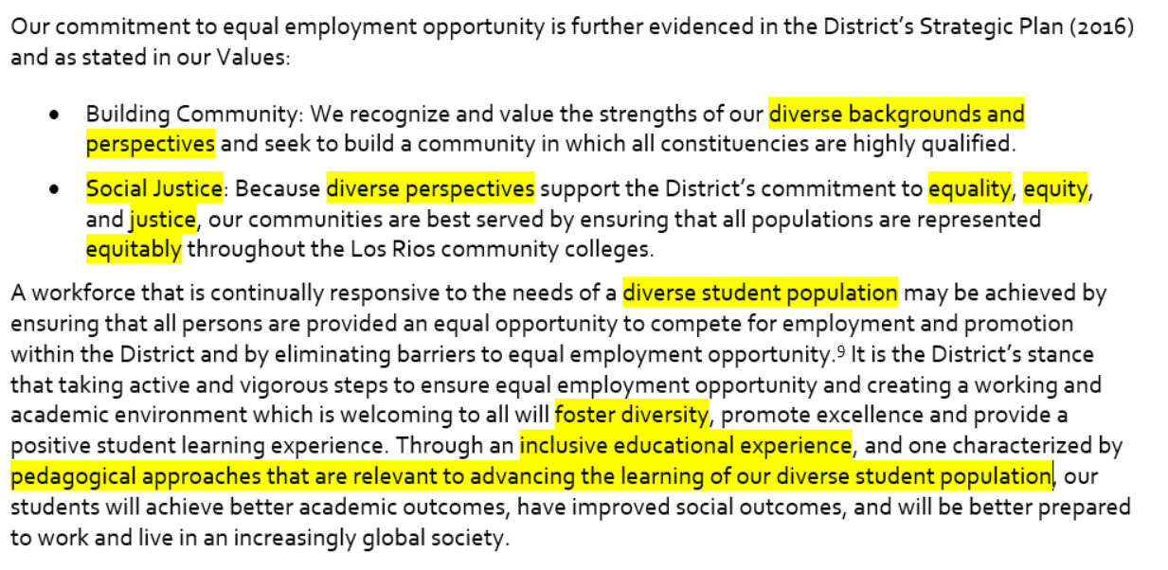
Connect to Strategic Plan

Slide 22
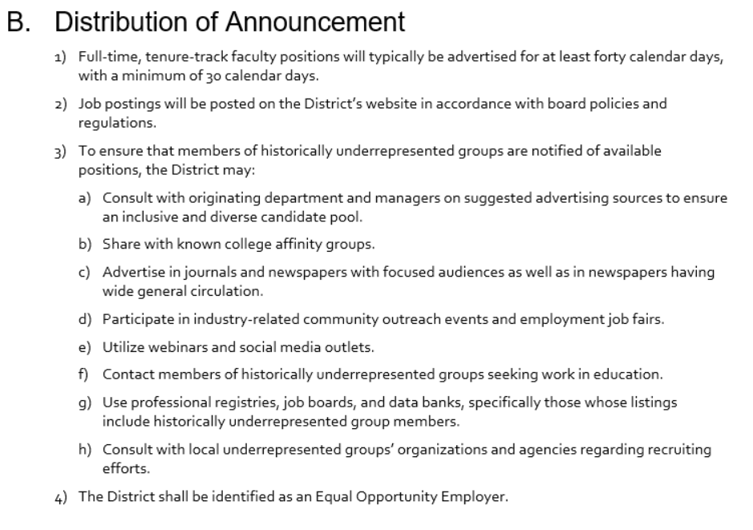
Clarify Expectations

Slide 23
Be Transparent

Slide 24
Disrupting Inequitable Practices
Updated job postings
Share departmental profile data and employee demographics
Increase travel allowance
Openly share tools typically used by HR staff: the Matrix, Hiring Flow Chart
Change the diversity statement item
Disrupt the committees and how faculty are appointed
Require a student be invited to every faculty panel
Equity roles are now racially equity focused
Equity-focused rubrics
Clarify role of committee members
Openly share interview questions

Slide 25
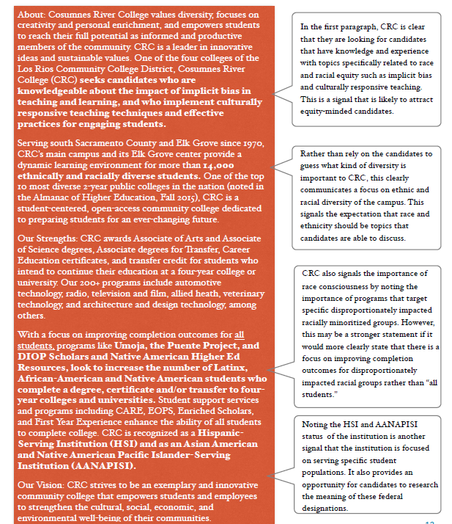
Examine Job Postings

Slide 26
Before and After

Slide 27
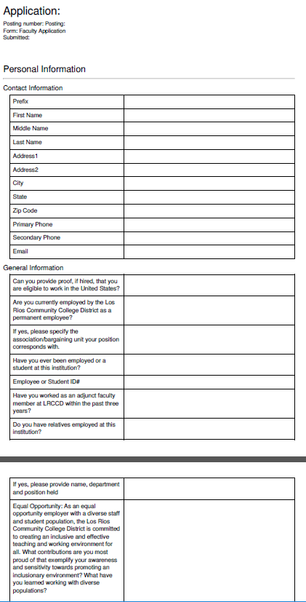
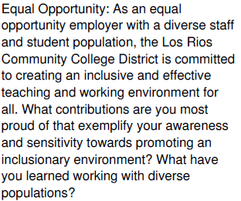
Update Application

Slide 28
Before and After
Equal Opportunity: As an equal opportunity employer with a diverse staff and student population, the Los Rios Community College District is committed to creating an inclusive and effective teaching and working environment for all. What contributions are you most proud of that exemplify your awareness and sensitivity towards promoting an inclusionary environment? What have you learned working with diverse populations?
Equal Opportunity: As an equal opportunity employer with a diverse staff and student population, the Los Rios Community College District is committed to the principles of social justice and racial equity in creating an inclusive and equitable learning and work environment for all. Please answer this question completely. What have you done to support and promote racial equity and inclusion in your community or workplace, specifically for racially minoritized groups (e.g. African Americans, Latinx and Native Americans)?

Slide 29
Job Posting Review

Slide 30
Content Analysis

Slide 31
Pipeline and Retention
FACULTY DIVERSITY INTERNSHIP PROGRAM (FDIP)
Notes:
Victoria

Slide 32
FDIP Program Goals
Meet
Meet the changing needs of our diverse students
Enhance
Enhance the diversity of full and part-time faculty
Attract & Recruit
Attract and recruit qualified candidates to serve as faculty
Provide
Provide mentoring and training opportunities for prospective faculty

Slide 33
Year-long Program
Classroom experience in the spring
Faculty training in the fall
40 hours of faculty training
7 Saturdays: 8:30-2:30
Topics: System overview, preparing for class, student learning assessment, classroom strategies, working with diverse learning styles and student populations, online teaching, Pathway to Los Rios (how to get a job at Los Rios).
Hands-on experience with a faculty mentor
Classroom observation
Deliver lessons
Instructional activities: create assignments, prepare tests, review textbooks, conduct office hours, read/grade homework, papers, and tests, meet division personnel or attend committee meetings

Slide 34
Eligibility Criteria
Demonstrate sensitivity to and understanding of the diverse academic, socioeconomic, cultural, disability, gender identity sexual orientation, and ethnic background of community college students, including those with physical or learning disabilities as it relates to differences in learning styles.
Meet by end of Spring the minimum qualifications for subject area discipline described in the Minimum Qualifications for Faculty and Administrators in California Community Colleges
No prior paid higher ed. teaching experience as instructor of record

Slide 35
Application Process
Interview Process
Complete LRCCD Faculty Application www.losrios.edu under Jobs.
Search for Temporary Positions, then Adjunct Faculty. Select FDIP Pool for information and correct application.
Professional Resume/Curriculum Vitae
Letter of Interest (one page maximum)
Unofficial copies of college transcripts
Equivalency Review conducted by campus faculty
15” interviews with faculty and DO staff
5 questions
Selection
Mentor matching conducted by FDIP Facilitators

Slide 36
Current Class (June 2020)
Race/ethnic | Count | % of Total
Not disclosed | 0 | 0.0%
Male | 12 | 22.6%
Female | 41 | 77.4%
Non-binary | 0 | 0.0%
African American | 17 | 32.1%
Am Indian/Alaskan Native | 0 | 0.0%
Asian/Pacific Islander | 2 | 17.0%
Hispanic/Latinx | 20 | 35.7%
2+ | 3 | 5.7%
White | 3 | 5.7%
Not disclosed | 1 | 1.9%
Total | 53 | 100%

Slide 37
Advertising: Where and how we post
College Departments
CareerBuilder
Chronicle of Higher Ed (Vitea.com)
Community College Registry Job Fair: Oakland
Community College Registry Job Fair: Los Angeles
Community College Registry Online Job Board
Community Outreach (ex. Festivals, etc.)
CommunityCollegeJobs
Craigslist
EdJoin
Facebook (Campaign)
Facebook (Los Rios Page)
Glassdoor
Greater Sacramento Urban League
HigheredJobs
Indeed
Instagram
Job Sites
Job Journal
Latina Leadership Network of the California Community Colleges
LinkedIn
Professional Networks & affinity groups
Sacramento African American Chamber of Commerce
Sacramento Asian Chamber of Commerce
Sacramento Builders Exchange
Sacramento Hispanic Chamber of Commerce
Sacramento Rainbow Chamber of Commerce
Sacramento Works
Twitter
Vitae
YouTube
ZipRecruiter
(0.24%)
(0.87%)
(0.24%)
(2.99%)
(10.9%)
(1.14%)
(22.7%)
(2.95%)
(54.9%)

Slide 38
Training
2016: Neuroscience of Decision Making, EEO Laws and the Educational Benefits of Diversity and Best Practices Training (Kimberly Papillon, Esq, Dr. Jackie Rez, Nitsha K. Sawhney, Esq)
2018: Institute for Equity in Faculty Hiring (Center for Urban Education, USC)
2018: Being Conscious about Unconscious Bias (Molly Senecal, Dean Research & Planning, FLC; Dr. Belinda Lum, Sociology , SCC))
2018: Healing Justice film (Shakti Butler, Ph.D.)
2018: LRCCD Institute for Equity in Faculty Hiring (CUE)
2018: LCW workshop on Creating a Culture of Respect (Kristen Lindgren)
2019: The Benefits of Diversity & The Effects of Unconscious Bias on the Hiring Process (Eugene Whitlock, J.D.)
2019: LRCCD Institute for Equity in Faculty Hiring (CUE)
2019: Improving Outcomes for Community College Students (Robert Fairlie)

Slide 39
Training 2020-2021
6/18 ARC: Part One: Equity Foundations (Nicolas Daily)
6/25 ARC: Part Two: Personal and Professional Equity (Nicolas Daily)
7/16 5-Part Webinar Series: Black Lives Matter, widely promoted by ARC (Hosted by Luke Wood & Donna Ford)
7/20 Webinar: How to Be an Anti-Racist (Ibram X. Kendi) with 7/27 ARC Debrief (Nicolas Daily)
12/1 Los Rios Notable Speaker Series: Beyond the Plan; Implementing Equity Efforts (Dr. Frank Harris III)
12/15 LRMA: Addressing Systemic Racism in an Institution (presenters TBD)
2/16 LRMA: Helping Deans Practice Equity-Minded Leadership Using a Race-Equity Lens & Interventions (presenters TBD)
TBD: Los Rios Notable Speaker Series: Ethical Leadership in Community Colleges (Dr. Luke Wood)

Slide 40
Community, Networking, and Social Components
Participant perspective
Value of social and networking components
Notes:
Chelsea: 5 minutes

Slide 41
Budgets, Funding, Compensation
Things to consider:
Faculty Stipends: interviews ($37-57/hour), facilitators ($2,500), lead teachers ($3,500), mentors ($500), guest speakers in the training
Materials: handbooks, training binders, textbook(s) (New to College Teaching/$44)
Meals: $3,400
Total: ~$50,000
Notes:
Victoria (3 minutes)

Slide 42
Retention
Programs after getting hired
New faculty orientations or academies
Discipline mentoring
Affinity groups
ASCCC Faculty Leadership and Empowerment Academy (FELA)
ASCCC caucuses
Notes:
Michelle/Silvester: 5 minutes

Slide 43
ASCCC Canvas Hiring Module
Notes:
Michelle (2 min)
Canvas link: https://ccconlineed.instructure.com/courses/4924~5733

Slide 44
Who could champion this work?
Faculty
Administrators
and Staff
Notes:
Silvester: 3 minutes

Slide 45
Questions and Answers
Notes:
10 min Chelsea and Michelle moderate/monitor
Use the CHAT in Pathable

Slide 46
For Further Information and Support
Email info@asccc.org
Ask your local Human Resources Office
Contact Info:
mbean@riohondo.edu
shenderson@losmedanos.edu
hull_chelsea@smc.edu
rosariv@losrios.edu
Notes:
Michelle (1 min)

