Slide 1
Minimum Qualifications, Equivalency, and Assigning Courses to Disciplines
Lance Heard, ASCCC At-Large Representative
Robert L. Stewart Jr, ASCCC Area C Representative
June 18, 2021

Slide 2
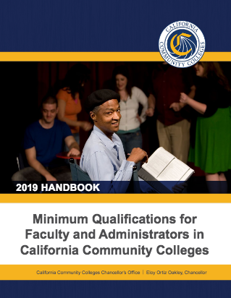

Today, we will discuss…
The Disciplines List
Minimum Qualifications Requirements
Equivalency to Minimum Qualifications.
Overview of Assigning Courses to Disciplines
Click on 2019 Handbook image or use QR Code on the right to access updated 2020 Handbook

Slide 3

FALSE
Equivalencies/Minimum Qualifications are used as the sole basis for faculty hiring.

Slide 4
Minimum Qualifications “Hierarchy”
“Basic MQs” for credit instructors, counselors, and librarians are the minimum degree and experience requirements specified in Title 5 §53410.
Discipline-specific MQs in the Disciplines List
  Define the fields of study or professional experience to required to fit within a discipline.
  Must conform to the degree and experience requirements of §53410.

Slide 5
Minimum Qualifications “Hierarchy”
Basic MQ
Master’s degree
Bachelor’s degree +2 years professional experience
Associate’s degree +6 years professional experience
Discipline-Specific MQ
Humanities - Master’s in Humanities
Biotechnology - Bachelor’s in biological sciences, chemistry, biochemistry or engineering, plus two years of professional experience

Slide 6
What is a Discipline?
Faculty must meet the MQs for the discipline of the faculty member’s assignment.
A “discipline” is defined as a grouping of courses that share common academic or vocational preparation, which are typically defined by a degree or degrees (MFA, MA, BA, AS, etc.), or specific professional preparation.
  Discipline is from the perspective of faculty preparation.
  Not the same as local departments or subject areas.
  Disciplines List specifies the minimum qualifications for each discipline.
  Instructional faculty must meet the MQs of the disciplines to which courses are assigned.
A discipline is not your local designator, a TOP code, or a FSA!

Slide 7
Discipline MQs and the Disciplines List
Revisions to Discipline List is done annually.
Through local senate or through professional organization
Must have two separate senate districts approve the proposal.
Must provide evidence to support rationale for change.
Minimum of two statewide hearings.
Board of Governors considers the recommendations of the Senate and formally acts on them.

Slide 8
Evidence for Disciplines List Proposals
Support from an associated professional organization
Evidence of degrees titles within the proposed revision of the discipline or new discipline:
  Minimum of three degrees
  Regionally accredited institutions (all public institutions in California)
  Disciplines in the Master’s List requires evidence of the availability of master’s degrees
  Disciplines in the Non-master’s List requires evidence of the availability of degree, certification, and/or professional experience, if necessary
Change is necessary & not merely a response to a unique need of one college, district or region and includes discipline seconder from another district
Impact of proposal across the state using a list the pro and con arguments and including refutation of the con arguments
Provided other evidence such as significant changes to the field that requires a change to the Disciplines List
Final deadline of September 30, 2021

Slide 9
TRUE
Local Qualifications May Exceed
State Minimum Qualifications.

Slide 10
TRUE
For a non-master’s discipline, professional experience is required even if the applicant has a master’s degree.

Slide 11
FALSE
A master’s degree is required even if the applicant has a doctorate in the discipline.

Slide 12
FALSE
Applicant degree titles must match the degree titles in the Disciplines List exactly in order to be hired.
One of two processes can occur---determination of an equivalency to an existing discipline, or proposal of a revision to the Disciplines list, either by proposing a new discipline or adding a degree to an existing discipline.

Slide 13
Are there MQs not in the Disciplines List?
Established in Title 5 regulations separately from the Disciplines List
Specialized MQs defined in other sections of Title 5 for the following faculty:
  Health services professionals
  Noncredit instructors
  DSPS
  Learning assistance/learning skills/tutoring
  EOPS
  Apprenticeship instructors
  Faculty interns
Revisions to these disciplines still come through the ASCCC, but the approved proposal then must be incorporated into Title 5.

Slide 14

Equivalency - Questions to Ponder
Why is equivalency permitted?
What are the benefits of equivalency?

Slide 15
TRUE
Equivalent to the minimum qualifications means equal to the minimum qualifications, not nearly equal.

Slide 16



Who determines equivalency?
“The process, as well as criteria and standards…shall be developed and agreed upon jointly by …the [local] governing board and the [local] academic senate.” (Title 5, §53430)

Slide 17
What are the minimum standards for equivalency?
A district may hire a person who “possesses qualifications that are at least equivalent to the [state] minimum qualifications.” They cannot be less rigorous than the state-established MQs.
A district may establish additional qualifications which are more rigorous than the state-established MQs.
Equivalency may also be granted on the basis of eminence in the field.

Slide 18
Criteria for Equivalency
Procedures established by agreement between local senates and boards of trustees for each district
  In multi college districts, the criteria for equivalency must be the same at all colleges in the district.
Discipline faculty determine criteria
Burden of proof belongs to the applicant

Slide 19
FALSE
Conditional or provisional equivalencies can be created as part of the local process.

Slide 20
TRUE
Human Resources Offices should not be instrumental in establishing equivalencies.
They should not be instrumental. While they serve a supportive role – their role should not be the primary role. Equivalency is established between the governing board and faculty.

Slide 21
FALSE
Single course equivalencies are permitted.

Slide 22
Single Course Equivalency
Ed Code and Title 5 refer to qualifications in terms of Disciplines not courses or subject areas within a Discipline (Ed Code §87357; Title 5 §53410 and §53430)
Legal Opinion L 03-28, Chancellor’s Office Legal Division
  Faculty are hired to teach a discipline, not a course

Slide 23
FALSE
Alternative equivalents to the associate’s, bachelor’s, and master’s degrees may not be established locally.

Slide 24
Considerations for Equivalency Committees
What is equivalent to a bachelor’s degree or associate’s degree?
What is equivalent to a master’s degree?
To what extent can experience be used to establish equivalency?
What are equivalent alternative degree titles to those in the Disciplines List?

Slide 25
TRUE
Assigning courses to disciplines is not part of the process of equivalency.

Slide 26
Courses, Disciplines, and MQs
Discipline
Defines required academic preparation and professional experience for faculty
Assignment of Course to Discipline Defines the MQs needed to teach the course.
Courses
What the faculty teach…curriculum!

Slide 27
Assigning Courses to Disciplines
Local senates maintain responsibility for placing courses in disciplines [T5 §53200(c)(1)]
All credit & noncredit courses must be placed within a discipline or disciplines
Not required for community service courses

Slide 28
Considerations for Discipline Assignment
Assignment based on course content, not personnel issues, enrollment or FTE
Placement should be based on knowledge required to teach the course
Discipline faculty need to be involved
Not all programs or department titles are disciplines
TOP codes are NOT disciplines

Slide 29
Options for Assigning Courses
Course assigned to a single discipline.
  Example: ENGL 101 assigned to English.
  The minimum qualifications for English provides adequate preparation to teach the course content.
  Faculty who meet MQs or the locally-determined equivalent for that discipline are eligible to teach the course.
Course assigned to more than one discipline with an “or”
  Example: ARTS 101 assigned to Art or Graphic Design.
  The MQs for either discipline provide adequate preparation to teach the course content.
  Faculty who meet minimum qualifications or the locally-determined equivalent in any of the listed disciplines are eligible to teach the course.
Course assigned to more than one discipline with an “and”
  HUMA 120 assigned to Humanities and Ethnic Studies.
  The MQs for both disciplines together provide adequate preparation to teach the course content.
  Faculty who meet minimum qualifications or the locally-determined equivalent for ALL of the listed disciplines are eligible to teach the course.

Slide 30


Resources
Equivalence to the Minimum Qualifications 2020, ASCCC
Disciplines List Handbook 2020 Revision, ASCCC
Additional Disciplines List resources, including an archive of past Disciplines Lists are found at http://asccc.org/disciplines-list.

Slide 31

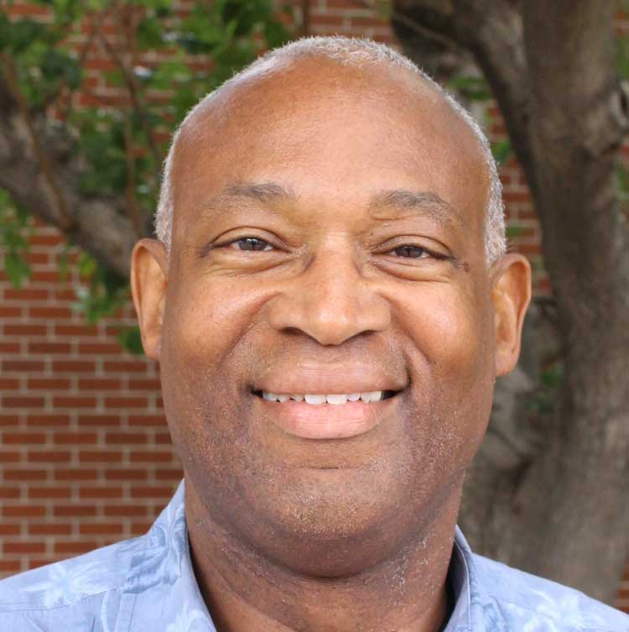
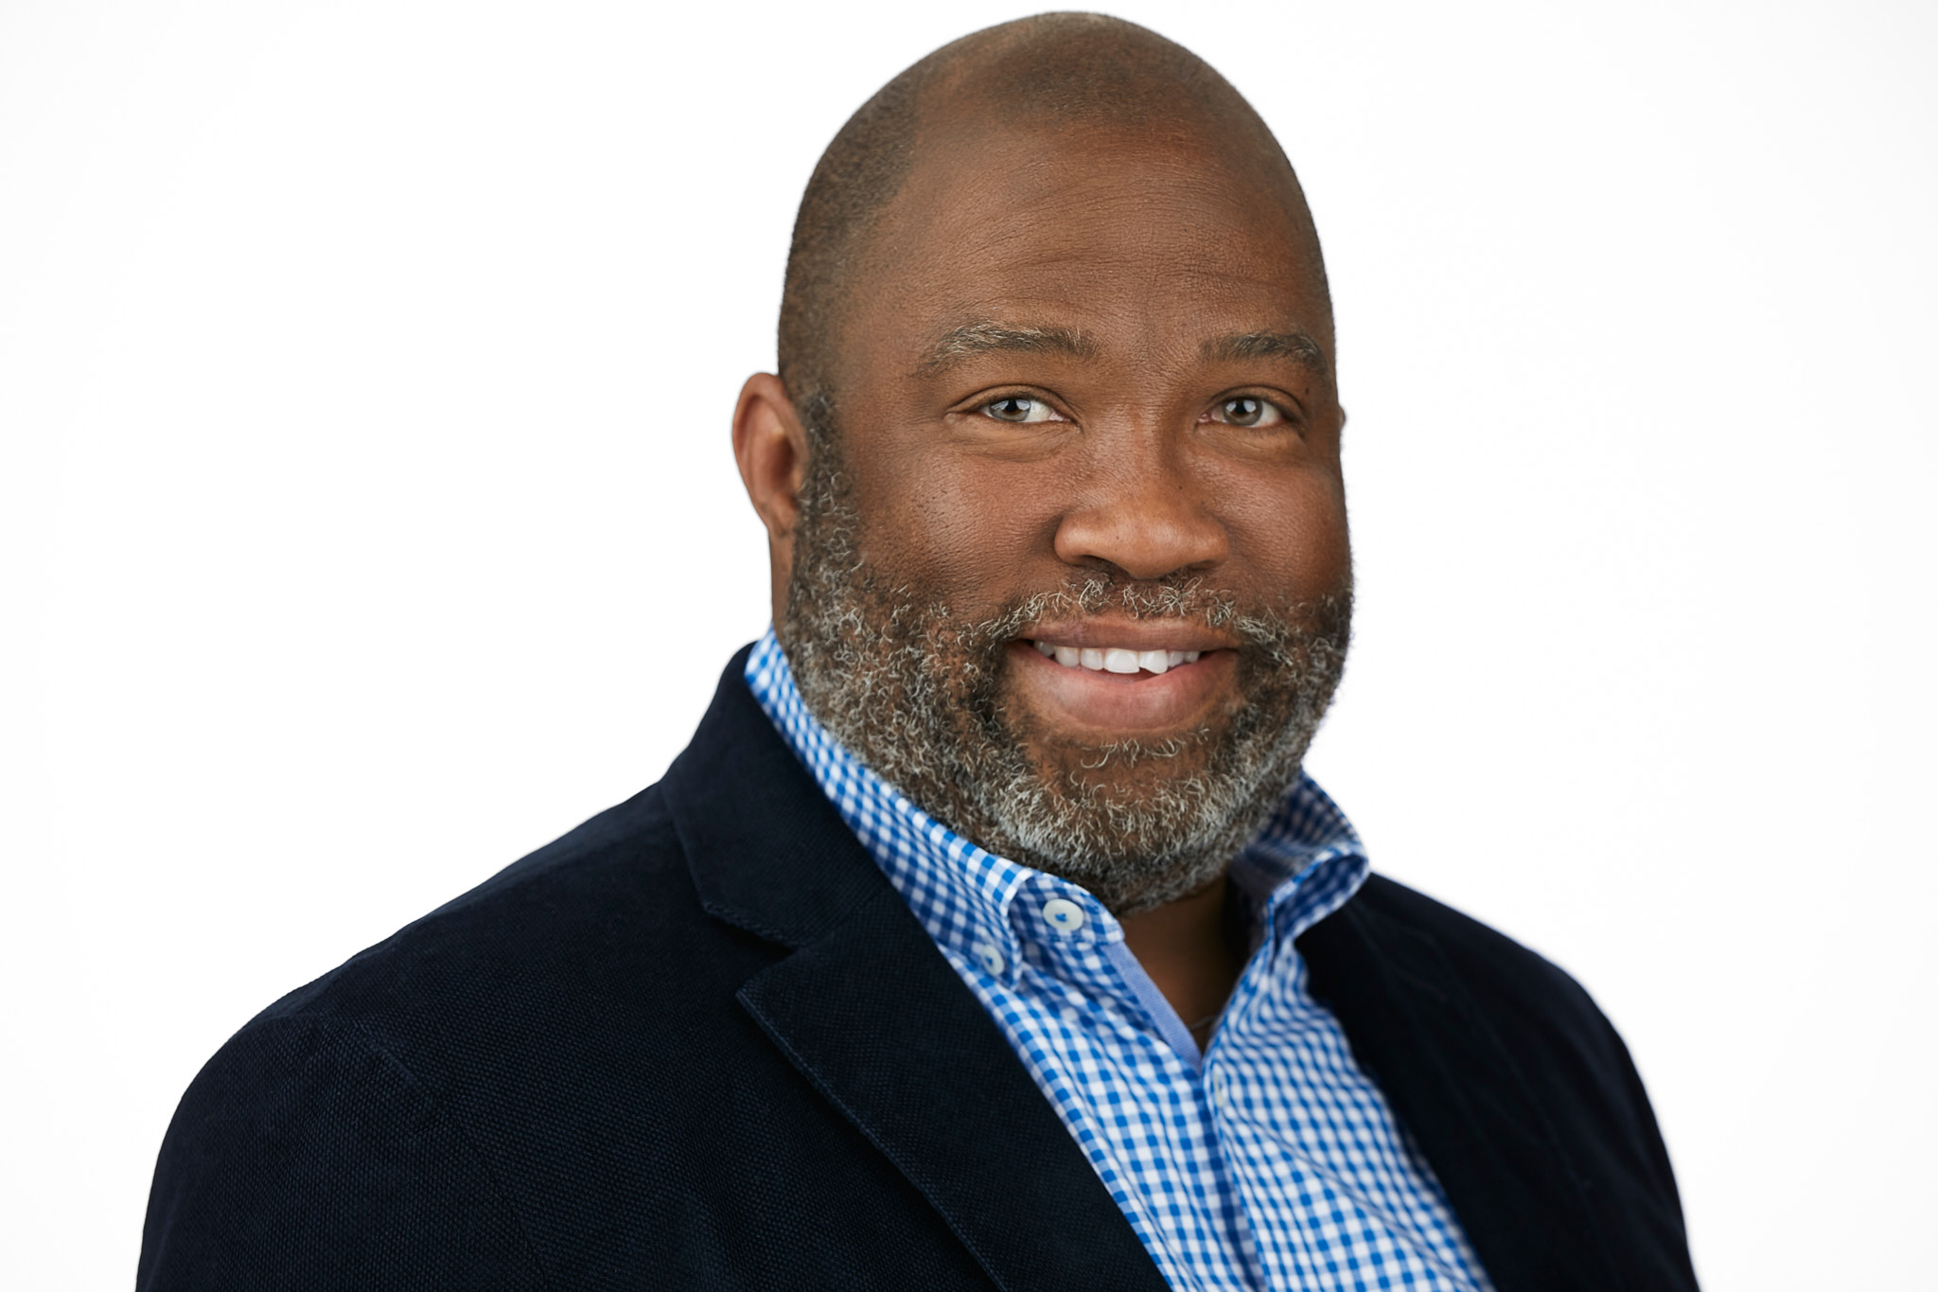

Lance Heard– lheard@mtsac.edu
Robert L. Stewart Jr– stewarrl@lasc.edu

