Slide 1
Transcending Cultural Differences: Developing an International and Interdisciplinary Lens to Environmental Economics
Monika Thomas, Economics Professor, De Anza College
Institute for Instructional Design and Innovation
March 17, 2017

Slide 2
Why should I internationalize the curriculum?
Global economy
Worldwide trade
Climate change
Interconnectedness
Fostering mutual understanding

Slide 3
What Aspects of the Course are Internationalized?
Overarching topics that students research, discuss, and connect to curriculum
Adding an ‘international lens’ to the curriculum
Utilizing global themes
Example: Food Security

Slide 5
Food Security Feeding 10 Billion People by 2050

Slide 6
Can the World:
Produce Enough Food?
At Reasonable Prices?
Provide Access to Food for the Poor?
And Not Destroy the Environment in the Process?

Slide 8
Thailand

Slide 9
Thailand

Slide 10
Thailand

Slide 12
Malawi

Slide 13
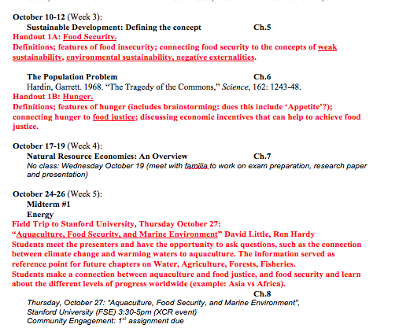

Slide 14
Hunger and Food Justice

Slide 16
Green Revolution

Slide 17
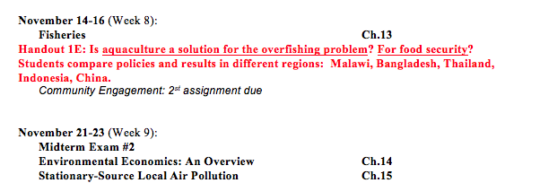

Slide 18
Fisheries / Aquaculture

Slide 19
Bangladesh

Slide 20
Java

Slide 23
Environmental Justice
Notes:
https://www.nytimes.com/2016/11/30/learning/lesson-plans/battle-over-an-oil-pipeline-teaching-about-the-standing-rock-sioux-protests.html

Slide 24
Notes:
https://www.nytimes.com/2016/11/30/learning/lesson-plans/battle-over-an-oil-pipeline-teaching-about-the-standing-rock-sioux-protests.html

Slide 27
Notes:
Oil and gas pipelines
http://www.foreffectivegov.org/blog/map-displays-five-years-oil-pipeline-spills

Slide 28
Pedagogy
Familias
Research and discussion (based on provided handouts)
Presentation
Research paper
Community engagement
Field trip

Slide 29
EPIC Fellowship, Stanford University
Mentors (Gary Mukai, Jonas Edman)
Peer mentors (the other fellows)
Events
Literature
Lesson plans

