Slide 1
Moving Beyond Buzzwords: Implementing Diversity, Equity, Inclusion, and Anti-racism Thursday, February 18 4:30–5:30 pm

Slide 2
Land Acknowledgement
We acknowledge the land we are zooming from today as the traditional home of the Nisenan, Maidu, Miwok, Kizh, Tongva, and Chumash tribal nations. These sovereign people have been the caretakers of this land since time immemorial. Despite centuries of genocide and occupation, these native peoples continue as vibrant and resilient tribes and bands, both Federally recognized and unrecognized. We take this opportunity to acknowledge the generations that have gone before as well as the present-day Nisenan, Maidu, Miwok, Kizh, Tongva, and Chumash.
https://native-land.ca/

Slide 3
Introductions
Dr. Emilie Mitchell
ASCCC Part-time Committee
American River College
Psychology Professor
Faculty Coordinator for ARC Pride Center
Lead Planner on CCC LGBTQ+ Summit
Dr. LaQuisha Beckum
American River College
Part-time Faculty in Psychology
Interim STEM center coordinator/ MESA director
Faculty professional development liaison
Faculty trainer
LRCFT executive board member
Star Glover
California State University, Northridge
Part-time Faculty in English
Consultant in the Learning Resource Center
Los Angeles Valley College
Part-time Faculty in English

Slide 4
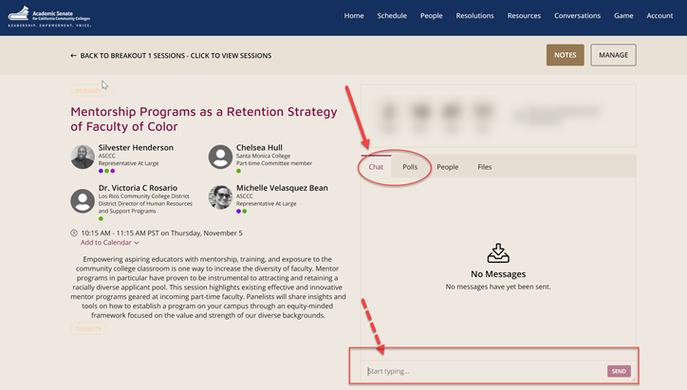
Questions
Use the Pathable platform CHAT box

Slide 5
This Presentation Will Include:
Introductions
Defining terms/clearing up confusion
Discussion of how to get started in this work
Commitment to making a change to help support BIPOC students
Notes:
Quisha

Slide 6
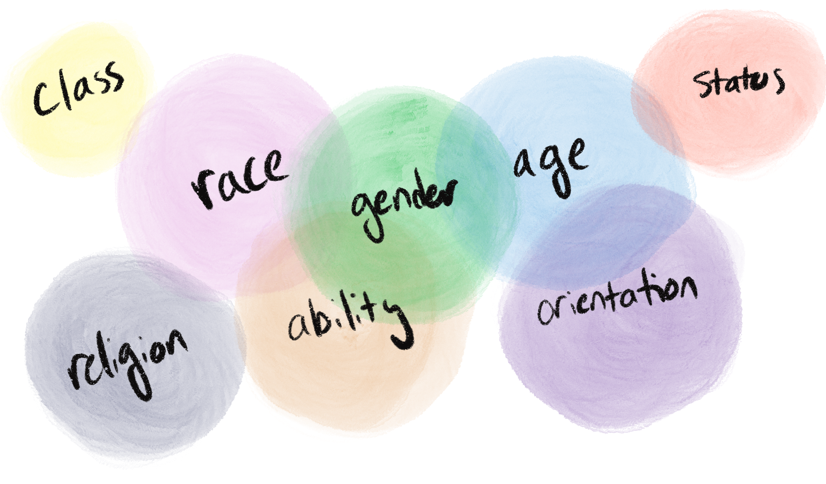
Intersectionality/Identity
“The events and conditions of social and political life and the self . . . are generally shaped by many factors in diverse and mutually influencing ways” – Patricia Hill Collins & Sirma Bilge
Notes:
Star

Slide 7
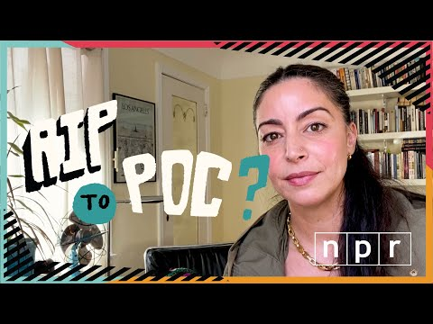
BIPOC - What happened to POC?
BIPOC
Black, Indigenous, and people of colour— it emphasizes the particular oppression faced by Black and Indigenous peoples when compared to others who may identify as POC but benefit from privilege as the result of their skin colour or physical appearance and/or the particular historical and societal circumstances associated with their race or culture.” -The Canadian Centre for Gender + Sexuality Diversity
Intersectionality
Levels of Oppression
Notes:
Emilie

Slide 8
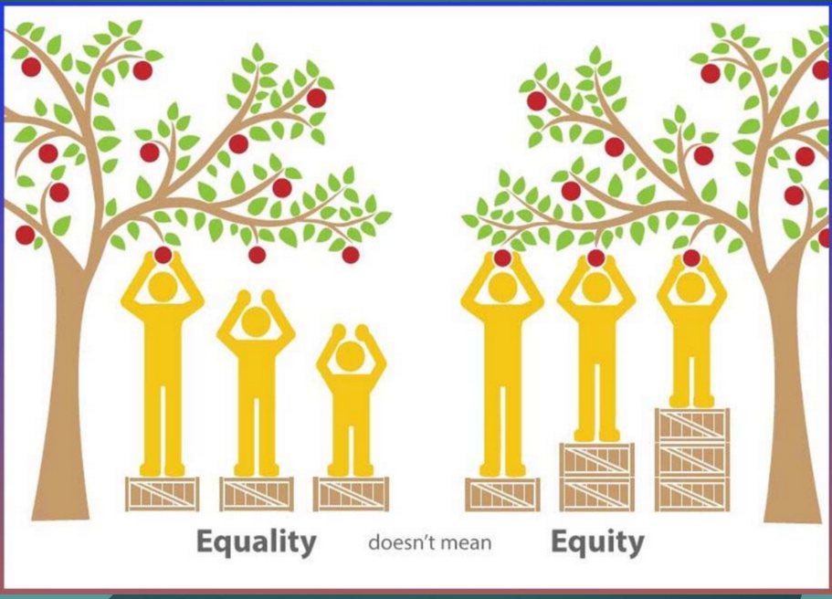
Equality versus Equity
Equality – students are treated equally.
Equity – students are treated fairly or justly.
Notes:
Quisha

Slide 9
Tolerance versus Inclusion
Tolerance - the act of allowing something. A secondary definition is to endure pain or suffering.
Inclusion - the act of being included.
Most students want to be included, not to be someone whose identity must be endured.
Notes:
Emilie

Slide 10
Diversity, Inclusion, Belonging
"Diversity is having a seat at the table, inclusion is having a voice, and belonging is having that voice be heard." - Liz Fosslien & Mollie West Duffy, No Hard Feelings
Who’s at the table versus who’s at the head
Who’s in the room versus who’s in charge
Who speaks versus who stays silent
Tokenism
Notes:
Star

Slide 11
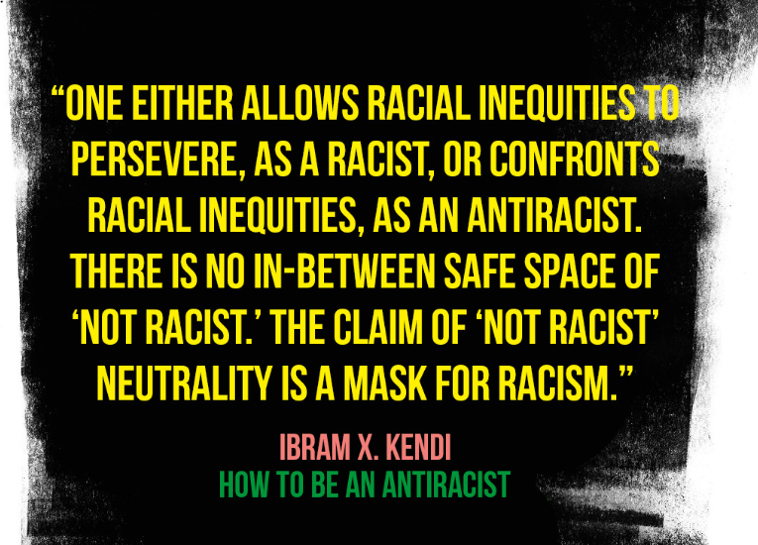
Anti-Racism
What is the difference between being “not” racist and an anti-racist?
The onus of responsibility is on white people.
Notes:
Quisha

Slide 12
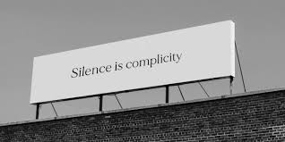
Ally is a verb
It’s not enough to say it matters to you.
Notes:
Emilie (co-conspirator)

Slide 13
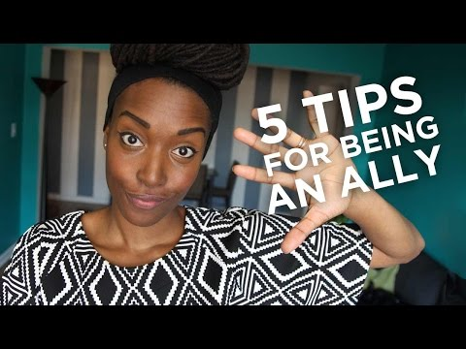
How to be an Ally
Notes:
Emilie

Slide 14
The “Color Blind” Fallacy
“When I claim not to see race, what else am I not seeing in my students?”
Makeda Brome, Education Week Teacher
https://www.edweek.org/teaching-learning/opinion-claiming-to-not-see-race-leads-to-inequity-in-education/2020/02
Notes:
“I don’t see color”; “I treat everyone the same”; “I don’t care if you’re white, black, brown or purple”—even if these statements were true, this would still be a harmful attitude.
Star

Slide 15
“I don’t see color”
Refuses personal responsibility
Denies nonwhite racial and ethnic experiences
Ignores important racial and cultural aspects of the individual
Demands that minority groups assimilate to dominant culture
Notes:
Star

Slide 16
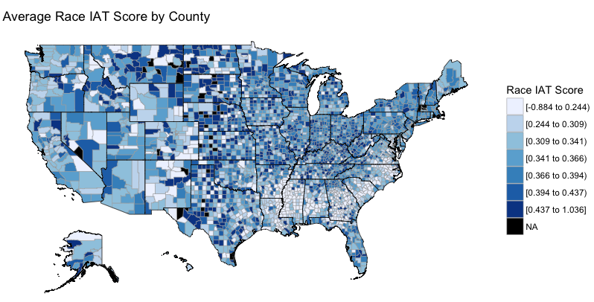
Acknowledge Bias
Bias is cultural
Challenging subconscious beliefs takes work
Our world is not colorblind
https://implicit.harvard.edu/implicit/blog.html
Notes:
Many of you may be familiar with the Harvard Implicit Association Test,which proposes to measure subconscious bias by having participants associate emotionally-charged words with photographs to measure, among other things, colorism (if you haven’t taken it, check it out!) While its validity on an individual level has been challenged, Project Implicit maintains that these results are useful on a national level. We, and our students, are frequently exposed to racist attitudes just in our daily lives.
Star and Quisha
Star

Slide 17
Microaggressions
Expressing surprise at someone’s position, level of education, or academic skill—“You’re so articulate!”
Projecting stereotypical assumptions (preferences, family background, etc.)
Exclusion/Environmental (lack of models/mentors, lack of diversity)
Communicate that someone “does not belong”
Can be demoralizing, frustrating, isolating, and frightening
Difficult for the victim to challenge (concerns are often dismissed or met with hostility)
Notes:
Being anti-racist means acknowleding what racism actually looks like and the ways in which it hurts BIPOC. Microassaults like racial slurs or overt white favoritism are easy to spot, but unintentional microinsults and microinvalidations are insidious.
Star

Slide 18
Taking Action
“There is power in naming racism for what it is, in shining a bright light on it, brighter than any torch or flashlight. A thing as simple as naming it allows us to root it out of the darkness and hushed conversation where it likes to breed like roaches. It makes us acknowledge it. Confront it.” – Jesmyn Ward
“Courage is a decision you make to act in a way that works through your own fear for the greater good as opposed to pure self-interest. Courage means putting at risk your immediate self-interest for what you believe is right.” – Derrick Bell
Notes:
Star

Slide 19
How/where do you get started?
Best practitioner before best practice (but not stymied by perfection and inaction):
Interested versus invested
Try to minimize self-judgment
Critical evaluation of your own classroom, your own policies, your own history, and your own racial identity
Objective/subjective interaction with our material
Acknowledge the issues
Notes:
Quisha - lead and all of us chime in.

Slide 20
What will you do?
What is one action that you could take to support your BIPOC students today?
Put your answers in the chat!

Slide 21
Tool Kit
“RIP to POC?” NPR Code Switch
“5 Tips for Being an Ally”
“What is White Privilege” Teaching Tolerance
“Inclusive Teaching Practices Toolkit” ACUE
“Employing Equity-Minded & Culturally-Affirming Teaching Practices in Virtual Learning Communities” CORA

Slide 22
For Further Information and Support
Email info@asccc.org
Contact Info:
Dr. LaQuisha Beckum beckuml@arc.losrios.edu
Star Glover star.glover@csun.edu
Dr. Emilie Mitchell mitchee@arc.losrios.edu
https://cccqsummit.blogspot.com/

