Slide 1
Moving Beyond Triage: Balancing Academic Freedom, Equity, Anti-Racism and Strengthening Online Education Thursday, April 7, 2022 ǀ 2:45pm – 4:00pm

Slide 2
Breakout Description
As mask mandates begin to lift and we see students return to on-campus instruction, we are moving beyond instructional triage and now able to reflect on our journey of offering online curriculum. We will consider the innovations as well as the challenges that persist. As faculty leaders we need to encourage college-wide conversations on what our online “new normal” will look like, being mindful that academic freedom, equity, and anti-racism should be paramount in our efforts. In this session we will collectively discuss strategies on making space to have these tough conversations and what is needed to engage faculty. Guiding ASCCC resources will be shared to support conversations locally about academic freedom, accessibility, and equitable practices online.

Slide 3
Introductions and Welcome
Christopher Cardona, ASCCC Online Education Committee
Karen Chow, ASCCC Area B Representative
Christopher Howerton, ASCCC North Representative
Opening question: Why did you pick this session?
Notes:
We will take turns introducing ourselves, our roles, and discipline background. We can also discuss some of our online teaching experience.
Invite online participants to put in the chat, and ask in-person attendees to share. We need to be sure to balance and share from all participants regardless of modality of participation. If there is limited participation, we can discuss why we thought this was an important session to build. Please put into the Pathable chat and introduce yourself, your role, and college.
Also norms for our participation in this session.

Slide 4
Preview
Topics:
Reflection of online education before and during the pandemic
The opportunity to infuse anti-racist and equity work in online instruction going forward
Where and how to start these conversations and your role as faculty leaders to facilitate the space.
Balancing it all: academic freedom, equity and anti-racism, accessibility & compliance.
Resources and upcoming ASCCC opportunities
Keeping the work going and motivating faculty
Notes:
Remind attendees that the focus of this session is on academic/curriculum/instruction not on workplace union negotiations
At this point we may set up some norms about how we are engaging with the online participants, etc.
Impact of work, call-to-action.

Slide 5
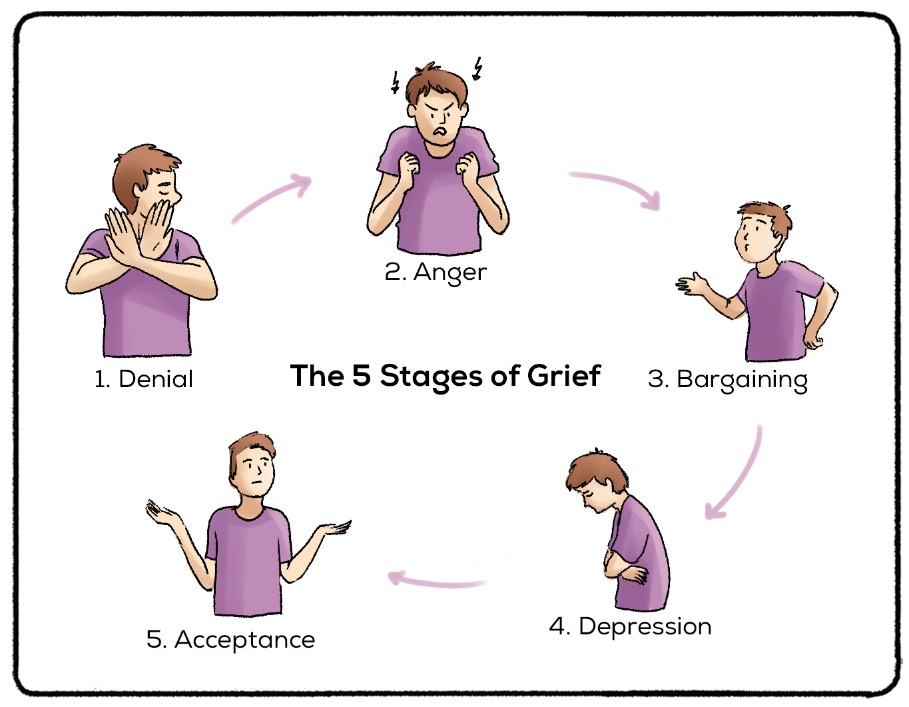
“The before time” and “The Pivot”
Limited or targeted online instruction
Forced Pivot – it was messy! As a community were engaged in educational triage and surviving the semester without knowing how long we would have to be “treading water”
Online emergency lasted longer than anyone predicted, so what have we learned? What were the challenges? And What were the surprises?
Notes:
Prior to the pandemic colleges offered some targeted online instruction, but with emergency declarations we all had to make “THE PIVOT”
CH-Personally I went through the 5 stages of Grief, like many of you and your colleagues. So now that I’m in stage 5-Acceptance, how do we move forward and in the mindset of continuous quality improvement.
Prior to the pandemic, we all experienced, many colleges and districts had either very focused online instructional presence, or limited targeted programs that had online componentes, or there were trailblazer faculty who had a desire to teach their discipline online. Every college had a different method for developing and designing their online curriculum.

Slide 6
Looking Forward
We have an opportunity!
As we find a “new normal” we can look at the opportunity we have to be thoughtful as we plan for long-term implementation of online offering of curriculum and curriculum design.
As we adjust, we can also consider the thoughtful infusion of anti-racism and equity in how we deliver our online instruction.
What might that look like?
What may be challenges?
Notes:
During “the pivot” we were focused on compliance and the “bare minimum” to get the courses ready for our students. Many colleges started “just in time” online instructor trainings and forced many college senates working locally to review and update DE handbooks. Now as we adjust we have an opportunity to think of what our ideal and best practices will be moving forward. WE CAN SHAPE THE VISION OF OUR FUTURE OF ONLINE EDUCATION.

Slide 7
Where and How to Start the Conversation
Time to Open the Dialogue!
Where and how to have these conversations, and what can you do as faculty leaders to help facilitate moving forward?
What are some of the challenges to have these conversations?
What are steps we can take when others are not ready to have the conversation?
Who should you bring into the conversation to build synergy?
Notes:
single-college vs. multi-college districts

Slide 8
Balancing it All
Academic freedom, equity & anti-racism, accessibility & compliance
Each of these are BIG topics, but they intersect and impact student learning
Notes:
Academic Freedom paper link and resources provided later in presentation

Slide 9
Academic Freedom
ACADEMIC FREEDOM: Academic freedom is a fundamental concept that exists to ensure that institutions of higher education function for the public good and that colleges are constructed on the foundations of genuine trust.
ACADEMIC FREEDOM Principles:
Freedom in the classroom in discussing their subject
Full freedom of research and in the publication of the results
Freedom from “institutional censorship or discipline” in their extramural speech
Notes:
Title 5: Title 5 §51023 requires governing boards of community college districts to adopt a policy statement on academic freedom, California Education Code does not include specific provisions protecting academic freedom, resulting in a wide variety of academic freedom policies across districts and colleges and a lack of “the uniformity necessary to uphold and ensure the principles of academic freedom across all of California’s community colleges” (SR45, Min as of March 17, 2022)

Slide 10
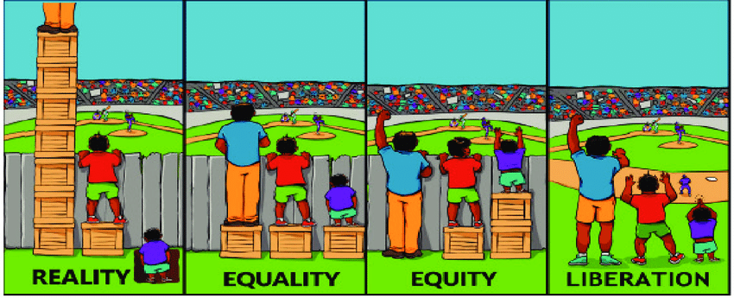
Equity and Anti-Racism
Higher education has been built on foundations of inequity and injustice.
Anti-racist practice for digital and online learning – Jessica Rowland Williams, Ph.D., Director of Every Learner Everywhere (Sep. 29, 2020)
Youtube video (approx. 30 mins.)
Notes:
Prior to our forced “pivot” there was already inequity for our online students, some of these gaps widened. Who of our students were the most affected?
Myths busted in this video:
Digital learning is the solution for inequity in digital learning
“evidence based" teaching practices are always equitable
In digital learning environments there is no way for students to be judged on their race or gender
Access to technology, resources to online learning. How can we change the system?

Slide 11
Accessibility and other Compliance Factors
Title 5
§ 55200. Definition and Application
§ 55204. Instructor Contact
§ 55206. Separate Course Approval.
§ 55208. Faculty Selection and Workload
This is just a small sample of CA legislative requirements for online education. Additional accessibility requirements such as covered under Section 508 of the Rehabilitation Act (and others) are also requirements we must match.
Notes:
Title 5:
Section 55200
Distance education means instruction in which the instructor and student are separated by time and/or distance and interact through the assistance of technology. All distance education is subject to the general requirements of this chapter as well as the specific requirements of this article. In addition, instruction provided as distance education is subject to the requirements of the Americans with Disabilities Act (42 U.S.C. § 12100 et seq.) and section 508 of the Rehabilitation Act of 1973, as amended (29 U.S.C. § 794d)
Section 55204
In addition to the requirements of section 55002 and any locally established requirements applicable to all courses, district governing boards shall ensure that:
(a) Any portion of a course conducted through distance education includes regular effective contact between instructor and students, and among students, either synchronously or asynchronously, through group or individual meetings, orientation and review sessions, supplemental seminar or study sessions, field trips, library workshops, telephone contact, voice mail, e-mail, or other activities. Regular effective contact is an academic and professional matter pursuant to sections 53200 et seq.
(b) Any portion of a course provided through distance education is conducted consistent with guidelines issued by the Chancellor pursuant to section 409 of the Procedures and Standing Orders of the Board of Governors.
Section 55206
If any portion of the instruction in a new or existing course is to be provided through distance education, an addendum to the official course outline of record shall be required. In addition to addressing how course outcomes will be achieved in a distance education mode, the addendum shall at a minimum specify how the portion of instruction delivered via distance education meets:
(a) Regular and effective contact between instructors and students and among students as referenced in title 5, section 55204(a), and
(b) Requirements of the Americans with Disabilities Act (42 U.S.C. § 12100 et seq.) and section 508 of the Rehabilitation Act of 1973, as amended, (29 U.S.C. § 749d)
The addendum shall be separately approved according to the district's adopted curriculum approval procedures.
Section 55208
(a) Instructors of course sections delivered via distance education technology shall be selected by the same procedures used to determine all instructional assignments. Instructors shall possess the minimum qualifications for the discipline into which the course's subject matter most appropriately falls, in accordance with article 2 (commencing with section 53410) of subchapter 4 of chapter 4, and with the list of discipline definitions and requirements adopted by the Board of Governors to implement that article, as such list may be amended from time to time.
(b) Instructors of distance education shall be prepared to teach in a distance education delivery method consistent with local district policies and negotiated agreements.
(c) The number of students assigned to any one course section offered by distance education shall be determined by and be consistent with other district procedures related to faculty assignment. Procedures for determining the number of students assigned to a course section offered in whole or in part by distance education may include a review by the curriculum committee established pursuant to section 55002(a)(1).
(d) Nothing in this section shall be construed to impinge upon or detract from any negotiations or negotiated agreements between exclusive representatives and district governing boards.

Slide 12
Now What?
So, with all these BIG issues and considerations, how do we infuse these efforts moving forward?
Who is responsible?
Where is your college/district in preparation to have these conversations and make a commitment to the work?
What is the degree, rate, and desirability to make these changes?
Who on your campus are champions and who may be detractors?
Notes:
Group conversation. Self assessment of desire and ability to move on these topics.

Slide 13
Other Resources
ASCCC Rostrum articles and paper(s)
Effective Student-Centered Online Education Using the CVC-OEI Online Course Design Rubric and Local POCR
Moving the Needle: Equity, Cultural Responsiveness, and Anti-Racism in the Course Outline of Record
Protecting the Future of Academic Freedom During a Time of Significant Change
CVC –OEI Course Design Rubric
info@asccc.org
Notes:
Reference resolution in packet, other documents in development?
CH & KC
Other sources?

Slide 14
Keeping the Work Going and Motivating Faculty
We are all exhausted! (faculty, staff, and administrators)
The challenge of converting our programs and curriculum was a Herculean effort and we met the moment.
What can we do as faculty leaders to invigorate and help move the important work we need to continue?
Notes:
Collaboration has also become more difficult as we have become isolated working from off campus and many have become less engaged. Are there opportunities to “recommit” to the efforts and as a college create a shared priority that also influences our approach to online instruction. Getting our senates, curriculum committees, DE committees, IT services, administration, student services, full-time and part-time faculty, and others involved. This work is OUR work and can not be done by one person, one committee, just the senate, but developed and sustained by all.

Slide 15
Upcoming ASCCC Event on Academic Freedom
Equity and Anti-racism in Academic Freedom
April 25, 2022 2pm-3pm
The Student Voice in Academic Freedom
May 23, 2022 2pm-3pm

Slide 16
Open Discussion Time
What is something you will do as a first step when you leave this plenary and go back to your college/district?
What are some strategies that have worked for you to bring first awareness, then action on some of these topics?
What are some of the challenges, or “roadblocks” to move the needle forward?
Notes:
remind about resolutions.
What is something you will do as a first step when you leave this plenary and go back to your college/district?
What are some strategies that have worked for you to bring first awareness, then action on some of these topics?
What are some of the challenges, or “roadblocks” to move the needle forward?

