Slide 1
Accreditation in multi-college districts
Raúl Rodriguez, Chancellor, Rancho Santiago Community College District
Craig Rutan, ASCCC Area D Representative
Deborah Wulff, Vice President of Academic Affairs, Cuesta College

Slide 2
Welcome!
Are you a faculty member? Researcher? Administrator?
How many of you have been involved with accreditation in a multi-college district?
Are there specific questions you are hoping we will answer?
Notes:
Craig

Slide 3
Overview
Single College vs. Multi-College Districts
Review of Standard IV.D
Role of District Chancellor
District Functional Mapping
District Governance
Integrated Planning
Notes:
Craig

Slide 4
Multi-College vs. Single College Districts
In single college districts, all services are housed at a college facility and are evaluated during the self evaluation process
Unlike a single college district, multi college districts have shifted some services from a single campus to the district level to be shared among all of the colleges
Even though districts are not accredited, the services and decision making that occurs at the district level must be reviewed during the self evaluation process
Notes:
Raul

Slide 5
Standard IV.D – Multi-College Districts or Systems
Standard | Description
IV.D.1 | CEO provides leadership in setting and communicating expectations of educational excellence and integrity and assures support for the effective operation of the colleges. CEO establishes clearly defined roles, authority, and responsibility between the colleges and the district/system.
IV.D.2 | CEO clearly delineates, documents, and communicates the operational responsibilities and functions of the district/system from those of the colleges. CEO ensures the colleges receive effective and adequate district/system provided services to support the colleges in achieving their mission.
IV.D.3 | District/system has a policy for allocation and reallocation of resources that are adequate to support the effective operations and sustainability of the colleges and the CEO ensures effective control of expenditures.
IV.D.4 | CEO delegates full responsibility to the CEOs of the colleges to implement and administer delegated district/system policies without interference, and holds them accountable.
Notes:
Raul

Slide 6
Role of the District Chancellor
In a multi college district, the chancellor serves as the district CEO and is the employee of the the local Board of Trustees
The chancellor serves as the spokesperson for district and represents the district to the public
The chancellor works with the Board of Trustees to establish district goals and expectations for educational quality
The chancellor is responsible for delineating the role of the district’s CEO vs. the role of the college presidents. The chancellor must ensure the autonomy of the college presidents to lead their campuses.
Notes:
Raul

Slide 7
District Functions Mapping
Each district need to outline all functions that within in the district and describe the role of the colleges and the roll of the district.
This document is often referred to as a functional map
Each college typically includes the functional map in the ISER
It is important that college and district personnel collaborate when preparing the functional map to ensure that all colleges present the same information
Notes:
Craig

Slide 8
Notes:
Craig

Slide 9
Standard IV.D – Multi-College Districts or Systems
Standard | Description
IV.D.5 | District/system planning and evaluation are integrated with college planning and evaluation to improve student learning and achievement and institutional effectiveness.
IV.D.6 | Communication between colleges and district/systems ensures effective operations of the colleges and should be timely, accurate, and complete in order for the colleges to make decisions effectively.
IV.D.7 | District/system CEO regularly evaluates district/system and college role delineations, governance and decision-making processes to assure their integrity and effectiveness in assisting the colleges in meeting educational goals for student achievement and learning. The district/system widely communicates the results of these evaluations and uses them as the basis for improvement.
Notes:
Deborah

Slide 10
District Governance
Colleges have governance committees and must document how those committees fit into decision making
Districts also have district level committees that must document how those committees fit into the decision making at the district level
Districts must also document how college level decisions feed into the district level decision making processes
Notes:
Deborah

Slide 11
Documentation of District Governance
Does your district have a governance manual? When was the last time it was reviewed/updated?
When was the last time your functional map was reviewed? Who is responsible for keeping the functional map up to date?
How are district committees integrated with college committees?
How do the planning processes at the colleges feed into the district planning process?
Notes:
Deborah

Slide 12
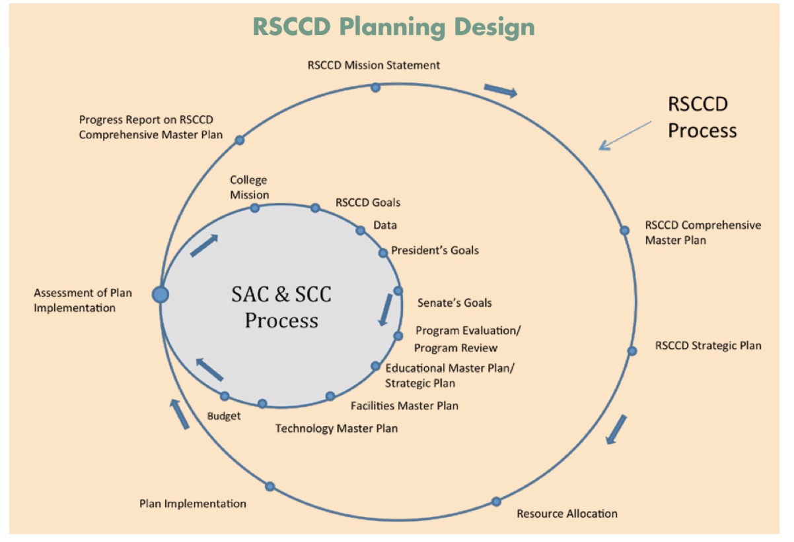
Notes:
Craig

Slide 13
Integrated Planning
An important part of the district planning process is how district level planning feeds into college level planning
If colleges have a process for resource allocation requests, the district should also have a similar process
If the district has financial resources that are allocated to it, the district planning process can allocate resources the same way that the college processes do
If the district is requesting additional financial resources, those requests may need to go through the college planning processes
Notes:
Craig

Slide 14
Summary
Districts aren’t accredited, but colleges are responsible for demonstrating how districts meet the requirements of Standard IV.D
The Chancellor acts as the CEO for the district and is responsible for the quality and effectiveness of the district
Colleges must clearly outline how functions operate on the college and district level
Districts are required to have governance structures, just like colleges
The interaction of planning at the college and district level must be documented
Notes:
Craig

Slide 15
Questions?
“
Our Contact Information:
Raúl Rodriguez, rodriguez_raul@rsccd.edu
Craig Rutan, rutan_craig@sccollege.edu
Deborah Wulff, Deborah_Wulff@cuesta.edu
THANK YOU!
Notes:
All

