Slide 1
Noncredit Pathways to College and Career Readiness 2020 ASCCC Curriculum Institute Graciela Vasquez, Associate Dean, Adult Education and Diversity Programs, Cerritos College L.E. Foisia, Professor, Basic Skills, Mt. SAC Allison Tom- Miura, Dean, Adult & Continuing Education, West LA College

Slide 2
Cerritos College
Noncredit Support of Incoming Students
Promise Program – Cerritos Complete
English and Math Support
Emphasis on Math
Adult School to Noncredit to Credit
ESL Pathway
Transition to college credit for the most vulnerable students (noncredit and adult education pipeline)

Slide 3
Located in the South East section of Los Angeles County

Slide 4
Cerritos Complete - 2 Years Tuition Free
A promise delivered to our community
Supportive academic programs and student services
Two-year free tuition (in-state rates only)
Two-year priority enrollment
Step by step assistance
One-on-one counseling and advisement
Personalized schedule for Fall and Spring semesters
Tracking student progress and success

Slide 5
Noncredit Safety Net
Noncredit Math
Math Support Statistics
Math Support College Algebra
Pre-Algebra
Prep Math – Basic Math Skills
Cerritos Complete FA 2019 | Cerritos Complete FA 2020
Intent = 2395 students | Intent = 2951 students
NCR Intent = 84 students (3.5%) | NCR Intent = 92 students (3.1%)
Enroll = 1573 students | N/A
NCR Enroll* = 27 (1.7%) | N/A
*Noncredit students enrolled in credit courses and Cerritos Complete program
Cerritos Complete FA 2019 Credit Math Courses
Students enrolled = 722
Students enrolled in noncredit Math Support = 200
Approx. 50% Successful Completion
Noncredit English
Pre College English Support
College English Skills

Slide 6
Cerritos Complete - 2 Years Tuition Free
for noncredit and adult school students
Actions in program development should reflect our equity values
Noncredit students completing High School Equivalency Certificate Programs
Successful completion of HS Equivalency exam or HS diploma credits at Adult Schools
All CAEP consortium partner members included
Incentivizing students toward completion of HS diploma program/equivalency
Transition support from PAACE Consortium Staff, including outreach to adult schools, onboarding (application, enrollment, counseling, resources)

Slide 7
ENGLISH AS A SECOND LANGUAGE PATHWAY
ADULT SCHOOL
COLLEGE NONCREDIT
COLLEGE CREDIT
ESL
Low to Intermediate
NonCredit Transition Course
ESL Low Advanced
ESL 5/NonCredit Mirrored Course
High Advanced/Basic Comp
ESL 120 – Composition Beginning
ESL 152 – Composition Intermediate
ENG 100 – Freshman Comp

Slide 8
Lessons Learned
Understanding expectations (student/college & college/student)
The traditional model was a disconnect with our students
Noncredit (all) Students come for a variety of reasons
Innovate with urgency of eliminating equity gaps and achieving full student equity
Equity in curriculum and program development should reflect equity in resource access and allocation (impact systemic change)
Design programs and courses with noncredit students in mind
Most vulnerable; multiple challenges
Noncredit students are credit students/credit students are noncredit students

Slide 9
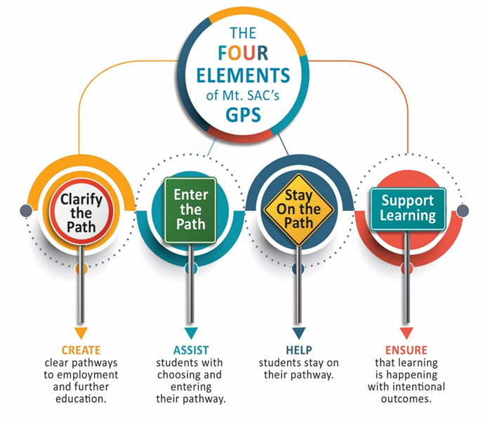
Mt. SAC Noncredit and Credit Pathway Collaborations
Collaborate with credit CTE faculty in Noncredit SWP Project
Focused on student needs
Attended credit faculty meetings & professional development events
Found faculty champions – noncredit and credit faculty
Developed noncredit to credit pathways and/or integrated noncredit into credit pathways
Notes:
I combined SWP and credit relationship

Slide 10
Emergency Medical Technician Pathway
EMT Noncredit State Certificate
EMT 90A: Introduction to Emergency Medical Services (EMS) System
Embedded EMT support course
Research paper writing skills¹
Librarian research workshop
EMT 90: Emergency Medical Technician
Credit Certificate
Paramedic
AS Degree
Emergency Medical Services – Paramedic
Work Experience
College
Pathway
BS RWCCR: Reading & Writing for CCR
Nursing ADN Program (Credit)
BSN Program (Credit)
Credit Certificates
Fire Officer
Fire Technology
College Pathway: Fire Tech
Take EMT State License Exam for EMT employment
AS Degree
Fire Technology
Notes:
I’ll transition to show an example of a contextualized course. Mention that will be working on a similar course with Fire Technology and Aircraft Maintenance at Mt. SAC

Slide 11
Noncredit Anatomy Support Course VOC ANA50: Basic Anatomy and Physiology
Students in a credit, Intro to Human Anatomy course needed anatomy skills building support
Approached by credit anatomy and physiology faculty to develop a noncredit anatomy support course
Used VOC ANA50, noncredit course for the support course (not a contextualized course)
Support course for all anatomy students and helped other students in various pathways: nursing, kinesiology, respiratory therapy, radiologic technician
Taught online by credit professor as a noncredit co-requisite during the Spring semester
Notes:
- This class was supported by the entire bio department at Mt. SAC
ANA 50 was already a course in other noncredit STV programs so we used that one instead of creating a new course
Because anatomy is often a required course in those pathways
Professor used her skeletons and other materials for demonstrations; synchronous

Slide 12
How can one course impact several pathways?
Health and Wellness Pathways
Partnership between credit kinesiology faculty and noncredit ABE faculty
Course Level
Kinesiology 34: Fitness for Living
Required Course in Degree or Certificate Pathway
Kinesiology, AA
Athletic Trainer Aide, Certificate
Coaching, Certificate
Meets AA/AS Physical Well-Being Requirement & Area E. “Lifelong Understanding & Self-Development” GE Requirement
Alcohol & Drug Counseling
Paramedic
Psychiatric Technician
Nursing
Public Health
Respiratory Therapy
Radiologic Technology
Notes:
Kinesiology partnered with ABE (collaboration between credit and noncredit) – held in ABE facility.
Offered KIN 34 (entry level kinesiology course, no pre-req) to credit and noncredit students. Half the class was credit and the other half was noncredit (credit saved 15 seats for noncredit students).
Credit faculty member visited noncredit classes and told students they need to take this course
Started in Spring 2019, 8 weeks, and offered during prime time (9:30am – 11am)
Noncredit students from various areas in our division participated – ABE, ESL, EOA, STV
NC advising course met for1 hour after – provided student success support –academic advising (ed plans, next steps) and resource referral (tutoring)
Point is that one class can lead to several different pathways for both credit and noncredit students – gives them options and provides them with an option for next steps – it’s important that our noncredit students know that their journey may begin in noncredit but it can continue in credit
All noncredit students had to apply– eligible for Promise Grant and got fee waiver, challenges were residency (couldn’t establish so it was a challenge)
Did similar collaboration with English 1A – selecting/hitting courses required for a lot of majors
Oh and all but one person has passed the KIN and Eng 1 A

Slide 13
Noncredit ESL to Credit ESL Pathway
Notes:
AMLA 70, 80, and 90 are mirrored. I will briefly mention that but ask that if there are questions about mirrored that they hold them to the end of the presentation.

Slide 14
VESL Career Paths
VESL 1st Semester
• ESL Speaking • ESL Writing • Career & Life Planning • Computer Keyboarding
VESL 2nd Semester: Transitions
Credit Programs Pathway
Health Careers Pathway
Business Careers Pathways
• ESU Academic English
(LANG3)
• Microcomputer Applications
(VOC CSB15)
• ESL for Health Professionals
(VHLTH)
• Microcomputer Applications
• ESU Accounting
• ESU Hospitality
• ESU Real Estate
• ESU Child Development
• Microcomputer Applications
College
A.A./A.S.
B.A./B.S.
M.A./M.S.
Health
Certificates and Degrees
Credit or Noncredit
Business
Certificates and Degrees
Credit or Noncredit

Slide 15
Transitioning Students to College @ West
College Readiness Certificate of Competency
BSICSKL 75 – Intro to Post-Secondary Education
BSICSKL 73 – Industry Overview & Career Opportunities
BSICSKL 5 – Academic Guidance
Options for populations who need more support:
VOCED 290 - Computer Literacy for College
BSICSK 105 - Student Success in Hybrid & Online Classes
LA College Promise students
Formerly Incarcerated students
Uniquely Abled students
Adult HS Diploma or Equivalency Non-Completers
ESL students

Slide 16
Reentry Success Pathway for Formerly Incarcerated Students
Orientation & Application Assistance
Assist students w/completing CCCApply and enrolling in classes
College Readiness Academy (3 wks)
Intro to Post-Secondary Education
Resilient Leadership for College & Career Success
Reading & writing for college and career readiness
Student Success in Hybrid & Online Classes
Computer Literacy for College
Industry Overview & Career Opportunities
Academic Guidance
Confirm students have consistent and reliable technology to participate in class
Confirm students have reliable transportation when in-person
Address student holds w/help of partners
Fundamentals for Workplace Success II – Effective Communications & Leadership
Resilient Leadership
Introduction to Workforce Opportunities
Simultaneous with HSD/GED classes, credit classes, getting financial aid & scholarships, work, etc.
Students start/complete FAFSA & apply for scholarships, apply to other colleges, apply for employment

Slide 17
Transition Career & Education Plans for Students
Transition to credit
Transition to job training (noncredit); some with VESL
Transition to career training (may do noncredit bridge or co-requisites w/credit CTE)
Transition to employment

Slide 18
Noncredit to Credit & Employment & Transfer
Noncredit
Noncredit & Mirrored
Credit
Custodial Technician Certificate
Facilities Management Certificate
Business ADT
Work Experience
Transfer
Job Placement
Supported by Career Connections Center
Supported by Transfer Center

Slide 19
21st Century Workforce Readiness for All Students
New World of Work (NWOW) 21st century skills curriculum created as .5 STD Hr (9 hours) courses and into 5 certificates https://newworldofwork.org/
Some courses and certificates are integrated into cohort noncredit and CTE programs
Integrated into our student employee training program (workstudy, CalWorks, and other paid student employees) through our Career Connections Center
Integrated into our work experience & job placement program through the Career Connections Center

