Slide 1
Noncredit Distance Education
Presenters:
Chrissy Gascon
Santiago Canyon College
Division of Continuing Education
Kathy O’Connor
Santa Barbara City College

Slide 2
The Realities of a Noncredit Distance Education Program
There is still MUCH to learn!
Title 5 Guidelines and Regulations
DE Guidelines and ADA Accessibility
Regular and Substantive Interaction
Noncredit FTES and Alternative Attendance
Reference Links
From Regulations to Practice→ How, What, Where?
Scheduling, Evaluating Online Courses, Student Support Services
Example of a New Noncredit Online Program

Slide 3
Title 5, §55200 requires DE courses to be accessible, in compliance the ADA and 508
Title 5
Draft DE guidelines include 10 principles of accessibility:
All DE materials must be created with UD
Campus procedures for DE
Accommodations
All resources, including third-party, are accessible
Annual audit of course materials
Equally effective for students with or without disabilities
Remove accessibility barriers in a timely manner
Undue costs claims rejected
Colleges must provide accommodations, regardless of cost or alteration of instructional activity
Faculty, admin, and staff are responsible for ensuring accessibility
Accessibility
§ 55200

Slide 4
Title 5
Regular and Substantive Interaction
Title 5 § 55204. Instructor Contact.
In addition to the requirements of section 55002 and any locally established requirements applicable to all courses, district governing boards shall ensure that: (a) Any portion of a course conducted through distance education includes regular effective contact between instructor and students and among students, through:
group or individual meetings
orientation and review sessions
supplemental seminar or study sessions
field trips
library workshops
telephone contact
voice mail
e-mail
or other activities.
Instructor Contact
§ 55204

Slide 5
Calculating FTES for Noncredit DE Courses
Title 5
Noncredit DE courses must use the Alternative Attendance accounting procedure to calculate FTES. As noncredit courses do not have units upon which to base attendance accounting, FTES derives from the average of the contact hours generated at two census points during the term and divided by 525. Enrollment at the two census points (one-fifth and three-fifths) point in the length of each course is averaged. The weekly student contact hours is determined by instructional hours, outside of class hours, plus regular effective contact hours (as defined in section 55204). For noncredit courses, the record of the estimated hours of instruction for the weekly student contact component are included in the official course outline of record and the DE addendum.
Noncredit FTES Computed
§ 58003.1
Alternative Attendance
§ 58007

Slide 6
Title 5: § 58003.1. Full-time Equivalent Student; Computation.
(f)(2) For noncredit course: full-time equivalent student for such noncredit course sections shall be computed by:
(A) multiplying the average of the number of students actively enrolled in the section as of each census date (those dates nearest to one-fifth and three-fifths of the length of the course section) by,
(B) the weekly student contact hours (WSCH factor) as derived above in this section, by
(C) the primary term length multiplier of 17.5, and
(D) dividing by 525.
Source: Student Attendance Accounting Method Manual (SAAM)
$$FTES= \frac{Average \# of active students as of Census 1 \& 2×WSCH factor ×17.5 }{525}$$

Slide 7
Calculating FTES for Noncredit DE Courses
Example: if 20 students, and will be in contact with them for 20 hours, and then assign 20 out-of-class hours
Calculate Average Census: number of students at census one (20%) and add to census two (60%) and divide by two. This is your Average Census.
Calculate WSCH: (total hours of instruction + instructor contact + out of class hours), divide by 54. This is your WSCH.
Calculate FTES: Multiply Average Census with WSCH and term length multiplier (17.5 for semesters, 11.67 for quarters), and divide that by 525

Slide 8
Calculating FTES for Noncredit DE Courses

Slide 9
EXAMPLES
Noncredit DE FTES Example
In a class with 30 hours of instruction of 25 students where two students withdraw, the average census is:
Calculate Average Census = Number of students actively enrolled at 1/5 and 3/5 census dates = (25 + 23)/2 = 24
Calculate Weekly Student Contact Hours = (Total number of hours of instruction to be received by students in the class + Instructor contact hours + Number of hours expected for any outside-of-class work as noted in the approved class online)/54 = (30 + 15 + 60)/54 = 1.94

Slide 10
EXAMPLES
Noncredit DE FTES Example (Continued)
Calculate FTES:
Multiply Average Census with WSCH and term length multiplier (17.5 for semesters, 11.67 for quarters),
and divide that by 525.

Slide 11
Reference Links
Noncredit Distance Learning Summary Grid
Example of Noncredit Course
SBCC’s Distance Education Website Page
DRAFT -- Distance Education Guidelines
(Chancellor's Office, 2019)

Slide 12
There will be glitches in what you thought was a perfect plan!
Teaching online is not as easy as it seems!
Evaluating online courses is a new territory!
Oops – Don’t Forget Student Support Services…
The funding formula is difficult, but not impossible!
Ugh!
Scheduling!
From Regulations to Practice…

Slide 13
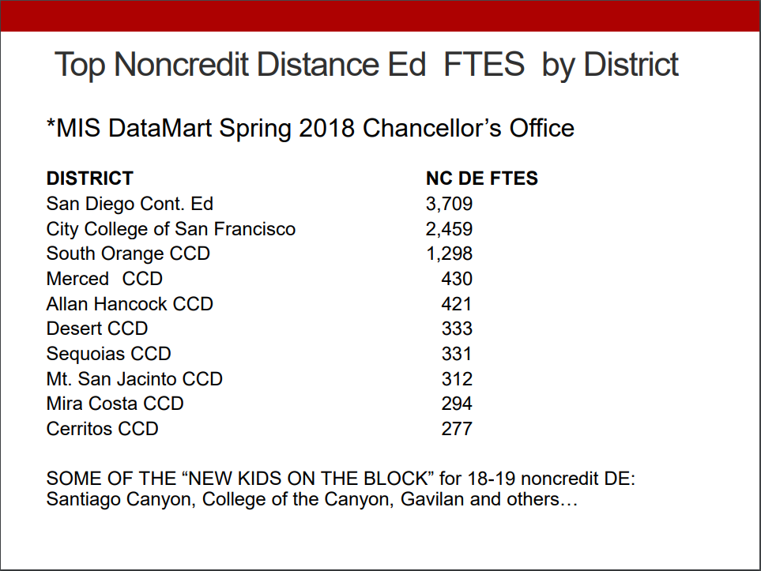
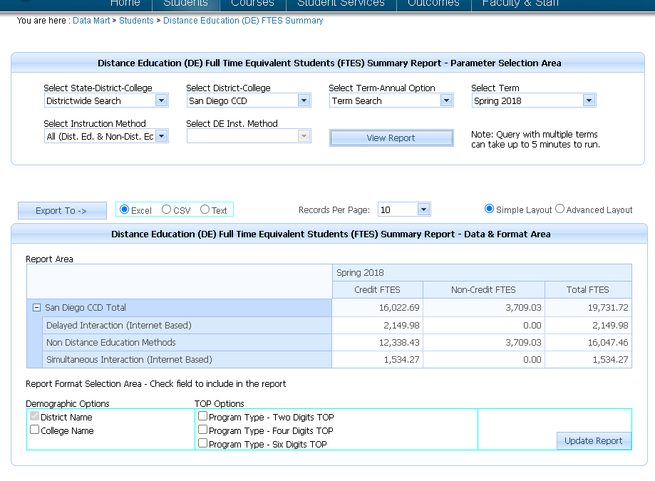
Clarification of Past Errors – What is the actual NCDE FTES?
Slide 1 Source: ASCCC Noncredit Distance Education presentation ( Curriculum Institute 2019)
Slide 2 Source: MIS Datamart Spring 2018 Chancellor’s Office

Slide 14
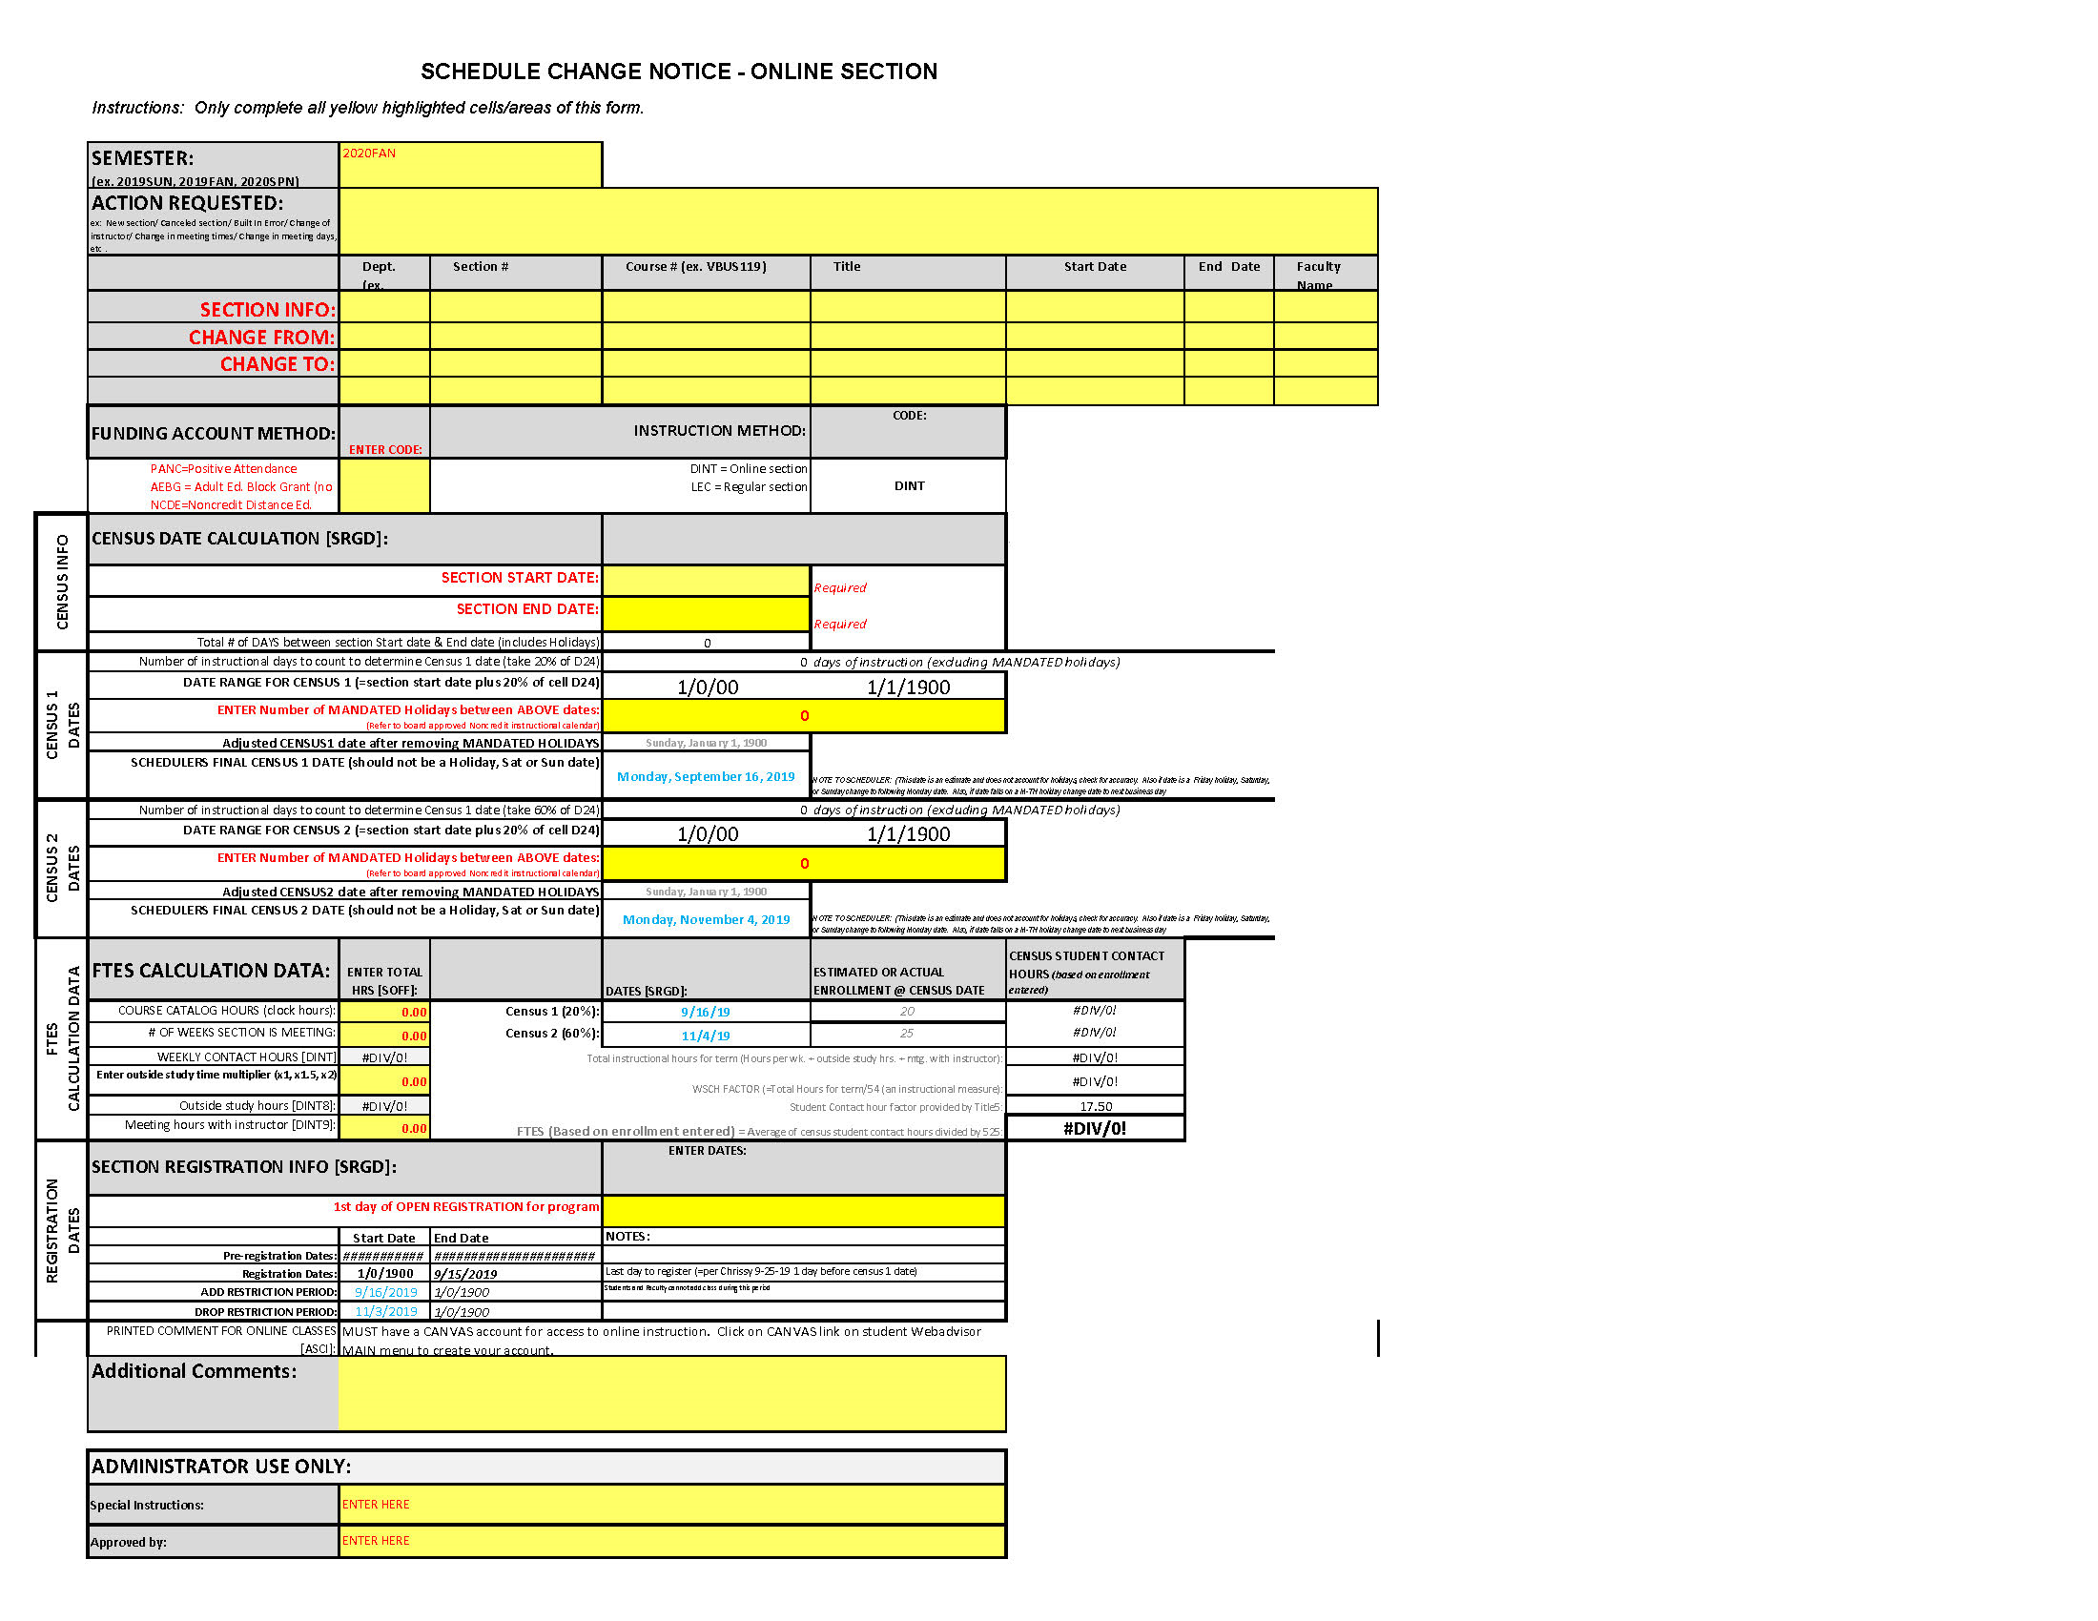
SCHEDULING
Ugh!
Scheduling!

Slide 15
Online class FTES calculator
The funding formula is difficult, but not impossible!
$$FTES= \frac{Average \# of students at census×WSCH factor ×17.5 }{525}$$

Slide 16
Distance Education Assignment Addenda
Teaching online is not as easy as it seems!

Slide 17
Title 5
Important
Information
for
Faculty

Slide 18
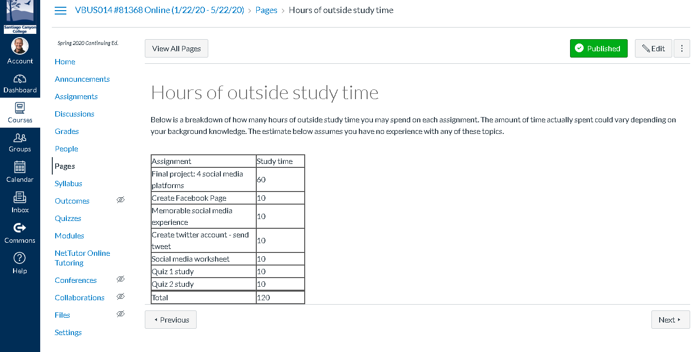
DOCUMENTING

Slide 19
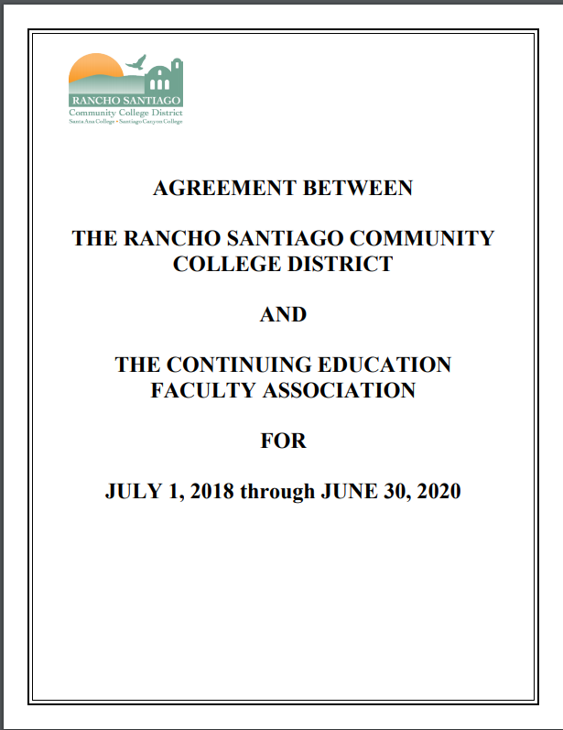
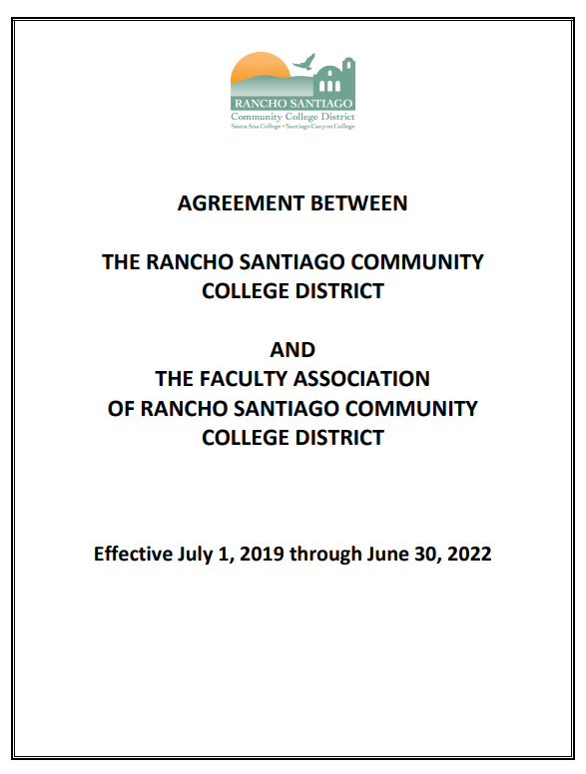
Evaluating online courses is a new territory!

Slide 20
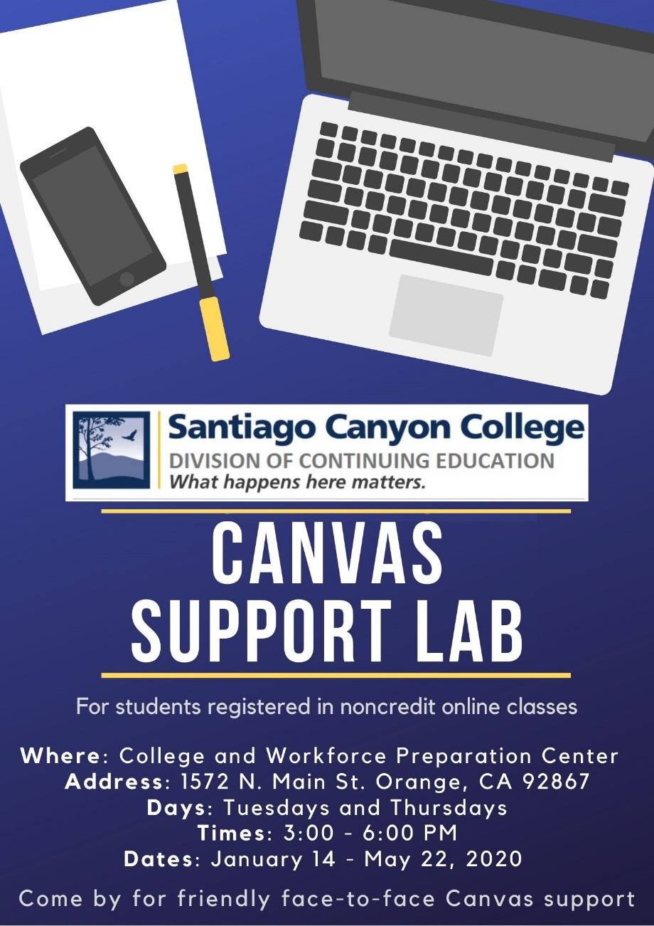
Oops – Don’t Forget Student Support Services…
Student Support Services

Slide 21
Example of a New Noncredit Distance Education Program: Santiago Canyon College
SCC Continuing Education: Noncredit Distance Education (NCDE)
Semester | Classes Offered | Teaching Instructors | Certified Instructors | FTES Earned
Totals for 2017-2018 | 2 | 1 | 3 | 2
Spring 2018 | 2 | 1 | 3 | 2
Totals for 2018-2019 | 8 | 3 | 3 | 21
Summer 2018 | 0 | 3 | 3 | 0
Fall 2018 | 0 | 3 | 3 | 0
Spring 2019 | 8 | 3 | 3 | 20.64
Totals for 2019-2020 | 45 | 11 | 15 | 105
Summer 2019 | 7 | 4 | 5 | 9.28
Fall 2019 | 13 | 5 | 5 | 30.99
Spring 2020 | 20 | 11 | 15 | 64.20
Estimates for 2020-2021 | 63 (Summer/Fall) 115 (Annual) | 40 (Summer & Fall) | 85 (By Dec 1, 2020) | 120 (Summer @ C1) 400 (Annual Estimate)

Slide 22
Career Technical Education
Windows 10
Intro to Keyboarding
Intro to Adobe Premiere
Intro to Adobe Photoshop
Intro to Adobe Illustrator
Intro to Personal Commerce
Intro to Google Apps for Work
Intro to Dreamweaver
Intro to Web Page HTML
How to Build a Home-Based Business
Accounting for Non-Accountants
Seminar: MS Office Overview
Intro to MS Outlook
Intro to MS PowerPoint
Intro to MS Word
Intro to MS Excel
Intro to MS Access
Intro to Mobile and Social Media
Intro to Digital Marketing
Intro to 3D Modeling using Blender
Intro to 3D Animation using Blender
Intro to Medical Billing
English as a Second Language (ESL)
EL Civics (Citizenship)
ESL Seminar: Literacy
ESL Seminar: ESL Low
ESL Seminar: ESL High
ESL Seminar: ESL Intermediate Low
ESL Seminar: ESL Intermediate High
Int. ESL Seminar: Advanced
Workforce Preparation
Workforce Readiness
Adults with Disabilities
Transition to Higher Learning
Basic Finances in the Workplace
Public Communications
Noncredit Distance Education Courses Offered Summer 2020

Slide 23
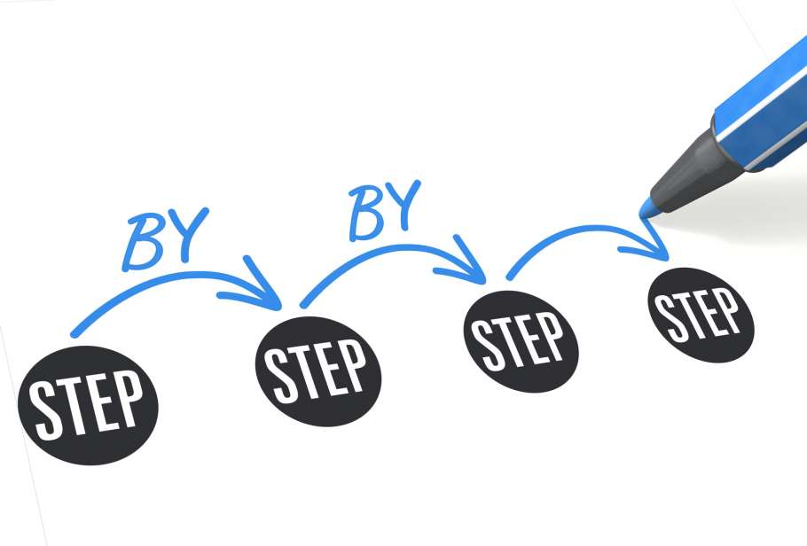
We started a Noncredit Distance Education program…
what should we do now?
Here are some of the projects that we tackled over the past two years.
Work with ITS!
Continue to work with ITS!
Work with ITS some more!
Update the website to be more user-friendly for online students
Create new NCDE Schedule Change Forms
Update the online registration procedure to allow students to complete the A&R process off-campus
Opened services in Cranium Café and an in-person CANVAS Support Lab

Slide 24
Contact
Information
Chrissy Gascon
Interim Dean of Instruction and Student Services
Santiago Canyon College
gascon_christine@sccollege.edu
Kathy O’Connor
Faculty and Curriculum DE Specialist
Santa Barbara City College
oconnork@sbcc.edu

